Slide 1
Phase One Evaluation of Different IMUs
Supervisor: Prof. Leutlet
Author: Abdelrahman Hewala

Slide 2
1. Exploring Different Sensors
2. Allan Variance
3. IMUs Errors
4. SW Architecture
5. Results
6. Sensor Fusion

Slide 3
1. Exploring Different Sensors

Slide 4
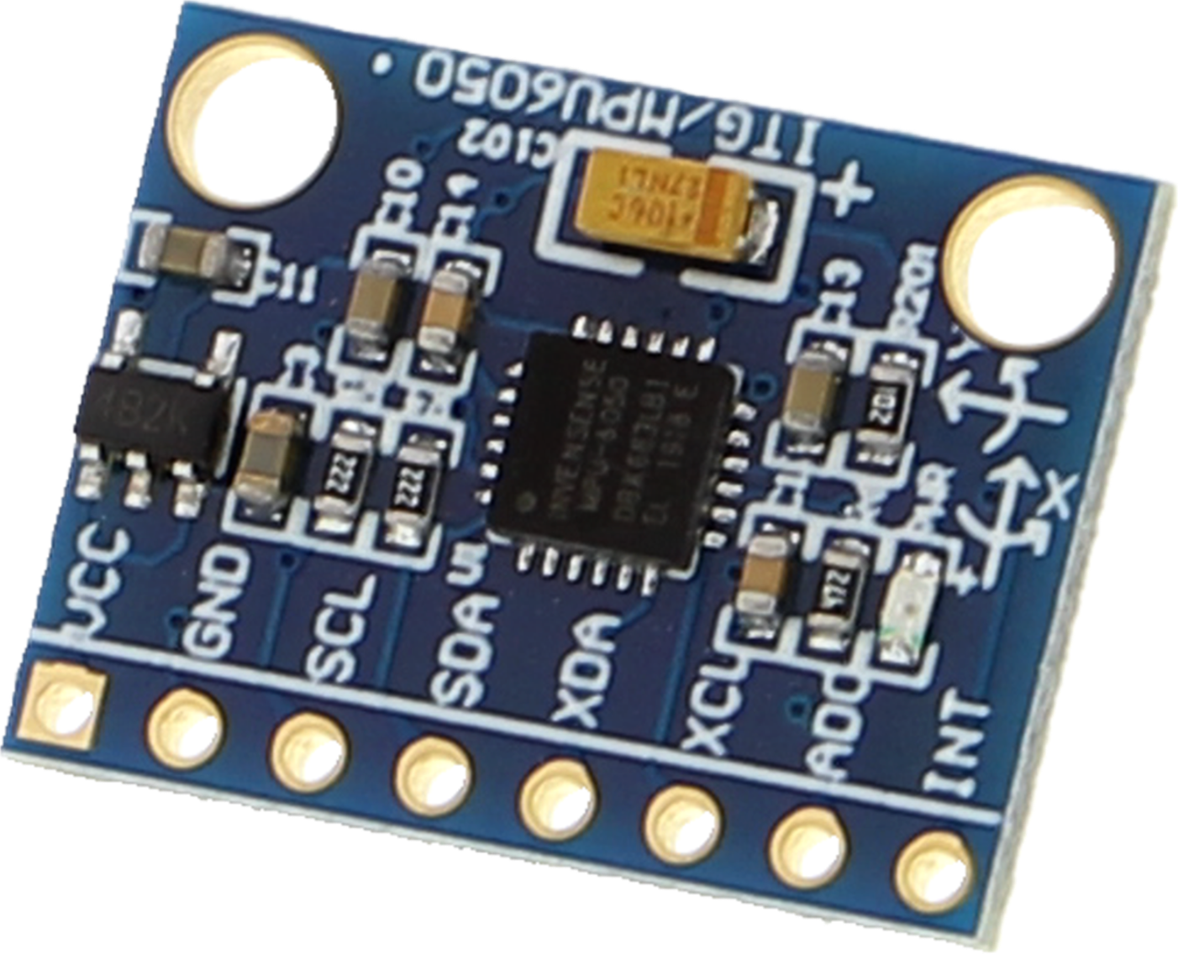
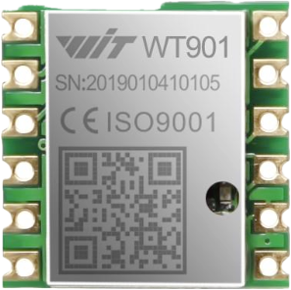
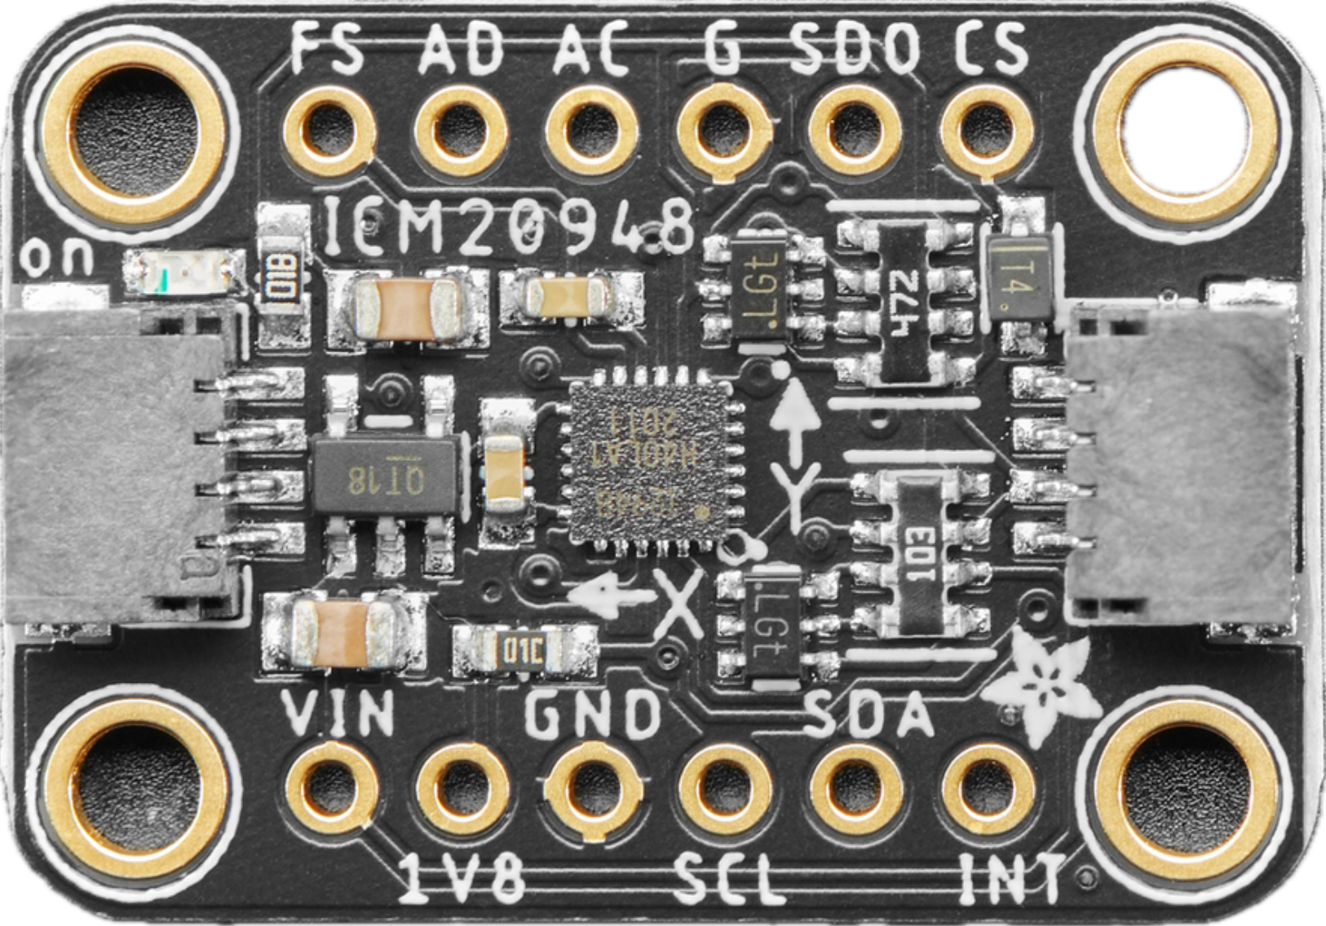
Exploring Different Sensors Noise Characterstics
Sensor | MPU6050 | ICM-20948 | ICM-45686 | WT901
Manufacturer | InvenSense | InvenSense (TDK) | InvenSense (TDK) | WitMotion Shenzhen Co.,Ltd
Initial Release date | 11/24/2010 | 12/07/2016 | July 2024 | 2019 (Lack of Doc)
Max Sampling rate | G: 8 kHz, A: 1kHz | G: 9 kHz , A: 4.5 kHz | G, A: 6.4 kHz | 200 Hz
Filters | DLPF | DLPF | Complex Filtering | Kalman Filter
Accel’S Noise Spectral Density | 400 µg/√Hz | 230 µg/√Hz | 70 – 110 µg/√Hz | 75 - 100 µg /√Hz
Gyro’S Noise Spectral Density | 0.005 dps/√Hz | 0.015 dps/√Hz | 0.0038 dps/√Hz | 0.007 dps/√Hz.
Notes:
In December 2016, the company was acquired by electronics company TDK for US$1.3 billion.^{[6]} InvenSense became part of the MEMS Sensors Business Group in 2017. In February 2018, Chirp Microsystems joined InvenSense through its acquisition by TDK. Sources Wikipedia: https://en.wikipedia.org/wiki/InvenSense. --> InvenSense History Data sheets of each sensor Release data of mpu from its datasheet

Slide 5
To Design the best Filtering Algotisthm for an IMU, we need to understand the Static Behaviour of the sensor (its noise Charactersitcs/ Parameters). The Lower the Noise Coeffecients the better the Sensor is The Method being used for Extracting & comparing the Noise Coeffecients is The Overlapping Allan Varriance
Exploring Different Sensors Noise Characterstics

Slide 6
2. Allan Varriance

Slide 7
Allan Varriance
David Allan Introduced his method for measuring the stability of oscillator
In 1983, M. Tehrani gave out the detailed deviation about the Allan variance noise terms expression from their rate noise power spectral density for the ring laser gyro (Tehrani 1983)
Because of the close analogies to inertial sensors, the method has been adapted to random drift characterization of a variety of devices (IEEE Std952-1997). – Tehrani equations included in the Annex
In 2003, the Allan variance method was first applied in Micro Electrical Mechanical Sensor (MEMS) noise identification (Hou and El-Sheimy 2003).
One of the most notable deficiencies of the standard Allan variance is the non-unique characterization of white angle, flicker angle, and quantization noise at the high frequency end, and random rate ramp vs. flicker angular acceleration at the low-frequency end. These, however, may be sorted out by using the Modified Allan variance and/or prewhitening methods (IEEE Std952-1997) – page 51
Maximum efficiency is obtained by using an algorithm that uses maximum overlap. (IEEE Std952-1997) – page 51
Notes:
Sources
Modeling Inertial Sensors Errors Using Allan Variance, UNIVERSITY OF CALGARY IEEE Std 952-1997 Annex C7

Slide 8
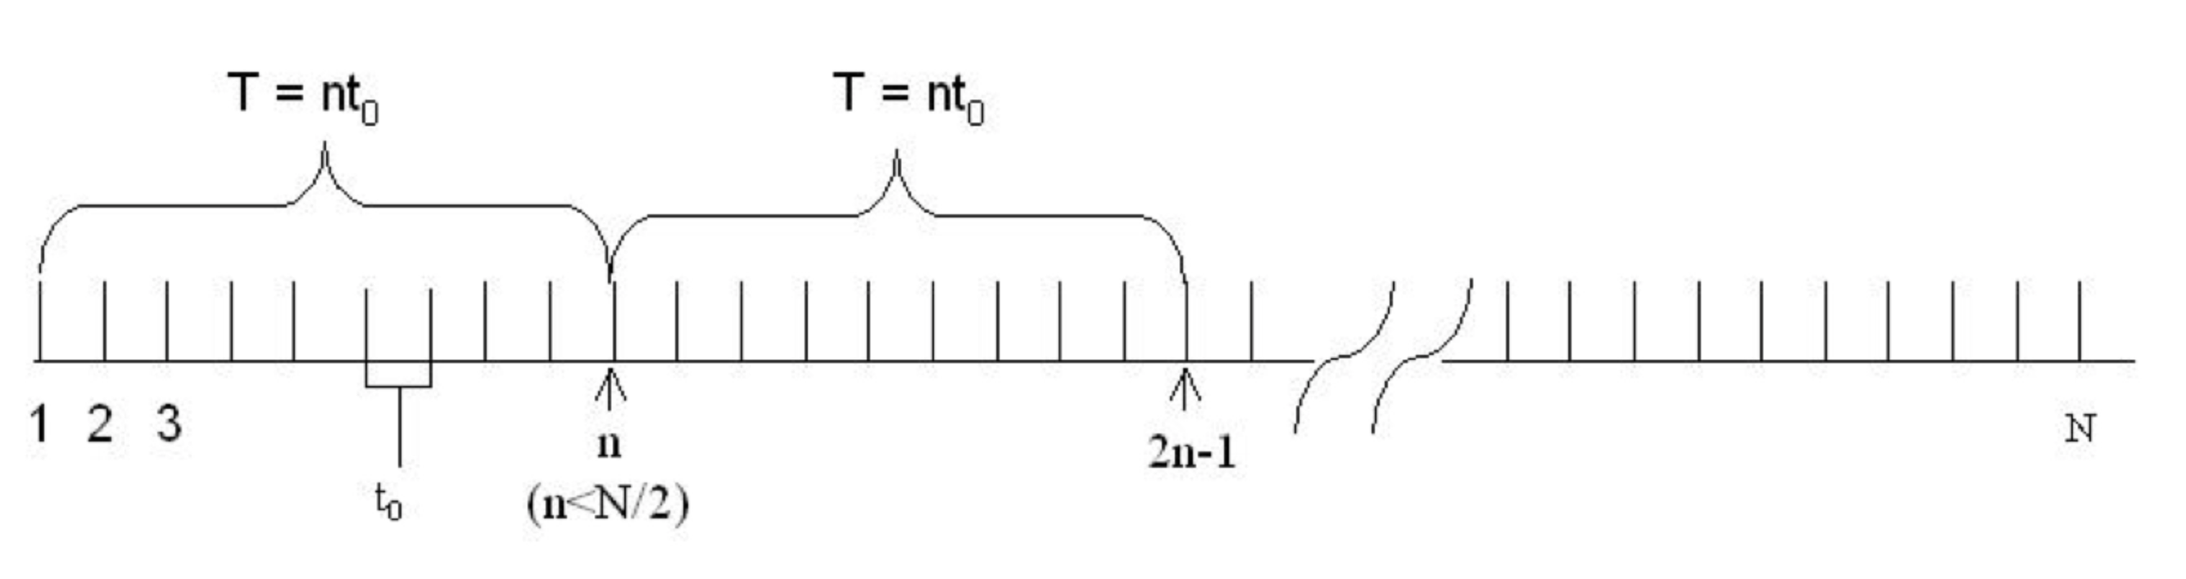


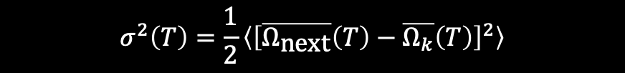
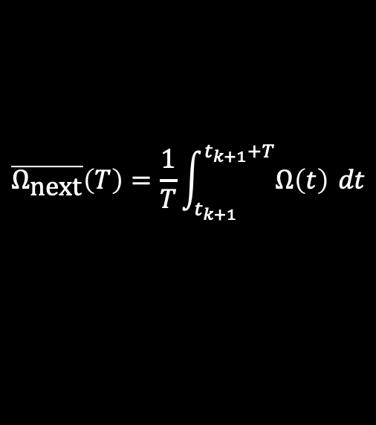

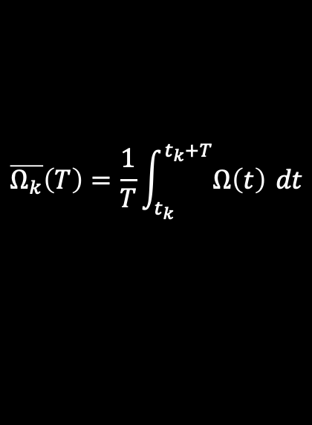
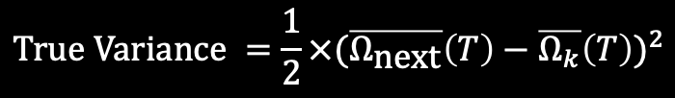
Allan Varriance
The average Variance/std between each two adjacent Clusters with Varying Size
Since we are subtracting two uncorrelated quantities, the variance of the difference is the sum of their individual variances:
ss
$$\overline{Ω_{k}}\left(T\right)=\frac{1}{T}\int_{t_{k}}^{t_{k}+T}{Ω\left(t\right)} dt$$
$$\overline{Ω_{\text{next}}}\left(T\right)=\frac{1}{T}\int_{t_{k+1}}^{t_{k+1}+T}{Ω\left(t\right)} dt$$
$$\text{Var}\left(ξ_{k+1,k}\right)=\text{Var}\left(\overline{Ω_{\text{next}}}\right)+\text{Var}\left(\overline{Ω_{k}}\right)$$
$$\text{where} {\text{t}}_{\text{k}\text{+1}} \text{=} {\text{t}}_{\text{k}} \text{+} \text{T}$$
$$ξ_{k+1,k}=\overline{Ω_{\text{next}}}\left(T\right)−\overline{Ω_{k}}\left(T\right)$$
$$σ^{2}\left(T\right)=\frac{1}{2}\left\langle {\left[\overline{Ω_{\text{next}}}\left(T\right)−\overline{Ω_{k}}\left(T\right)\right]}^{2}\right\rangle$$
$$Variance ={(ξ_{k+1,k})}^{2}={(\overline{Ω_{\text{next}}}\left(T\right)−\overline{Ω_{k}}\left(T\right))}^{2}$$
where ⟨ ⟩ is the ensemble average.
$$True Variance =\frac{1}{2}×{(\overline{Ω_{\text{next}}}\left(T\right)−\overline{Ω_{k}}\left(T\right))}^{2}$$
Notes:
Sources
1) Modeling Inertial Sensors Errors Using Allan Variance, UNIVERSITY OF CALGARY 2) IEEE Std 952-1997 Annex C7 Characterization of Errors and Noises in MEMS Inertial Sensors Using Allan Variance Method

Slide 9
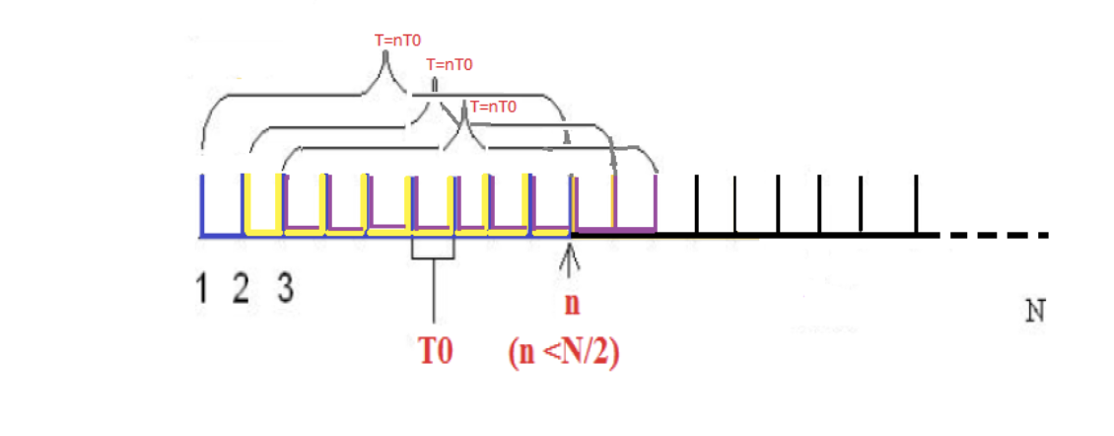
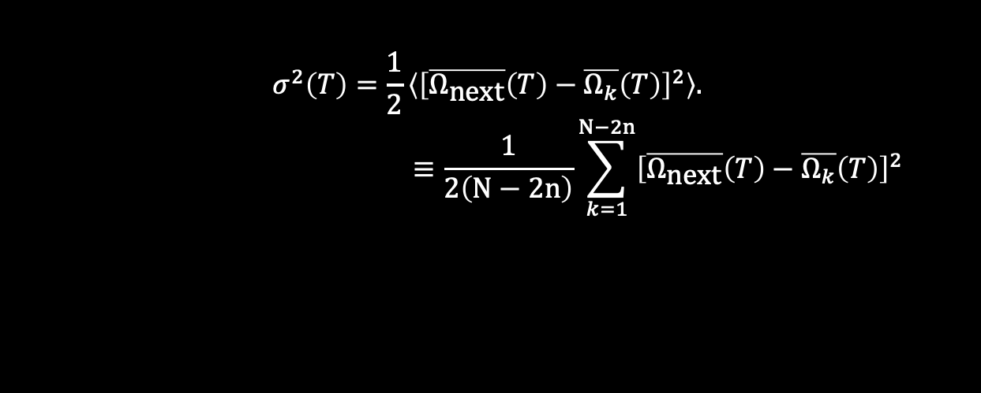
Overlapping Allan Varriance
$$σ^{2}\left(T\right)=\frac{1}{2}\left\langle {\left[\overline{Ω_{\text{next}}}\left(T\right)−\overline{Ω_{k}}\left(T\right)\right]}^{2}\right\rangle .$$
$$≡\frac{1}{2\left(N−2n\right)}\sum_{k=1}^{N−2n}{{\left[\overline{Ω_{\text{next}}}\left(T\right)−\overline{Ω_{k}}\left(T\right)\right]}^{2}}$$
N-2n, so that when I’m at that last K term (N-2n), still have n samples for the current Cluster and another n samples for the next Cluster to be able to get their variance
Notes:
Sources
1) Modeling Inertial Sensors Errors Using Allan Variance, UNIVERSITY OF CALGARY 2) IEEE Std 952-1997 Annex C7 Characterization of Errors and Noises in MEMS Inertial Sensors Using Allan Variance Method

Slide 10
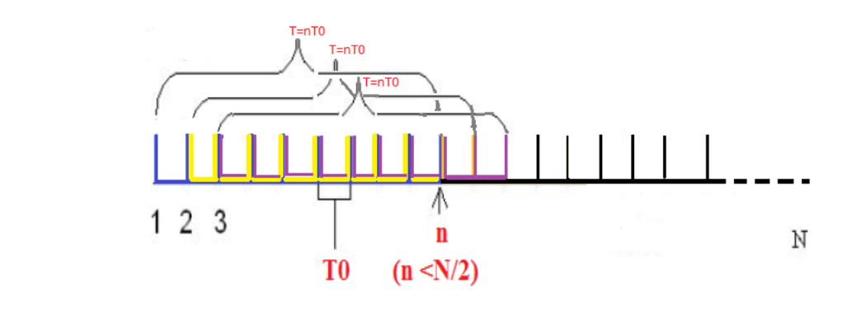
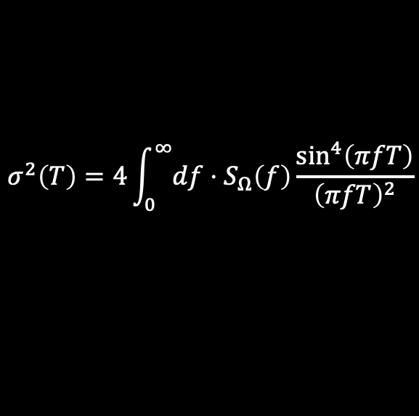
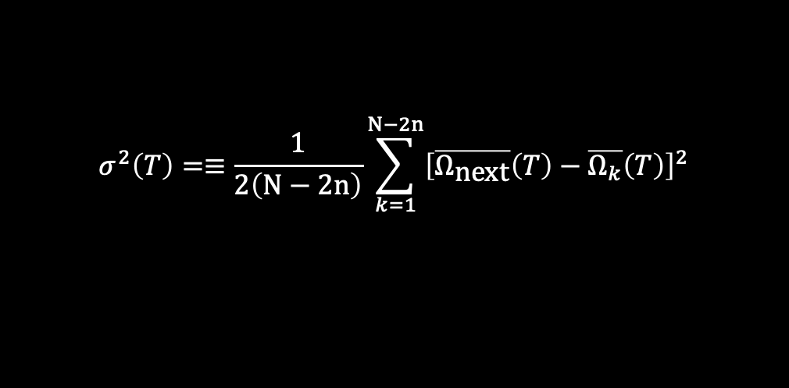
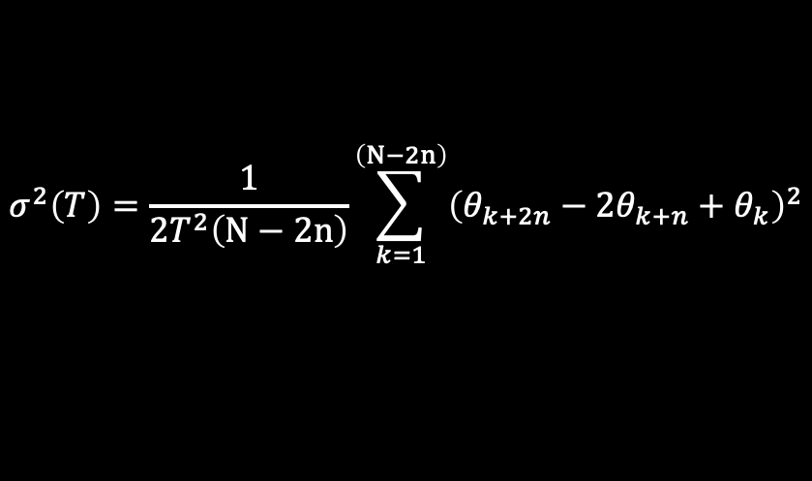
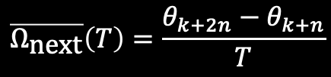
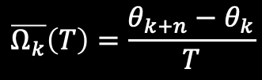
Overlapping Allan Varriance in Discrete Form
ss
As The angle or velocity measures are done in discrete times given by t= kt0, k = 1,2,3...,N. The notation is simplified as θk = θ(kt0). The cluster averages can be rewritten as
$$\overline{Ω_{k}}\left(T\right)=\frac{θ_{k+n}−θ_{k}}{T}$$
$$\overline{Ω_{\text{next}}}\left(T\right)=\frac{θ_{k+2n}−θ_{k+n}}{T}$$
$$σ^{2}\left(T\right)=≡\frac{1}{2\left(N−2n\right)}\sum_{k=1}^{N−2n}{{\left[\overline{Ω_{\text{next}}}\left(T\right)−\overline{Ω_{k}}\left(T\right)\right]}^{2}}$$
$$σ^{2}\left(T\right)=\frac{1}{2T^{2}\left(N−2n\right)}\sum_{k=1}^{\left(N−2n\right)}{{\left(θ_{k+2n}−2θ_{k+n}+θ_{k}\right)}^{2}}$$
$$σ^{2}\left(T\right)=4\int_{0}^{∞}{df}⋅S_{Ω}\left(f\right)\frac{\sin^{4}\left(πfT\right)}{{\left(πfT\right)}^{2}}$$
Notes:
Sources
1) Modeling Inertial Sensors Errors Using Allan Variance, UNIVERSITY OF CALGARY 2) IEEE Std 952-1997 Annex C7 Characterization of Errors and Noises in MEMS Inertial Sensors Using Allan Variance Method

Slide 11
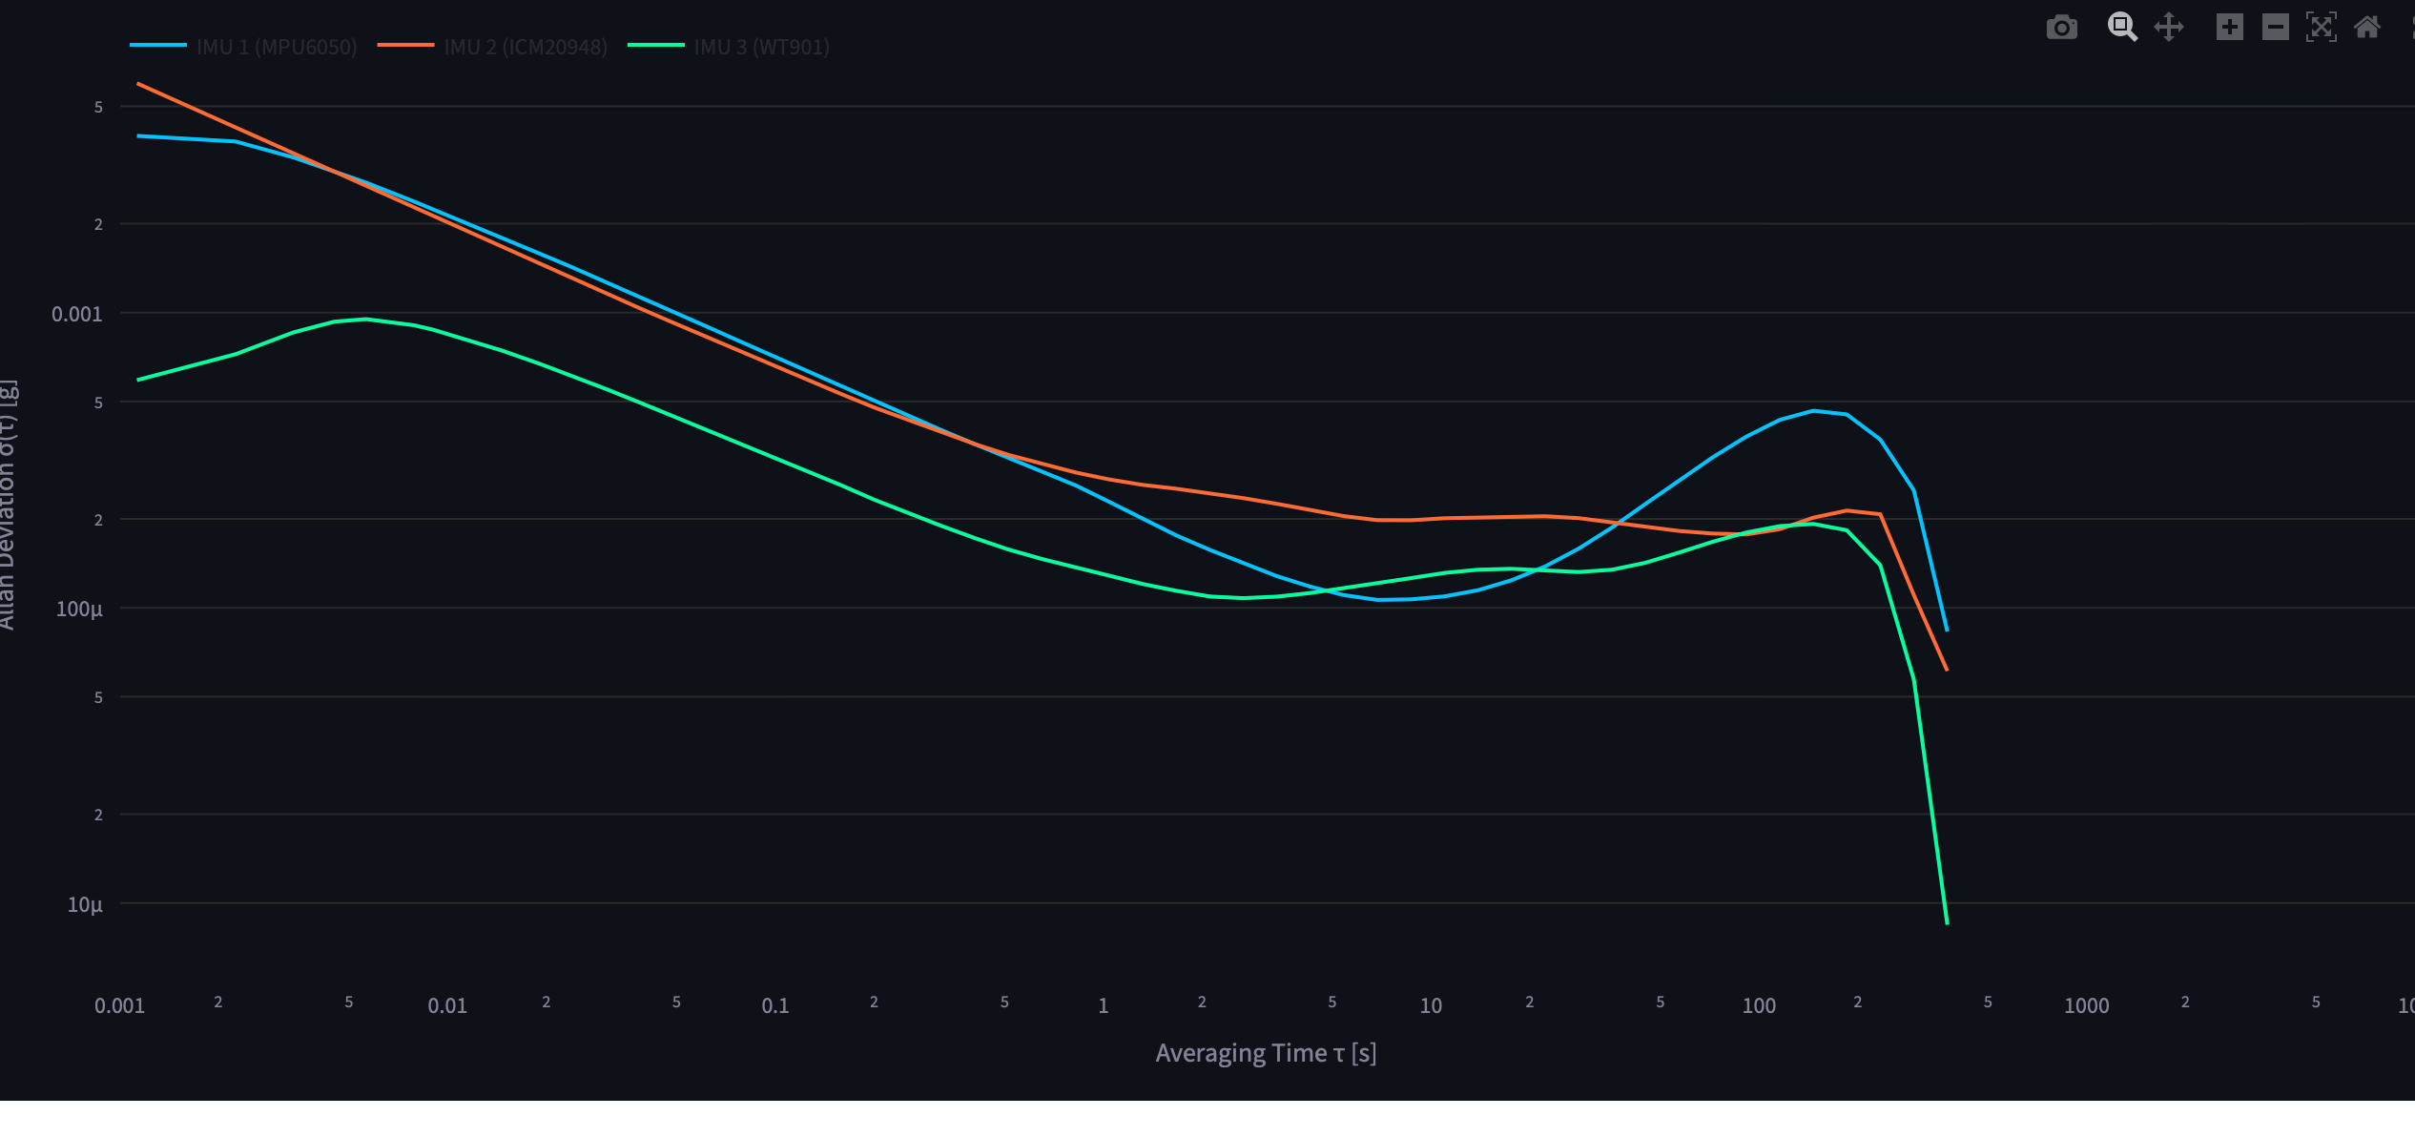
Overlapping Allan Varriance in Discrete Form

Slide 12

Allan Variance Uncertainty
Estimation accuracy of the Allan variance for a given τ, on the other hand, depends on the number of independent clusters within the data set.
It can be shown that the percentage error, σ, in estimating σ(τ) when using clusters containing n data points from a data set of N points is given by:
$$σ=\frac{1}{\sqrt{2\left(\frac{N}{n}−1\right)}}$$
Sh: We should run our logger at the highest meaningful frequency to maximise N and therefore increase the number of independent clusters at each τ.
The provided Equation is just an approximation to the CHI Distribution Estimation.
IEEE Std 952-1997 – Page 71
Notes:
But shouldn’t exceed the filter bandwidth to avoid coleration.

Slide 13
3. IMUs Errors

Slide 14
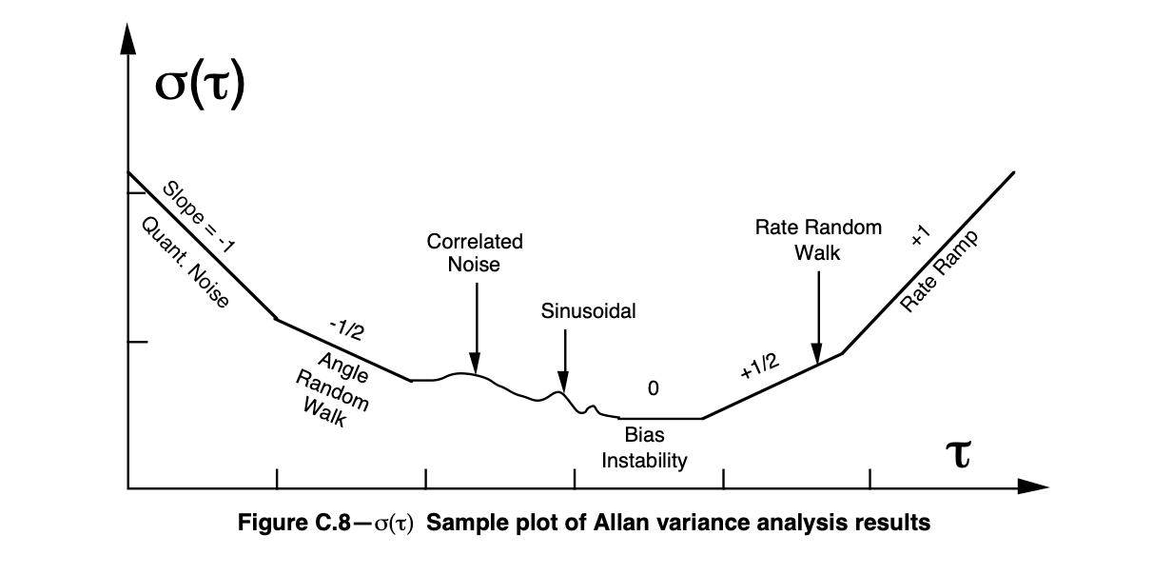
White noise.
Does angle of random Walk need to be normalised ?
(Not Much)

Slide 15
Quantisation Error
Current nowadays ADC are already big enough to reduce it very much. To the point that it won‘t be seen much on the graph
It happens at slope -1
It is a determisnitic error!
Notes:
https://www.ucalgary.ca/engo_webdocs/NES/04.20201.HaiyingHou.pdf

Slide 16
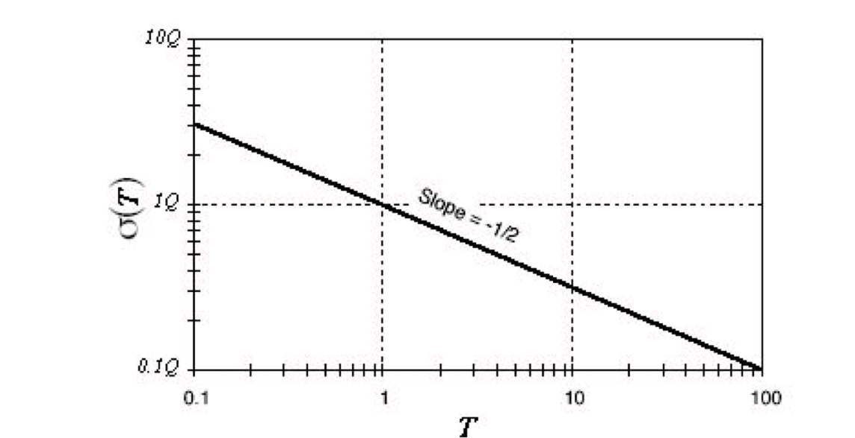
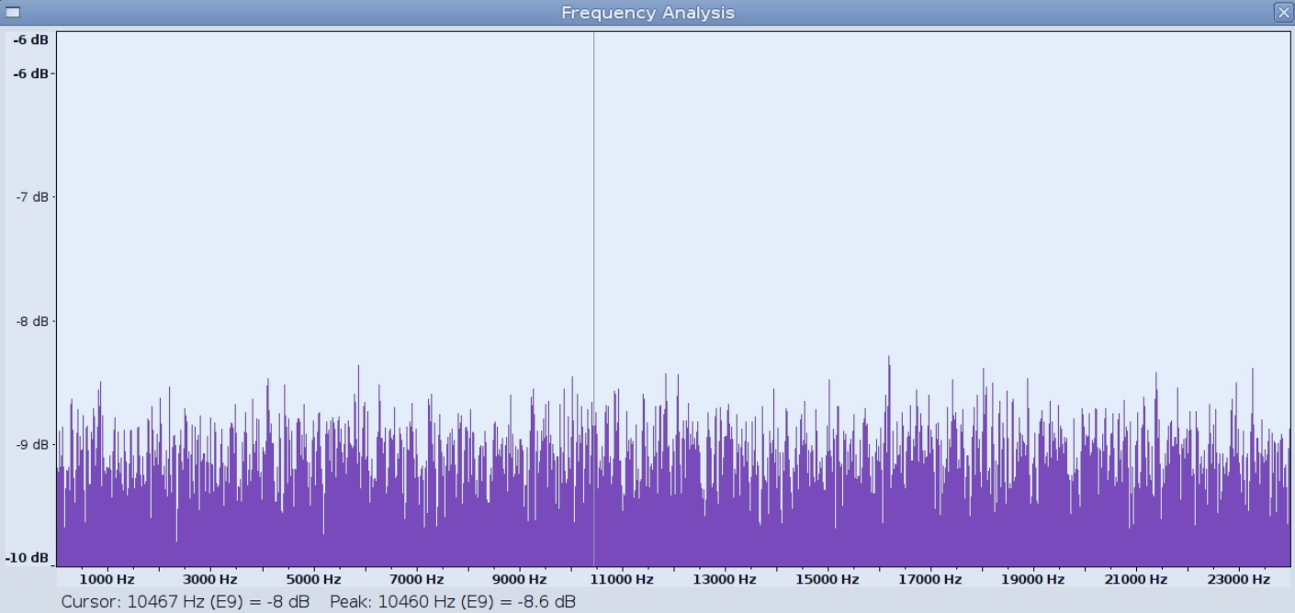
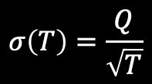


ANGLE (VELOCITY) RANDOM WALK
White Noise
if not modeled accurately, can be a major source of error that limits the performance of an attitude control system
$$S_{Ω}\left(f\right)=Q^{2}$$
$$σ^{2}\left(T\right)=\frac{Q^{2}}{T}$$
$$σ\left(T\right)=\frac{Q}{\sqrt{T}}$$
The Equation indicates that a log-log plot of σ(T) versus T has a slope of –1/2. Furthermore, the numerical value of Q can be obtained directly by reading the slope line at T = 1.
Notes:
https://www.ucalgary.ca/engo_webdocs/NES/04.20201.HaiyingHou.pdf

Slide 17
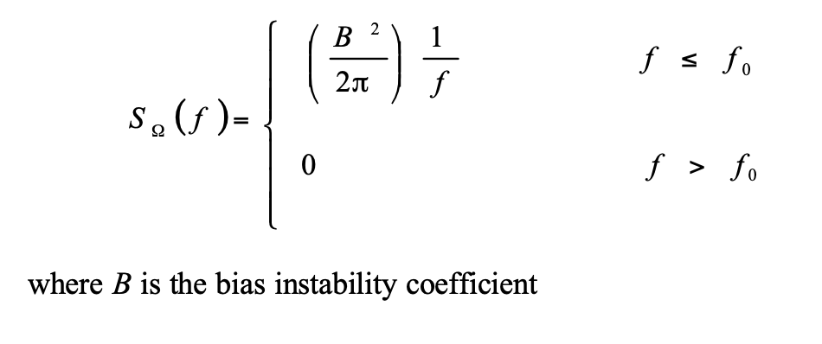
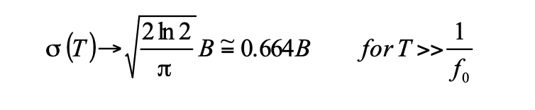
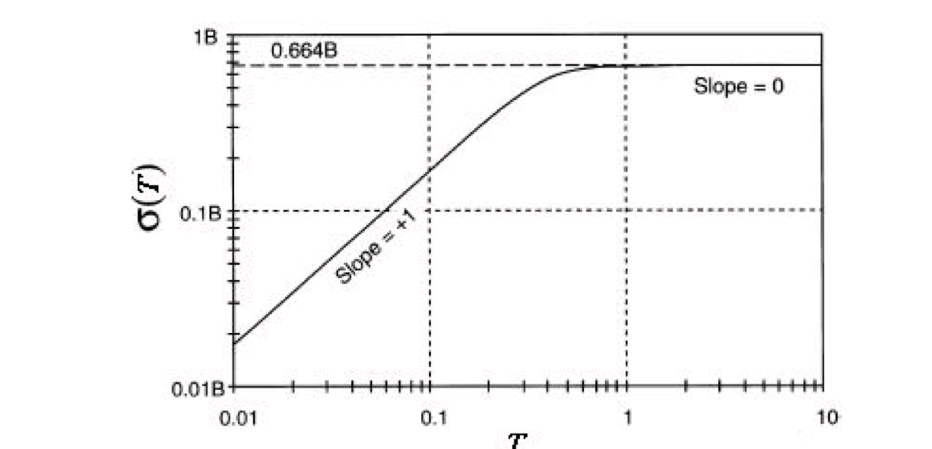
Bias instability
The origin of this noise is the electronics, or other components susceptible to random flickering (Keshner 1982).
Notes:
https://www.ucalgary.ca/engo_webdocs/NES/04.20201.HaiyingHou.pdf

Slide 18
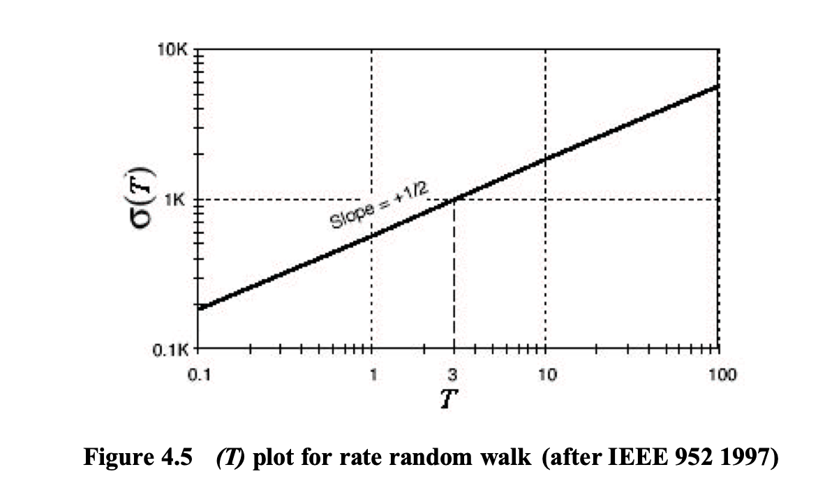
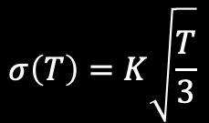
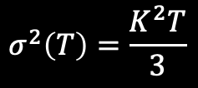
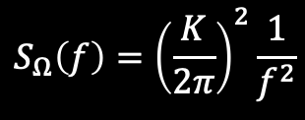
Rate of Random walk
This is a random process of uncertain origin, possibly a limiting case of an exponentially correlated noise with a very long correlation time.
$$S_{Ω}\left(f\right)={\left(\frac{K}{2π}\right)}^{2}\frac{1}{f^{2}}$$
$$σ^{2}\left(T\right)=\frac{K^{2}T}{3}$$
$$S_\{\backslash Omega\}(f) = \backslash left(\backslash frac\{K\}\{2\backslash pi\}\backslash right)^2 \backslash frac\{1\}\{f^2\}$$
$$σ\left(T\right)=K\sqrt{\frac{T}{3}}$$
The magnitude of this noise, K can be read off the slope line at T = 3.
Notes:
https://www.ucalgary.ca/engo_webdocs/NES/04.20201.HaiyingHou.pdf

Slide 19
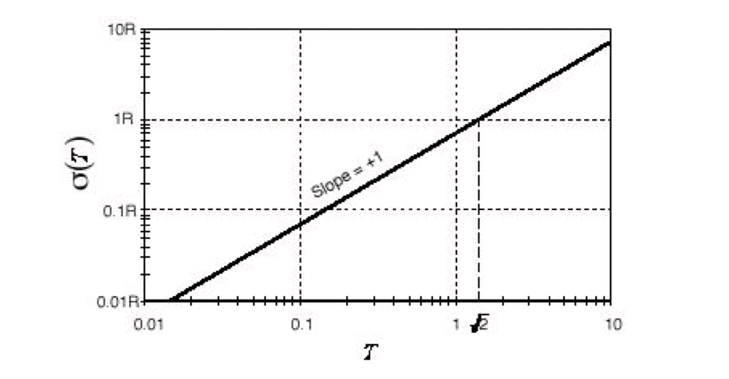
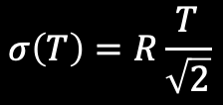
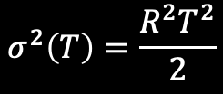

Drift Rate Ramp
It is a systematic and determisntic error ( - IEEE 952 1997)
Slope of +1
$$Ω=RT$$
$$σ^{2}\left(T\right)=\frac{R^{2}T^{2}}{2}$$
$$σ\left(T\right)=R\frac{T}{\sqrt{2}}$$
The amplitude of drift rate ramp R can be obtained
from the slope line at T = 2^(-0.5)
Notes:
https://www.ucalgary.ca/engo_webdocs/NES/04.20201.HaiyingHou.pdf

Slide 20
Total Noise
$$σ_{total}^{2}=σ_{quant.}^{2}+σ_{ARW}^{2}+σ_{biasInst}^{2}+σ_{sin}^{2}+σ_{RRW}^{2}+…$$
Notes:
https://www.ucalgary.ca/engo_webdocs/NES/04.20201.HaiyingHou.pdf

Slide 21
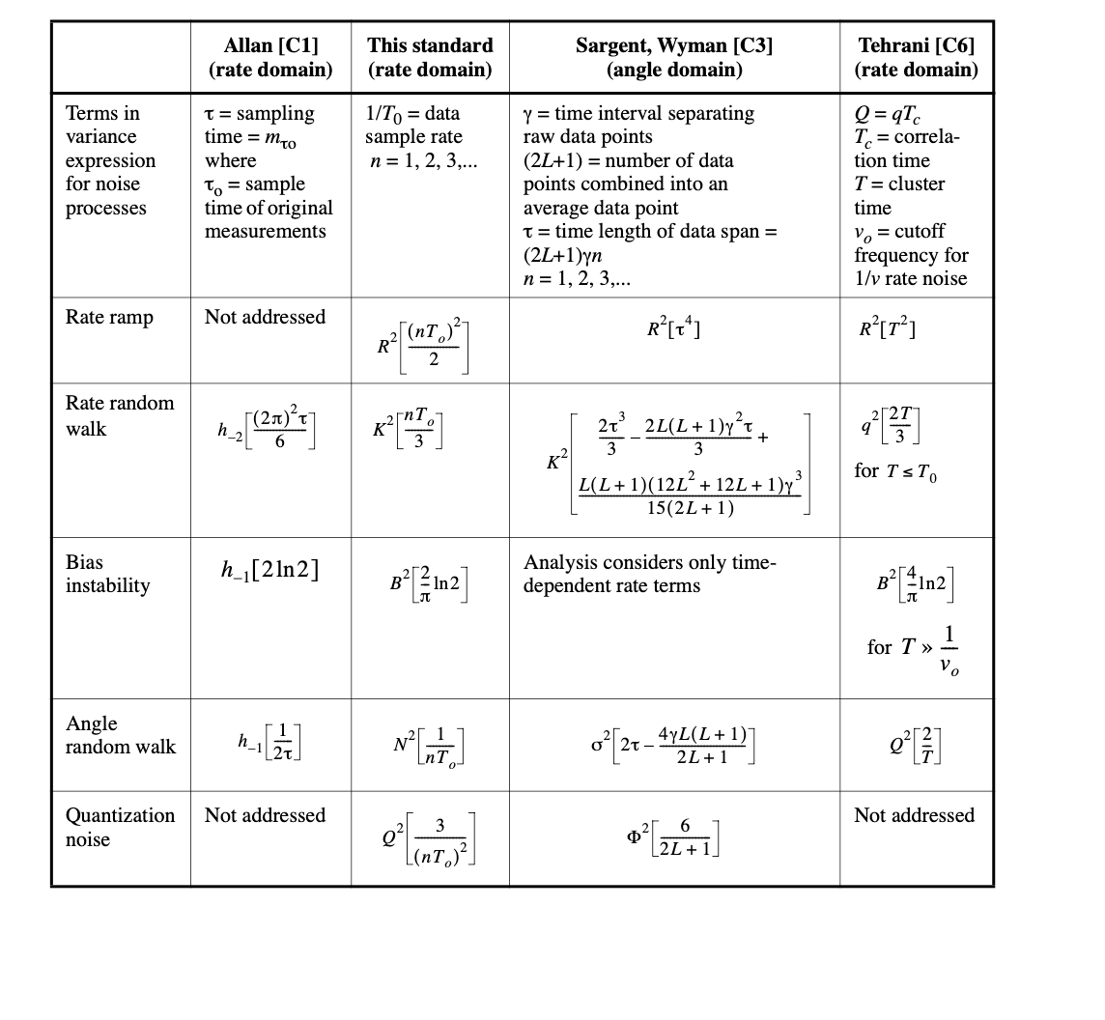

Slide 22
4. SW Architecture

Slide 23
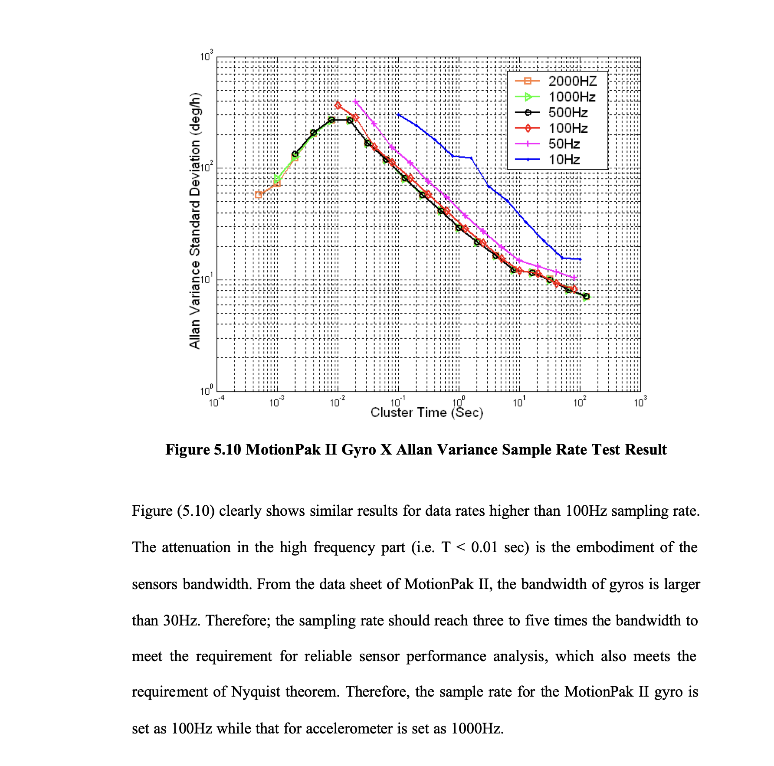
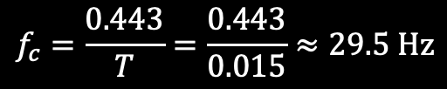

Allan Variance Sampling rate
$$σ=\frac{1}{\sqrt{2\left(\frac{N}{n}−1\right)}}$$
We should run our logger at the highest meaningful frequency to maximise N and therefore increase the number of independent clusters at each τ.
The study from ucalgary. Shoes the higher the samling rate the better the convergance is for several runs
However as we can see here, at some point, we will start to enter the attenuation region of the gistial filter. In the paper this happens at window size of 0.015 sec. which coresponds around 30 HZ cut of freq. which fits the actual BW of the sensor.
$$f_{c}=\frac{0.443}{T}=\frac{0.443}{0.015}≈29.5 \text{Hz}$$
Notes:
https://www.ucalgary.ca/engo_webdocs/NES/04.20201.HaiyingHou.pdf

Slide 24
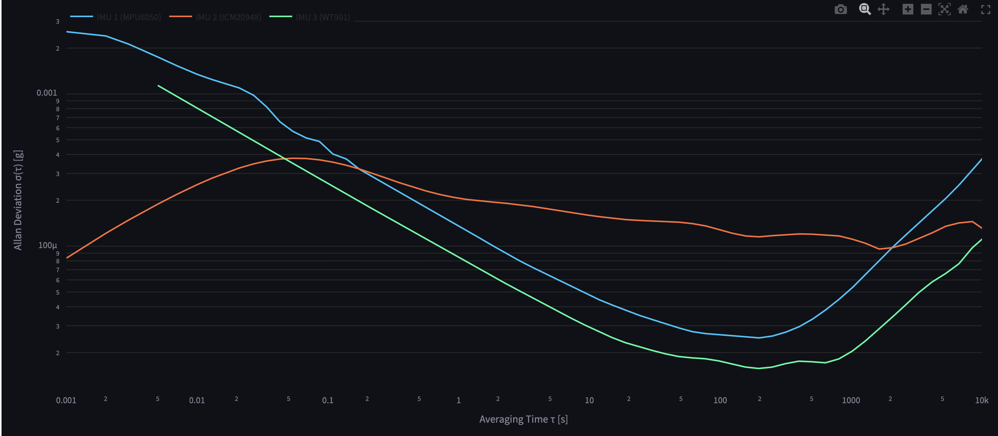
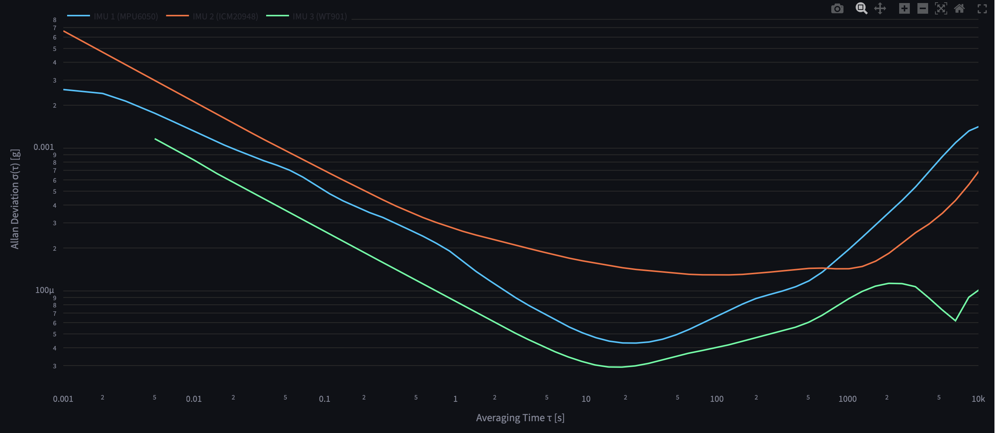
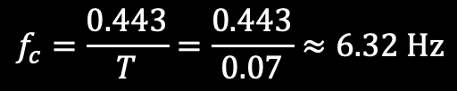
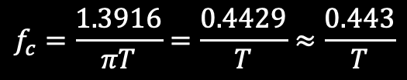
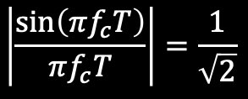

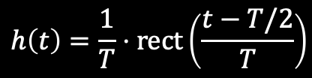
Allan Variance Acc X with DLPF of 5.7 Hz, 8.3 NBW
$$h\left(t\right)=\frac{1}{T}⋅\text{rect}\left(\frac{t−T/2}{T}\right)$$
$$\left|H\left(f\right)\right|=\left|\frac{\sin\left(πfT\right)}{πfT}\right|$$
$$\left|\frac{\sin\left(πf_{c}T\right)}{πf_{c}T}\right|=\frac{1}{\sqrt{2}}$$
$$f_{c}=\frac{0.443}{T}=\frac{0.443}{0.07}≈6.32 \text{Hz}$$
$$f_{c}=\frac{1.3916}{πT}=\frac{0.4429}{T}≈\frac{0.443}{T}$$
The Morale is, we need to get determine first the Filter Bandwidth, to determine the sampling Freq
Mit filtering
Ohne filtering

Slide 25
Allan Variance Filters BandWidth
Parameter | MPU6050 | ICM20948 | WIT901
Filter Type | DLPF | DLPF | Kalman Filter
Accel’s Filter BandWidth | 260 Hz | DLPF 3dB @ 246 Hz (NBW 265 Hz), | 256 Hz
Gyro’s Filter BandWidth | 256 Hz | 3dB @ 196.6 Hz (NBW 229.8 Hz) | 256 Hz
Filter Type | DLPF | DLPF | Kalman Filter
Accel’s Filter BandWidth | 260 Hz | DLPF 3dB @ 246 Hz (NBW 265 Hz), | 256 Hz
Gyro’s Filter BandWidth | 256 Hz | 3dB @ 196.6 Hz (NBW 229.8 Hz) | 256 Hz
All of them as Close as possible to each other. The best solution is to turn the filters off, but for WT901 And MPU Filters can not be bypassed

Slide 26
Allan Variance Sampling Freq
The sampling rate should reach three to five times the bandwidth to meet the requirement for reliable sensor performance analysis, which also meets the requirement of Nyquist theorem. ucalgary.
So, The Best sampling Frequancy in our situation is between 3* 256 Hz to 5 * 256 Hz
Due to the limitation of the Computational power of the MC, we decided to go with 1 kHz
Logging rate is 1 kHz (determistic)
Parameter | MPU6050 | ICM20948 | WIT901
Actual Sampling rate | 1 kHz | 1.125 kHz | 200 Hz (Max possible rate)
Is it okay to log at 1 kHz, while the FS is 1.125 kHz?
Notes:
https://www.ucalgary.ca/engo_webdocs/NES/04.20201.HaiyingHou.pdf
Logging at 1 kHz while FS = 1.125 kHz means you are occasionally missing one internal sample every ~8 samples — the internal buffer gets a new sample every 0.889 ms but you read every 1 ms. This creates a very slight irregular spacing — some reads grab a fresh sample, some grab a sample that is 0.125 ms stale.
For Allan Variance purposes this is negligible. The timing jitter introduced is 0.125 ms which is far smaller than your shortest τ of interest

Slide 27
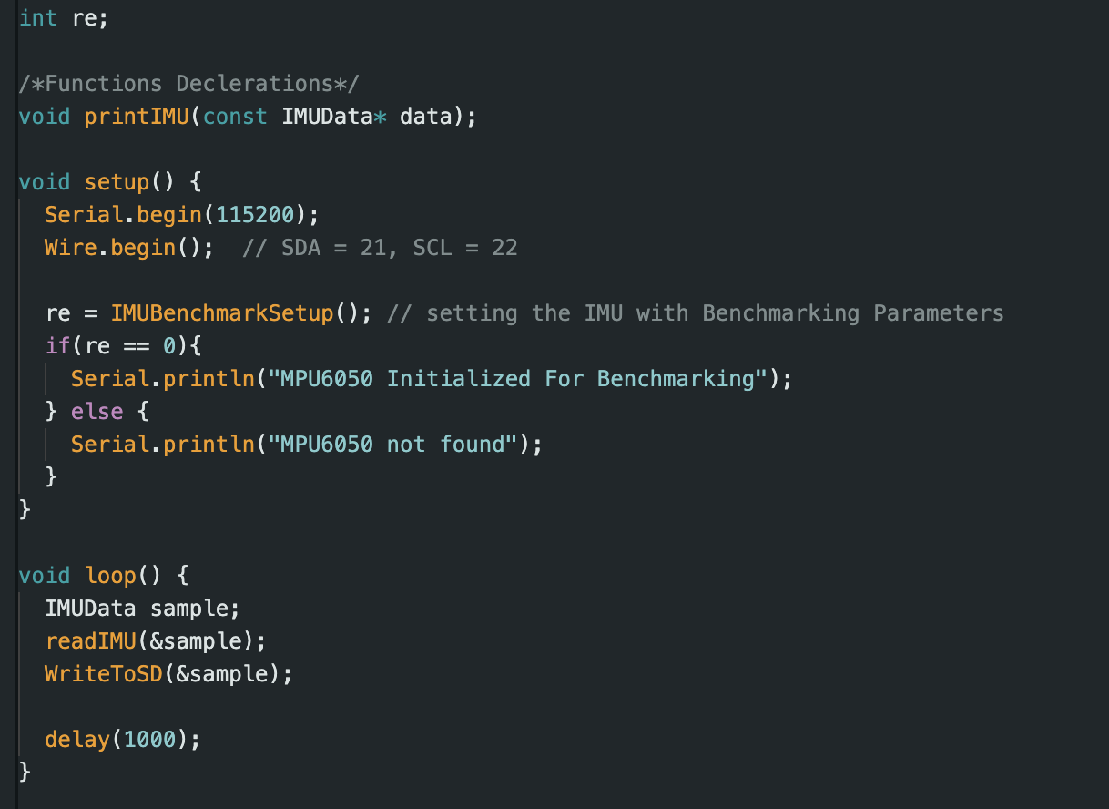
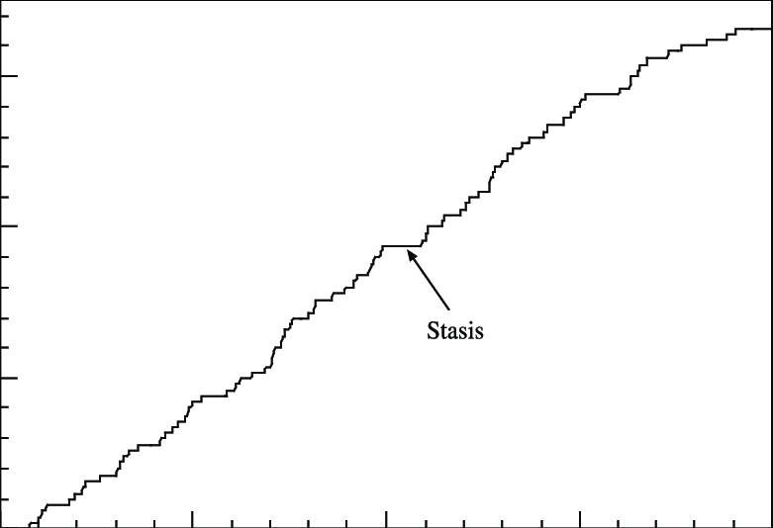
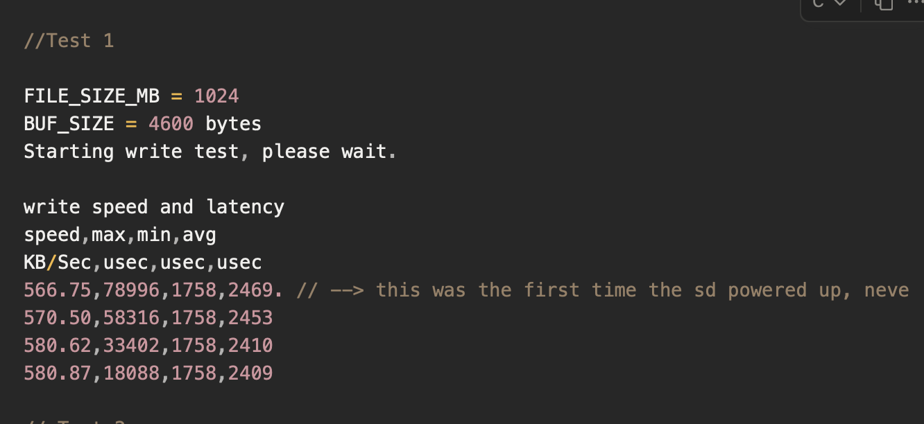
BareMetal Program
Using Delays is a bad approach – why?
In case SD Wrinting function stall we will be losing data
Notes:
A) Wasting Cycles and Not determinstic (5 ms code excution + 1000)

Slide 28
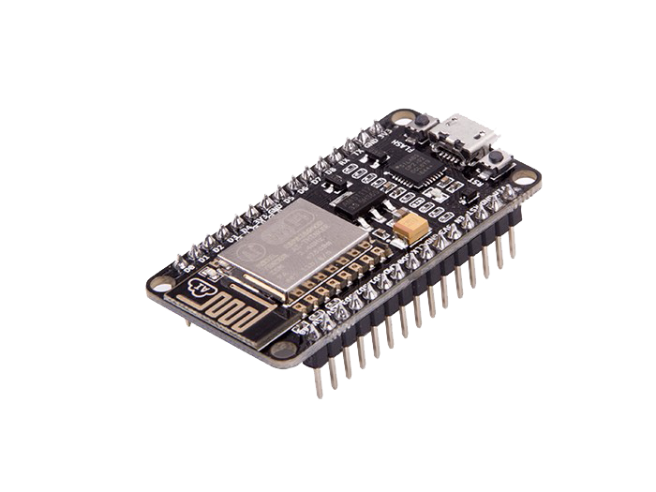
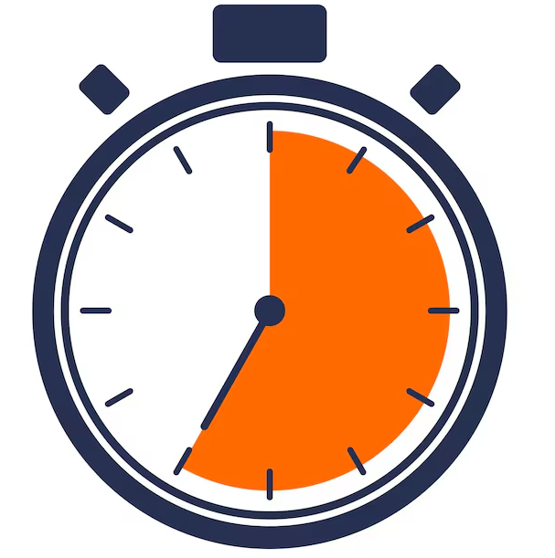
ESP32 + Architecture
Queue
Buffer
Buffer
Core 0
Core 1
Sensors Collector
Writing to SD(Logger)
Buffer Release
Notes:
https://www.youtube.com/watch?v=seQuVd4oR2w

Slide 29
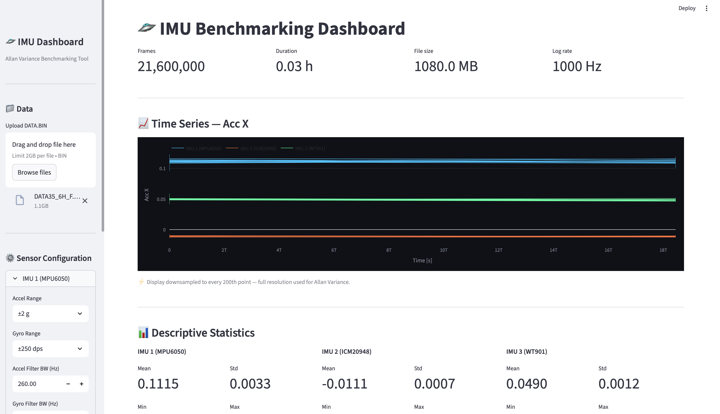
Visulaisation

Slide 30
4. Findings

Slide 31

Results – Gyro X

Slide 32
Results – Gyro X
Sensor | MPU6050 | ICM | WIT901
ARW(°/s/s^½) | 4.2799e-03 | 8.1608e-03 | 3.4866e-05 (Not real)
ARW - Data Sheet (°/s/s^½) | 0.005 º/s/√Hz | 0.015 dps/√Hz | 0.0028 - 0.007 dps/√Hz.
BIAS- instability (°/s/s^½) | 0.0038 | 0.0043655 | 4.8657e-07 (Not Real)
Rate Of Random walk (°/s/s^½) | 1.5942e-03 | 2.9729e-03 | 1.5483e-05
Ramp rate (°/s/s^½) | -- | -- | --
MPU has a better short term performance but when it comes to hgiher long periods, ICM Works better
The Reason why the ICM behaviour is inferior to MPU, because it is a newer one die with two sensors

Slide 33

Results – AccY

Slide 34
Results – Acc Y
Sensor | MPU6050 | ICM | WIT901
ARW(°/s/s^½) | 1.3952e-04 | 2.7137e-04 | 8.3488e-05
ARW - Data Sheet (°/s/s^½) | 400 µg/√Hz | 230 µg/√Hz | 75 - 100 µg /√Hz
BIAS- instability (°/s/s^½) | 4.7515e-05 | 2.069e-4 | 4.4259e-5
Rate Of Random walk (°/s/s^½) | 4.4354e-05 | 1.1822e-04 | 3.0852e-05
Ramp rate (°/s/s^½) | -- | -- | --
ICM has a highrt bias instability and a higher Noise Desnity, but better in long terms
The Reason why the ICM behaviour is inferior to MPU, because it is a newer one die with two sensors

Slide 35

Results – Acc X

Slide 36
FreeRTOS

Slide 37
Just Scheduler + some extras
FreeRTOS
Notes:
A) Wasting Cycles and Not determinstic (5 ms code excution + 1000)

Slide 38



FreeRTOS Flavours
IPC
Queue
Interupt with task Notification
Buffer
Buffer
High Prio (3)
Core 0
Affinity
Core 1
Task Prio
Sensors Collector
Writing to SD(Logger)
Sending data to RF
Low Prio (2)
Tasks
Buffer Release
+ Name
+ TaskFunction
+ Stack size
+ Parameter list
+ Pointer to the task
(Task Handel)
Counting Semaphore

Slide 39
Task States
Queue
Buffer
Buffer
High Prio (3)
Core 0
Affinity
Core 1
Read all Sensors
Writing to SD
Sending data to RF

Slide 40





Queues

Slide 41




Task Notifications
Interupt every 1 ms

Slide 42
Quick Game
Mutex and Semphores

Slide 43
Mutex force Ownership, Semaphores are not
Mutex and Semphores

Slide 44

Counting Semapore

Slide 45


Counting Semapore

Slide 46


Task Function

Slide 47

Task Function

Slide 48



Task Creation
Main() or Setup()

Slide 49

Scheduler Start

Slide 50
Thanks!

