Slide 1
Cloze-driven Pretraining of Self-attention Networks
Made by:
Ilya
Kachalov;
First year master degree students at NUST MISIS

Slide 2
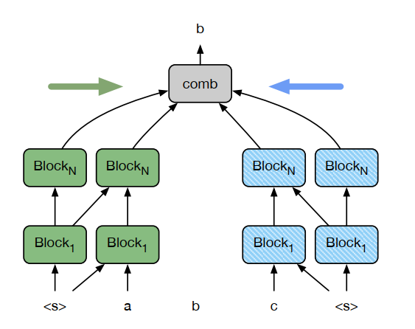
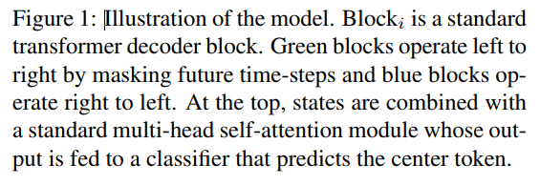
The example of the model

Slide 3
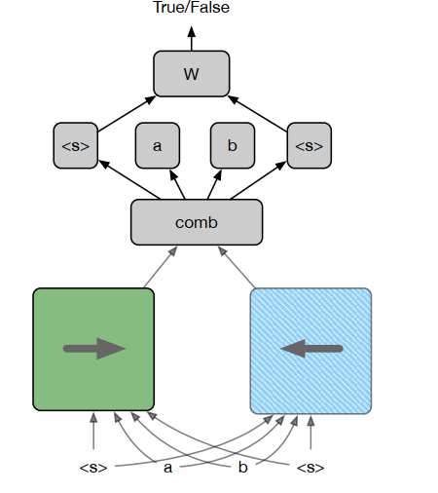
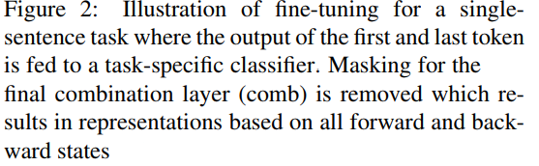
Fine-tuning

Slide 4
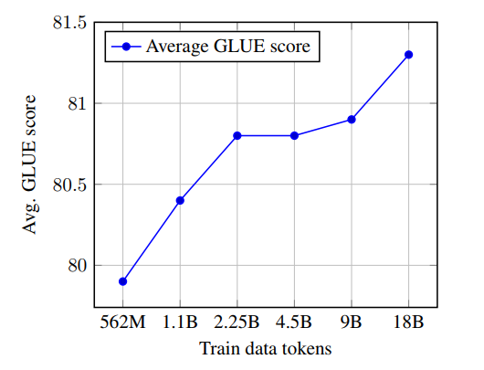
Average GLUE score with different amounts of Common Crawl data for pretraining.

Slide 5


