Slide 1
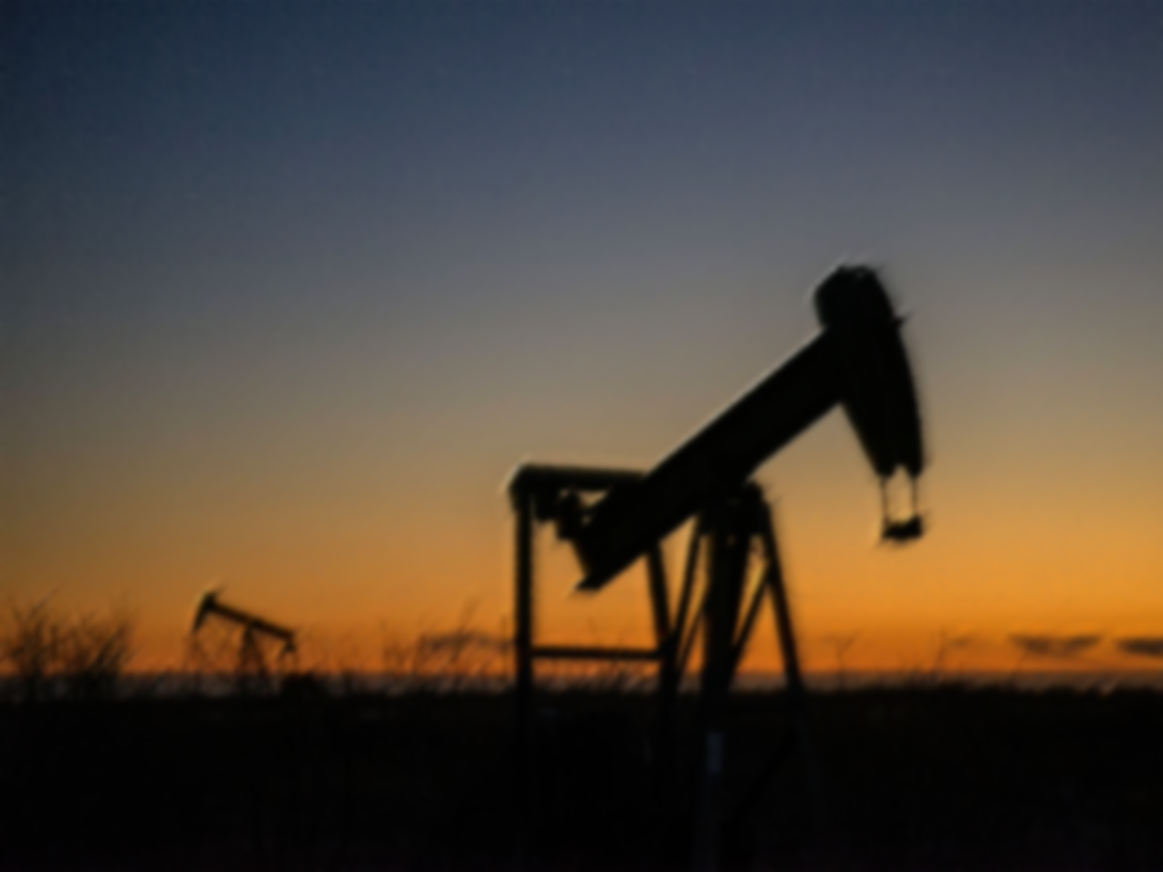


Slide 1
Statistical Report: Permian Basin
- Aswin Lohani-

Slide 2

Population & Labor force
Population Growth Rate(2010-2021)
Labor Force Growth Rate(2010-2021)

Slide 3
Median Age
Median Age (2010-2021)
From 2010 to 2020, the population of Midland county increased by 19% (33,111) and Ector county increased by 17% (28,041).
In, 2020 Permian basin made 4.1% of the state population which is roughly 1.2 million people.
In 2020, the median age of Permian Basin is 38.4 which is 4 years higher than the state of Texas (34.4). For Midland and Ector county that number is 30.6 and 31.8 respectively.

Slide 4
Real Gross Domestic Product(Thousands of Chained 2012 dollars)
RGDP growth (2010-2020)
In 2020, Midland county made 17% of the total RGDP from Permian Basin area while Ector county made 7%. Combined they made 24%!
From 2010 to 2020, the RGDP for Midland county increased by 60%. Ector county made a 17% increase in RGDP in the same time period. The state of Texas made a 24% increase in its RGDP in the same time period.
In 2019, Permian Basin made up to 10% of total RGDP of the state of Texas.

Slide 5
Personal Income(Thousands of dollars)
Personal Income growth (2010-2020)

Slide 6
Per Capita Income(Thousands of dollars)
In 2020, Midland county per capita of $126,631 is 230% that of the state of Texas ($55,129). In 2019 it was up to 259%.
Ector county per capita in 2020 was $49,887 which is 90% of state per capita that year. Combined the average per capita of Midland and Ector county was 160% of state in 2020.
From 2010 to 2020, per capita income of Midland county increased by 40% while Ector county’s per capita increased by 29% which is the same as the state’s per capita growth.
Per capita Income growth (2010-2020)

Slide 8
Housing Cost vs Wage

Slide 12
Oil & Gas Production
Oil Production(2010-2021)
Gas Production(2010-2021)

Slide 13
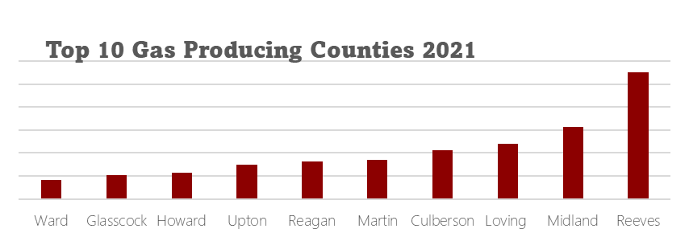
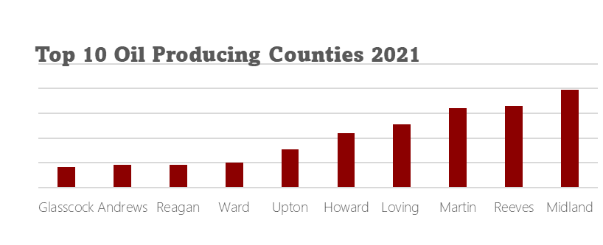
Oil & gas Production
Severance (2011-2021)
In 2020 Permian Basin made 45.3% of the total Gas produced in Texas and 71% of the state’s oil production.
From 2010 to 2020, Midland County increased its Oil production by 92% while Ector county decreased by 37%.
From 2010 to 2020, Midland County increased its Gas 91% while Ector county decreased by 28%.

Slide 14
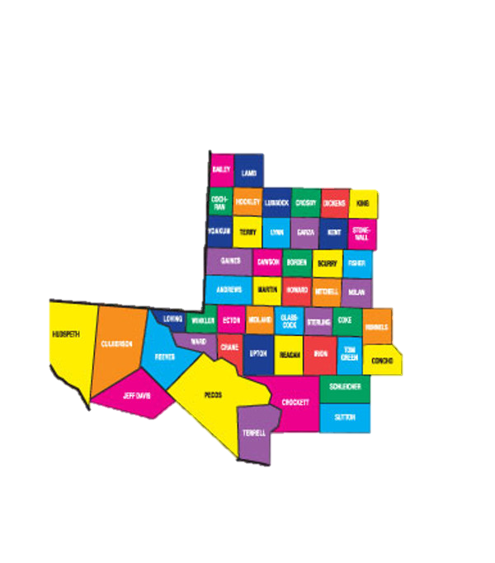
Permian basin 2020
1,235,501,643 BL
4,673,251,154 MCF
Population(4.1%)
1,206,939
Median Age(+3.6)
38.4 years
78% increase from 2010
8% increase from 2019
75% increase from 2010
14% increase from 2019
RGDP(9.2%)
$159 billion(approx.)
Per Capita(94%)
Oil Produced
Gas Produced
$51,598
Personal Income(5%) 7.38 billion(approx.)
497,209
Map
Production
Sales Tax(5%) $1.3billion(approx.)
71%
Housing Units(4.3%) 497,209
Labor Force(4.2%) 593,545
Oil produced in state
45.3%
Severance(66%) $3.54 billion(approx.)
Gas produced in state

Slide 15
MSA 2020 (Midland, ector & Martin county)
341,823,746 BL
873,810,528 MCF
Population (1.16%)
340,391
Median Age (+1.8)
36 years
87% increase from 2010
10% increase from 2019
86% increase from 2010
23% increase from 2019
RGDP (2.89%)
$1.7 billion(approx.)
Per Capita (146%)
Oil Produced
Gas Produced
$80,373
Personal Income (1.93%) $31,264,807
497,209
Map
Production
Sales Tax(1%) $250,398,033
20%
Housing Units (1.11%) 127,734
Labor Force(4.2%) 593,545
Oil produced in state
8.5%
Severance(19.75%) $1.06billion(approx.)
Gas produced in state

