Slide 1


October 2024
Revolutionizing Data Processing with AI
Unleashing the Power of Automation in Document Management

Slide 2
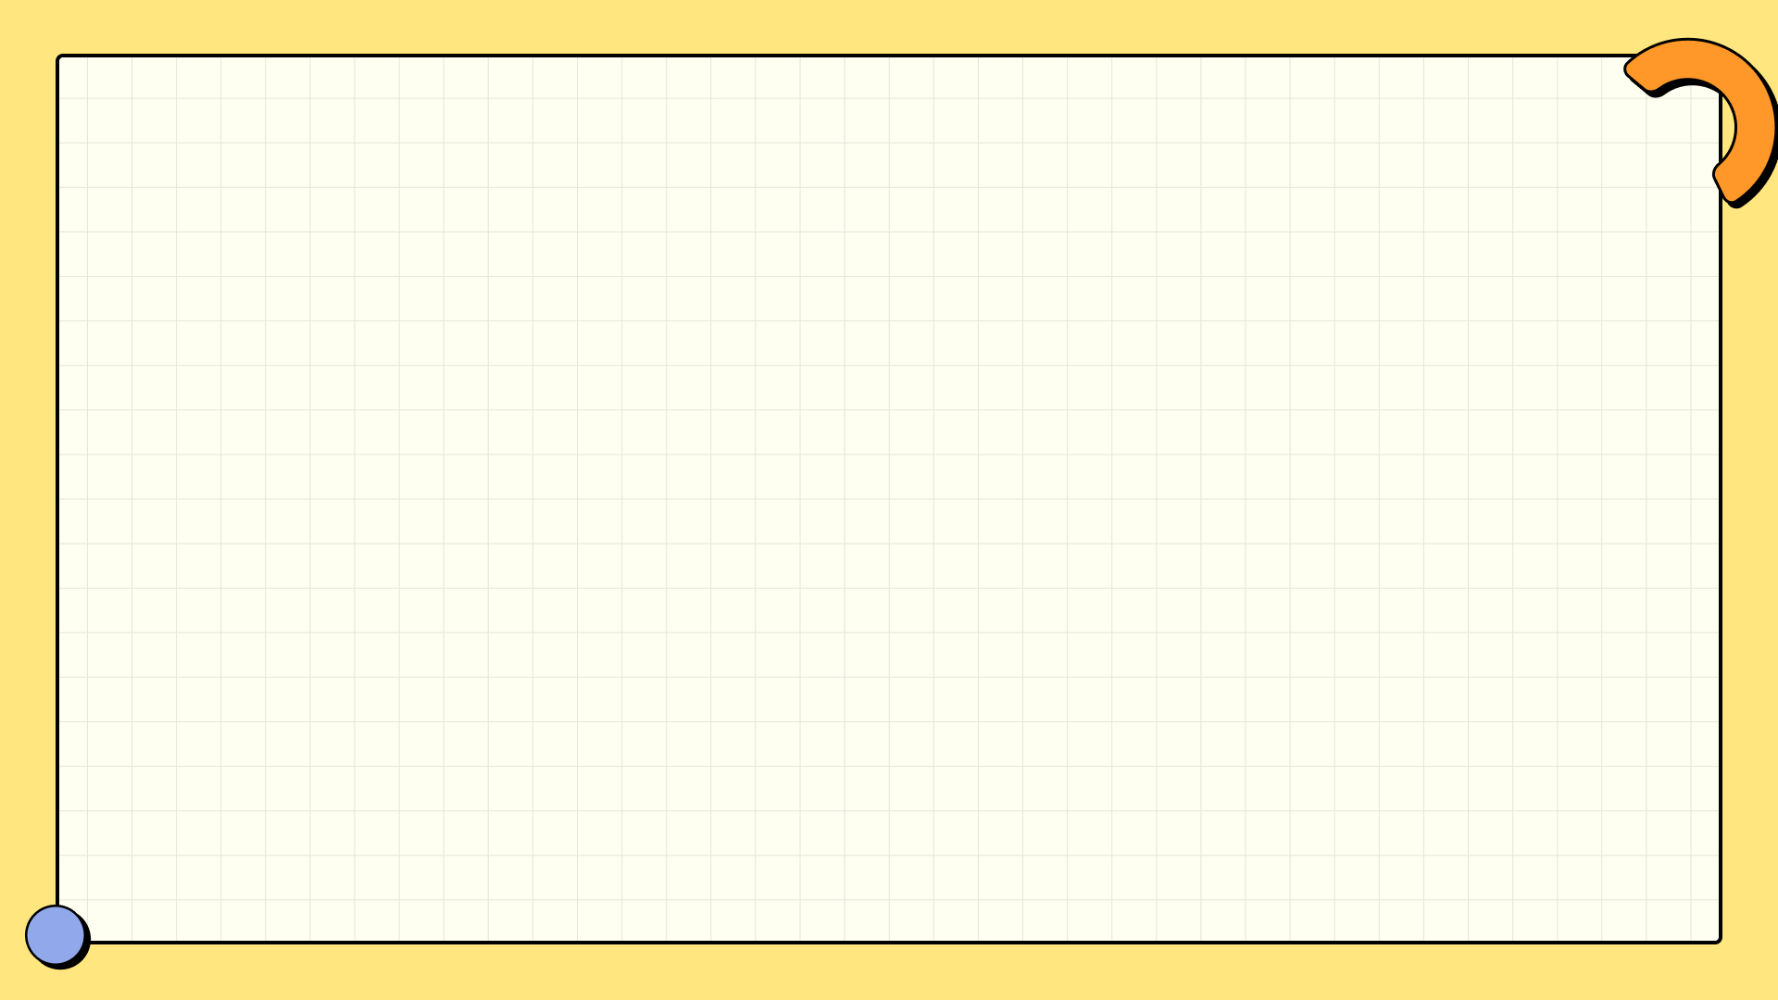

Table of Contents
Introduction to Our Innovative Project
AI Integration: Smart and Contextual Responses
1
5
Environment Configuration: Secure and Efficient
2
6
Workflow: A Step-by-Step Guide
Document Processing Pipeline: A Unified Approach
3
7
Strengths of Our Application
User Interface: Seamless Experience
4
8
Target Audience: Who Benefits?

Slide 3
Use Case Scenarios: Real-World Application
9
10
Future Perspectives: The Road Ahead
11
Conclusion: Thank You!

Slide 4
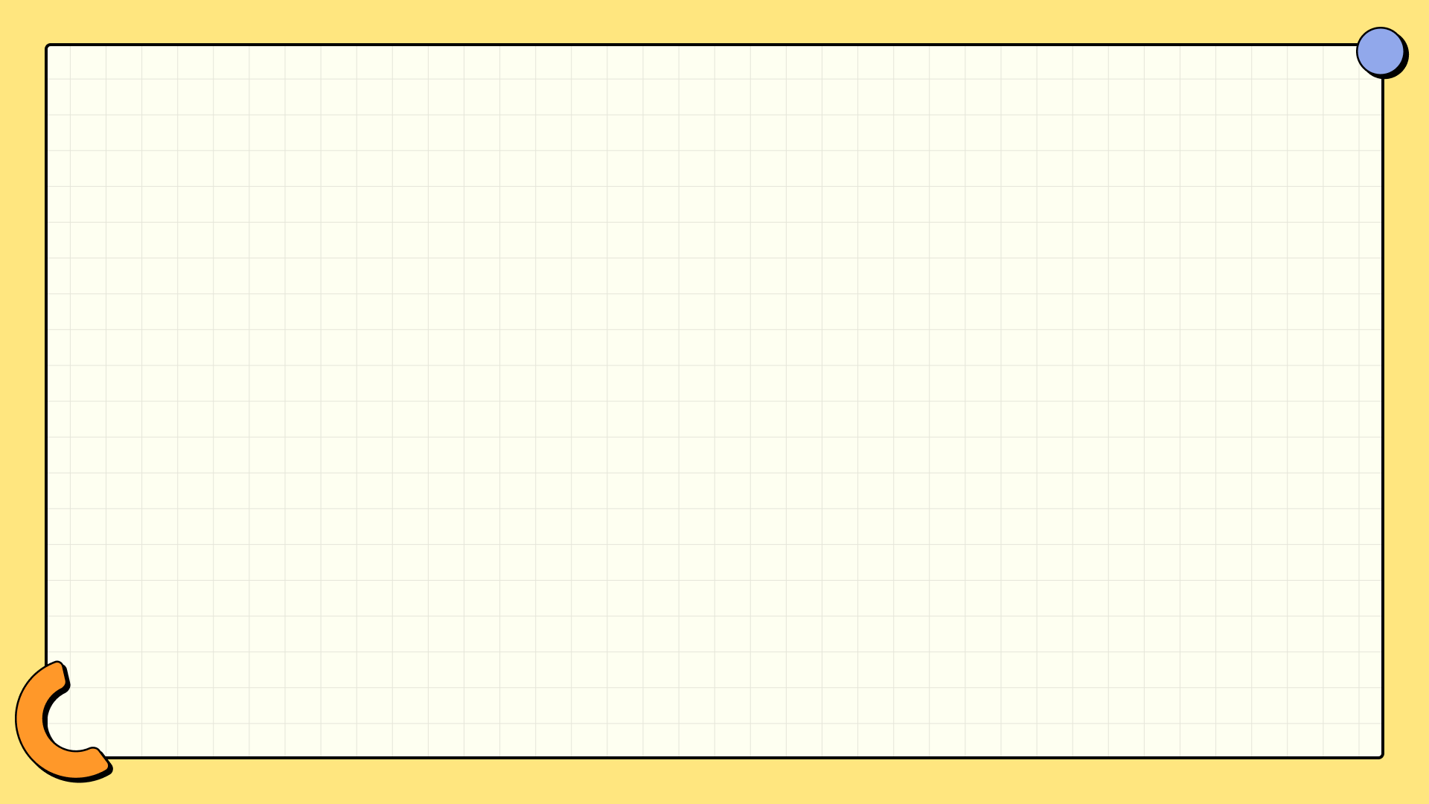
Introduction to Our Innovative Project
In today's data-driven world, processing unstructured information is a daunting task. Our project aims to transform how we handle PDFs and images.
By leveraging advanced technologies, we provide a solution that simplifies the extraction and understanding of vital information from documents.
Imagine effortlessly accessing and querying your vast array of handwritten notes and scanned documents—this is what we offer.
Let's delve into the key components that make this project a game-changer in document management.
We are committed to empowering users with unprecedented access to their data.

Slide 5
Environment Configuration: Secure and Efficient
Our project begins with robust environment configuration using `dotenv`, ensuring secure management of sensitive information.
We utilize the `genai` library for seamless integration with Google Gemini's API access.
Security is paramount; therefore, we prioritize confidentiality in our setup.
This strategic approach lays the foundation for stable and secure document processing.
With an efficient environment, we’re ready to process unstructured data.

Slide 6
Document Processing Pipeline: A Unified Approach
The core of our application is the Document Processing Pipeline, where `PyMuPDF` (fitz) excels at extracting images from PDFs.
Tesseract OCR technology enhances our capability by extracting text from various document types, including images and handwritten notes.
This pipeline's efficiency allows users to upload multiple files simultaneously, saving precious time.
All extracted texts are consolidated into a centralized knowledge base for easy access and querying.
Our commitment to processing prowess ensures no information is left behind.

Slide 7
User Interface: Seamless Experience
Built with Streamlit, our user interface is designed for simplicity and ease of use.
Users can effortlessly upload multiple PDF and image files, making data entry smooth and user-friendly.
They can also interact with the application by posing questions about their uploaded content.
Our interface allows for real-time display of responses from the Gemini LLM, enhancing user interaction.
This intuitive design breaks down barriers to accessing complex data.

Slide 8
AI Integration: Smart and Contextual Responses
At the heart of our solution lies the integration with the `gemini-1.5-flash` model, enabling advanced processing of user queries.
This integration allows the system to generate contextually relevant and accurate responses.
Handling complex data types, including handwritten text, showcases our AI's versatility.
The AI continuously learns, improving its ability to assist users in navigating their documents.
We’re not just answering questions; we’re transforming data into knowledge.

Slide 9
Workflow: A Step-by-Step Guide
Our workflow is designed for efficiency: users upload documents, and the system extracts text automatically using OCR.
Extracted texts are compiled into a knowledge base, ready for queries.
Users can then ask questions, and the Gemini LLM processes these alongside the knowledge base.
Relevant responses are returned based on analyzed content, streamlining the entire process.
This seamless workflow is all about maximizing productivity.

Slide 10
Strengths of Our Application
This application stands out by its ability to handle diverse document formats effortlessly.
It effectively processes complex unstructured data, including handwritten notes and scanned documents.
Users receive accurate, context-aware responses to their queries, enhancing decision-making.
Our user-friendly interface makes the technology accessible to all, regardless of technical skills.
We are setting a new standard in document management.

Slide 11
Target Audience: Who Benefits?
Our solution is invaluable for organizations and individuals inundated with unstructured documents.
Businesses, educators, and researchers will find our tool enhances their productivity and understanding.
It’s perfect for anyone looking to extract, process, and query information efficiently.
Imagine the time saved when document management becomes easy and automated.
We’re here to empower you with effective data handling.

Slide 12
Use Case Scenarios: Real-World Application
Consider a student uploading multiple handwritten notes and scanned documents to query specific content.
Our application processes this data rapidly, providing accurate answers to their questions.
Researchers can analyze vast amounts of literature without manual sorting and searching.
This functionality is not just practical; it's revolutionary in academia and beyond.
Real-world applications showcase our project's true potential.

Slide 13
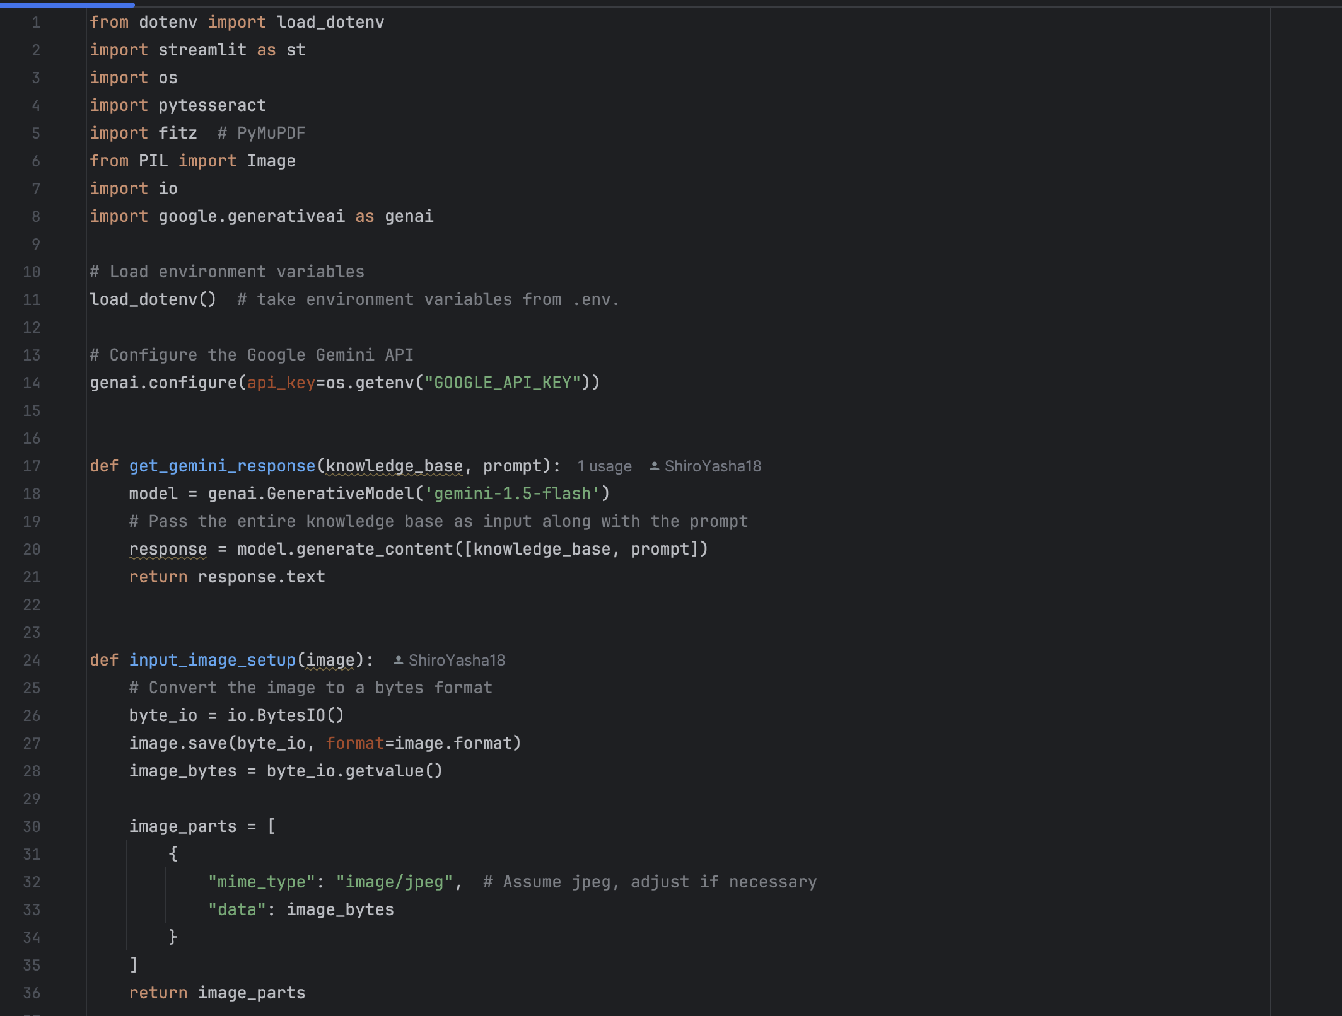
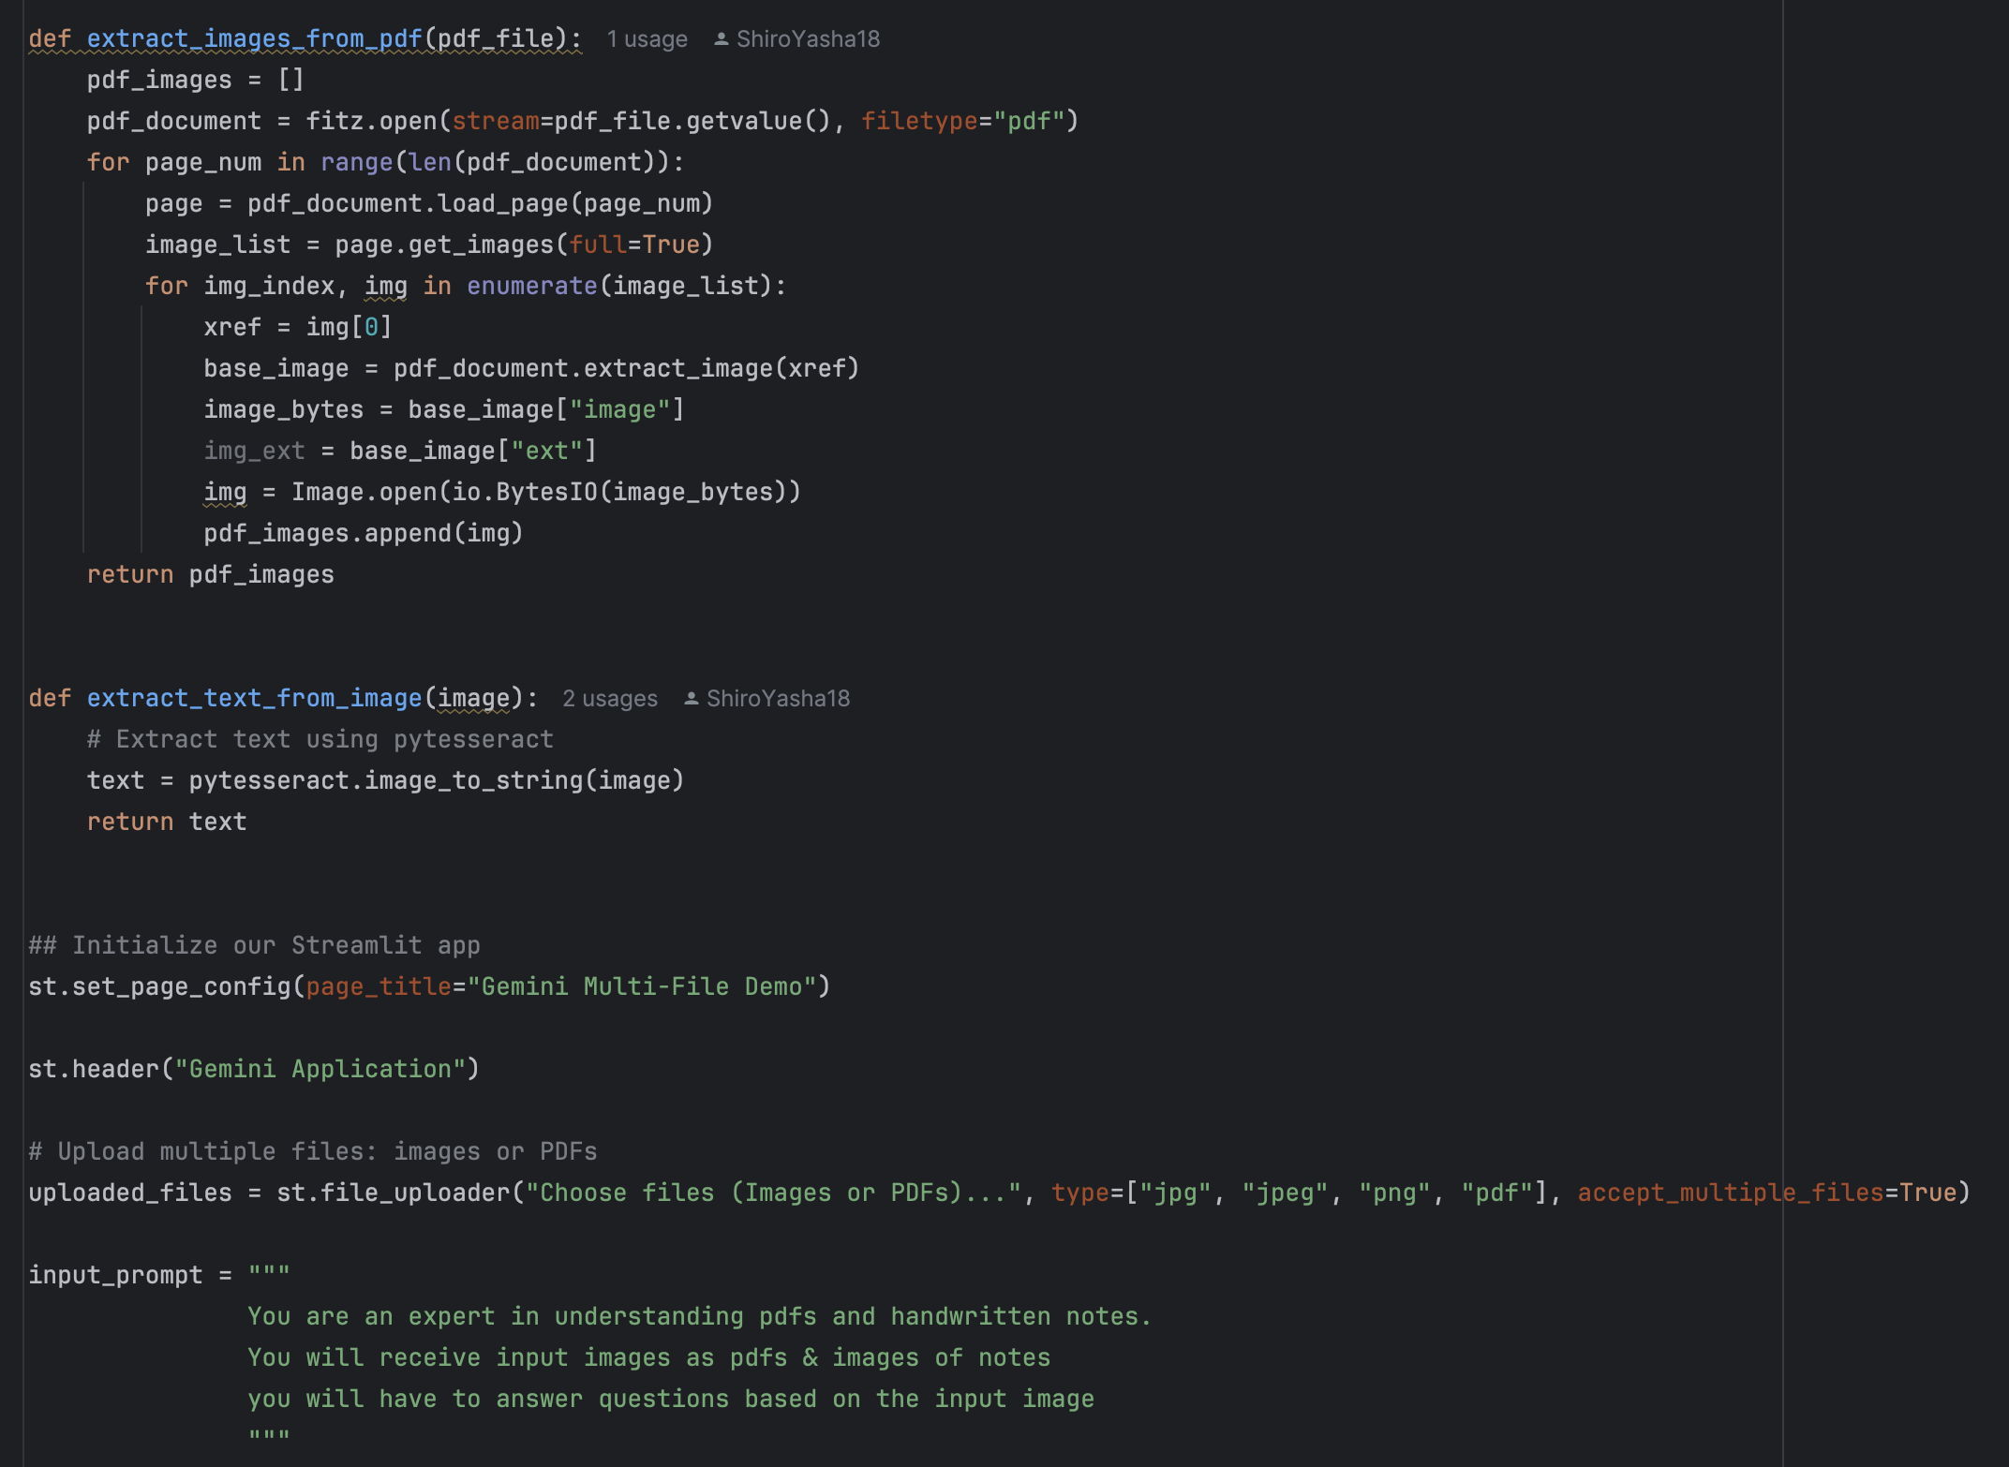
Future Perspectives: The Road Ahead
Code Demonstration
As we move forward, we aim to further enhance our AI capabilities for even better data processing.
Expanding our user interface capabilities to accommodate more features is a priority.
We’re committed to evolving with technology trends to remain at the forefront of document automation.
Collaboration with education and business sectors will foster innovation and improvements.
The future is bright, and we invite you to be part of this journey.

Slide 14
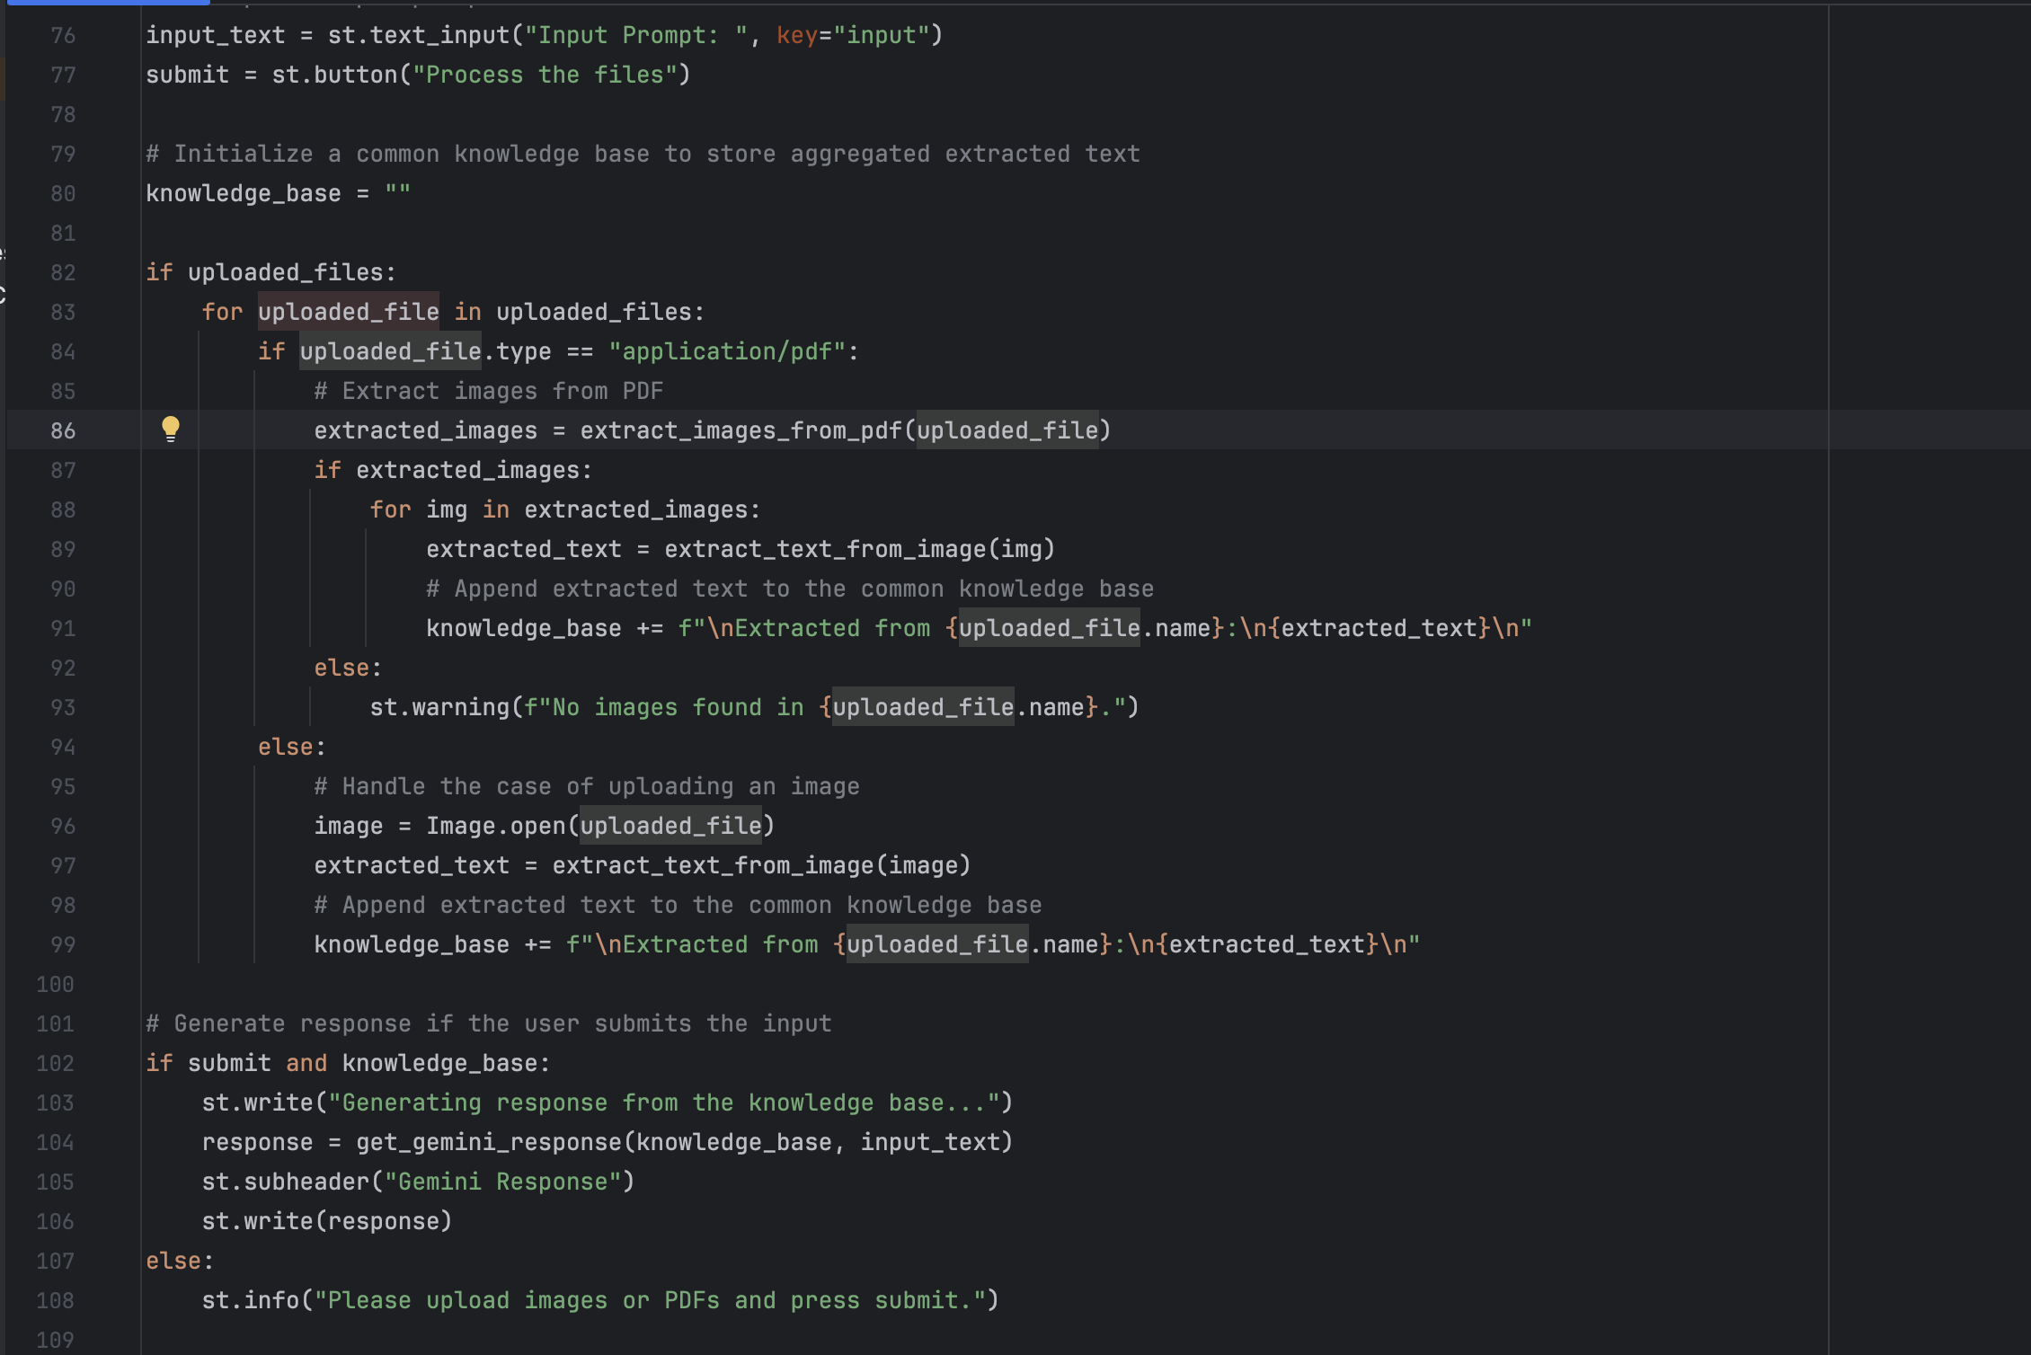
Future Perspectives: The Road Ahead
Code Demonstration
As we move forward, we aim to further enhance our AI capabilities for even better data processing.
Expanding our user interface capabilities to accommodate more features is a priority.
We’re committed to evolving with technology trends to remain at the forefront of document automation.
Collaboration with education and business sectors will foster innovation and improvements.
The future is bright, and we invite you to be part of this journey.

Slide 15
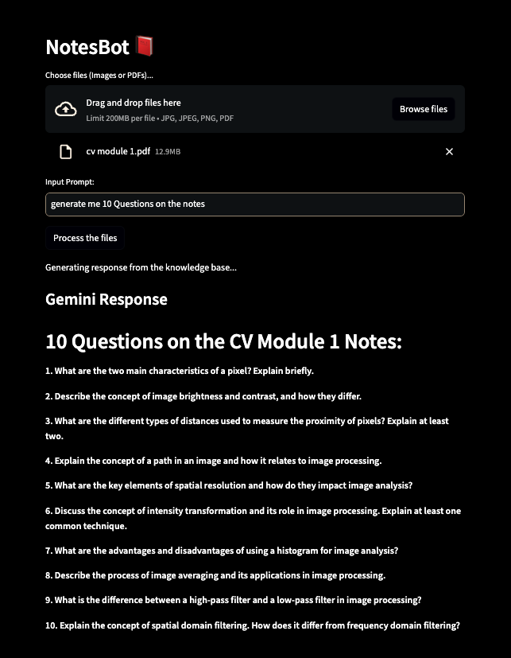
Future Perspectives: The Road Ahead
As we move forward, we aim to further enhance our AI capabilities for even better data processing.
Expanding our user interface capabilities to accommodate more features is a priority.
We’re committed to evolving with technology trends to remain at the forefront of document automation.
Collaboration with education and business sectors will foster innovation and improvements.
The future is bright, and we invite you to be part of this journey.
Output Demonstration

Slide 16
Conclusion: Thank You!
In conclusion, we believe our project will redefine how individuals and organizations manage unstructured data.
The combination of AI and user-friendly interfaces enables everyone to harness the power of their data.
Thank you for exploring our innovative solution—we’re excited about the future and its possibilities.
We invite your feedback and collaboration as we continue to grow and improve.
Together, let’s revolutionize the world of data management!

