Slide 1
SMART FOOD DIARY APP WITH CALORIE AND NUTRIENT BREAKDOWN
TEAM - 2

Slide 2
Table of contents
Introduction
01
04
Class diagram
Project overview
02
05
Working
Milestone
03
06
Future works & Conclusion

Slide 3
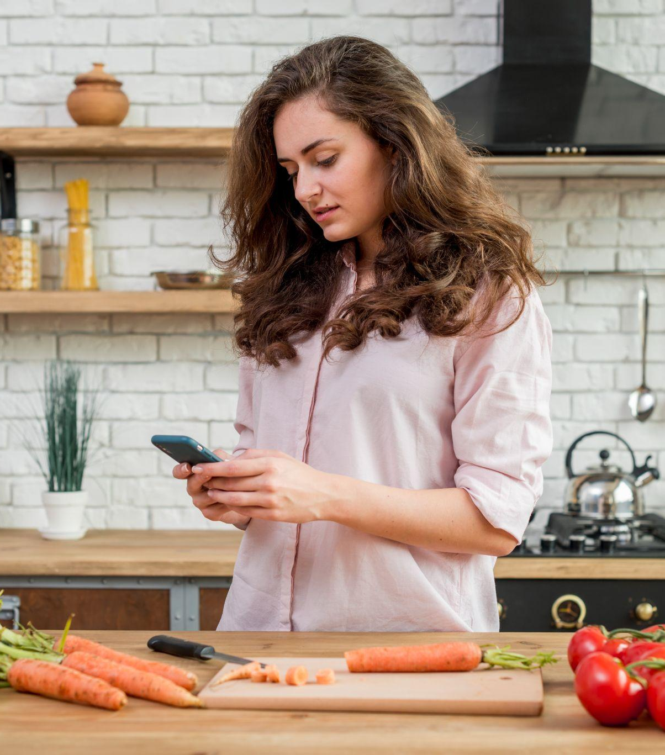
01
Introduction

Slide 4
INTRODUCTION
A user-friendly meal tracking and nutrition management application built with Django, allowing users to register, log in, and manage their profiles.
Supports manual and image-based meal logging, providing detailed calorie and nutrient breakdowns, along with personalized dietary recommendations.
Tracks daily, weekly, and monthly nutritional trends through interactive charts and graphs to empower users in making informed dietary decisions and achieving their health goals.

Slide 5
2
Project Overview

Slide 6
PROJECT OVERVIEW
CUSTOMER FEATURES
User Registration: Create a new user account with email verification.
User Login: Access the application securely with a username and password or Google login.
Meal Logging: Log meals manually by entering food items or by uploading images for automatic recognition.
Food Detection: Detect food items and quantities in images using machine learning models.

Slide 7
5. Nutritional Analysis: View detailed information on calories, macronutrients, and micronutrients for logged meals.
6. Data Visualization: Track daily, weekly, and monthly nutritional trends through interactive graphs and charts.
7. Historical Data: View past logs, track progress over time, and generate/export reports in PDF or CSV format.

Slide 8
PROJECT OVERVIEW
ADMINISTRATOR FEATURES
User Management:
View and manage user accounts for application security.
Nutritional Data Updates:
Add or update food database entries for accuracy in nutritional calculations.
System Monitoring:
Monitor app performance and ensure seamless user experience.

Slide 9
3
Milestones

Slide 10
MILESTONE 1 : WEEK 1-3
Implemented user registration with email verification and login via username/password.
Secured session management with personalized user dashboards.
Developed a robust schema to store meal logs and associated image data.
Integrated Hugging Face ML models to detect food items from uploaded images accurately.
Enabled manual and image-based meal logging with editable detected items.

Slide 11
MILESTONE 2 : WEEK 4-5
Developed backend functionality to calculate and store nutritional content for logged meals.
Implemented logic to analyze user intake and provide tailored dietary improvement suggestions.
Designed visualizations for tracking nutritional intake trends using Django for dynamic charts and graphs.
Compared user intake with dietary guidelines and provided insights.

Slide 12
MILESTONE 3: WEEK 6-7
Enabled user-defined reports with selected metrics and visualizations. Supported export functionality in PDF and CSV formats.
Implemented backend logic to ensure secure access and management of report data.
Developed a notification system for dietary alerts using user intake patterns.
Integrated machine learning models for personalized dietary improvement suggestions.
Provided recommendations based on user goals.

Slide 13
MILESTONE 4 : WEEK 8-10
ADMIN DASHBOARD
Designed an intuitive admin dashboard interface to ensure efficient navigation.
Implemented features for managing user accounts and monitoring user activity.
Configured system settings to provide enhanced control over the application.

Slide 14
4
Class Diagram

Slide 15
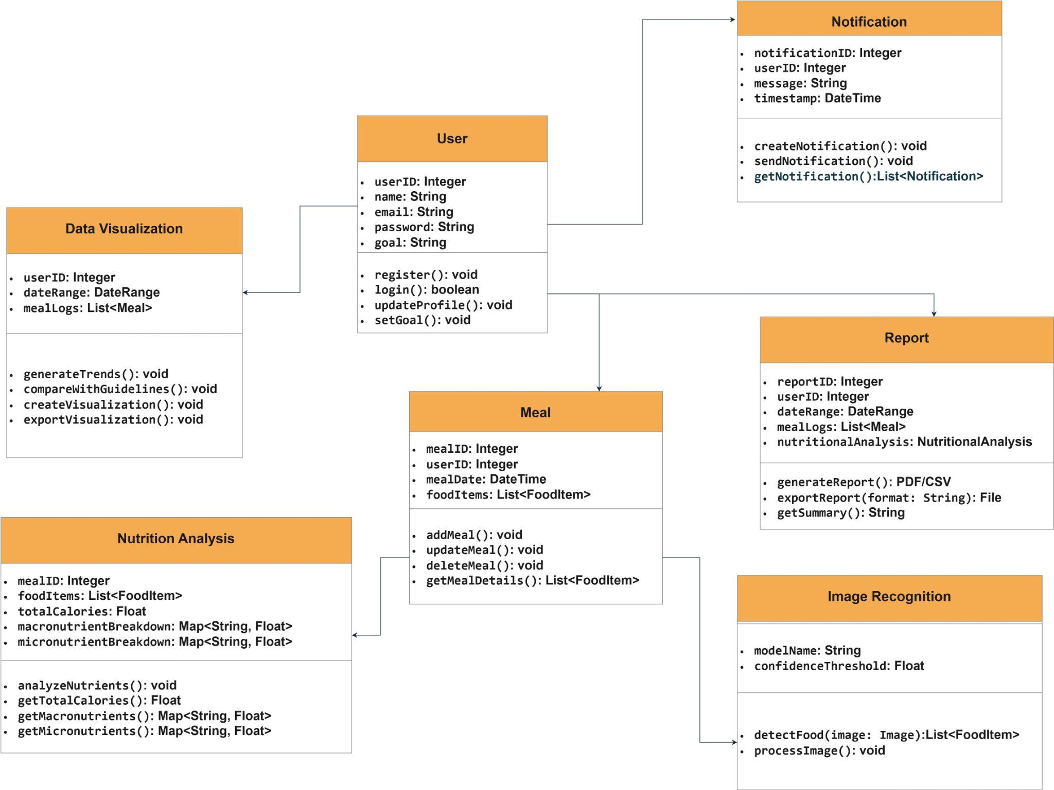
Class diagram

Slide 16
5
Working

Slide 17
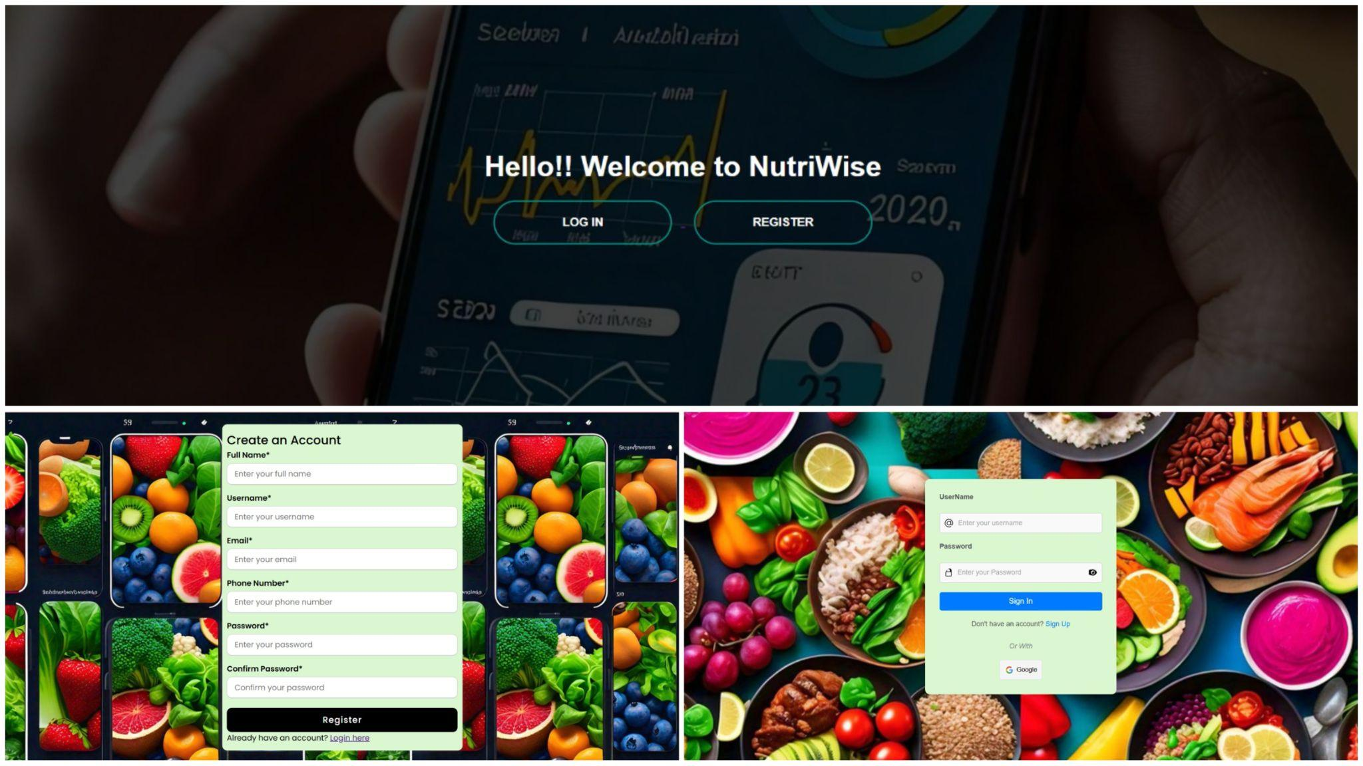
Login/Register

Slide 18
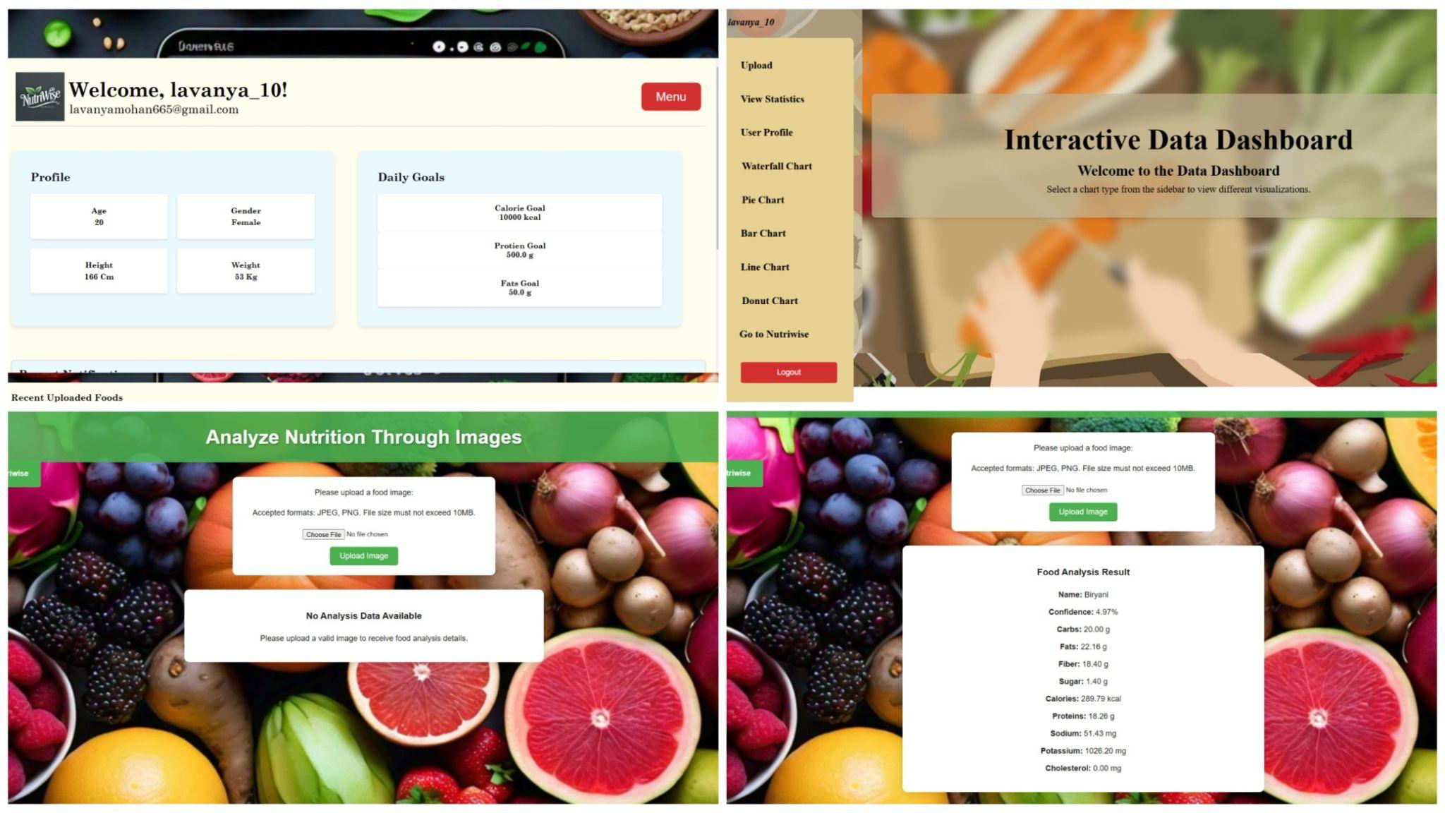
Meal logging & food detection

Slide 19
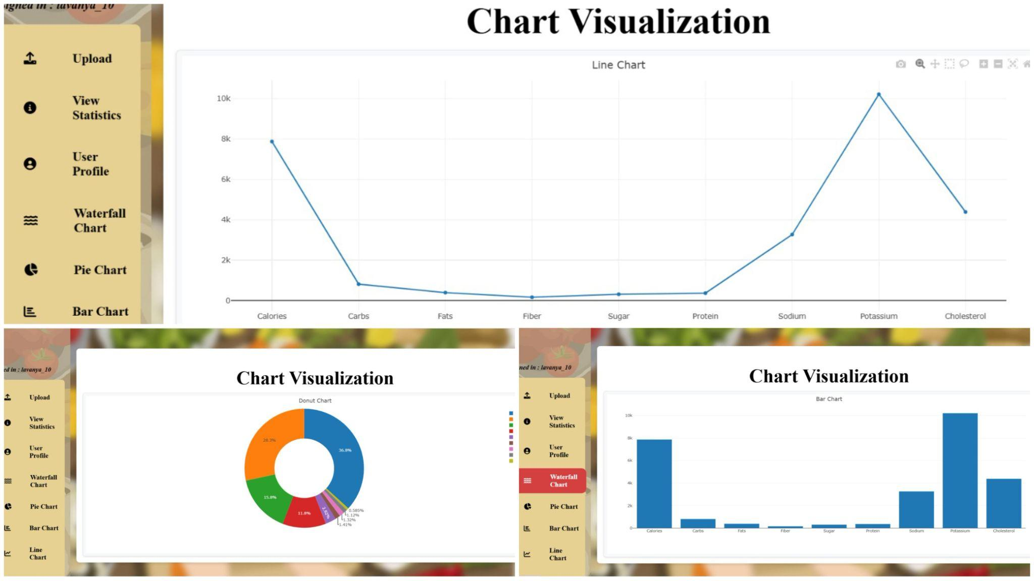
Data Visualization

Slide 20
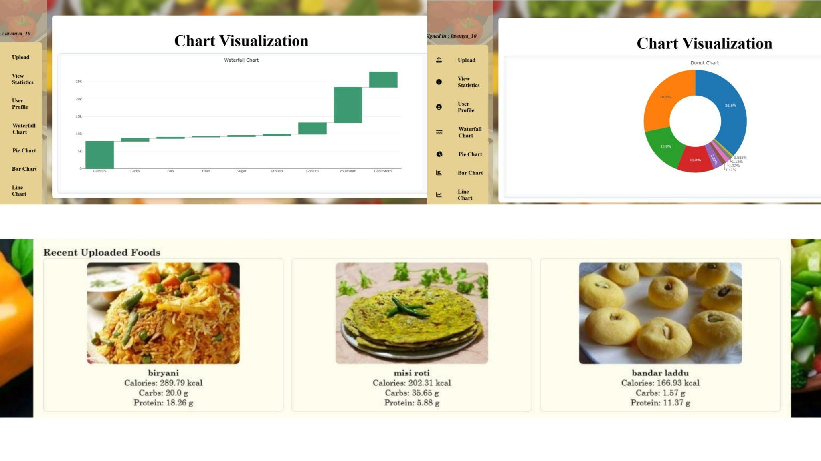
Data Visualization

Slide 21
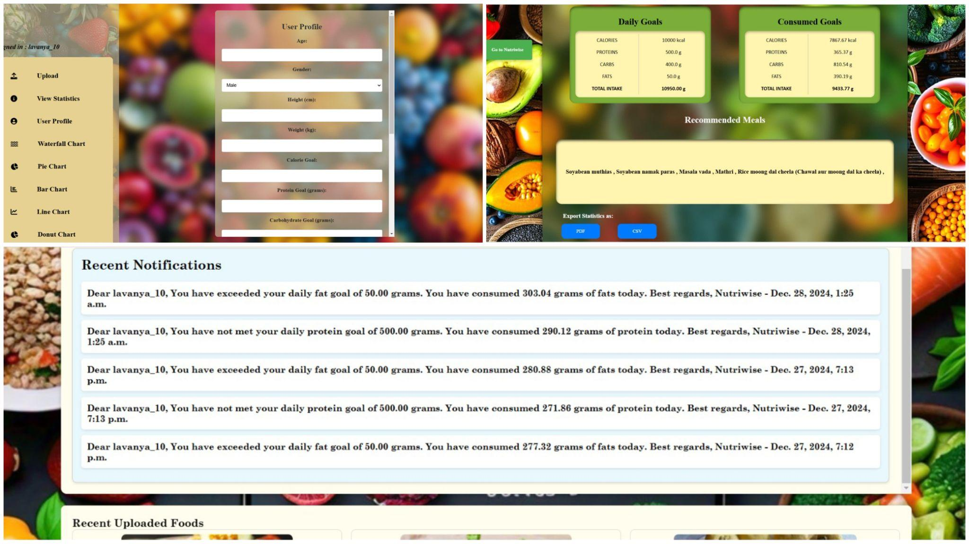
Historical data (PDF/CSV)

Slide 22
6
Future works & Conclusion

Slide 23
FUTURE ENHANCEMENTS
Hydration Tracking : A water logging feature with daily reminders will be added, along with a visual progress bar to track hydration goals.
Barcode Scanning for Meal Logging : Barcode scanning functionality will be integrated to enable quick logging of packaged foods.
Streak Tracking and Badges : A streak tracking system will be introduced to monitor consecutive days of meal logging. Users will also receive badges for achievements, which will be displayed on their profiles.
Recipe Sharing : A recipe-sharing feature will be added, allowing users to upload and share recipes. Nutritional analysis will be provided for recipes.
Gamification Features : The app will include badges, streaks, and rewards to create an engaging and motivating experience for users.

Slide 24
CONCLUSION
Developed a smart food diary application that combines meal logging, image recognition, and nutritional analysis into an intuitive platform.
Enabled users to make informed dietary decisions through detailed nutritional insights, interactive visualizations, and personalized recommendations.
Integrated features like custom reporting, dietary alerts, and trend tracking to provide a holistic user experience.
Designed the system to accommodate future enhancements, such as integration with wearables and advanced machine learning models.
Delivered a tool that promotes healthier lifestyles, supports dietary goals, and helps users track progress over time.

Slide 25
TEAM MEMBERS
Harsh Gupta
Ilakkiya
Ishan Sangani
Kaashifa Tanveer
Lavanya
Shirsaa Saha
Vaishnavi
Yuva Akhil

Slide 26
THANK YOU

