Slide 1
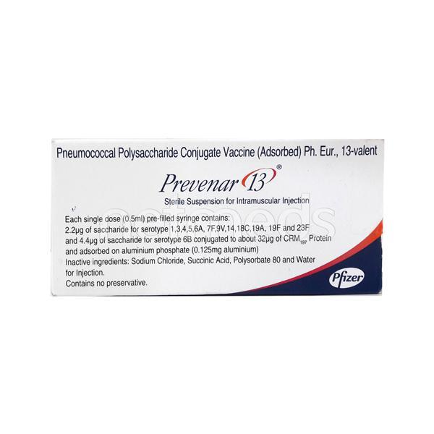
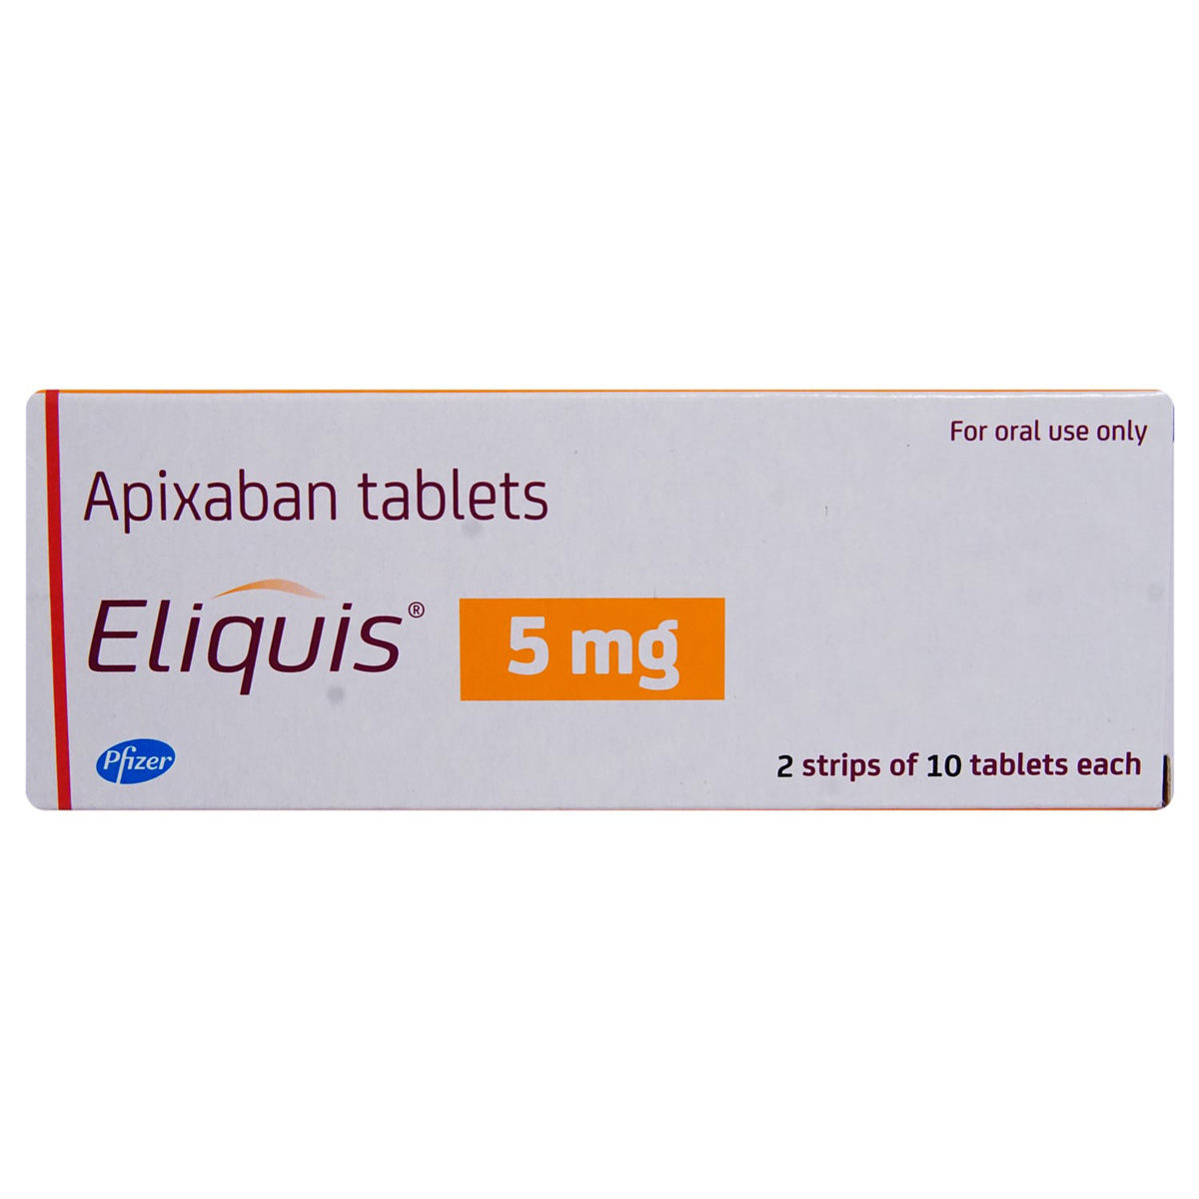


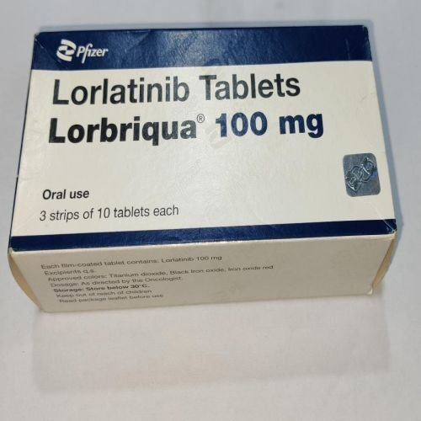
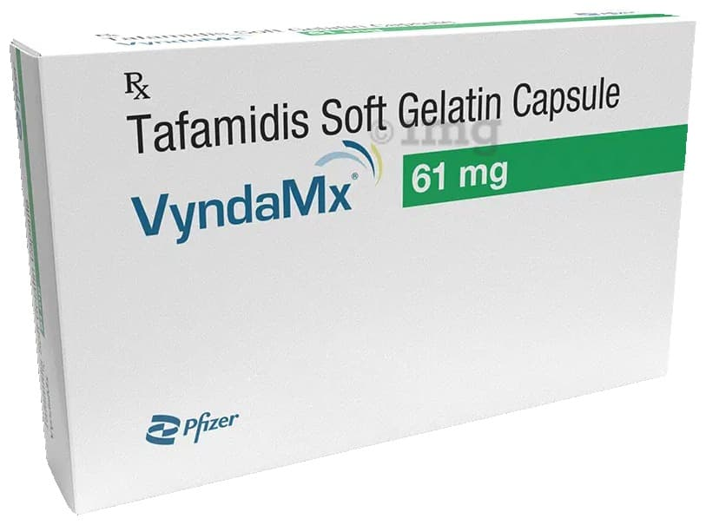
Private-company franchises could broaden listed Pfizer’s specialty portfolio
Selected therapy franchises and representative brands, as of 25 October 2026
Therapy / category | Pfizer Limited (listed) | Pfizer Products India Pvt. Ltd. (private)
Vaccines | ✓ Prevenar 13, Prevenar 20 | —
Vitamins and nutrition | ✓ Becosules, Folvite, Autrin | —
Gastrointestinal | ✓ Gelusil, Mucaine, Neksium* | —
Cardiovascular / anticoagulation | ✓ Eliquis, Targit, Lopid | ✓ Fragmin
Immunology / dermatology | ✓ Enbrel, Betrecep | ✓ Cibinqo
Hospital anti-infectives | ✓ Magnex, Meronem, Zavicefta, Emblaveo | ✓ Cresemba, Vfend, Eraxis
Cough and pain | ✓ Corex DX / LS*, Dolonex* | —
Neurology / migraine | ✓ Nurtec ODT, Prestiq | —
Oncology | — | ✓ Palbace, Lorbriqua, Crizalk, Inlyta, Sutent, Inonza, Elduxio
Rare diseases | — | ✓ Genotropin, Genryzon, BeneFIX, Xynthophilia, VyndaMx
Prevenar 13
Eliquis
Becosules
Palbace
Lorbriqua
VyndaMx
Potential expansion centres on oncology and rare diseases. The listed company already has chronic and specialty products.
✓ Portfolio presence, not market-share ranking. * Cipla markets/distributes these listed-company brands. Sources: Pfizer price lists effective 23 October 2026. No transfer assumed.
Notes:
Entity allocation: https://www.pfizerltd.co.in/files/Pfizer_Ltd_Price_List_-_Effective_October_23rd_2026.pdf
Private entity allocation: https://www.pfizer.co.in/files/Pfizer_India_Price_List_-_TMR_Order_Update.pdf
Cipla: https://www.expresspharma.in/pfizer-india-partners-with-cipla-for-marketing-and-distribution-of-select-brands/
Legal entities: https://www.pfizer.co.in/about-us/pfizer-in-india
Ticks show selected portfolio presence, not quantified market leadership. A dash highlights no comparable franchise in the selected comparison, not zero sales. PPIPL is distinct from Pfizer Healthcare India Pvt Ltd. No confirmed transfer pipeline is asserted.
Image sources:
Prevenar 13: https://cdn.pixelbin.io/v2/plain-cake-860195/netmed/wrkr/products/assets/item/free/original/PKHwKeEri4-prevenar_13_vaccine_0_5ml_0.jpg
Eliquis: https://images.apollo247.in/pub/media/catalog/product/E/L/ELI0077_1_1.jpg
Becosules: https://i.ebayimg.com/images/g/ZCcAAOSwQaBnOv5g/s-l1200.jpg
Palbace: https://www.amariindia.com/media/images/PALBACE_125MG_-_PALBOCICLIB_CAPSULES_RIG9bPO.original.jpg
Lorbriqua: https://img3.exportersindia.com/product_images/bc-full/2025/7/1369709/lorbriqua-100-mg-tablet-1752663176-8205570.jpeg
VyndaMx: https://onemg.gumlet.io/l_watermark_346/a_ignore%2Cc_fit%2Cq_auto%2Cf_auto/ed1768c8-aeab-4fd6-8fe9-59f217f6dbd0.jpeg

Slide 2
Private-company brands span targeted oncology and rare diseases
Selected brands explain the potential portfolio contribution to Pfizer Limited
Private brand | Molecule | Clinical area | Potential contribution
Palbace | Palbociclib | Breast cancer | Targeted oncology franchise
Lorbriqua | Lorlatinib | ALK-positive metastatic NSCLC | Precision lung-cancer treatment
Inonza | Inotuzumab ozogamicin | Relapsed / refractory B-cell ALL | Antibody-drug conjugate in haematology
Cibinqo | Abrocitinib | Moderate-to-severe atopic dermatitis | Deepens advanced dermatology exposure
Genryzon | Somatrogon | Paediatric growth-hormone deficiency | Once-weekly specialist endocrine treatment
VyndaMx | Tafamidis | Transthyretin amyloid cardiomyopathy | Adds rare-disease cardiology
Any expansion depends on parent allocation decisions and the economics agreed with the listed company.
Current portfolio placement establishes a potential source of products. It does not establish a transfer timetable or revenue forecast.
Sources: Pfizer India price lists and product information. Full URLs and clinical-area references are in the slide notes and Excel.
Notes:
All brands on this slide are allocated to PPIPL in the official current schedule: https://www.pfizer.co.in/files/Pfizer_India_Price_List_-_TMR_Order_Update.pdf
Product references:
Palbace: https://labeling.pfizer.com/ShowLabeling.aspx?id=16266
Lorbriqua: https://labeling.pfizer.com/ShowLabeling.aspx?id=16261
Inonza: https://labeling.pfizer.com/ShowLabeling.aspx?id=16264
Cibinqo: https://www.pfizer.co.in/files/Press-Release_Pfizer-Glenmark-Partnership-to-launch-Abrocitinib-in-India.pdf
Genryzon: https://labeling.pfizer.com/ShowLabeling.aspx?id=19566
VyndaMx: https://www.pfizer.co.in/our-science/product-list
Tafamidis indication cross-check: https://labeling.pfizer.com/ShowLabeling.aspx?id=11685
Contribution column is analyst interpretation. No announced transfer is asserted.

