Slide 1
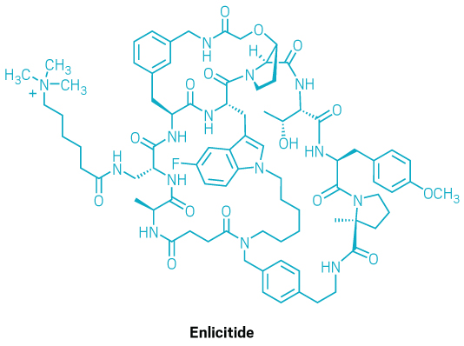
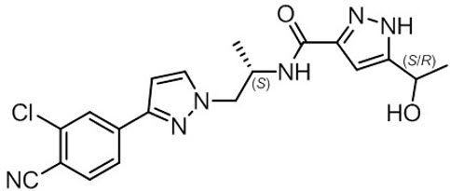
Complex APIs: India CRDMO opportunity shifts to chemistry and process control
ENLICITIDE
NUBEQA (DAROLUTAMIDE)
Oral macrocyclic PCSK9 inhibitor
Chiral small-molecule androgen-receptor inhibitor
1
Macrocyclic scaffold
1
Two active forms
Pre-organises the binding surface for PCSK9
1:1 mixture of (S,R) and (S,S) diastereomers
2
Engineered building blocks
2
AR antagonism
Multiple amide bonds and stereocentres raise route complexity
Competes with androgen at the receptor
3
Biocatalytic assembly
3
Downstream blockade
Selective fragment formation, coupling and macrocyclisation
Inhibits AR nuclear translocation and transcription
BIOLOGICAL EFFECT
BIOLOGICAL EFFECT
Enlicitide binds PCSK9
LDL receptors recycle
LDL-C clearance increases
Darolutamide blocks AR
Nuclear entry falls
AR transcription falls
SYNTHESIS
Fragment coupling + selective macrocyclisation
Stereochemistry + controlled diastereomer mixture
PURIFICATION
Crystallisation-enabled purification
Impurity profile + crystal-form control
CRDMO READ-THROUGH
Value shifts to route design, biocatalysis and analytical control
Source: Merck; DailyMed; Chemical & Engineering News; published literature; Bernstein analysis
BERNSTEIN
Notes:
Sources:
Merck, large-scale biocatalytic synthesis of enlicitide decanoate, May 7, 2026: https://www.merck.com/news/merck-scientists-publish-landmark-paper-on-novel-method-for-large-scale-biocatalytic-synthesis-of-investigational-oral-pcsk9-inhibitor-enlicitide-decanoate/
DailyMed, NUBEQA prescribing information, sections 11 and 12.1: https://dailymed.nlm.nih.gov/dailymed/drugInfo.cfm?setid=1a7cb212-56e4-4b9d-a73d-bfee7fe4735e
Chemical & Engineering News, enlicitide process chemistry and structure image, May 7, 2026: https://cen.acs.org/pharmaceuticals/process-chemistry/biocatalysts-build-big-molecule/104/web/2026/05
Podgorsek et al., Clinical Pharmacokinetics and Pharmacodynamics of Darolutamide, 2023: https://pmc.ncbi.nlm.nih.gov/articles/PMC10386912/
Enlicitide structural image credit: C&EN / Merck & Co. Darolutamide structural formula: DailyMed / FDA label.

