Slide 1


VAT is the semiconductor industry's vacuum-control leader - orders create the next earnings inflection
BUY | VAT Group AG (SIX: VACN)
Dominant supplier of mission-critical vacuum valves and modules embedded inside semiconductor equipment; the stock call is about backlog conversion and structural vacuum intensity, not generic AI exposure.
Price
Target
Upside
Mkt cap
CHF 604
CHF 800
~33%
CHF 18.1bn
28 Jul 2026
FY28 framework
vs. spot
~30m shares
H1 2026: order intake CHF856m (+75% YoY); backlog CHF648m (+121% YoY) vs revenue CHF512m (-8%).
FY23-FY25 sales / EBITDA (CHFm)
Near-term debate: manufacturing ramp execution rather than end-demand discovery.
885 / 271
942 / 294
1,074 / 322
FY23
FY24
FY25
Source: VAT FY2023-FY2025 results; VAT H1 2026 release; market data as at 28 Jul 2026; analyst estimates.
1
Notes:
Open with the stock call, not the technology. VAT is a BUY because reported orders and backlog imply a visible conversion opportunity while structural vacuum intensity should allow VAT to outgrow generic WFE over the cycle. Point the audience to the key tension: demand has accelerated; reported sales have not yet caught up because the constraint is manufacturing output and ramp execution. Transition: the next slide explains how AI demand becomes demand for a vacuum valve without implying that Nvidia is a direct customer.

Slide 2
SEMICONDUCTOR VALUE CHAIN
From an AI server to a vacuum valve: VAT monetises semiconductor capex several layers downstream
END DEMAND
FABLESS
FOUNDRY / IDM
EQUIPMENT OEMs
VAT GROUP
AI servers
Cars / phones
Industrial
Design chips
No owned fabs
Nvidia / AMD / Apple
Manufacture chips
Own fabs
TSMC / Samsung / Micron
Build process tools
ASML / Lam / Applied / TEL
Vacuum valves
Control modules
Service
AI server
NVIDIA
TSMC
ASML
VAT
EV
AMD
Samsung
Lam
MKS
Phone
Apple
Micron
Applied
Edwards
Key clarification: Nvidia may drive incremental chip demand, but VAT generally sells into equipment OEM platforms whose tools are purchased by foundries and IDMs.
Source: Uploaded VAT 101 document; VAT IR materials; company filings; analyst estimates. Logos shown as clean wordmarks for consistency.
2
Notes:
Use this as the map for the rest of the deck. The demand starts with AI servers and other end markets, passes through chip designers, then to foundries and IDMs, then to equipment OEMs, and finally to subsystem suppliers. Emphasise that VAT is not a chip company and not a full equipment company. It supplies critical components inside the equipment. Transition: to understand why this matters, the audience needs the basic chip taxonomy: logic, memory and specialty semiconductors.

Slide 3
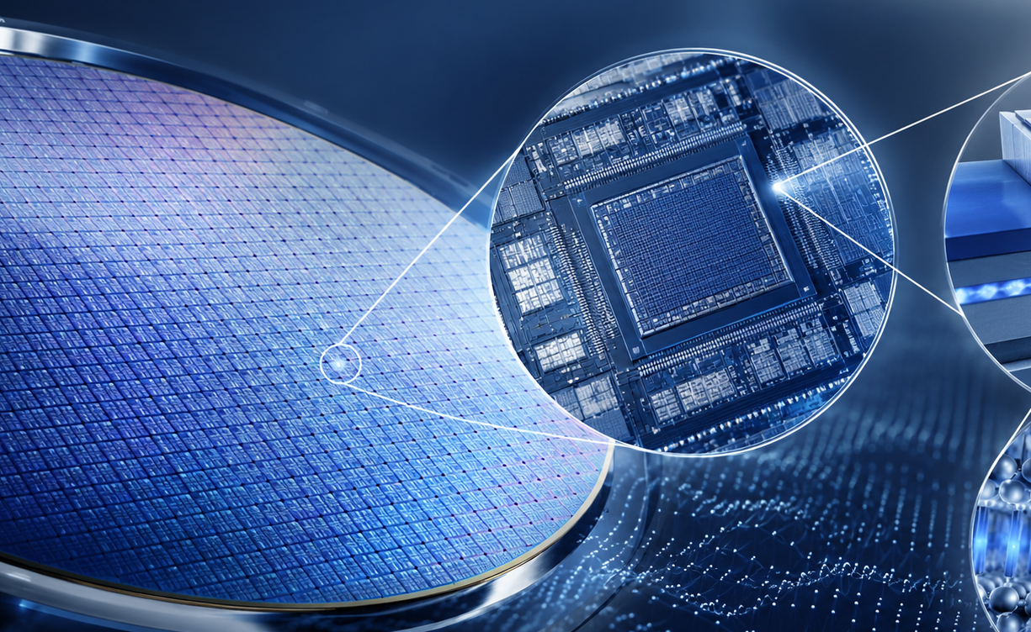
SEMICONDUCTOR 101
A chip is billions of microscopic switches - AI raises the complexity of both logic and memory manufacturing
LOGIC
MEMORY
ANALOG / POWER
CPU / GPU / AI accelerator
DRAM / HBM / NAND
Auto / industrial / sensors
Advanced process nodes, GAA and power efficiency drive equipment intensity.
HBM and advanced DRAM are central to AI; 3D NAND adds vertical complexity.
Broader exposure, typically less leading-edge intensity but still vacuum relevant.
Silicon wafer -> die -> transistor
Who actually buys the machines?
A chip is a silicon device containing microscopic electrical switches. Billions of switches together process, store and control information.
Fabless: designs chips, does not fabricate them (Nvidia). Foundry: manufactures for others (TSMC). IDM: designs and manufactures (Intel / Samsung / Micron). VAT demand follows foundry and IDM capex budgets, typically via equipment OEM procurement.
Source: Uploaded VAT 101 document; company materials; analyst estimates.
3
Notes:
Give a simple definition: a chip is a silicon device with billions of switches called transistors. The point is not physics; the point is which chip categories create equipment demand. Logic includes GPUs and AI accelerators. Memory includes HBM and advanced DRAM, which matter because AI compute needs very high bandwidth. NAND benefits from more vertical layers and difficult etch. Transition: those chips are not made in one step. They are built through a repeated manufacturing sequence, where vacuum-intensive steps are VAT's relevance zone.

Slide 4
PROCESS EXPOSURE
Advanced chips are built through repeated deposition, lithography and etch steps - VAT matters most where vacuum intensity is highest
Wafer
Deposition
Photoresist
Lithography
Etch
Implant
Clean / CMP
Metrology
Repeat
Low
High
Low
Med
High
Med
Low
Med
High
Where VAT relevance is highest
Why advanced nodes raise process difficulty
Vacuum relevance index
Deposition
Applied / Lam / TEL
More layers and three-dimensional transistor structures create more deposition and etch complexity, tighter pressure windows, narrower contamination tolerance and more process-control demand.
Dry etch
Lam / Applied / TEL
Vacuum chambers
Transfer / isolation / pressure control
Complexity, not volume alone, is the structural driver.
Do not claim VAT is equally important in every process. The thesis is concentrated in high-vacuum process chambers where pressure, plasma stability, cleanliness and reliability drive yield.
Analytical mapping based on process physics and VAT product relevance.
Source: Uploaded VAT 101 document; ASML, Applied Materials, Lam Research, TEL and KLA company materials; analyst estimates.
4
Notes:
Walk left to right: chip manufacturing repeatedly adds, patterns, removes and measures material. The most relevant steps for VAT are deposition, etch and other vacuum chamber environments. Be precise. Lithography is central to advanced chips, but we should not overstate VAT's role in lithography unless specific tool-level data support it. Transition: now show the economic reason a valve can matter enough to create a moat.

Slide 5
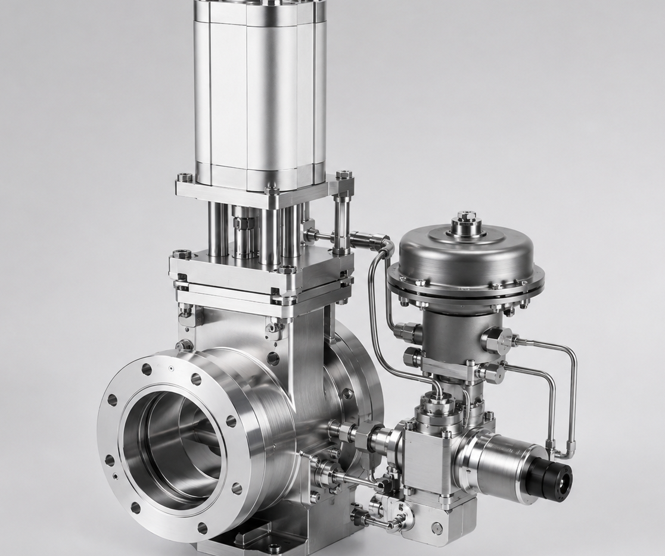
VACUUM ECONOMICS
The valve is inexpensive relative to the tool - but a particle, leak or pressure error can destroy wafer yield
Simplified process chamber
Process
chamber
VAT valve
Pump
1
Remove atmospheric gases and contamination
2
Introduce only required process chemistry
Qualification path
Low component cost, extremely high cost of failure
OEM architecture
VAT co-dev
Chamber qual.
Spec-in / volume
3
Precisely control chamber pressure
The valve controls the environment in which precise deposition, etch and transfer occur. Failure can create downtime, contamination or yield loss.
Once qualified, replacement requires redesign, retesting and customer approval for limited component-cost savings.
4
Prevent cross-contamination between chambers
Source: Uploaded VAT 101 document; VAT product materials; analyst estimates. Valve image is AI-generated technical rendering used for illustration.
5
Notes:
The economic claim is straightforward. A VAT valve may be small relative to the tool cost, but it sits at a point where failure can stop the process or damage wafer yield. Explain the four vacuum functions: remove unwanted gases, introduce only the required chemistry, control pressure precisely and prevent cross-contamination. Transition: the product matters because advanced semiconductor capex is becoming more vacuum intensive, and that drives VAT's revenue equation.

Slide 6
MARKET STRUCTURE
WFE remains cyclical, but AI, HBM and leading-edge logic increase the vacuum intensity of equipment spend
Wafer-fab equipment spending
VAT semiconductor revenue = WFE x vacuum intensity x VAT share x VAT content per tool
WFE
+
Vacuum
intensity
+
VAT share
+
Content
per tool
+
Service
market capex
process complexity
spec wins
modules / motion
installed base
Installed base x fab utilisation x service revenue per installed valve adds a more resilient, but still utilisation-sensitive, revenue stream.
US$bn; 2026E approx. 20%+ growth
5nm -> 3nm -> 2nm
FinFET -> GAA
DRAM -> HBM
3D NAND layers
tighter process windows
more 3D transistor complexity
AI memory bottleneck
deeper etch structures
The structural claim is not that every smaller node mechanically adds valves; it is that advanced architectures raise process steps, chamber complexity and pressure-control requirements.
Source: Uploaded VAT 101 document; SEMI forecast cited in VAT 101; VAT CMD materials; analyst estimates.
6
Notes:
Separate cyclical from structural. WFE is cyclical and VAT will remain exposed to capex cycles. But within WFE, advanced logic, HBM, advanced DRAM and higher-layer NAND increase vacuum intensity. The revenue equation is the most important part of the slide. VAT can outgrow WFE if vacuum intensity, content per tool, share and service installed base all contribute. Transition: the next question is why VAT specifically captures this, instead of the economics getting competed away.

Slide 7
MOAT + EARNINGS FLYWHEEL
Specification lock-in and scale reinforce 75%+ share - today's backlog can convert that moat into earnings
VAT flywheel
Backlog-to-earnings bridge
>75% core semi share
Early OEM co-dev
1
Order intake
CHF856m
+75% YoY
Market leadership
2-5 years before revenue
2
Backlog
CHF648m
+121% YoY
Spec-in
leadership
3
Factory run-rate
>CHF450m
target by YE26
High switching cost
Redesign + requalification
4
Revenue conversion
FY27-28
capacity dependent
More spec wins
Reinforces share
5
EBITDA leverage
mix/utilisation
not automatic
Scale + service
R&D, quality, field support
Management has reported the demand; the investment debate is whether VAT can lift output without quality slippage or margin dilution.
Source: VAT H1 2026 release; VAT CMD materials; uploaded VAT 101 document; analyst estimates.
7
Notes:
This slide links structural moat to near-term earnings. VAT's share is protected less by the mechanical complexity of the valve alone and more by qualification, co-development, customer intimacy and failure cost. Then pivot to the bridge on the right. Orders and backlog are already visible. The question is conversion: capacity, quality, shipping and margin absorption. Transition: now turn this into the variant perception. If VAT is a known quality compounder, what exactly is the market missing?

Slide 8
VARIANT PERCEPTION
The market recognises VAT's quality; the variant view is vacuum intensity plus backlog conversion can beat expectations
1. Vacuum intensity
2. Backlog conversion
3. Operating leverage
Street assumes
Street assumes
Street assumes
WFE recovery drives VAT broadly in line with equipment spend.
Orders are visible but near-term output risk limits confidence.
Ramp costs and hiring dilute margins.
Our view
Our view
Our view
Advanced logic, HBM and complex memory drive disproportionate deposition / etch / chamber intensity.
Backlog plus factory run-rate target creates a credible FY27-28 revenue bridge.
Utilisation, mix normalisation and service can re-expand margins once output catches demand.
Signpost
Signpost
Signpost
OEM commentary on advanced nodes, HBM tools and VAT spec wins.
Quarterly run-rate, shipments, lead times and book-to-bill.
Gross margin, EBITDA margin, service growth and yield stability.
What would make us wrong: orders roll over before conversion; factory ramp misses; leading-edge specification/share deteriorates.
Source: VAT H1 2026 release; VAT CMD materials; SEMI; analyst estimates.
8
Notes:
This is the investment slide. The market already understands VAT is a high-quality franchise. The variant perception must therefore be specific. There are three pillars: vacuum intensity is underestimated; backlog conversion is underappreciated; and operating leverage could reappear if the ramp is executed cleanly. Stress the signposts. This is not a faith-based thesis; it can be tracked quarter by quarter. Transition: the final slide translates the thesis into valuation and the CHF800 target framework.

Slide 9
VALUATION + CONCLUSION
VAT deserves a premium for a scarce semiconductor-component franchise - FY28 earnings support CHF800 if backlog converts
Competitive positioning
FY28 EV/EBITDA target framework
Company
Overlap
Position
FY28E revenue
CHF 1.75bn
VAT
Vacuum valves / modules
Leader
EBITDA margin
~34%
FY28E EBITDA
~CHF 595m
MKS
Vacuum / flow / RF
Adjacent
Target EV/EBITDA
~40x
Edwards
Pumps / abatement
Adjacent
Target EV
~CHF 23.8bn
Horiba
Gas / process instruments
Selective
Net cash / other
~CHF 0.2bn
CKD / SMC
Industrial / pneumatic valves
Limited
Shares
~30m
Target price
~CHF 800
Premium logic: market share, leading-edge spec-in position, qualification moat, margin profile and installed-base service economics.
BUY | CHF604 current | CHF800 target | ~33% upside
Three reasons: rising vacuum intensity; specification-driven 75%+ moat; backlog / capacity conversion.
Source: VAT filings; VAT H1 2026; consensus and analyst estimates; peer company filings. Valuation framework is analyst estimate.
9
Notes:
Close with the investment conclusion. VAT deserves a premium because it is a scarce semiconductor component franchise with very high share and qualification-driven switching costs. Walk through the target framework transparently. It is not a reverse-engineered CHF800; it requires a credible FY28 EBITDA base and a premium multiple consistent with a scarce high-share semi-component supplier. Finish with the three reasons to own the stock: vacuum intensity, moat and backlog conversion.

Slide 10
APPENDIX
VAT product portfolio: from individual valves to higher-content modules and sensing
Control valve
Isolation valve
Transfer / gate valve
Gas-inlet valve
Maintains exact chamber pressure
Seals one vacuum section from another
Opens clean passage for wafer movement
Controls process-gas entry
Vacuum module
Motion / pin lifter
Global Service
Atonarp sensing
Combines valves/functions into one subsystem
Positions wafer precisely inside chamber
Spares, repairs, upgrades, retrofits
Real-time process analytics
Source: VAT product materials; uploaded VAT 101 document.
10

Slide 11
APPENDIX
Vacuum valve types: control, isolation and transfer solve different chamber problems
Control
Isolation
Transfer / gate
Gas inlet
Continuously adjusts opening to hold target chamber pressure
Completely seals sections of a vacuum system
Large opening for wafer robot movement
Introduces process gases precisely
Critical spec
Critical spec
Critical spec
Critical spec
Pressure accuracy; software integration
Leak rate; reliability; cleanliness
Particles; seal integrity; speed
Contamination; chemistry compatibility
Common attribute: qualification risk. After chamber integration, small procurement savings are rarely worth retesting, yield risk and tool-up time.
Source: VAT product materials; uploaded VAT 101 document; analyst estimates.
11

Slide 12
APPENDIX
Detailed process heatmap: VAT relevance is concentrated in vacuum-intensive chamber environments
Process
Key OEMs
VAT relevance
Rationale
Deposition
Applied / Lam / TEL
High
Atomic-scale films, reactive gases, plasma, vacuum
Dry etch
Lam / Applied / TEL
High
Plasma, deep structures, particle sensitivity
Lithography
ASML
Selective
Vacuum used in some environments; avoid overstatement
Ion implantation
Applied / Axcelis
Medium
Ion beam and pressure control
Cleaning / CMP
TEL / Applied
Low-med
Less consistently vacuum-intensive
Metrology
KLA / others
Selective
Tool-specific vacuum requirement
Source: Uploaded VAT 101 document; process OEM company materials; analyst estimates.
12

Slide 13
APPENDIX
OEM and customer ecosystem: VAT demand is pulled by fab capex but specified into OEM platforms
Foundries / IDMs
Equipment OEMs
Subsystem suppliers
TSMC, Samsung, Intel, Micron, SK Hynix
ASML, Applied, Lam, TEL, KLA
VAT, MKS, Edwards, Horiba
Capex owner and ultimate tool buyer
Tool platform where VAT is specified
Critical components inside tools
Important distinction: VAT's commercial route is equipment OEM procurement; ultimate demand is foundry / IDM capex.
Source: Uploaded VAT 101 document; company filings; analyst estimates.
13

Slide 14
APPENDIX
WFE cyclicality: orders lead reported sales and can reverse faster than chip consumption
Semiconductor capex cycle
1
Chip demand strengthens
2
Fab utilisation rises
3
Capex / WFE orders accelerate
4
VAT order intake rises
5
Equipment is shipped
6
New capacity comes online
7
Capex growth slows or reverses
Pitch discipline: the BUY thesis must acknowledge cyclicality; it rests on structural outgrowth plus visible backlog conversion, not on claiming VAT is non-cyclical.
Source: Uploaded VAT 101 document; analyst estimates.
14

Slide 15
APPENDIX
Backlog / book-to-bill / capacity: the near-term debate is execution, not demand visibility
Book-to-bill
Backlog
Factory run-rate
1.7x
CHF648m
>CHF450m
H1 2026
+121% YoY
target by YE26
H1 2026 demand accelerated faster than shipments. The thesis requires backlog conversion without major quality, supply-chain or margin disruption.
Source: VAT H1 2026 release; uploaded VAT 101 document.
15

Slide 16
APPENDIX
Historical financials and forecast bridge
Forecast is analyst estimate, not company guidance. Outcome depends on backlog conversion, run-rate expansion and margins remaining at sustainable levels.
Source: VAT filings; analyst estimates.
16

Slide 17
APPENDIX
Risk matrix: what breaks the thesis
Risk
Observable breaker
Severity
WFE / memory downturn
Orders roll over before backlog conversion
High
Factory ramp execution
Quality, delivery or yield problems
High
Margin dilution
Hiring and ramp costs outpace revenue
Medium
Customer second-sourcing
Loss of spec-in or excessive dual sourcing
Medium
China / export controls
Geographic exposure and order delays
Medium
Valuation de-rating
Premium multiple contracts despite EPS growth
High
Source: Analyst estimates; company filings.
17

Slide 18
APPENDIX
Valuation sensitivity: CHF800 requires execution plus a premium scarcity multiple
Target price per share, CHF
Target EV/EBITDA multiple
35x
38x
40x
42x
32%
653
708
744
781
FY28E EBITDA margin
33%
673
730
768
806
34%
693
752
793
833
35%
714
775
817
859
CHF800 is not a mechanical output. It requires a credible FY28 revenue base, margins around the mid-30s and a premium multiple justified by scarcity, share and backlog visibility.
Source: Analyst estimates.
18

