Slide 1

Capstone Project Software Technology-1(4483) Shop Customer Data
Shrawan Basnet
U3242039
Tutorial Group – Thursday(1:30-3:30)

Slide 2

Table of Contents
1. Introduction / Problem Statement 2. Dataset Details 3. EDA (Exploratory Data Analysis) Outcomes 4. PDA (Predictive Data Analytics) Outcomes 5. Implementation and Deployment (Tkinter/Flask/Streamlit) Plan and Status Update 6. References/Bibliography

Slide 3
Introduction / Problem Statement
The dataset consists of a shop’s ideal customers. It addresses the problems like spending score of customers, customer size, from which professions are the most customers attracted to the business. It helps business to understand their customers.

Slide 4
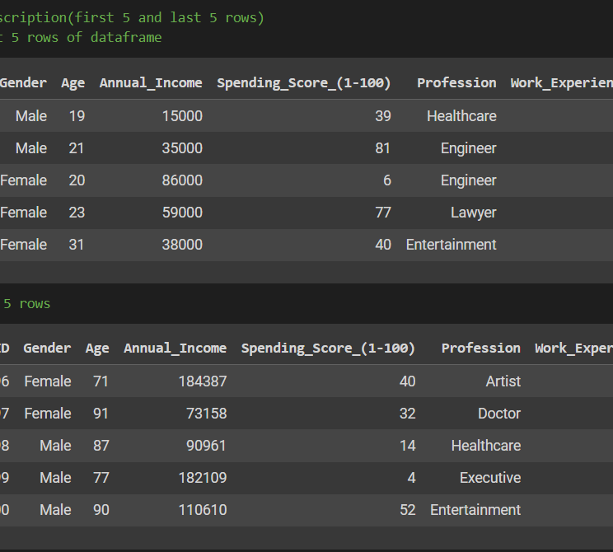
Dataset Details
The Dataset consists of a shop’s ideal customers. It helps the business to understand the customers.

Slide 5
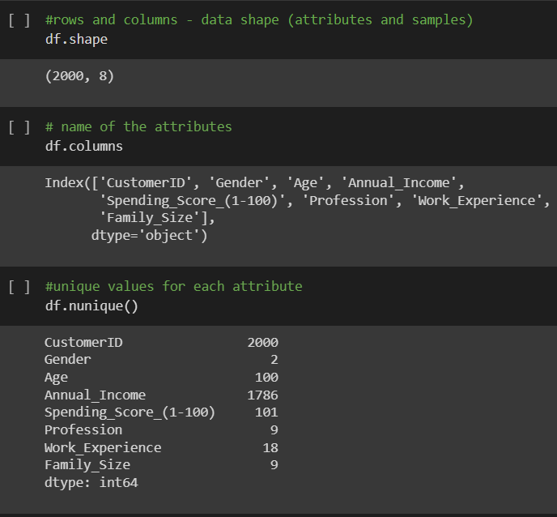

Slide 6
EDA (Exploratory Data Analysis) Outcomes
EDA done on:
Count the number of customers by gender
Correlation between age and work.
Spending Score according to the gender
Calculating customers from a certain profession.
Finding the distribution of family size.

Slide 7
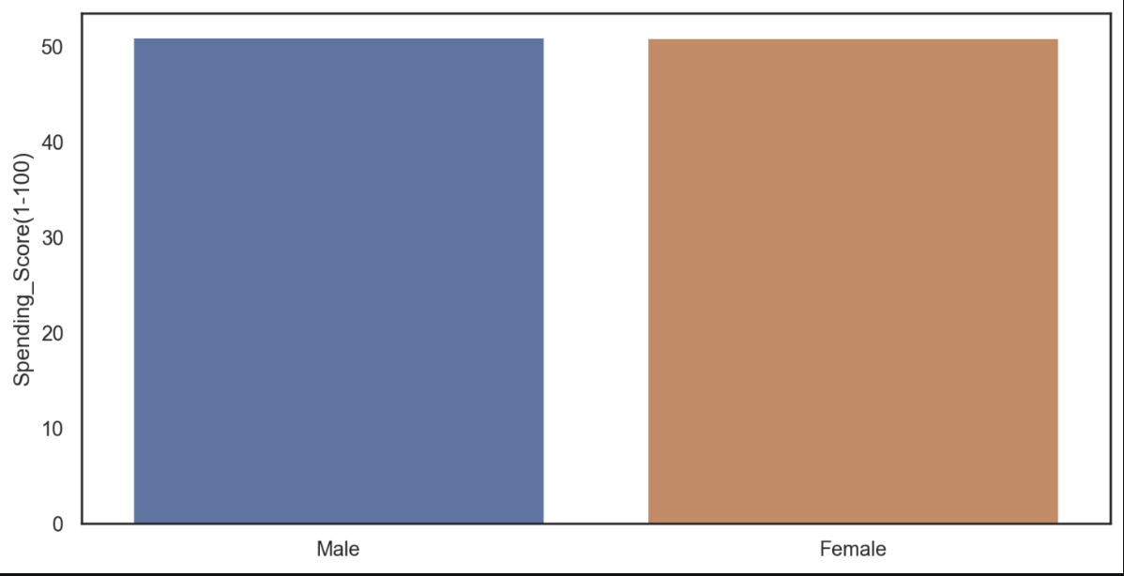
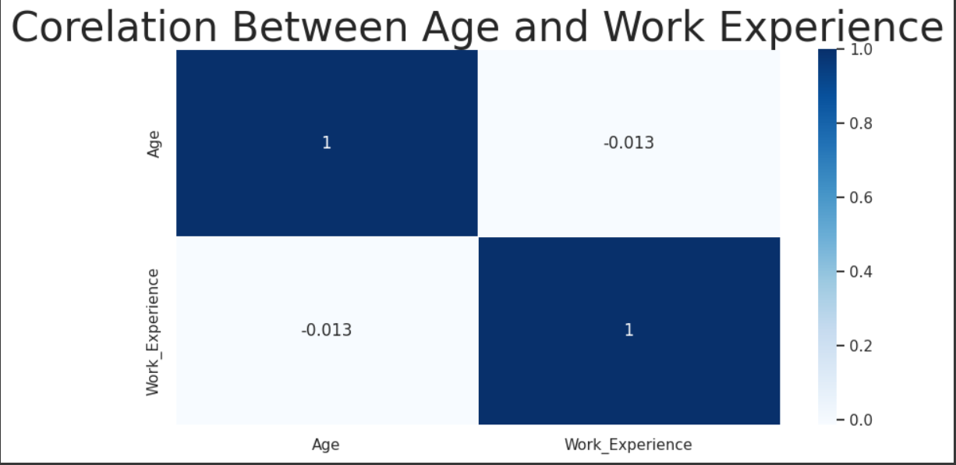
. EDA (Exploratory Data Analysis) Outcomes

Slide 8
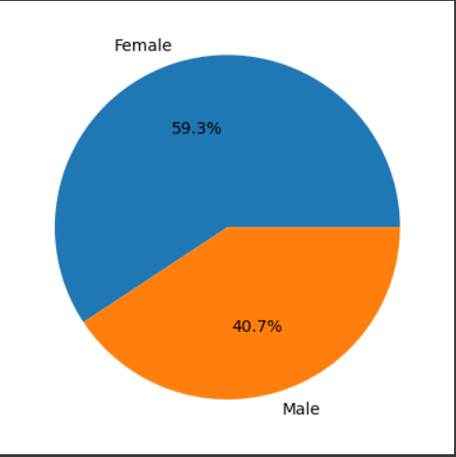
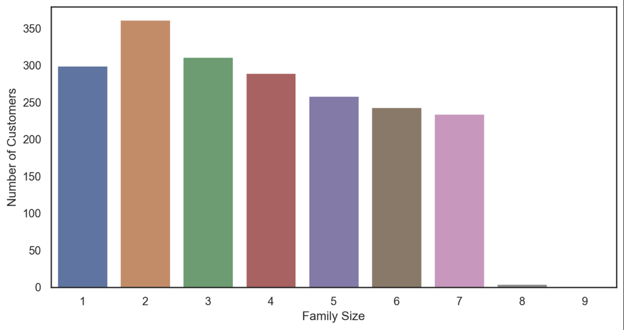

Slide 9
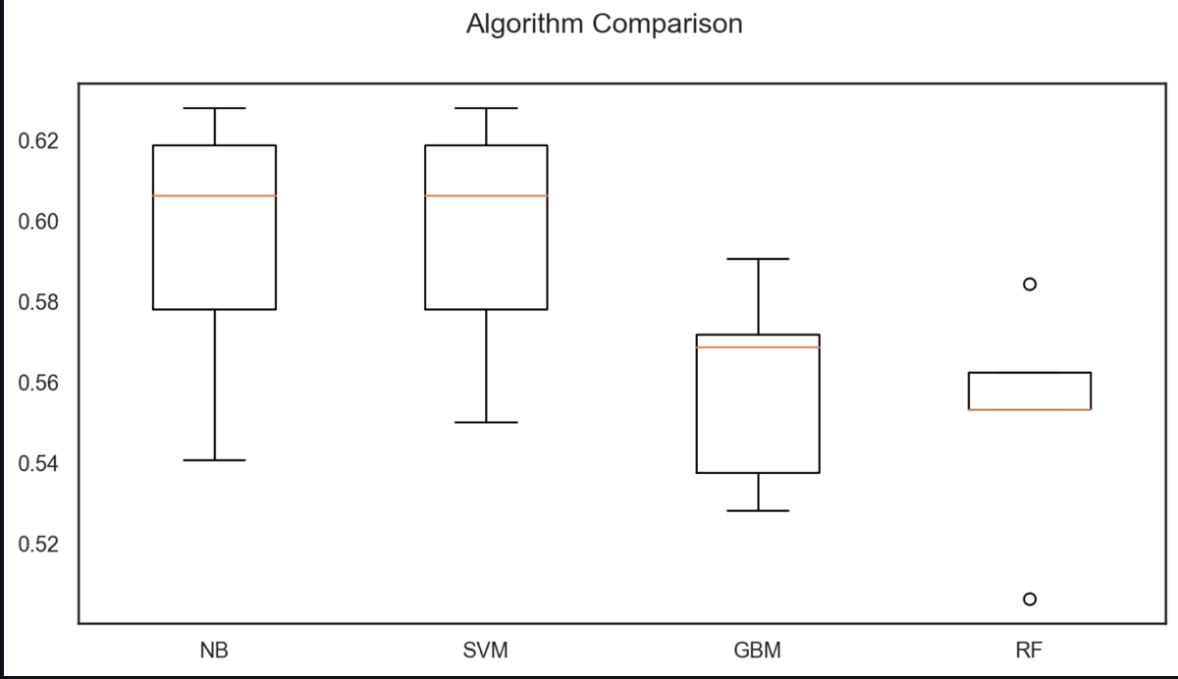
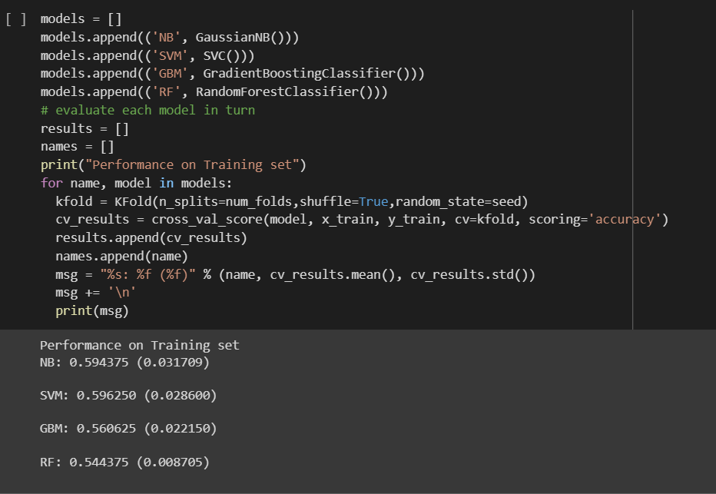
4. PDA (Predictive Data Analysis) Outcomes

Slide 10
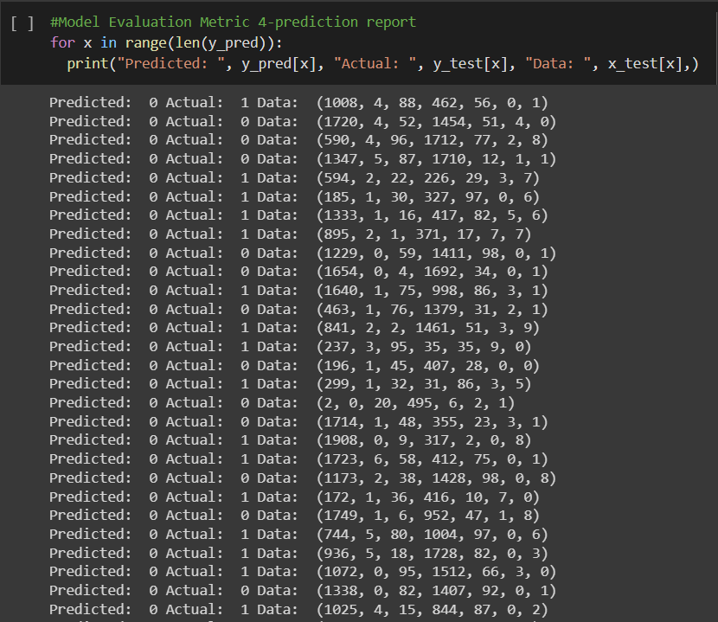

Slide 11
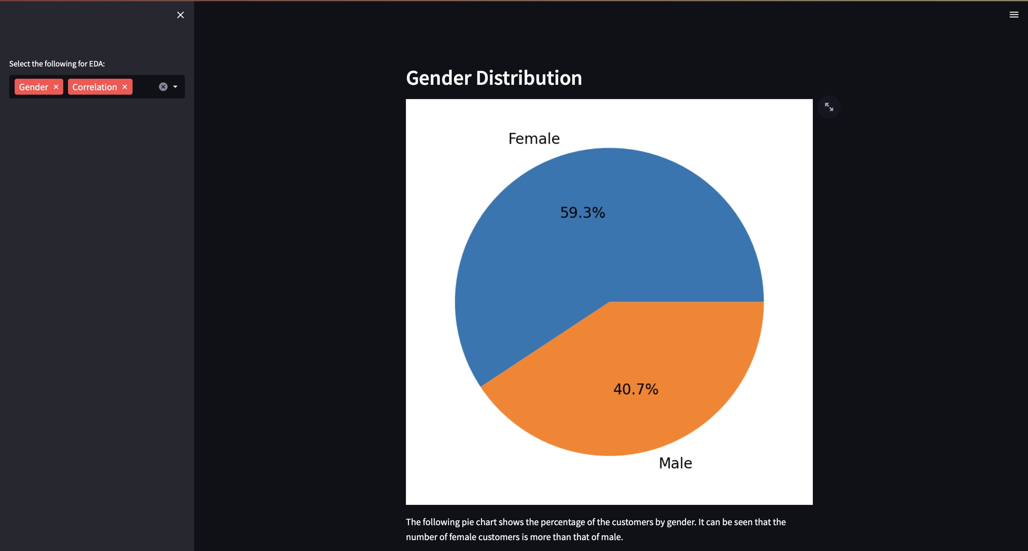
5. Implementation and Deployment Plan and Status Update
I have used Streamlit to deploy my code.

Slide 12
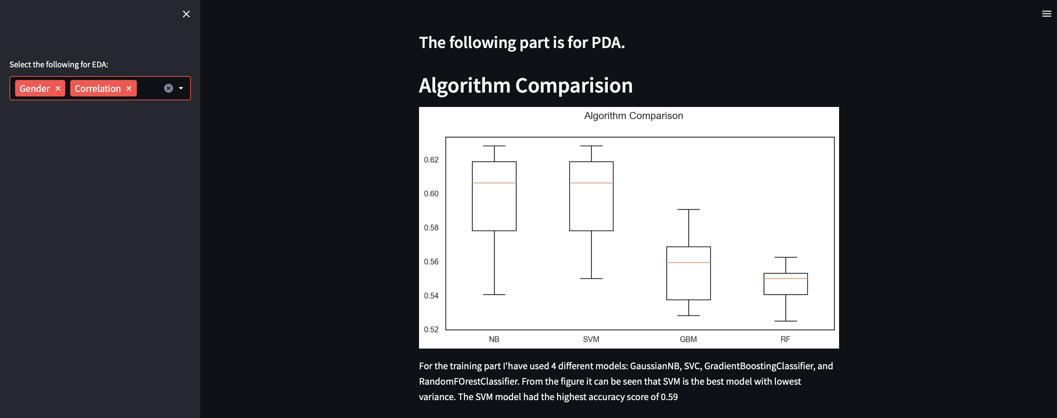

Slide 13
References /Bibilography
D. S. Anna, “Shop Customer Data,” Kaggle, https://www.kaggle.com/datasets/datascientistanna/customers-dataset (accessed May 3, 2023).
“Shop Customer Analysis,” kaggle.com. https://www.kaggle.com/code/nihar14/shop-customer-analysis/notebook (accessed May 03, 2023).
Micaeld, “Customer - segmentation and prediction,” Kaggle, https://www.kaggle.com/code/micaeld/customer-segmentation-and-prediction (accessed May 3, 2023).
Amalsalilan, “Customer insights: Unleashing shopper potential,” Kaggle, https://www.kaggle.com/code/amalsalilan/customer-insights-unleashing-shopper-potential (accessed May 3, 2023).

Slide 14
Thank You

