Slide 1
YouTube API
Getting YouTube to the terminal.

Slide 2
Team Details :
Harsh Raj (180010017)
Manjeet Kapil (180010021)
Rupesh Kalantre (180010029)
Shriram Ghadge (180010015)

Slide 3
Contents
API Definition and Youtube APIs
Steps to access the YouTube API
Various Methods that YouTube API provides
Various real life use cases scenarios of this API

Slide 4
What Is An API ?
An application programming interface (API) is a computing interface which defines interactions between multiple software intermediaries.
It defines the kinds of calls or requests that can be made, how to make them, the data formats that should be used, the conventions to follow, etc

Slide 5
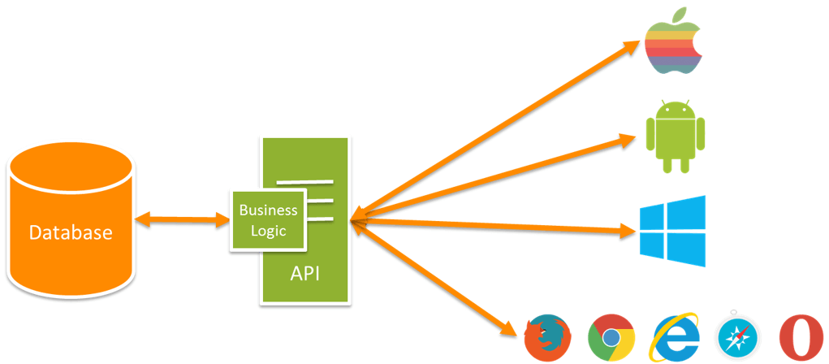

Slide 6
1.1 Youtube API
The youtube APIs and Tools let you bring the Youtube experience to your webpage, application , or device.
It is possible to search for videos, retrieve standard feeds, and see related content. A program can also authenticate as a user to upload videos, modify user playlists, and more.

Slide 7
1.2 Youtube APIs
Youtube is having mainly two APIs
Data and analysis API
Player and Players API
Data and Analytics APIs :
The Data and Analytics APIs section briefly describes APIs that let your application access features and data normally available on the YouTube website : such as no. of likes on a video, no. of subs to a channel.

Slide 8
2. Players and Player APIs :
The Data and Analytics APIs section briefly describes APIs that let your application access features and data normally available on the YouTube website : such as no. of likes on a video, no. of subs to a channel.

Slide 9
1.3 Useful things to do with APIs
Upload
Search
Rate a video(Like/Dislike)
Comment
Add a playlist
Retrieve Insight video statistics
And much more!

Slide 10
1.4 Advantages
A great advantage of using YouTube's API is that 3rd party companies are able to arrange pay per click coupled with advertising for your videos. This allows the video uploader to receive money for the work they have put into their videos.
YouTube API's also allow a tighter integration of the video service into a 3rd party website. This essentially means that the user does not need to click a link to go to the YouTube video. Instead, they are able to view the video in the same page that they are visiting.

Slide 11
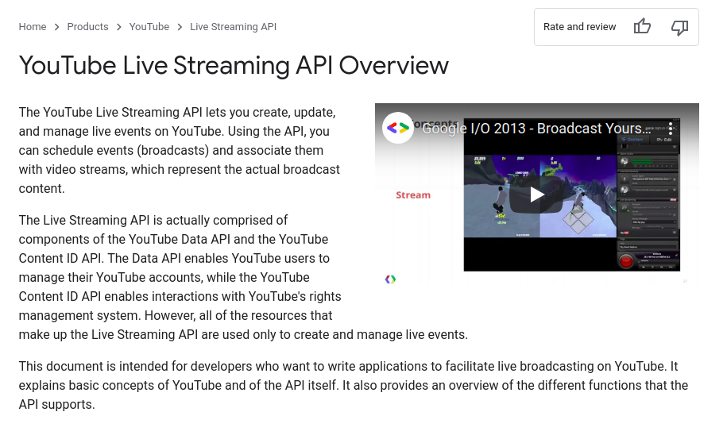
Example,

Slide 12
2. Accessing The API
In order to use the publicly available youtube API, one must:
Generate an API key
Read and understand documentation to know about various methods provided.

Slide 13
2.1 Generating API Key
Demo Video

Slide 14
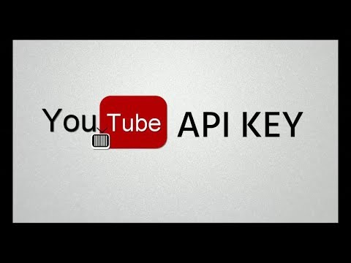

Slide 15
3. Various Methods That YouTube API Provides
YouTube API provides numerous of methods to access both public and private data from the youtube. Users can get straightforward details like channel details, comments on the video, etc to more narrow details like the geographic diversity of viewers.
But for accessing/changing private data of a channel such as making a video private/public or liking other video on behalf of the channel requires accessing rights granted by channel owner.
There are various scopes in Youtube API.

Slide 16
3.1 Different Resources of Youtube Data API
Videos (documentation)
Captions (documentation)
Comments (documentation)
CommentsThread (documentation)
VideoCategories (documentation)
VideoAbuseReportReasons (documentation)
Playlist (documentation)
PlaylistItems (documentation)
Subscribers (documentation)
Thumbnails (documentation)

Slide 17
Watermarks (documentation)
Channels (documentation)
Activities (documentation)
ChannelBanners (documentation)
ChannelSection (documentation)
Search (documentation)
i18nLanguages (documentation)
I18nRegions (documentation)
Members (documentation)
MembershipLevels (documentation)

Slide 18
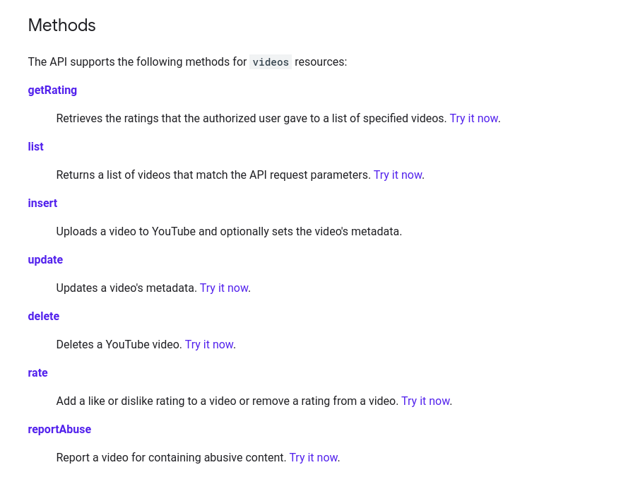
3.2 Different methods for each of these Resources
Example,
Videos (documentation)

Slide 19
4. Real Life Use Cases
Getting public channel statistics
Accessing/ uploading videos locally via script
Generating various data analytics (like country specific view count etc)
Easily choosing best/ worst comments if there are lots of comments

Slide 20
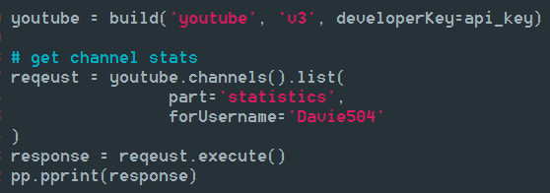
4.1 Getting channel statistics
With the youtube api, getting the youtube channel statistics is as easy as calling a function with channel id/username as given parameters.
<Screenshot>

Slide 21
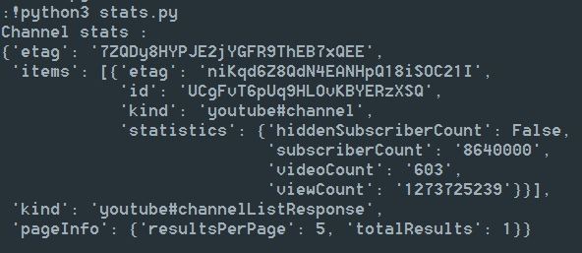
Statistics Output :

Slide 22
4.2 Uploading videos via script
With YouTube api, uploading videos becomes really easy. One may easily write script to upload lots of videos sequentially. This would save content creator’s time to great extent, compared to case when they upload each video manually.
Documentation

Slide 23
4.3 Generating various data analytics
With the amount of methods provided for specific types of data, collecting/ extracting required data for data analysis/ machine learning has become insanely simple. One doesn’t have to spend hours cleaning data after scraping them using some web scraping library.
Documentation

Slide 24
4.4 Ordering comments
Tasks like selecting most voted comment from thousands of comment on videos, can be made as simple as sorting an array using the youtube API, saving hours of manual work or writing web scraper.
Documentation

Slide 25
Thank you !
For listening our presentation patiently

