Slide 1
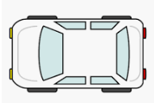
Road
Road
Obstacle
Obstacle
Car
Car

Slide 2
Boundary can be recognized definitely

Slide 3
Boundary can not be recognized between these areas

Slide 4
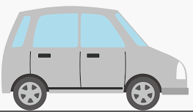

Braking can not
be in time
Car need to brake
to escape a collision
Pedestrian will pass
before collision
36km/h
(10m/s)
Running out into road
at 3.6km/h(1m/s)
0m
7.3m
11m
22m
Car should be able to stop
without collision at this point

Slide 5
10
Velocity can not be calculated with only 1 point
9
8
7
Error is smaller with a point at 10 frame later
6
Distance[m]
5
Error is large with only 2 points
4
3
Error is the smallest by fitting a straight line with all of points
2
1
0
0
2
4
6
8
10
Time[frame]

Slide 6
Predicted direction as straight line
Predicted position
Collision here
Relative velocity
Original moving direction
Escaping
Car changed direction to escape collision
In this case, car is escaping because it collide straightly

Slide 7
Object Position
Frame 1
Frame 2
Tracking at every frame
Frame 10
Relative velocity vector is calculated by comparing between frame 1 and frame 2

Slide 8
Obstacle
(xl, yl)
y
(xr, yr)
Relative velocity
(Vx Vy)
(Vx Vy)
A<D and C>B
Collision will happen
A
B
C
D
x
Host vehicle
Width: W

