Slide 1






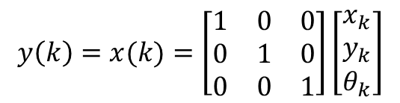

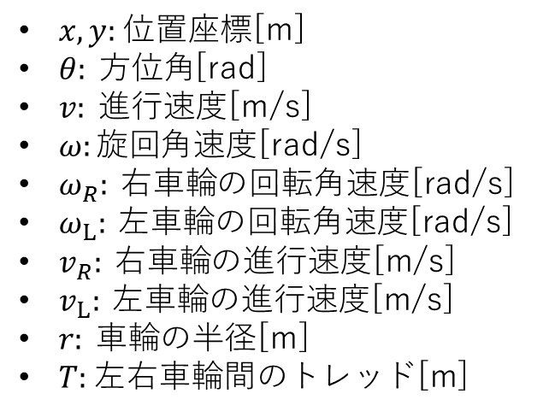

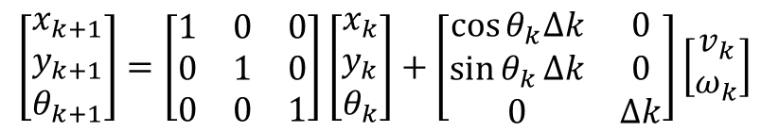



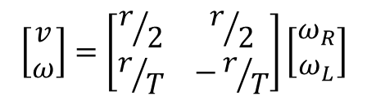
$x, y:$位置座標[m]
$θ: 方位角$[rad]
$v: 進行$速度[m/s]
$ω:旋回$角速度[rad/s]
$ω_{R}: 右車輪$の回転角速度[rad/s]
$ω_{L}: 左車輪$の回転角速度[rad/s]
$v_{R}: 右車輪$の進行速度[m/s]
$v_{L}: 左車輪$の進行速度[m/s]
$r: 車輪$の半径[m]
$T:$左右車輪間のトレッド[m]
$${\left[\begin{matrix}x & y & θ\end{matrix}\right]}^{T}$$
$$\left[\begin{matrix}v \\ ω\end{matrix}\right]=\left[\begin{matrix}r/2 & r/2 \\ r/T & −r/T\end{matrix}\right]\left[\begin{matrix}ω_{R} \\ ω_{L}\end{matrix}\right]$$
$$Y$$
$$v_{L}=rω_{L}$$
$$v$$
$$θ$$
$$ω$$
$$y$$
$$T$$
$$v_{R}=rω_{R}$$
$$y\left(k\right)=x(k)=\left[\begin{matrix}1 & 0 & 0 \\ 0 & 1 & 0 \\ 0 & 0 & 1\end{matrix}\right]\left[\begin{matrix}x_{k} \\ y_{k} \\ θ_{k}\end{matrix}\right]$$
$$x$$
$$X$$
$$\left[\begin{matrix}x_{k+1} \\ y_{k+1} \\ θ_{k+1}\end{matrix}\right]=\left[\begin{matrix}1 & 0 & 0 \\ 0 & 1 & 0 \\ 0 & 0 & 1\end{matrix}\right]\left[\begin{matrix}x_{k} \\ y_{k} \\ θ_{k}\end{matrix}\right]+\left[\begin{matrix}\cos{θ_{k}∆k} & 0 \\ \sin{θ_{k}}∆k & 0 \\ 0 & ∆k\end{matrix}\right]\left[\begin{matrix}v_{k} \\ ω_{k}\end{matrix}\right]$$

Slide 2


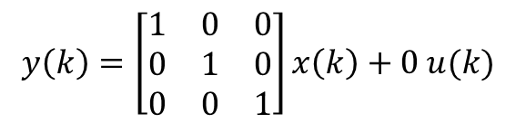

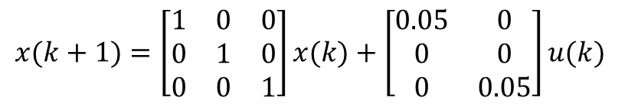
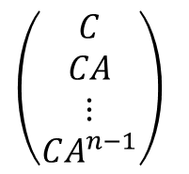

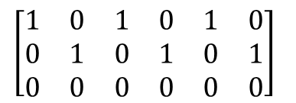


$$x(k+1)=\left[\begin{matrix}1 & 0 & 0 \\ 0 & 1 & 0 \\ 0 & 0 & 1\end{matrix}\right]x(k)+\left[\begin{matrix}0.05 & 0 \\ 0 & 0 \\ 0 & 0.05\end{matrix}\right]u(k)$$
$$\left(B|AB|A^{2}B⋯A^{n−1}B\right)$$
A
B
$$\left(B|AB|A^{2}B\right)$$
$$y\left(k\right)=\left[\begin{matrix}1 & 0 & 0 \\ 0 & 1 & 0 \\ 0 & 0 & 1\end{matrix}\right]x\left(k\right)+0 u(k)$$
C
D
$$\left(\begin{aligned}C \\ CA \\ ⋮ \\ CA^{n−1}\end{aligned}\right)$$
$$B$$
$$AB$$
$$A^{2}B$$
$$\left[\begin{matrix}\begin{matrix}1 & 0 \\ 0 & 1 \\ 0 & 0\end{matrix} & \begin{matrix}1 & 0 \\ 0 & 1 \\ 0 & 0\end{matrix} & \begin{matrix}1 & 0 \\ 0 & 1 \\ 0 & 0\end{matrix}\end{matrix}\right]$$

Slide 3
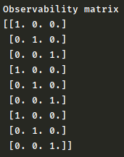

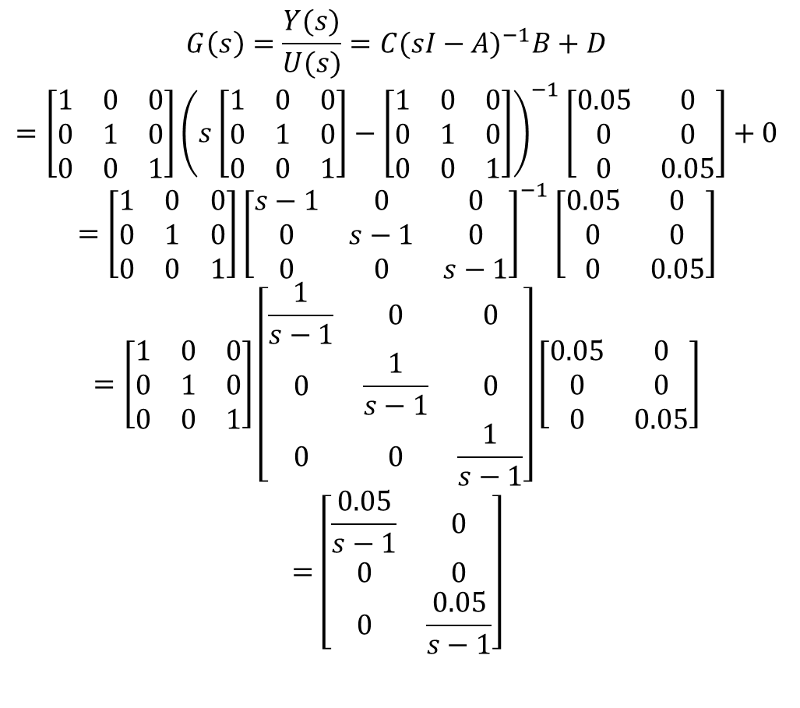


$$G\left(s\right)=\frac{Y(s)}{U(s)}={C(sI−A)}^{−1}B+D$$
$$=\left[\begin{matrix}1 & 0 & 0 \\ 0 & 1 & 0 \\ 0 & 0 & 1\end{matrix}\right]{\left(s\left[\begin{matrix}1 & 0 & 0 \\ 0 & 1 & 0 \\ 0 & 0 & 1\end{matrix}\right]−\left[\begin{matrix}1 & 0 & 0 \\ 0 & 1 & 0 \\ 0 & 0 & 1\end{matrix}\right]\right)}^{−1}\left[\begin{matrix}0.05 & 0 \\ 0 & 0 \\ 0 & 0.05\end{matrix}\right]+0$$
$$=\left[\begin{matrix}1 & 0 & 0 \\ 0 & 1 & 0 \\ 0 & 0 & 1\end{matrix}\right]{\left[\begin{matrix}s−1 & 0 & 0 \\ 0 & s−1 & 0 \\ 0 & 0 & s−1\end{matrix}\right]}^{−1}\left[\begin{matrix}0.05 & 0 \\ 0 & 0 \\ 0 & 0.05\end{matrix}\right]$$
$$=\left[\begin{matrix}1 & 0 & 0 \\ 0 & 1 & 0 \\ 0 & 0 & 1\end{matrix}\right]\left[\begin{matrix}\frac{1}{s−1} & 0 & 0 \\ 0 & \frac{1}{s−1} & 0 \\ 0 & 0 & \frac{1}{s−1}\end{matrix}\right]\left[\begin{matrix}0.05 & 0 \\ 0 & 0 \\ 0 & 0.05\end{matrix}\right]$$
$$=\left[\begin{matrix}\frac{0.05}{s−1} & 0 \\ 0 & 0 \\ 0 & \frac{0.05}{s−1}\end{matrix}\right]$$
$$C$$
$$CA$$
$$CA^{2}$$

Slide 4

$$\frac{1}{(s−1)(s−1)(s−1)}\left[\begin{matrix}(s−1)(s−1) & 0 & 0 \\ 0 & (s−1)(s−1) & 0 \\ 0 & 0 & (s−1)(s−1)\end{matrix}\right]$$
$$=\left[\begin{matrix}\frac{1}{s−1} & 0 & 0 \\ 0 & \frac{1}{s−1} & 0 \\ 0 & 0 & \frac{1}{s−1}\end{matrix}\right]$$

