Slide 1
















$$d_{i}$$
Forward
$$x$$
$$y$$
$$φ_{i}$$
$$d_{i}$$
$$o$$
$$o$$
$$y$$
$$x$$
$$φ_{i}$$
$$o$$
$$d_{i}$$
$$x$$
$$φ_{i}$$
$$\left(φ_{0},d_{0}\right) \left(φ_{1},d_{1}\right) ⋯ (φ_{n−1},d_{n−1})$$
$$o$$
$$y$$
$$\left(x_{0},y_{0}, θ_{0}\right) \left(x_{1},y_{1}, θ_{1}\right)⋯\left(x_{n−1},y_{n−1}, θ_{n−1}\right)$$

Slide 2
Preprocessing
Scan data
Making
Reference Scan
Data
Association
Robot Pose
Optimization
Sensor
Fusion
Mapping

Slide 3
Low Density
Low Density
High Density
$$o$$
Laser Origin

Slide 4
Space
Threshold
Before
After
Delete original scan point
Insert new scan point

Slide 5
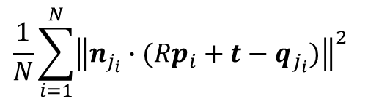
Current
Scan Point
$$\frac{1}{N}\sum_{i=1}^{N}{{\left\|n_{j_{i}}∙(Rp_{i}+t−q_{j_{i}})\right\|}^{2}}$$
Normal
Vector
Reference
Scan Point
Point-to-Point Distance
Perpendicular Distance
Current Scan Point
Reference Scan Point

Slide 6


$$x_{t}$$
$$x_{t−1}$$

Slide 7




$$⊖$$
$$x_{t}$$
$$d_{t}$$
$$x_{t−1}$$

Slide 8
Occlusion
Occlusion
Moving
Obstacle
Scanning
Robot
Robot

Slide 9

$$x_{t}^{1}$$

Slide 10


$$x_{t}^{2}$$
$$x_{t}^{1}$$

Slide 11
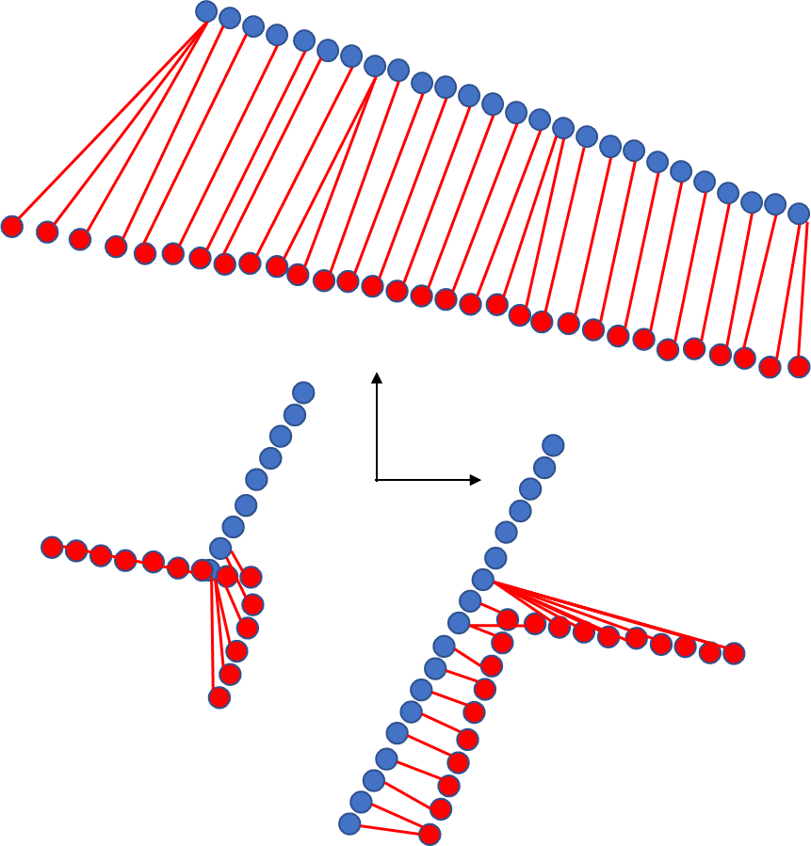
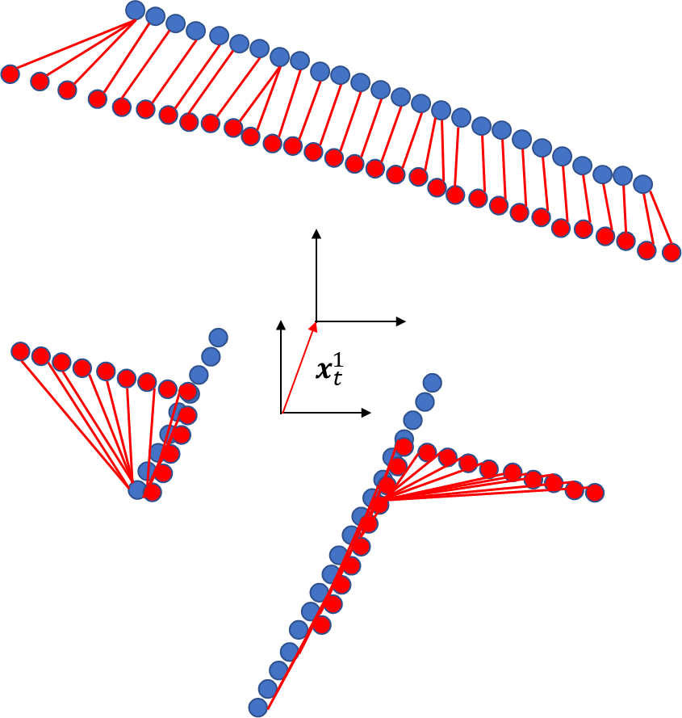
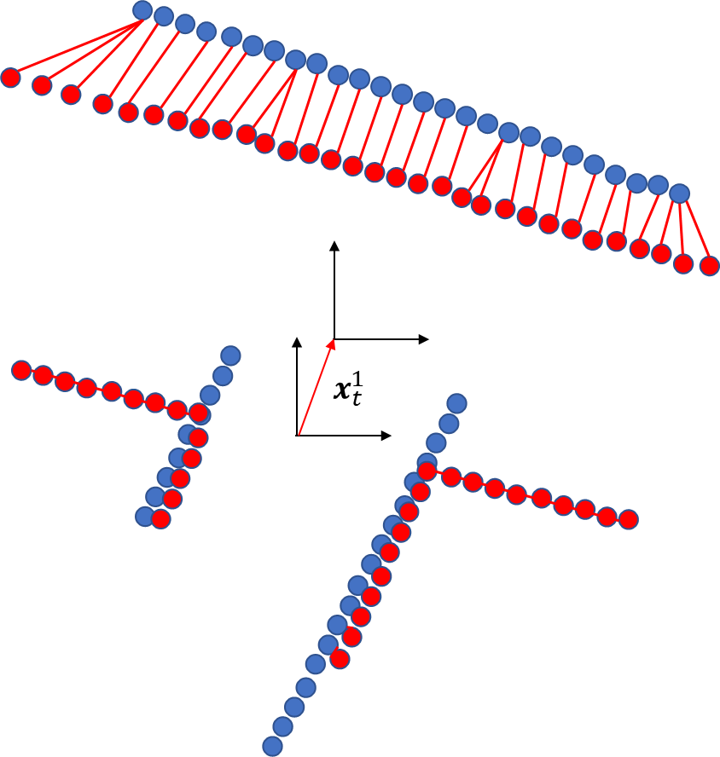
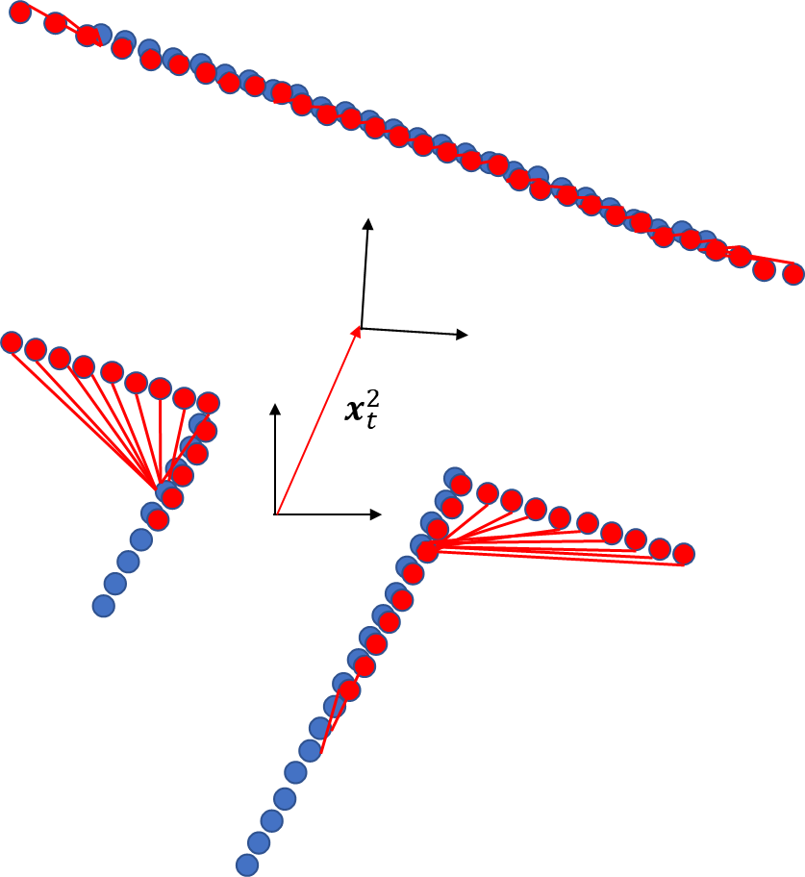
Current Scan Point
Reference Scan Point
K=1: Association
K=1: Optimization
K=2: Association
K=2: Optimization

Slide 12




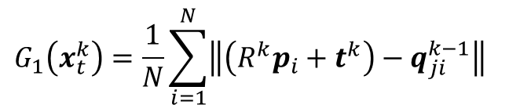
$$p_{i}^{k}=R^{k}p_{i}+t^{k}$$
$$q_{ji}^{k}=argmin\left\|p_{i}^{k}−q_{i}^{k}\right\|$$
$$G_{1}\left(x_{t}^{k}\right)=\frac{1}{N}\sum_{i=1}^{N}{\left\|\left(R^{k}p_{i}+t^{k}\right)−q_{ji}^{k−1}\right\|}$$
$$i_{x}=floor(\frac{x−c_{x}}{d})$$
$$i_{y}=floor(\frac{y−c_{y}}{d})$$

Slide 13
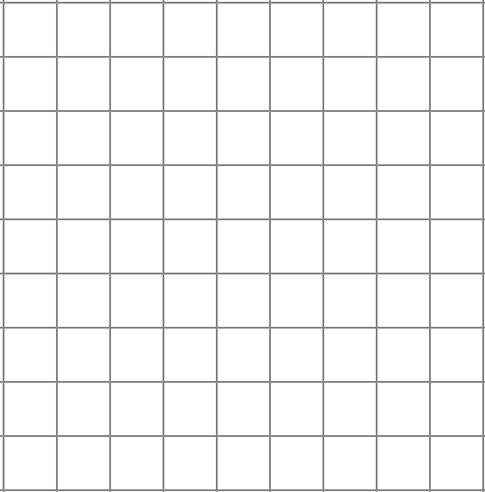
Original Scan points
Representative points

Slide 15
Current Scan Point
Reference Scan Point
Point-to-Point distance
Perpendicular distance

Slide 16



？
？
？
？
Wall
Estimation
By Scan Matching
Estimation
By Odometry
$$x_{s}$$
$$x_{o}$$
Estimation
By Sensor Fusion
$$x_{f}$$

Slide 17
Goal
Start
Start
Goal
Not Closed Loop 1
Not Closed Loop 2

Slide 18
Goal
Start
Closed Loop

Slide 19
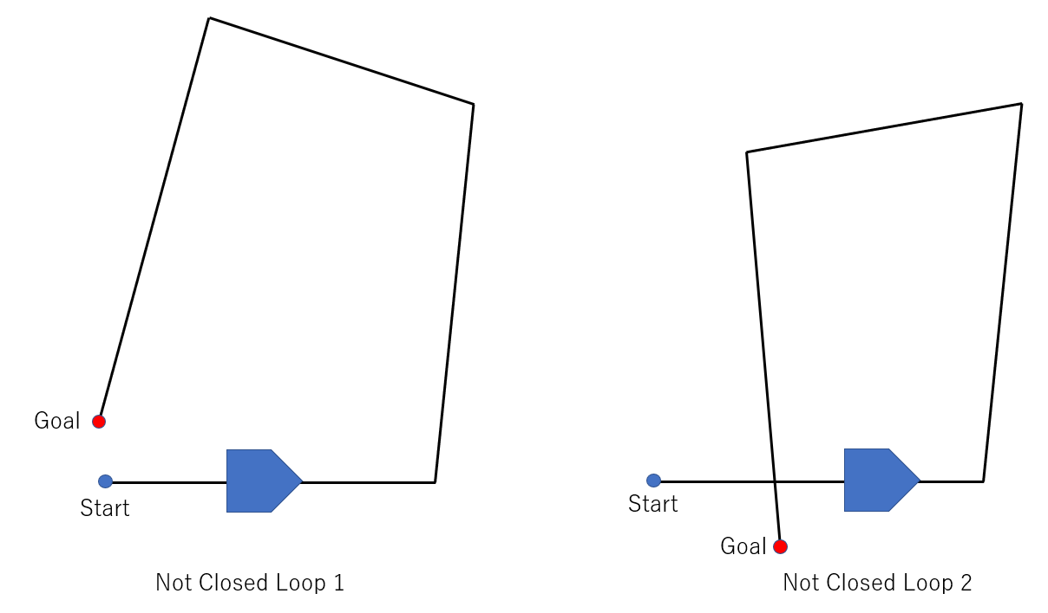
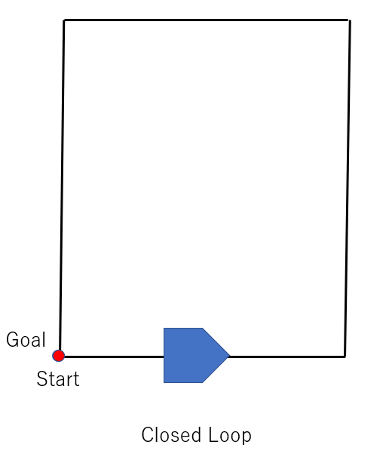

Slide 20

















$${\acute{q}}_{2}$$
$$q_{2}$$
$$x_{k−1}$$
$$z_{k2}$$
$$x_{3}$$
$$z_{2}$$
$$z_{3}$$
$$z_{5}$$
$$x_{1}$$
$$x_{k}$$
$$a_{1}$$
$$x_{2}$$
$$z_{4}$$
$$q_{3}$$
$$z_{k1}$$
$$z_{1}$$
$${\acute{q}}_{1}$$

Slide 21




Modified trajectory
and map
$$q_{2}$$
$$x_{3}$$
$$z_{k2}$$
$${\hat{x}}_{k−1}$$
$$z_{3}$$
$$z_{2}$$
$$z_{5}$$
$$x_{1}$$
$$a_{1}$$
$${\hat{x}}_{k}$$
$$x_{2}$$
$$z_{4}$$
$$q_{3}$$
$$z_{1}$$
$$z_{k1}$$

Slide 22
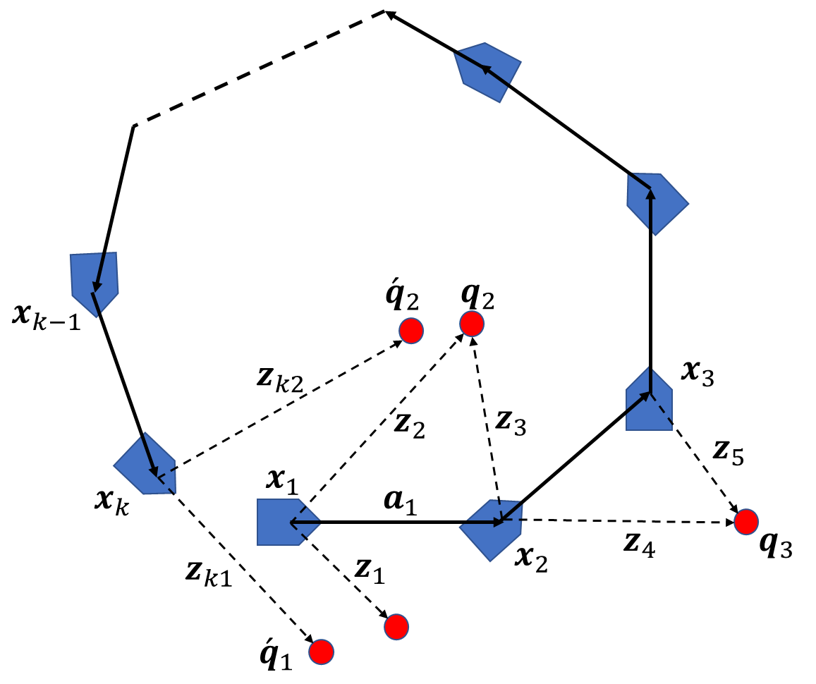
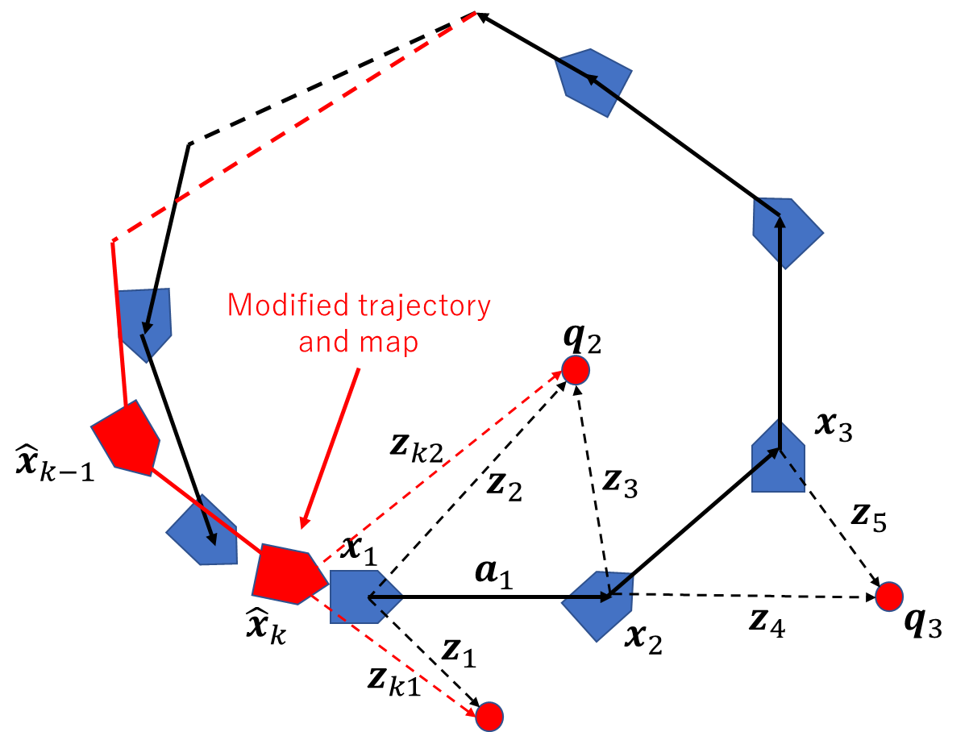
Before Closed
After Closed

Slide 23
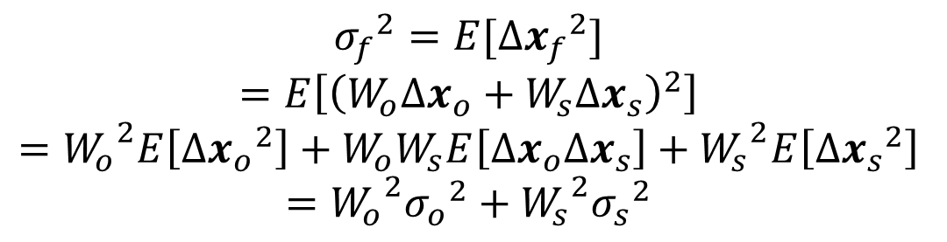
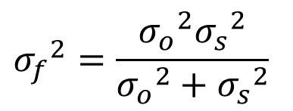

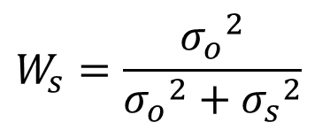
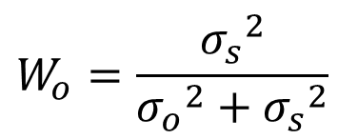
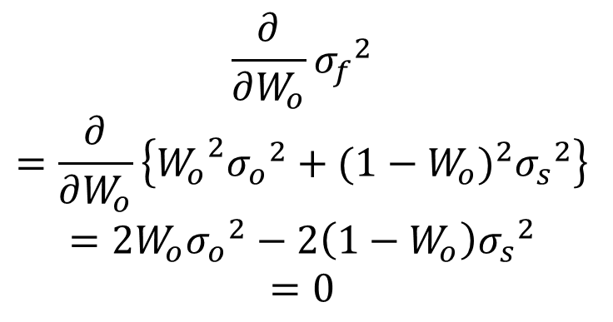
$${σ_{f}}^{2}=E[∆{x_{f}}^{2}]$$
$$=E\left[{\left(W_{o}{∆x}_{o}+W_{s}{∆x}_{s}\right)}^{2}\right]$$
$$={W_{o}}^{2}E\left[∆{x_{o}}^{2}\right]+W_{o}W_{s}E\left[∆x_{o}{∆x}_{s}\right]+{W_{s}}^{2}E\left[∆{x_{s}}^{2}\right]$$
$$={W_{o}}^{2}{σ_{o}}^{2}+{W_{s}}^{2}{σ_{s}}^{2}$$
$$x_{f}=W_{o}x_{o}+W_{s}x_{s}$$
$$\frac{∂}{∂W_{o}}{σ_{f}}^{2}$$
$$=\frac{∂}{∂W_{o}}\left\{{W_{o}}^{2}{σ_{o}}^{2}+{{(1−W}_{o})}^{2}{σ_{s}}^{2}\right\}$$
$$=2W_{o}{σ_{o}}^{2}−2\left(1−W_{o}\right){σ_{s}}^{2}$$
$$=0$$
$${σ_{f}}^{2}=\frac{{σ_{o}}^{2}{σ_{s}}^{2}}{{σ_{o}}^{2}+{σ_{s}}^{2}}$$
$$W_{o}=\frac{{σ_{s}}^{2}}{{σ_{o}}^{2}+{σ_{s}}^{2}}$$
$$W_{s}=\frac{{σ_{o}}^{2}}{{σ_{o}}^{2}+{σ_{s}}^{2}}$$

