Slide 1

MINI PROJECT REPORT on
Vehicle Number Plate Detection
Submitted in partial fulfillment of the requirement for the award of the degree of
BACHELOR OF TECHNOLOGY IN
COMPUTER SCIENCE & ENGINEERING
Submitted by:
University Roll No.
2017023
Student Name
SHISHANK RAWAT
Under the Mentors Mrs. Meenakshi Maindola
Assistant professor
Department of Computer Science and Engineering Graphic Era (Deemed to be University)
Dehradun, Uttarakhand January 2023

Slide 2

CANDIDATE’S DECLARATION
I hereby certify that the work which is being presented in the project report entitled “Vehicle Number Plate Detection” in partial fulfillment of the requirements for the award of the Degree of Bachelor of Technology in Computer Science and Engineering of the Graphic Era (Deemed to be University), Dehradun shall be carried out by the under the mentorship of Mrs. Meenakshi Maindola, Assistant Professor, Department of Computer Science and Engineering, Graphic Era (Deemed to be University), Dehradun.
Name
SHISHANK RAWAT
University Roll no:
2017023
signature
Shishank Rawat

Slide 3
Table of Contents
Chapter No. | Description
Chapter 1 | Introduction
Chapter 2 | Literature Survey
Chapter 3 | Methodology
Chapter 4 | Result and Discussion
Chapter 5 | Conclusion and Future Work
REFRENCES

Slide 4
Chapter 1
INTRODUCTION
Automatic License Plate Recognition (ANPR) is a technology that uses pattern recognition to "read" a vehicle's license plate. Simply put, an ANPR camera "pictures" the license plates of passing vehicles. This "picture" is sent to a computer system to examine the details of the vehicle itself. ANPR consists of a camera connected to a computer.
Automatic License Plate Recognition is a technology that uses optical character recognition in images to
read vehicle license plates and create vehicle location data. You can use your existing security cameras, road enforcement cameras, or cameras specifically designed for the task. ANPR is used for law enforcement purposes by law enforcement around the world. This includes verifying that the vehicle is registered or licensed. It is also used for electronic toll collection on toll roads and as a method
of cataloging traffic movements, such as by highway authorities.
As a vehicle passes by, the ANPR captures the vehicle's registration plate (more commonly known as the license plate) with a camera placed on a mobile unit, on-board vehicle, or closed circuit television (CCTV). "read" from the digital image.
Automatic License Plate Recognition can be used to save images captured by the camera and text from license plates. Some are configurable to save a picture of the driver. Systems typically use
infrared illumination to enable cameras to capture images at any time of the day or night.
The ANPR technique must take into account plate differences from site to site.
Digital images are converted into data that is processed by the ANPR system. We proposed methods mainly based on edge detection, OCR operations, and detection of rectangles in vehicle images.
Number Plate Detection (NPD) is one of the innovative mechanisms that uses advanced technology to identify specific parts of a license plate and understand the characters.

Slide 5
Chapter 2
Literature Survey
Automatic License Plate Recognition (ANPR) Market:
The Automatic License Plate Recognition (ANPR) Market Research study delves into the evolving
aspects of the market along with the dynamics that influence market growth. This research study focuses on the major developments made and other upcoming developments in the Automatic License
Plate Recognition Systems market.
The report talks about various macro- and micro-economic factors that are having a significant impact on the growth of the Automatic License Plate Recognition Systems market.
Direct market overviews provide growth scenarios and market potential with maximum precision assessed with appropriate assumptions. The report includes unique and relevant factors that are likely to have a significant impact on the ANPR Systems market during the forecast period.
This report provides a wealth of detailed information to help new manufacturers understand in the most comprehensive way.
Multiple stakeholders in the
Automatic License Plate Recognition Systems market can rely on the data provided in this research study to engage in actionable decisions. In addition, the information provided in
the Automatic License Plate Recognition Systems Market report will also help new entrants to expand their base in the market.
The report discusses the historical and current trends shaping the growth of the Automatic License Plate
Recognition Systems market. The performance journey of the market is depicted and analyzed in a manner such that the advantageous aspects are revealed to the reader. Provides detailed
outlook on profiles of leading companies operating in the industry along with their various strategies and areas of focus.

Slide 6
ANPR Market: Answers to Key Questions The Automatic License Plate Recognition Systems Market Research Study provides comprehensive insights on market growth in the most concise way to better understand users. The key findings of the report answer some of the key questions to help stakeholders assess emerging opportunities.
Is the rapidly changing business environment becoming the key growth driver of the Automatic License Plate Recognition Systems market? What are the key trends that are constantly shaping the growth of the Automatic License Plate Recognition Systems market? Which are the prominent regions
offering more opportunities for the Automatic License Plate Recognition Systems market? What are
the different strategies employed by the major players to get their fair share?
Automatic License Plate Recognition Systems Market: Research Methodology
A unique and promising research methodology forms the basis of the Automatic License Plate Recognition Systems Market report for the forecast period. The report has
been produced after extensive analysis of what is happening in the market and meticulously compiled with fascinating insights

Slide 7
Chapter 3
Methodology
Installing and Importing required Packages:
1.OpenCV-Python 2.Pyplot from matplotlib 3.Numpy
Imutils
Easyocr
Read of Image: The first step is to read the image.Image is given by user . The image read is stored in JPEG format. Later on it is converted in to gray scale image in cv2.
Pre-processing: The next step after capturing an image is image preprocessing. When you take a photo, there is a lot of interference and noise that you can't use properly in your photo.
Therefore, in this step, we need to remove noise from the image to get accurate results.
Gray Processing: This step converts the image to grayscale. Color images are converted to gray images. Calculate the gray value according to the R, G, B values of the image and save the gray image at the same time.
Find Contours and apply mask: Now that I have detected the edges of the object in the image, I would like to find the main contours in the processed image. For this we
use cv2.findContours(image name,

Slide 8
cv2.RETR_LIST, cv2.CHAIN_APPROX_SIMPLE). Contours are basically curves
that connect all consecutive points with the same intensity or color, which are better detected.
Use EasyOcr to read text : In this step, we will use the Annotation component to get the O/P of the extracted license plate, then isolate each letter and split all the letters in
the license plate image. Also find license plate length to find correlations and databases. Both values are the same, it produces the values 0-9 and A-Z and finally converts the value
to a string to display in an edit box and this code saves the characters to a text file..
Polt the result: Now detected image will be visible .
This system will detect vehicle plates from a user’s uploaded file.
System Description
The system comprises 1 major module with their sub-modules as follows:
USER:
Detection
o Image
-
User has to upload an image for detection.

Slide 9
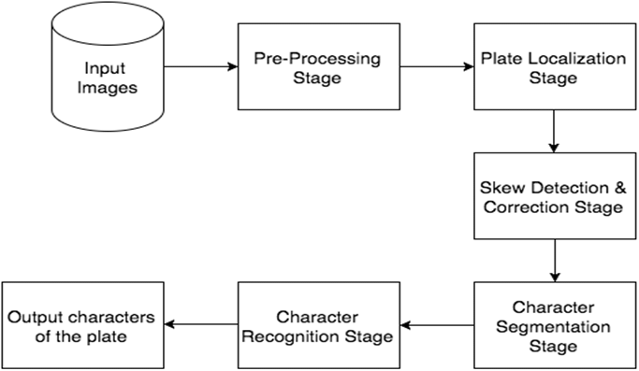
Data Flow Diagram of proposed system
System Requirements
Hardware Requirement
Laptop or PC

Slide 10
Windows 7 or higher
I3 processor system or higher
4 GB RAM or higher
100 GB ROM or higher
Software Requirement
Laptop or PC
Python
Visual Studio Code or Google Colab
10

Slide 11
Chapter 4
Result and Discussion
Raw image is passed to the model for the number plate detection after that colored image is converted into gray scale formate by using cv2 library then filter and edge condition is applied for the noise reduction and edge reduction then with the help of matplot lib we find the contours and now apply the mask which gives the image of number plate after that we apply the ocr to read the text from the number plate which is in character A-Z and number 0-9. After that result is displayed.
Advantages:
It is easy to maintain.
It is user-friendly.
The system will automatically detect the license plate.
It can detect vehicle license plates from an image.
It can also detect in real-time.

Slide 12
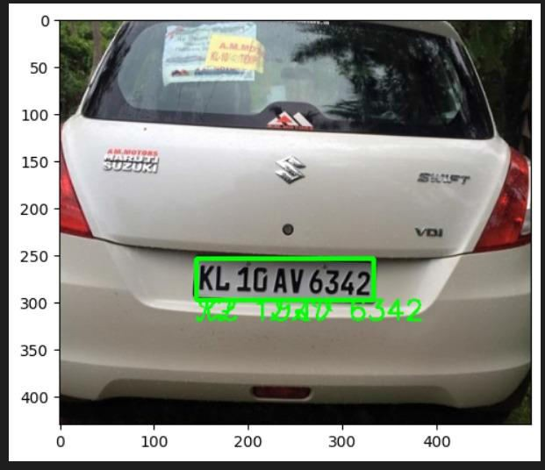
-

Slide 13
Chapter 5
Conclusion and Future work
Conclusion
The project titled "Vehicle License Plate Detection" was developed according to
project expectations and was declared approved by the project mentor. All required outputs have been created.
plate detection is useful for model development where data needs to be collected on the fly. It is true, relevant and accurate. This is desirable as it takes less time than the record implementation. The program was successfully implemented. The project was successfully completed.
Future Work
In this project we are only using image to detect the number plate so in future we can use videos or real time images or videos to detect the number plate .And we can also provide an interface which will be easier to use .

Slide 14
References
[1] https://www.youtube.com/watch?v=NApYP_5wlKY
[2] https://www.geeksforgeeks.org/
[3] https://www.javatpoint.com/

