Slide 1

ONLINE CODE EDITOR
By- SHISHANK RAWAT
MENTOR- Ms. TANUSHA MITTAL
Dated- 12/07/23

Slide 2

INTRODUCTION
ONLINE CODE EDITOR
Online code editors are a valuable tool for developers of all levels. They allow you to write and run code in your browser without having to install any software. This makes them ideal for learning new languages, testing code, and collaborating with others.

Slide 3
PROBLEM Statement
Existing online code editors are often lacking in features or have a poor user experience. This can make it difficult for developers to use them effectively. For example, some online code editors do not support syntax highlighting, which can make it difficult to read and understand code. Other online code editors have a complex user interface that can be difficult to learn and use.
The goal of this work is to build an online code editor that is feature-rich and has a great user experience. The editor will be built using React, a popular JavaScript library for building user interfaces.

Slide 4
methodology
Requirements Analysis: I conducted a comprehensive analysis of the requirements to identify the essential features and functionalities expected from the online code editor. This involved understanding my own needs as a developer, such as syntax highlighting, code completion, and error detection.
Technology Selection: I chose React, a JavaScript library for building user interfaces, as the primary technology for my code editor. React offers a component-based architecture, which allowed me to create modular and reusable code components. This technology choice facilitated the development of a dynamic and responsive user interface, enabling a seamless editing experience for myself.
Architectural Design: I designed the code editor using a component-driven approach, leveraging the capabilities of React. I implemented different features and functionalities as modular components, ensuring code reusability and maintainability.

Slide 5
methodology
Integration with External Libraries: To enhance the functionality and user experience of the code editor, I integrated external libraries, including:
Monaco Editor, React-Select, Judge0 API, Tailwind CSS.
Testing and Debugging: I employed rigorous testing and debugging processes to ensure the stability and reliability of the code editor. I performed unit testing on individual components to verify their functionality, while integration testing was conducted to ensure smooth interactions between different components.

Slide 6
RESULTS And Discussion
User Interface and Editor Functionality: The developed code editor exhibited an intuitive and user-friendly interface, allowing developers to seamlessly write and edit code. The user interface, designed with the help of Tailwind CSS, provided a clean and responsive layout, ensuring optimal readability and usability.
Code Execution and Testing: The integration of the JUDGE0 API from RAPID API facilitated code execution and testing directly within the code editor. Developers were able to execute their code and view the output without leaving the editor interface.
Syntax Highlighting and Error Detection: The integration of the code parsing library enabled real-time syntax highlighting and error detection. As developers typed their code, the code editor identified and highlighted syntax errors, enabling them to catch mistakes immediately.

Slide 7
RESULTS And Discussion
Customization and Theme Support: The inclusion of React-Select facilitated the implementation of customizable dropdown menus and select components within the code editor. Developers could customize various aspects of the editor, such as font size, theme colors, and key bindings, to suit their preferences. The flexibility provided by React-Select allowed for easy customization without sacrificing performance. The code editor offered a range of pre-defined themes and supported the ability to create and import custom themes, further enhancing the personalization options.
NEXT IS SCREENSHOT OF WORKING APPLICATION

Slide 8
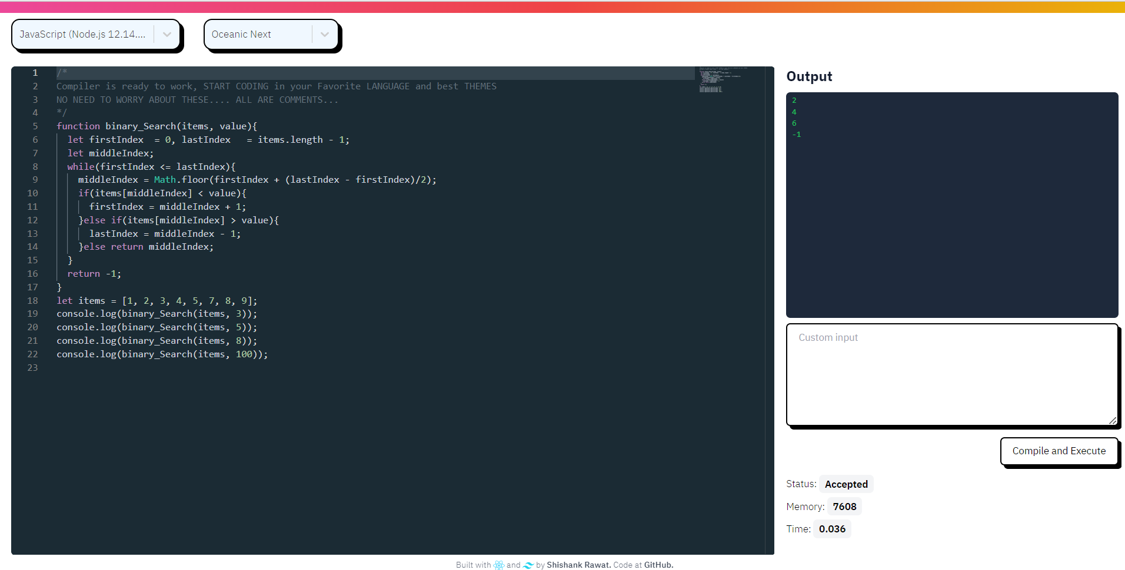


Slide 9
Conclusion
The development of the online code editor using React has been a significant achievement, successfully addressing the initial problem statement and fulfilling the identified requirements. Through a comprehensive methodology, we designed and implemented a feature-rich code editor that provides an intuitive user interface, advanced editing capabilities, and seamless code execution functionality. The integration of external libraries, such as Monaco Editor and React-Select, further enhanced the editor's functionality and customization options. The inclusion of the JUDGE0 API from RAPID API enabled real-time code execution and testing, providing a comprehensive development experience within the code editor.

Slide 10
What’s Next?
While the current implementation of the online code editor has been successful, there are several areas for future improvement and expansion:
Collaboration
User Authentication / Authorization
Code Persistence
Expanded Language Support
Integration with External API’s
By addressing these areas, the online code editor can evolve into a more comprehensive and user-friendly tool, offering enhanced collaboration, personalization, and an enriched coding experience.

