Slide 1
VQC Class Implementation using Sampler QNN and Estimator QNN
Shisheer S Kaushik (M23IQT006)
Mohammad Haris Ansari (M23IQT003)
Thirumalai M (M23IQT008)
Harsh Mehta(M23IQT011)

Slide 2
Workflow
Data
Binary Classification Data Sets
Encoding
Various Encoding Scheme and Comparison with Standard Encoding Scheme
Ansatz
Customized Ansatz using Rotation Gates and Comparison with Standard Ansatz
Algorithm
Algorithm Implementation using Sampler and Estimator QNN and Comparison with VQC Class and Classical ML Algorithms

Slide 3
Workflow
MNIST {Labels : 0→9,1→4} Splitting Ratio = 0.8
Citrus {Labels : 0→Orange,1→Grape} Splitting Ratio = 0.8
Binary Classification Data Set Selection
Data Encoding Schemes; Custom_FeatureMap_1 Custom_FeatureMap_2
ZZFeatureMap
Classical data Encoding Schemes
Compare

Slide 4
Workflow
Customized Ansatz; Custom_Var_1 Custom_Var_2
EfficientSU2 TwoLocal
Ansatz
Compare
Sampler QNN Estimator QNN
VQC Classical ML Algorithms
Algorithm
Compare

Slide 5
Binary Data
We have Used Two Different Data Sets.
MNIST (Only 4 and 9 Digits) {0.8 Splitting Ratio}
Citrus {0.8 Splitting Ratio}
The Data sets are also Analyzed by various Classical ML Algorithms for Benchmarking.

Slide 6
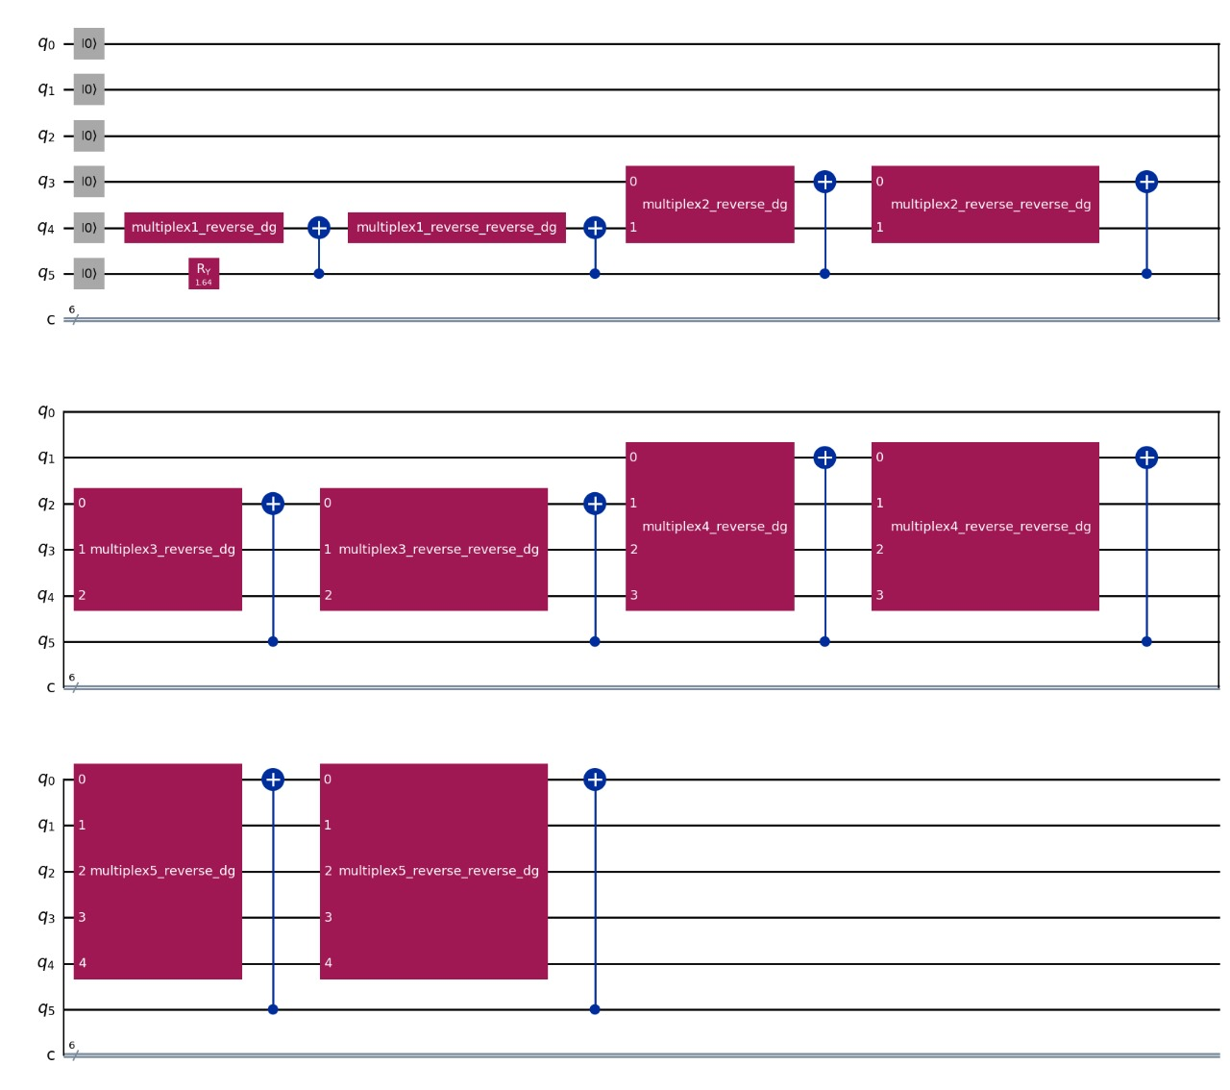
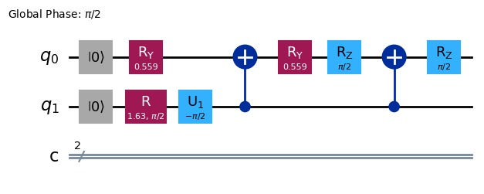
Amplitude Encoding

Slide 7
Classical Data Encoding
We’ll be using Various Data Encoding Schemes such as..
{Custom_FeatureMap_1;Custom_FeatureMap_2}
We’ll also Compare these Encoding Schemes with
ZZFeatureMap

Slide 8
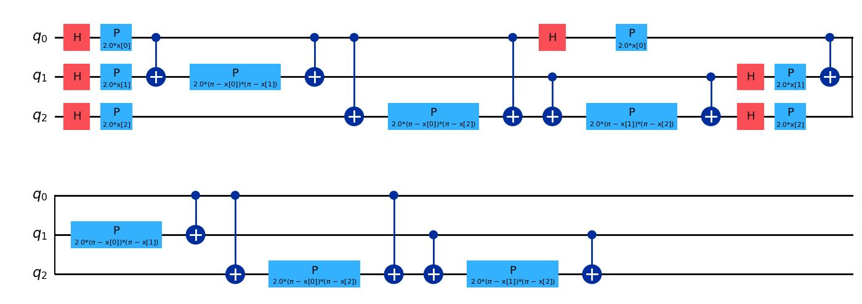
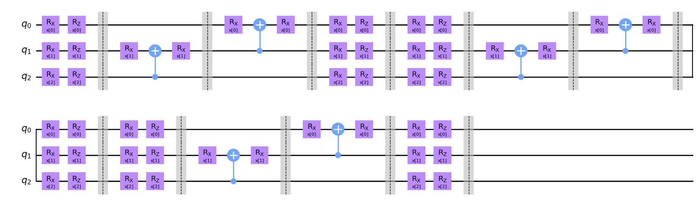
Classical Data Encoding
ZZFeatureMap
for MNIST
Custom_FeatureMap_1 for MNIST

Slide 9
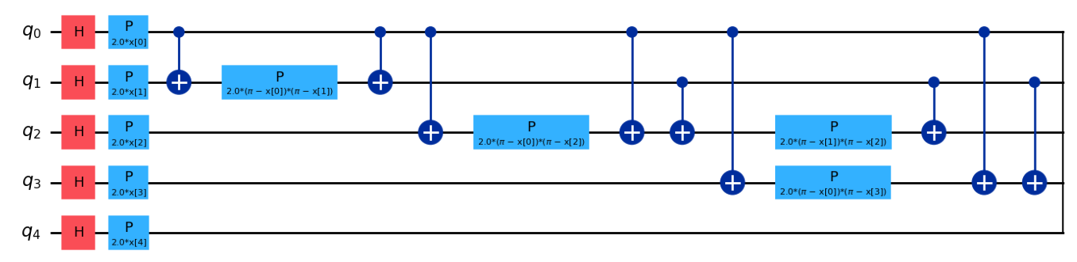
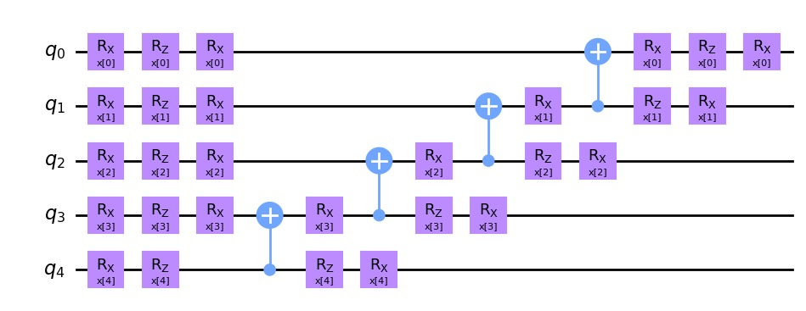
Classical Data Encoding
ZZFeatureMap
For Citrus
Custom_FeatureMap_2 for Citrus

Slide 10
Variational Circuit
A Customized Variational Circuit is prepared using Rotation Gates.
{Custom_Var_1;Custom_Var_2}
It is then compared with
EfficientSU2
TwoLocal

Slide 11
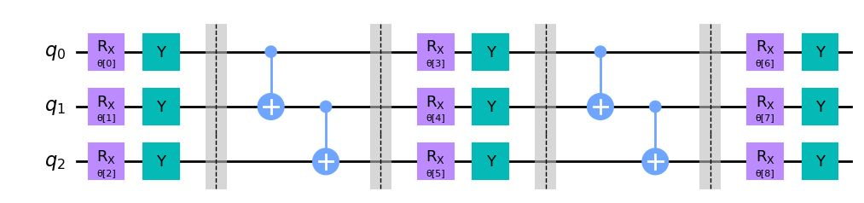
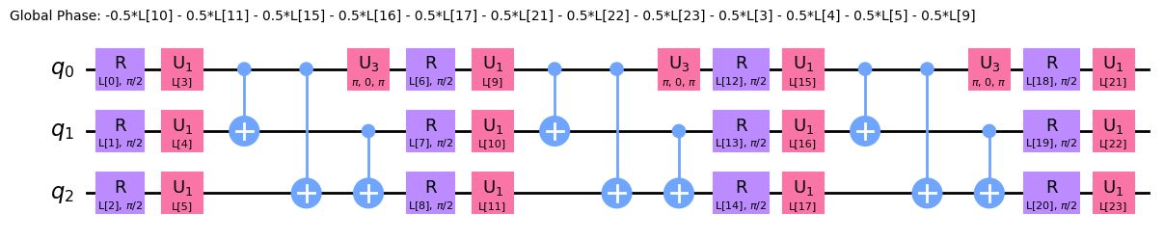
Variational Circuit
EfficientSU2 for MNIST
Custom_Var_1 for MNIST

Slide 12
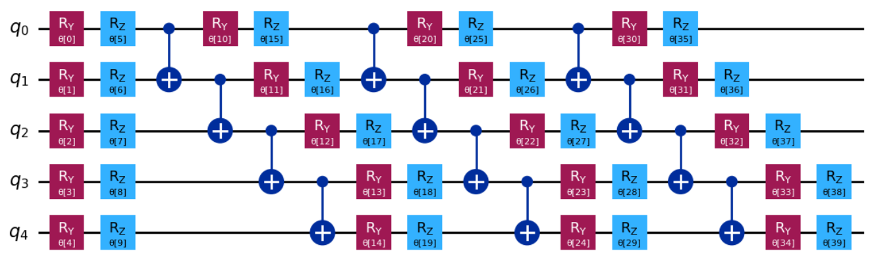
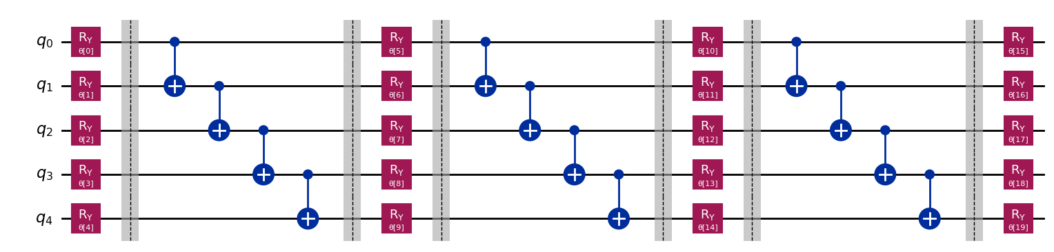
Variational Circuit
EfficientSU2 for Citrus
Custom_Var_2 for Citrus

Slide 13
Algorithm
Lastly Algorithm consist of two Different Classes
Estimator QNN
Sampler QNN
Results are Compared with VQC Class and Classical ML Algorithm

Slide 14
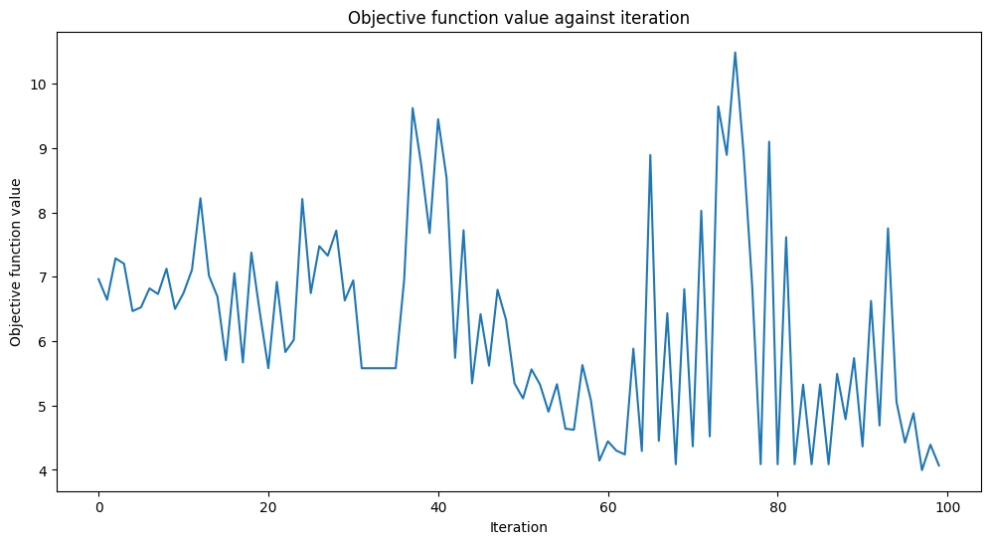
Training Model

Slide 15
Workflow
Data
Various encoding and comparing matrices – entanglement capacity, expressibility, circuit cost.
Encoding
Improving accuracy and reducing circuit depth
Ansatz
Executing code in different hardware
Algorithm
Runtime error mitigation

Slide 16
Thank You

