Slide 1
Interns - MDA
Ser No | Intern Name | College Name and Course Name | Period of Internship | Internship Mode | Mentor
1 | Sh Sarthak Verma | Delhi Technological University, B. Tech SE | 3 Month from 21 May 2026 | Offline | Sh Nitin Newalia, Sc E
2 | Sh Rajat Gupta | Raj Kumar Goel Institute of Technology, B. Tech CSE | 6 Month from 25 May 2026 | Offline | Sh Nitin Newalia, Sc E
3 | Smt Anugya Saxena | Delhi Technological University, B. Tech CSE | 3 Month from 21 May 2026 | Offline | Ms. Dhanya R Nair, Sc-C
4 | Sh Shivansh Tyagi | Raj Kumar Goel Institute of Technology, B. Tech CSE | 6 Month from 15 Jan 2026 | Offline | Sh Shivank Dixit, Analyst C
5 | Sh Shuddhabrota Banerjee | Delhi Technological University, B. Tech CSE | 3 Month from 21 May 2026 | Offline | Sh Shivank Dixit, Analyst C
6 | Sh Harsh Verma | Sagar Institute of Research and Technology, B. Tech CSE | 6 Month from 15 May 2026 | Offline | Sh Mohit Chaudhary, Sc C
7 | Sh Shubhank Gupta | Delhi Technological University, B. Tech CSE | 3 Month from 21 May 2026 | Offline | Sh Mohit Chaudhary, Sc C

Slide 2
Task Assigned
Intern Name | Assigned tasks | Work completed so far | Propose plan for remaining internship period
Sh Sarthak Verma | Data Collection for LLM training | Data Collection for LLM training | -
( 21 May 26 – 20 Aug 26) | Data Preprocessing and feature engineering | Working
 | Sentiment and Temporal analysis pipeline |  | July 2026
 | Testing and Evaluation of LLM |  | Aug 2026

Slide 3
Task Assigned
Intern Name | Assigned tasks | Work completed so far | Propose plan for remaining internship period
Sh Rajat Gupta | Identification and fixing Bugs in DHRUV Operation Management(DOM) | Fixed Timeline Data and order for multiple pages, Fixed character limit to 1000 from 200 on Recommendation page
(25 May 2026 – 24 Nov 2026) | Migration and Deployment of the Sea web Version 1.2 from Production to Megh (NTRO Cloud)

Slide 4
Task Assigned
Intern Name | Assigned tasks | Work completed so far | Propose plan for remaining internship period
Smt Anugya Saxena | Developed a GUI-based spreadsheet management platform with intelligent schema detection | Completed
(21 May 2026 – 20 Aug 2026) | Implemented full CRUD operations for spreadsheet management with dynamic query handling | Completed
 | Integration of NLP handling and Advance automation | Working | July 2026
 | Knowledge Base expansion and Assistive AI Collaboration |  | August 2026

Slide 5
Task Assigned
Intern Name | Assigned tasks | Work completed so far | Propose plan for repainting internship period
Sh Shivansh Tyagi | Data preparation for the PS09 stage II AIGC | Data preparation for the PS09 stage II AIGC | -
( 15 Jan 26 – 14 July 26) | Preparation for evaluation script for AIGC PS09 Stage 2 | Successfully completed | -
 | Optimization of Planet Image preprocessing, Ingestion and correlation with AIS data algorithm | Optimization of Planet Image preprocessing algorithm completed and working in production | Working on Ingestion and correlation with AIS data algorithm
 | Optimization of AIS decoder for fast data encoding and cleaning | Completed and working in production | -

Slide 6
Task Assigned
Intern Name | Assigned tasks | Work completed so far | Propose plan for repainting internship period
Sh Shuddhabrota Banerjee | Data preparation for ship-detection and classification for the PS09 stage III AIGC | Vessel annotation on medium and low resolution(EO/SAR) imagery | -
( 21 May 26 – 20 Aug 26 ) | Data preparation for path interpolation for the PS09 stage III AIGC | Work in progress | July 2026
 | Preparation for evaluation script for AIGC PS09 Stage III |  | August 2026

Slide 7
Task Assigned
Intern Name | Assigned tasks | Work completed so far | Propose plan for repainting internship period
Sh Harsh Kumar Verma | Debugging SICS dashboard | Successfully completed and currently in use
( 5 Feb 26 – 4 Aug 26 ) | Developed RF / AIS Correlation Engine | Successfully completed
 | Automated and documented the full data lifecycle - import, checkpoint, re-import, and cleanup | Successfully completely
 | Designed complete architecture for offline LLM deployment | Work in progress

Slide 8
Task Assigned
Intern Name | Assigned tasks | Work completed so far | Propose plan for repainting internship period
Sh Shubhank Gupta | Spoonbill Image Preprocessing | Spoonbill Image Preprocessing
( 21 May 26 – 20 Aug 26) | Satellite imagery to Mbtiles conversion | Working
 | GPU optimized clipping of detected vessels |  | July 2026
 | Combined master CSV with vessel data and AIS correlation |  | Aug 2026

Slide 9
Introduction and Problem Statement
Name : Sarthak Verma
College & Branch : Delhi Technological University, B.Tech-SE
Duration : 3 Months (Starting from 21 May 2026)
01
Data Collection for LLM training
02
Data Preprocessing and feature engineering
03
Sentiment and Temporal analysis pipeline
04
Testing and Evaluation of LLM

Slide 10
Working on the following :-
01
Data Collection for LLM training
02
Data Preprocessing and feature engineering
Responsibilities include analyzing internal office documents/files, creating train-validation-test datasets.
Data Cleaning, Batch-wise accuracy evaluation, WER preprocessing analysis
03
Sentiment and Temporal analysis pipeline
Studying Sentiment and Temporal analysis in context of the dataset.

Slide 11
Introduction and Problem Statement
Name : Rajat Gupta
College & Branch : Raj Kumar Goel Institute of Technology Ghaziabad, B.Tech-CSE
Duration : 6 Months (Starting from 25 May 2026)
01
Dhruv Operation Management (DOM) Bugs and Issue Fix
02
Migration and Deployment of the Sea web Version 1.2 from Production to Megh (NTRO Cloud)

Slide 12
Working on the following :-
01
Dhruv Operation Management (DOM)
Responsibilities include finding bugs and issues in timeline page and fixing them

Slide 13
Introduction and Problem Statement
Name : Anugya Saxena
College & Branch : Delhi Technological University, B.Tech-CSE
Duration : 03 Months (Starting from 21 May 2026)
01
Automation of management of Project Compute Resources
i will be working on this type of data :IT asset inventory and infrastructure registry and these data comes from different vendors and in different formats and even sometimes unstructured tabular data. I am aiming to unify the data for all the projects in maritime and data center in database (m using Postgresql ) and converting to structured format and take another data of vendor's repository (can also be from IT solution dataset from sites of DELL/HP/TYRONE etc ) + the IT Inventory data for compute specifications and generate 2 modules or functionalities one for analytics like report generation in the format input by the user and CRUD Operations and visualisation enabling the user to interact through natural language queries.
i will be working on this type of data :IT asset inventory and infrastructure registry and these data comes from different vendors and in different formats and even sometimes unstructured tabular data. I am aiming to unify the data for all the projects in maritime and data center in database (m using Postgresql ) and converting to structured format and take another data of vendor's repository (can also be from IT solution dataset from sites of DELL/HP/TYRONE etc ) + the IT Inventory data for compute specifications and generate 2 modules or functionalities one for analytics like report generation in the format input by the user and CRUD Operations and visualisation enabling the user to interact through natural language queries. second module constitutes query based llm and interface for optimal resources required for any project and even the existing ones by asking progressively the questions to refine the problem statement and streamline to the exact details of the estimation of optimal compute resources and algorithms and infracstructure to use.
i have a presentation with the senior most official in maritime so keep the terms technical and professional .
suggest me content for presentation and even visuals(confidential organisation it is) this is 3 months intern started on 21 may till 21 august .
dates or gantt chart can be iincorporated and specific details (not generic and vague) and use case and relevance to ntro maritime .dates should be incorporated in proposed plan and quantify the impact and achievements.
i will be working on this type of data :IT asset inventory and infrastructure registry and these data comes from different vendors and in different formats and even sometimes unstructured tabular data. I am aiming to unify the data for all the projects in maritime and data center in database (m using Postgresql ) and converting to structured format and take another data of vendor's repository (can also be from IT solution dataset from sites of DELL/HP/TYRONE etc ) + the IT Inventory data for compute specifications and generate 2 modules or functionalities one for analytics like report generation in the format input by the user and CRUD Operations and visualisation enabling the user to interact through natural language queries. second module constitutes query based llm and interface for optimal resources required for any project and even the existing ones by asking progressively the questions to refine the problem statement and streamline to the exact details of the estimation of optimal compute resources and algorithms and infracstructure to use. the it inventory data enables to build maritime geospatial intelligence: Asset inventory,Infrastructure monitoring,PostGIS spatial database directly leverage the existing servers, storage, GIS software, GPU resources, and maritime-focused Seaweb/Baaz infrastructure.
i have a presentation with the senior most official in maritime so keep the terms technical and professional .
suggest me content for presentation and even visuals(confidential organisation it is) this is 3 months intern started on 21 may till 21 august .
dates or gantt chart can be iincorporated and specific details (not generic and vague) and use case and relevance to ntro maritime .dates should be incorporated in proposed plan and quantify the impact and achievements.
outline of presntation (dont make it too text heavy):
Problem statement
work done so far
impact /achievemnet
proposed plan of work for the rest of the internship period
outcome expected
plan of integration of outcomes in project/centre(planning to implement it within the organisation office )
Estimation of Compute Requirements
02
03
Integration of NLP handling and Advance automation
04
Knowledge Base expansion and Assistive AI Collaboration

Slide 14
Introduction and Problem Statement
Name : Anugya Saxena
College & Branch : Delhi Technological University, B.Tech-CSE
Duration : 03 Months (Starting from 21 May 2026)
01
02
Automation of Management of Compute Resources by building Unified Infrastructure Intelligence Repository for Fragmented infrastructure inventories
Optimised Resource Planning & Advisory Engine
enables data-driven decisions
AI-Powered Analytics & Natural Language Operations
Enabling users to interact with infrastructure data through natural language queries
03

Slide 15
Work Done So Far
01
Developed a Unified Data Ingestion & Standardization Pipeline
Designed framework to ingest heterogeneous infrastructure inventories from multiple formats and vendors, transforming them into a structured PostgreSQL-based repository.
02
Implemented Infrastructure Data Management Capabilities
Developed CRUD-based asset management functionalities for inventory datasets, enabling efficient creation, retrieval, updating, and maintenance of infrastructure records.
03
Conducted Infrastructure Resource Analysis
Performed detailed study and mapping of compute, GPU, storage, networking, and scalability requirements different projects.
04
Evaluated Offline Deployment Feasibility Explored air-gapped/offline compatibility and deployment strategies for secure operational environments.

Slide 16
Impacts and achiemvements
01
02
✓ Enhanced Visibility of Maritime Technology Infrastructure
Provides a consolidated view of compute, storage, GIS, and software resources across projects, enabling faster identification and utilization of existing assets.
Supports Faster Infrastructure Planning for New Maritime Projects
Reduces dependence on manual assessment by creating a structured foundation for evaluating resource availability and infrastructure readiness.
Enables Data-Driven Capacity Assessment
Facilitates informed decisions regarding compute, GPU, storage, and network requirements for maritime analytics, surveillance, GIS, and AI workloads.
Impact & Achievements
Key Achievements
✓ Established a Unified Infrastructure Data Foundation standardize and centralize multi-vendor IT inventory data into a structured PostgreSQL repository.
✓ Enabled Analytics-Ready Asset Intelligence Structured compute, storage, network, GIS, and software asset information for querying, reporting, and future decision-support applications.
✓ Built Core Infrastructure Management Capabilities Implemented inventory management operations and data handling workflows for efficient maintenance of infrastructure records.
✓ Assessed Infrastructure Requirements for Maritime Workloads Analysed compute, GPU, storage, networking, and scalability requirements across AI, GIS, and maritime processing environments.
✓ Evaluated Secure Offline Deployment Feasibility Explored approaches for operating the solution within air-gapped and restricted-network environments.
04

Slide 17
Implement automated report generation and infrastructure summaries.
Develop interactive dashboards and visualization capabilities.
Reduced Manual Data Processing Effort by ~70–80% Automated ingestion, normalization, and management of heterogeneous infrastructure inventories, minimizing manual consolidation and data preparation efforts.
Proposed plan
Expand Infrastructure Intelligence Repository
Integrate additional infrastructure inventories, vendor catalogues, and technical specifications.
Refine infrastructure classification, metadata standards, and asset relationships.
Create a comprehensive knowledge repository covering compute, storage, networking, GIS, and software resources.
Analytics and dashboard advancements
Natural language search
Automated reporting
Dashboards & visualizations
Enhanced nlp
Improve Natural Language Query to handle more complex, multi-part queries and contextual
Outcomes :The project will evolve existing infrastructure inventories into an AI-enabled Maritime Infrastructure Intelligence and Decision Support Platform, providing enterprise-wide visibility, automated analytics, and intelligent resource planning capabilitie
Impact Area | Improvement
Manual Data Processing | 70–80% Reduction
Asset Discovery & Search | Hours/Days → Minutes
Report Generation | Automated & On-Demand
Infrastructure Visibility | Centralized Analytics & Visualizations
Resource Planning | Transitioning to AI-Assisted Recommendations

Slide 18
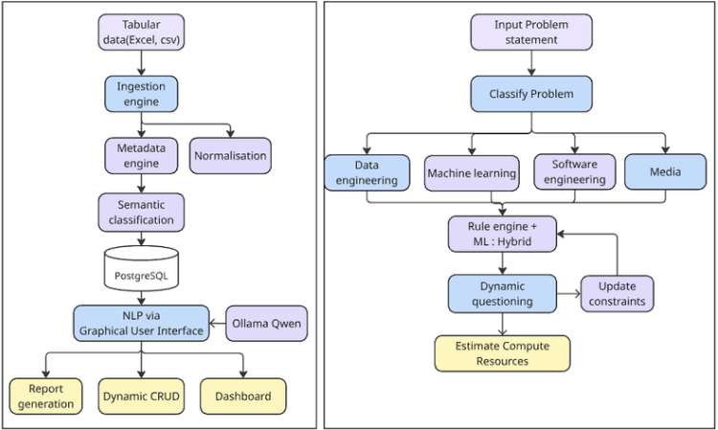
Infrastructure Inventories
(Servers, Storage, Network, GIS Assets)
│
▼
Unified Infrastructure Repository
(PostgreSQL / PostGIS Foundation)
│
▼
Infrastructure Intelligence Layer
(Search • Analytics • Reporting • Visualization)
│
▼
AI-Assisted Recommendation Engine
(Resource Planning & Estimation)
│
▼
Maritime Decision Support Platform

Slide 19
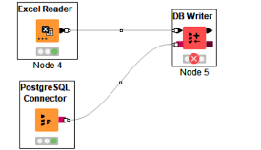
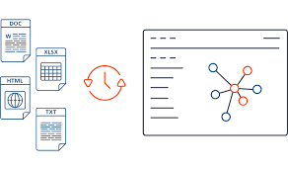

Slide 20
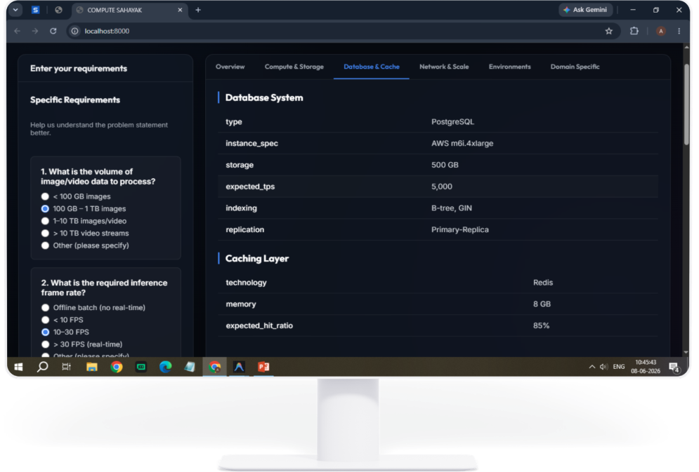

Slide 21
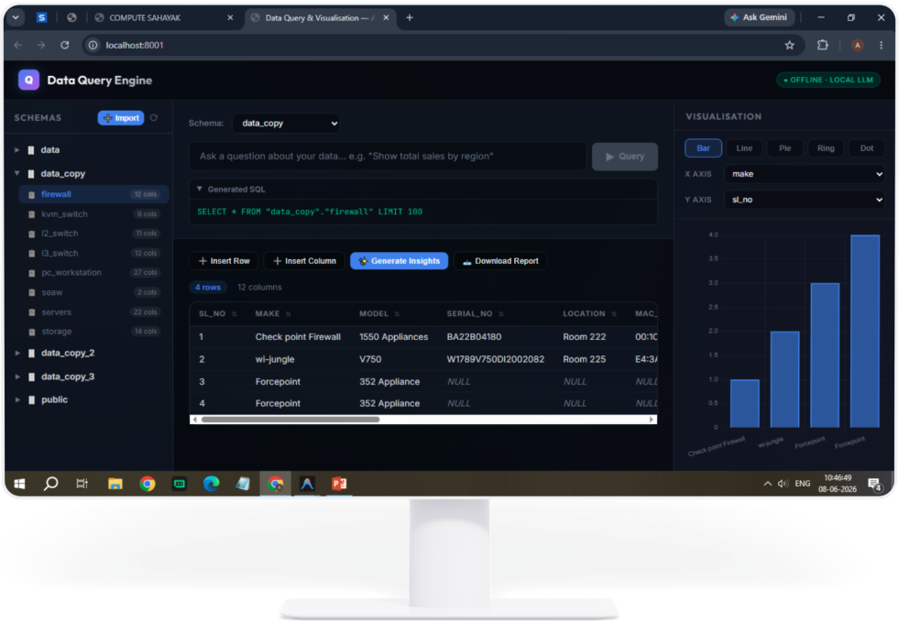

Slide 22
Impact & Achievements
KEY METRICS
200%
4
100%
>90%
Dashboard Speed Improvement
Production Systems Fixed
Zero-Dependency Ingestion
RF Correlation Accuracy
(from detection #1)
Operational Continuity
Air-Gap AI Capability
SICS dashboard restored from non-functional to fully operational — active maritime operations no longer blocked by software failures.
Designed complete architecture for offline LLM deployment; enables AI-assisted work on classified/restricted networks for the first time.
Data Pipeline Reliability
Scientific RF Matching
Automated and documented the full data lifecycle — import, checkpoint, re-import, and cleanup — reducing manual errors to zero.
Physics-grounded Bayesian correlation replaces manual vessel matching; provides quantifiable confidence scores aligned with ITU-R standards.

Slide 23
Introduction and Problem Statement
Name : Shivansh Tyagi
College : Raj Kumar Goel Institute of Technology
Duration : 6 Months (Starting from 15 Jan 2026)
01
GT Preparation - AIGC PS09
02
Evaluation Script for PS09 Stage II
03
PLANET Pipeline Optimisation
04
Decoder Pipeline for encrypted AIS Data

Slide 24
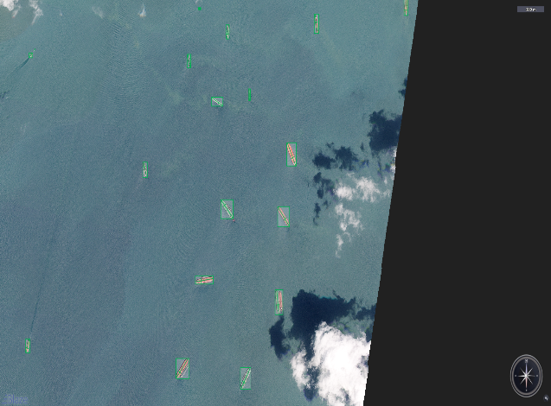
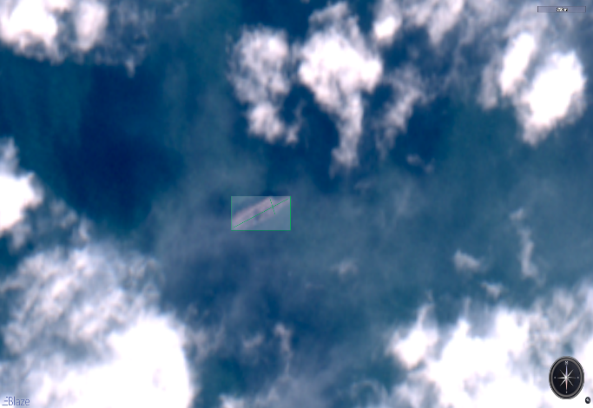
Work Done So Far
01
GT Preparation - AIGC PS09
Annotated SAR, EO & PLANET imagery for ground truth preparation for the AI Grand Challenge India problem statement.
02
Evaluation Script
F1 Score for AIS correlation by calculation no. of True Positives, False Positives, True Negatives.
RMSE Calculation for Path Prediction, Interpolation and length/width/heading ERROR
Weighted-F1 for Classification among 4 classes (undefined, Warship, Commercial, Ship-to-Ship)
Built Python evaluation pipeline: path prediction, interpolation, vessel detection & classification, and AIS correlation.

Slide 25
Work Done So Far
03
PLANET Pipeline Optimisation
Using Producer-Consumer Architecture to modularize the Re-projection/Classification and master csv generation for PLANET imagery.
Switching from ‘tensorflow’ to ‘pytorch’ for flexibility and better inference of classification model.
Proper Utilization of Server Compute to reduce time taken for per day PLANET imagery from 3-4 hrs to 25-30 mins
Reduced daily processing from 3–4 hrs → 25 mins via parallel model inference & full-RAM image processing.
Replaced Outdated AIS decoder to Latest maintained AIS decoder for better decoding accuracy.
Used Master-worker architecture for parallel decoding to 15+ encrypted files at once.
Included DGLL encrypted files in same pipeline to boost time taken from 1 file/10 min to 10 files/3 mins
04
AIS Decoder Pipeline
Master-worker architecture; 10 files/3 min vs 1 file/10 min. Integrates DGLL data. Supports up to 32 workers.

Slide 26
Impact & Achievements
KEY METRICS
~9×
30×
3
4
PLANET Pipeline Speedup
AIS Decoder Throughput
Pipelines Optimised
GT Datasets Annotated
HIGHLIGHTS
PLANET pipeline: 3–4 hours → 25 minutes per day via parallel inference & full-RAM I/O
AIS decoder: 10 min/file → 10 files/3 min; supports up to 32 parallel workers with updated decoder
Unified DGLL + AIS handling in a single pipeline, eliminating a separate legacy workflow
Delivered annotated GT for AIGC PS09 across SAR, EO, and PLANET image types
Automated ICE-EYE download workflow, removing all manual intervention

Slide 27
Impact and Plan
PLANET
Imagery
WIP
Optimised
PLANET
Pipeline
Data
Ingestion
(WIP)
Visually published data
AIS
Decoder
Pipeline
▶
▶
▶
Seaweb Pipeline
Incoming Encrypted AIS data
Optimised
AIS
Decoder
Verified Decoded
AIS published
AIS
Decoder
Pipeline
▶
▶
Decoder Pipeline
Work in Progress: Plan to implement MBTile conversion with optimized SQLite ingestion to massively reduce conversion time. Predicted gain :- 3-4x less conversion time.

Slide 28
Introduction and Problem Statement
Name : Shuddhabrota Banerjee
College & Branch : Delhi Technological University, B.Tech-CSE
Duration : 3 Months (Starting from 21 May 2026)
01
Image Annotation for AIGC PS09 Stage III
02
AIS Data Processing for Path Prediction and Interpolation
03
Evaluation Script for AIGC PS09 Stage III

Slide 29
Work Done So Far & Planned Work
01
Image Annotation for AIGC PS09 Stage III
02
AIS Data Processing for Path Prediction and Interpolation
Annotation of PLANET, Sentinel-1, Sentinel-2, ICEYE, NovaSAR, etc for Vessel Detection and Classification activity.
Filtering AIS data for suitable vessel path for Path Prediction and Interpolation Activity in PS09 Stage III
03
Evaluation Script for AIGC PS09 Stage III
Modifying the Evaluation script for Stage III

Slide 30
Introduction and Problem Statement
Name : Harsh Kumar Verma
College & Branch : Sagar Institute of Research and Technology, B.Tech-CSE
Duration : 6 Months (Starting from 5 Feb 2026)
01
Fix and Debug Data distribution Pipeline receiving data from Data Diode
02
Optimization of RF/AIS Correlation Engine
03
Offline LLM setup for maritime Awareness

Slide 31
Work Done So Far
01
Fix and Debug Data distribution Pipeline receiving data from Data Diode
Built the Automation which calls and checks the DB automatically after each 8 hours and auto runs on boot and connects to the db auomatically
02
Optimization of RF/AIS Correlation Engine
Optimization of RF/AIS Correlation Engine to enable parallel working to reduce latency of correlation
03
Offline LLM setup for maritime Awareness
Pipeline design and Data Processing for using Open-source LLM models for use on Internal Data on Local Servers

Slide 32
Impact & Achievements
KEY METRICS
200%
4
100%
>90%
Dashboard Speed Improvement
Production Systems Fixed
Zero-Dependency Ingestion
RF Correlation Accuracy
(from detection #1)
Operational Continuity
Air-Gap AI Capability
SICS dashboard restored from non-functional to fully operational — active maritime operations no longer blocked by software failures.
Designed complete architecture for offline LLM deployment; enables AI-assisted work on classified/restricted networks for the first time.
Data Pipeline Reliability
Scientific RF Matching
Automated and documented the full data lifecycle — import, checkpoint, re-import, and cleanup — reducing manual errors to zero.
Physics-grounded Bayesian correlation replaces manual vessel matching; provides quantifiable confidence scores aligned with ITU-R standards.

Slide 33
Introduction and Problem Statement
Name : Shubhank Gupta College & Branch : Delhi Technological University, B.Tech-CSE
Duration : 3 Months (Starting from 21 May 2026)
01
Spoonbill Image Preprocessing
02
Satellite imagery to Mbtiles conversion
03
GPU optimized clipping of detected vessels
04
Combined master CSV with vessel image, data and AIS correlation

Slide 34
Working on the following :-
01
Spoonbill Image Preprocessing
Recursively search satellite images from the multi sensor spoonbill .tar file and index the corresponding metadata
02
Satellite imagery to Mbtiles conversion
Optimizing Satellite Imagery to Mbtiles Converter
03
GPU optimized clipping of detected vessels
Studying how to use GPU to parallely clip and extract detected vessels with buffer
04
Combined master CSV with vessel data and AIS correlation
Studied the CSV header and AIS correlation

