Slide 1

Financial Data Analysis
Shishir Sachan
MBA (Finance)

Slide 2
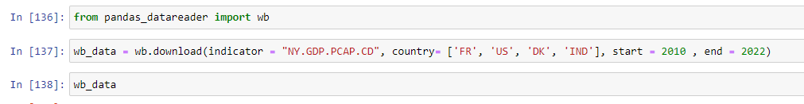
GDP Calculation for the period 2010 to 2022
GDP per capita calculation for a period for 2010 to 2022
Country included are France, United State, Denmark, India

Slide 3
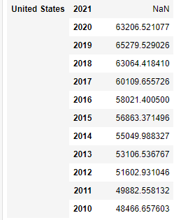
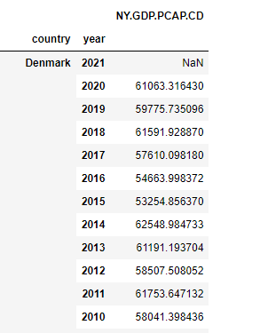
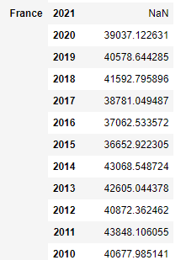
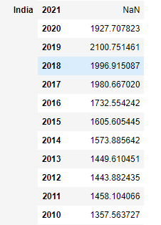

Slide 4
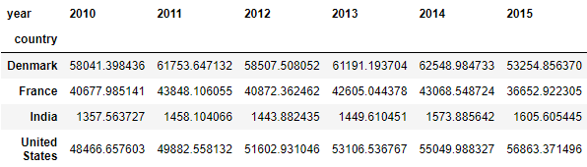
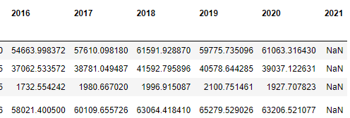

Slide 5
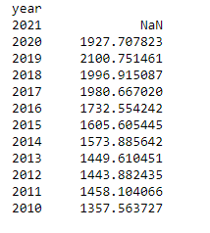
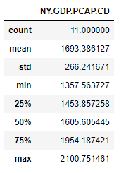
India GDP per Capita Income

Slide 6
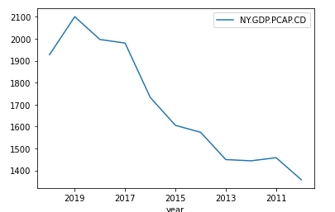
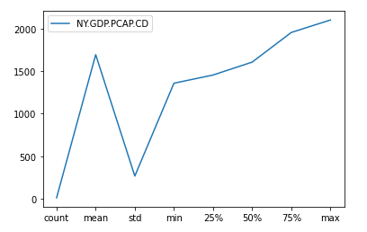
Diagrammatic representation of India GDP per capita

Slide 7
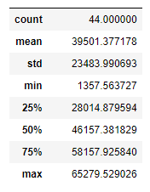


Slide 8

This Photo by Unknown Author is licensed under CC BY-SA

