Slide 1

Presented By: Shiva Prasad Bastola
Training Institute for Technical Instruction (TITI)

Slide 2
Objective of this Presentation
By the end of the session participants will be able to assign limit for bank guarantee.

Slide 3
What is Bank Guarantee?
Bank Guarantee is an undertaken/promise of an issuing bank to pay to the beneficiary if the applicant fails to perform the duties obligation as per the contact between applicant and beneficiary.

Slide 4
Applicant
/Customer
Beneficiary
Bank

Slide 5
Types of Bank Guarantee
Bid Bond Guarantee
Performance Guarantee
Deposit Guarantee
Advance Payment Guarantee

Slide 6
Important Points While Creating Guarantee Limit
Analyse customers social, managerial, technical, financial aspects.
Follow NRB directives.
Follow bank guidelines and manuals.
Remember branch approval limits.

Slide 7
Acquire Approved Valuation Report
Inform the Customer about Approved Limit
Collect Customer Application
Steps of Creating Bank Guarantee Limit
Find CIC Customer Form and Relevant Parties
Approve Limit Sheet by Branch Manager
Calculate the Limit For Different BG
Following Bank Guarantee Manual
Put the Value in the Limit Sheet

Slide 8
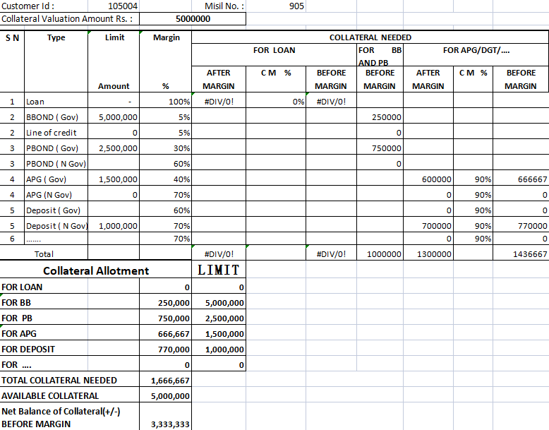

Slide 9
Conclusion
Participants are able to describe Bank Guarantee.
Participants knows the step of creating Limit Bank Guarantee.
From this powerpoint participants are able to create Bank Guarantee Limit.

Slide 10


