Slide 1
Traffic: Necessary Evil and Signal of Recovery
Kamron Afshar and Shishir Kumar

Slide 2
Dataset
30,243 entries of vehicle miles driven, per month, per State, broken down by rural vs urban arterial Roads
~200 xls files from fhwa.dot.gov (Federal Highway Administration)
Variables: State, Date, Road Type, Miles Driven

Slide 3
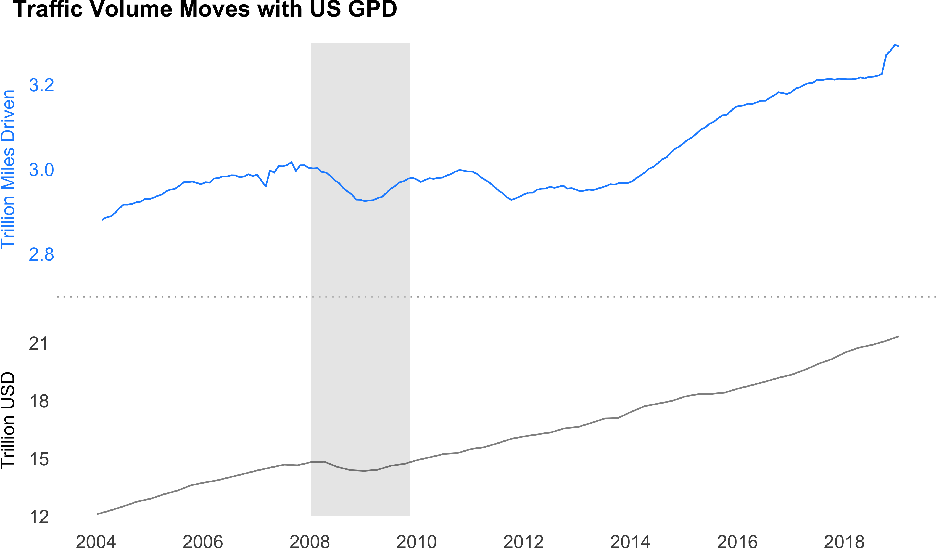

Slide 7



