Slide 1


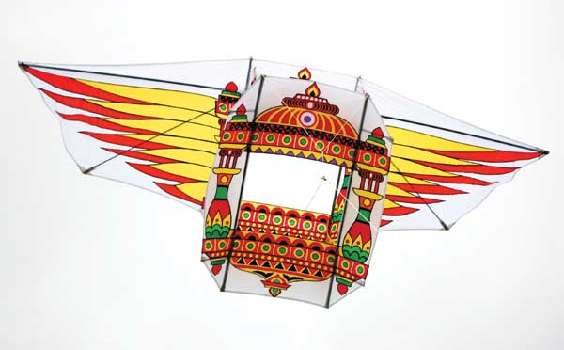
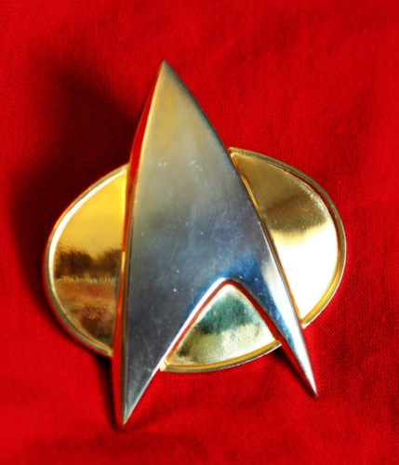
The Edge of Machine Learning
Resource-efficient ML in 2 KB RAM for the Internet of THings
Ashish Kumar
Microsoft Research India

Slide 2
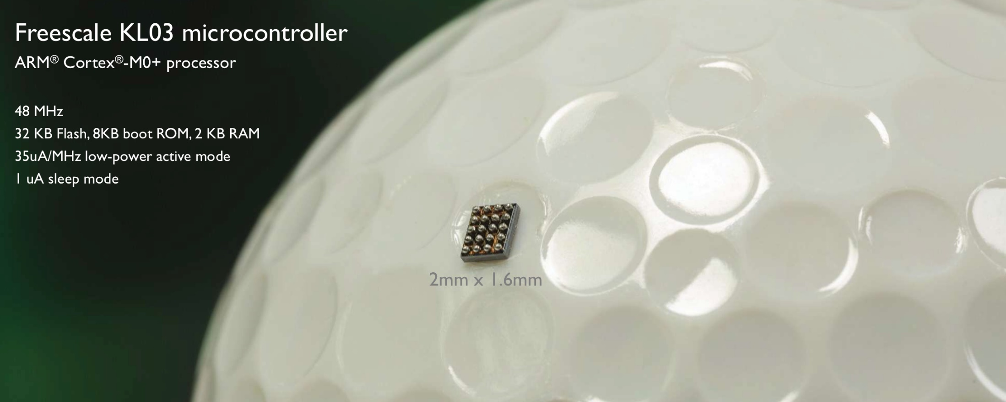

Resource-constrained IoT Devices
ARM Cortex M0+ at 48 MHz & 35 $μ$A/MHz
with 2 KB RAM & 32 KB read only Flash

Slide 3
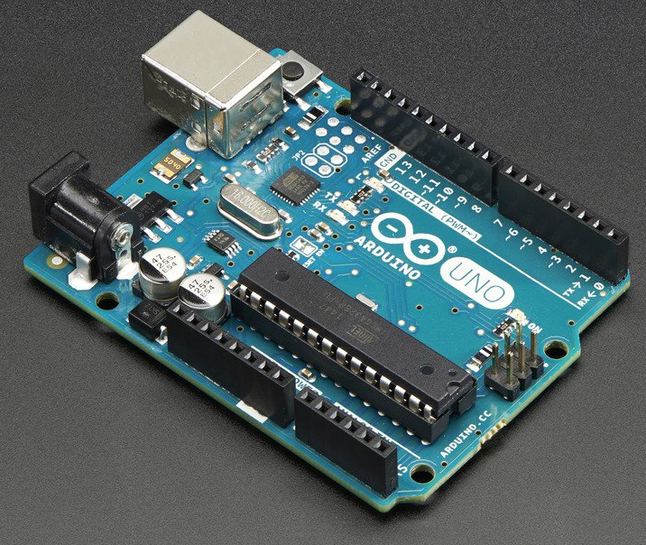
The Arduino Uno
8 bit ATmega328P Processor at 16 MHz
with 2 KB RAM & 32 KB read only Flash

Slide 4

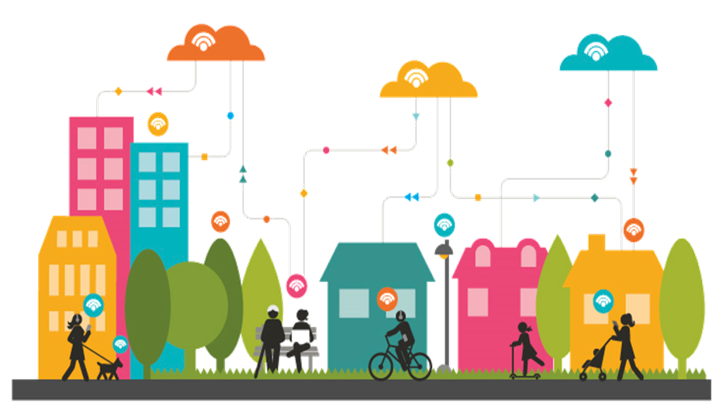

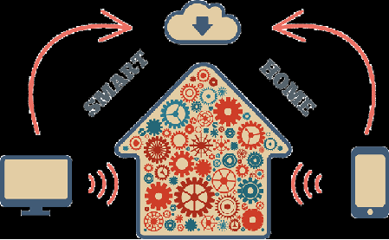

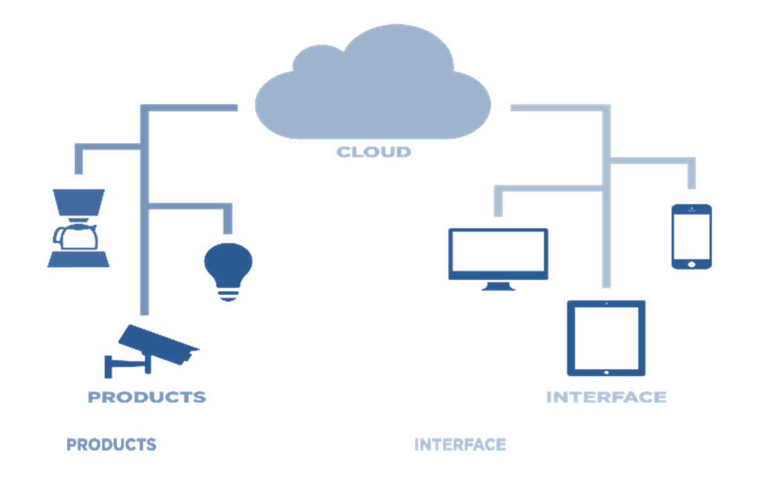
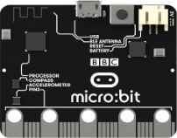
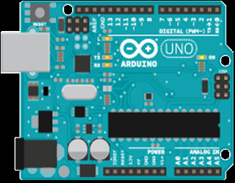
The Internet of Things
Smart City
SMART
HOME
Smart Appliances

Slide 5
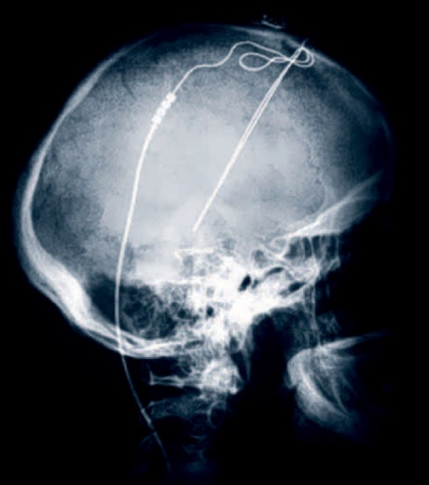
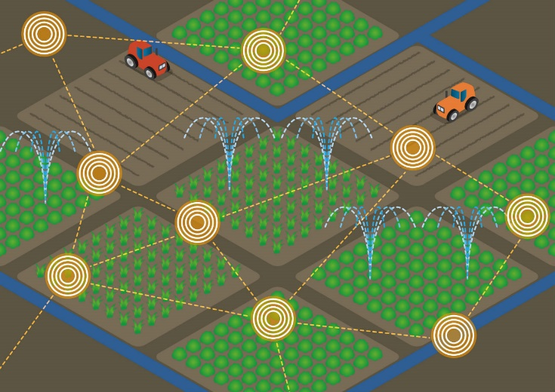
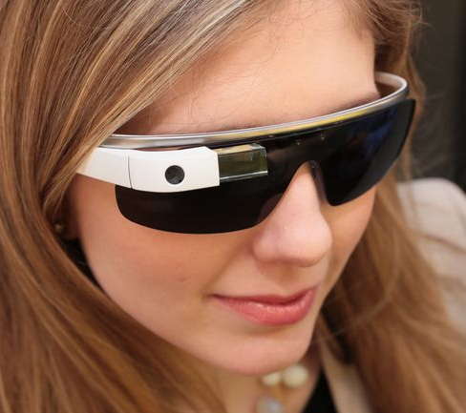

Intelligent IoT Devices
Intelligent IoT devices can help deal with latency, bandwidth, privacy and energy concerns
Low latency brain implants
Smart agriculture for disconnected farms
Privacy preserving smart glasses
Energy efficient smart forks

Slide 6

Bonsai
A Compressed Tree Model
Ashish Kumar (MSRI)
Saurabh Goyal (IITD)
Manik Varma (MSRI)

Slide 7
Advantages of Tree Based Learning
Trees are general and can be used for
Binary & multi-class classification
Multi-label learning
Regression
Ranking
…
Balanced trees have logarithmic prediction times
Efficient prediction in milliseconds
Lower energy consumption leading to longer lasting batteries

Slide 8
Bonsai – Key Ideas
We design Bonsai to be a single, shallow, sparse tree with powerful nodes for accurate prediction
We reduce model size by learning Bonsai in a low-dimensional space into which all data is projected
We jointly learn tree and projection parameters so as to maximize accuracy within the given budget

Slide 9










Bonsai Model
$$W_{1}, V_{1}$$
$$θ_{1}^{t}\hat{x}>0$$
Sparse Projection
(Z)
Yes
No
$$\hat{x}$$
$$x$$
$$W_{2}, V_{2}$$
$$θ_{2}^{t}\hat{x}>0$$
$$W_{3}, V_{3}$$
$$θ_{3}^{t}\hat{x}>0$$
Yes
No
$$\hat{y}=\left(\begin{aligned}\tanh\left(V_{1}^{t}\hat{x}\right)W_{1}^{t}\hat{x} \\ +\tanh\left(V_{2}^{t}\hat{x}\right)W_{2}^{t}\hat{x} \\ +\tanh\left(V_{4}^{t}\hat{x}\right)W_{4}^{t}\hat{x}\end{aligned}\right)$$
$$W_{4}, V_{4}$$
$$W_{5}, V_{5}$$
$$W_{6}, V_{6}$$
$$W_{7}, V_{7}$$

Slide 10

The Bonsai Objective Function
$${Min}_{Θ,Z} P = \frac{1}{2}Tr\left(ΛΘ^{⊤}Θ\right)+\frac{λ}{2}Tr\left(ZZ^{⊤}\right)+\frac{1}{N}\sum_{i=1}^{N}{𝓛(x_{i},y_{i}, \hat{y_{i}};Θ,Z)}$$
$s. t. { \left|\left|Θ\right|\right|}_{0}<B, { \left|\left|Z\right|\right|}_{0}<S$,$Θ=\left[W,V,θ\right]$
$𝓛$is any loss function which can be optimized via SGD
We place explicit budget constraints on the tree parameters $Θ$and sparse projection matrix $Z$

Slide 11
Results: Bonsai
Comparison to Uncompressed Methods
Comparison to Compressed Methods
Prediction Costs on the Arduino Uno

Slide 12
Dataset Statistics
Dataset | # Train | # Test | # Features
Chars4K-2 | 4,397 | 1,886 | 400
WARD-2 | 4,503 | 1,931 | 1,000
RTWhale-2 | 5,265 | 5,264 | 2,000
Eye-2 | 456 | 196 | 8,192
MNIST-2 | 60,000 | 10,000 | 784
USPS-2 | 7,291 | 2,007 | 256
CIFAR10-2 | 50,000 | 10,000 | 400
CUReT-61 | 4,204 | 1,403 | 610
MNIST-10 | 60,000 | 10,000 | 784
Chars4K-62 | 4,397 | 1886 | 400
Bing L3/L4 | 704,841 | 123,268 | 50

Slide 13
Comparison to Uncompressed Methods
Compressed :
Bonsai
Uncompressed :
GBDT
kNN
RBF-SVM
Neural Nets

Slide 14
Prediction Accuracy vs Model Size

Slide 15
Prediction Accuracy vs Model Size

Slide 16
Prediction Costs on the Arduino Uno
Accuracy (%)
Pred Time (ms)
Pred Energy (mJ)
2187
1312
Eye-2
521
313
RTWhale-2
Bonsai Linear LDKL
NeuralNet Cloud-GBDT

Slide 17
Bing L3/L4 Ranker Results

Slide 18
Conclusions
ML for IoT devices might provide many high-impact opportunities
The Intelligent Devices Expedition plans to develop an ML library and compiler for IoT devices
Bonsai & ProtoNN
Fit into a few Kilobytes of memory
Make predictions in milliseconds
Are energy efficient & extend battery life
Have state-of-the-art prediction accuracies

