Slide 1
Common Machine Learning Pattern
Model
State
Data
Draw ξ₁
Read θ₁, θ₃
Compute
Update θ₁, θ₃
Draw ξ₂
Read θ₂, θ₅
Compute
Update θ₂, θ₅
Draw ξ₃
Read θ₁, θ₄
Compute
Update θ₁, θ₄

Slide 2
Parallel Inference
Model
State
Data
Processor 1
Processor 2

Slide 3
Parallel Inference
Model
State
?
Data
Processor 1
Processor 2
Draw ξ_{1,1}
Read θ₁, θ₃
Compute
Update θ₁, θ₃
Draw ξ_{1,2}
Read θ₂, θ₆
Compute
Update θ₂, θ₆
Correctness:
Draw ξ_{2,1}
Read θ₂, θ₄
Compute
Update θ₂, θ₄
Draw ξ_{2,2}
Read θ₅, θ₆
Compute
Update θ₅, θ₆
Theoretical guarantees, preserve or approx serial outcome
Concurrency:
Runtime decreases with increasing computation resources

Slide 4
Coordination Free Parallel Inference
Model
State
?
Data
Processor 1
Processor 2
Keep Calm and Carry On.

Slide 5
Concurrency
Concurrency
Control
Coordination-
free
Coordination-
free
Transaction
High
Draw ξ_{1,1}
Read θ₁, θ₃
Compute
Update θ₁, θ₃
Database mechanisms
Update => transaction
Guarantee correctness
Maximize concurrency
Serial equivalence:
Parallel execution of transactions is equivalent to
some serial execution
Low
Low
Serial
Serial
Correctness
Low
High

Slide 6

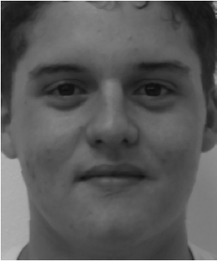
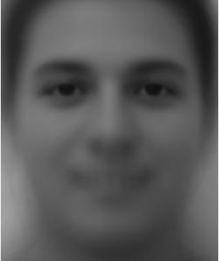

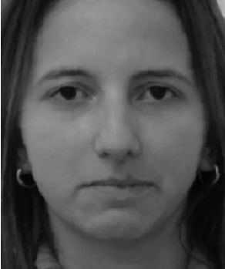
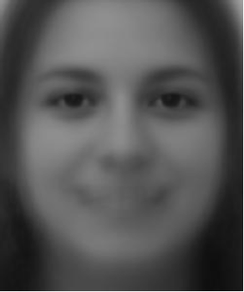
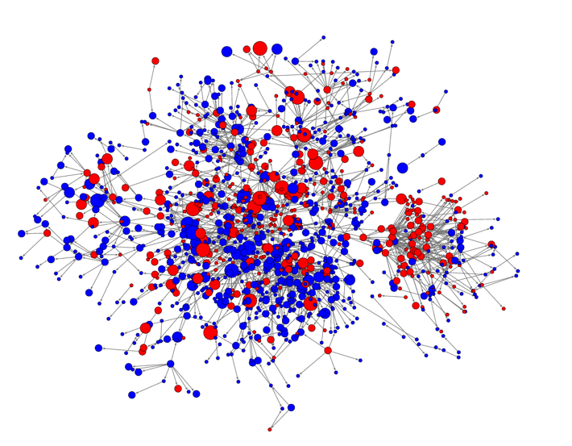
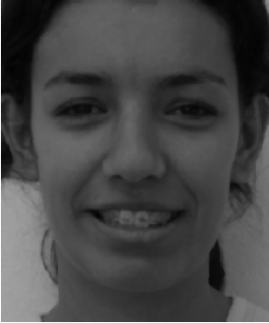
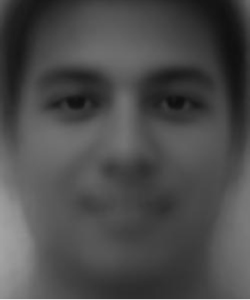
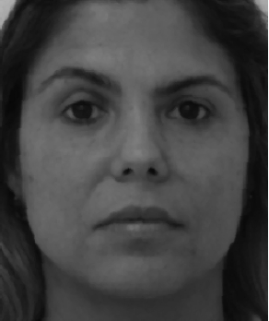
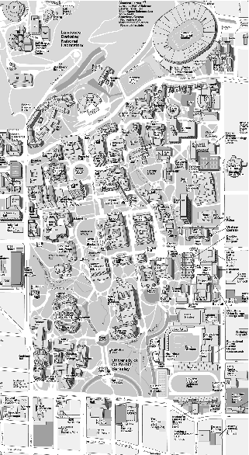
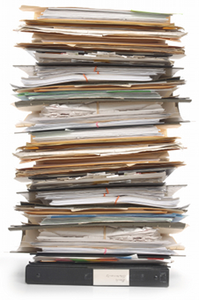
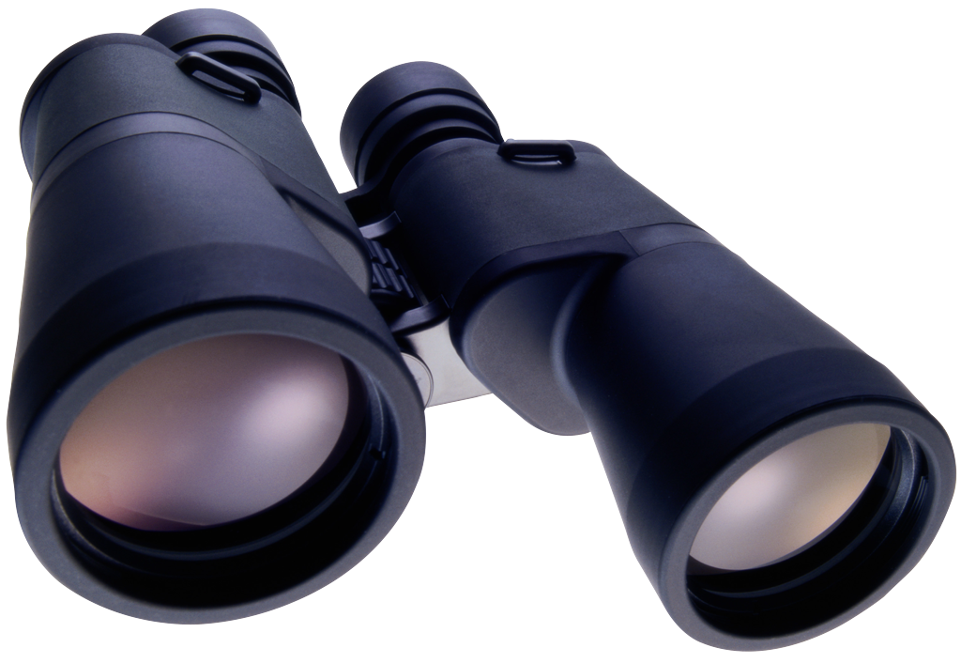
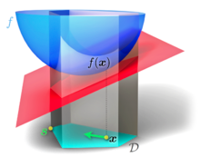
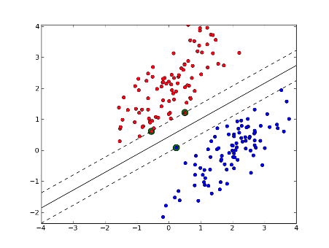
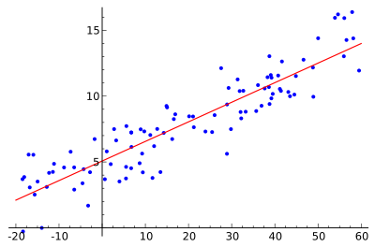

Machine Learning + Concurrency Control
Online Facility Location
NIPS 2014
NIPS 2013
Clustering
Feature Modeling
Submodular Maximization
Subset selection, diminishing marginal gains
≈
Max Graph Cut
Set Cover
Social Network
Influence Propagation
≈
+
≈
+
≈
+
+
Non-parametric Bayes Sampling
Work in progress
Sensor Placement
Document Summarization
Sports
Curry
Warriors
Steelers
Pogba
Politics
Clinton
Trump
Emails
Wall
Finance
QE
market
interest
Dow
NIPS 2016
NIPS 2015
Sparse Convex Optimization
Correlation Clustering
Regression
Classification
Deduplication
Community Detection
Notes:
Move to front, talk about general approach

Slide 7
Machine Learning + Concurrency Control
Online Facility Location
NIPS 2014
NIPS 2013
Clustering
Feature Modeling
Serial ML algorithm
Submodular Maximization
Subset selection, diminishing marginal gains
≈
Max Graph Cut
Set Cover
Social Network
Influence Propagation
≈
+
≈
+
Sequence of transactions
≈
+
+
Non-parametric Bayes Sampling
Work in progress
Identify potential conflicts
Sensor Placement
Document Summarization
Sports
Curry
Warriors
Steelers
Pogba
Politics
Clinton
Trump
Emails
Wall
Finance
QE
market
interest
Dow
Requires understanding of ML algorithm
Apply Concurrency Control mechanisms
NIPS 2016
NIPS 2015
Sparse Convex Optimization
Correlation Clustering
Regression
Classification
Deduplication
Community Detection
Theory for
concurrency, speed-up
Parallel ML algorithm
Serial equivalence
Guaranteed correctness
Notes:
Move to front, talk about general approach

Slide 8
Machine Learning + Concurrency Control
Online Facility Location
NIPS 2014
NIPS 2013
Clustering
Feature Modeling
Submodular Maximization
Subset selection, diminishing marginal gains
≈
Max Graph Cut
Set Cover
Social Network
Influence Propagation
≈
+
≈
+
≈
+
+
Non-parametric Bayes Sampling
Work in progress
Sensor Placement
Document Summarization
Sports
Curry
Warriors
Steelers
Pogba
Politics
Clinton
Trump
Emails
Wall
Finance
QE
market
interest
Dow
NIPS 2016
NIPS 2015
Sparse Convex Optimization
Correlation Clustering
Regression
Classification
Deduplication
Community Detection
Notes:
Move to front, talk about general approach

Slide 9

Cyclades: Conflict-free Asynchronous Machine Learning
NIPS 2016

Slide 10
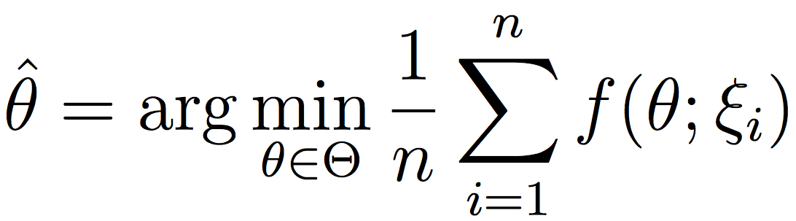
Convex Optimization
Given dataset D = {ξ₁,..., ξ_{n}}, find model θ∈Θ minimizing average convex loss f(θ; ξ_{n}):
Model | Loss
Linear Regression | Squared | f(θ; (x,y)) = (y – θ^{T}x)²
Logistic Regression | Logistic | f(θ; (x,y)) = log[1 + exp(– yθ^{T}x)]
SVM | Hinge | f(θ; (x,y)) = max(0, 1 – yθ^{T}x)

Slide 11
Stochastic Updates (Meta-)Algorithm
While not converged:
ξ^{(t)} ~ D
θ^{(t)} = Λ(θ^{(t–1),} ξ^{(t)})
Stochastic
Update
Updates Λ sparse
Algorithm
SGD: Stochastic Gradient Descent
SCD: Stochastic Coordinate Descent
AdaGrad / Stochastic Dual Averaging
SDCA: Stochastic Dual Coordinate Ascent
SDNA: Stochastic Dual Newton Ascent
SVRG: Stochastic Variance Reduced Grad
SAGA
Coordination free
[Niu et. al. 2011, Mania et. al. 2015]
[Liu et. al. 2013, Mania et. al. 2015]
[Duchi et. al. 2013]
[Hsieh et. al. 2015]
?
[Reddi et. al. 2015, Mania et. al. 2015]
[Leblond et. al. 2016]
Separate analysis for each algorithm
Unrealistic assumptions
→ Consistent / atomic read & write

Slide 12
Stochastic Updates (Meta-)Algorithm
While not converged:
ξ^{(t)} ~ D
θ^{(t)} = Λ(θ^{(t–1),} ξ^{(t)})
Stochastic
Update
Updates Λ sparse
Algorithm
SGD: Stochastic Gradient Descent
SCD: Stochastic Coordinate Descent
AdaGrad / Stochastic Dual Averaging
SDCA: Stochastic Dual Coordinate Ascent
SDNA: Stochastic Dual Newton Ascent
SVRG: Stochastic Variance Reduced Grad
SAGA
Coordination free
[Niu et. al. 2011, Mania et. al. 2015]
[Liu et. al. 2013, Mania et. al. 2015]
[Duchi et. al. 2013]
[Hsieh et. al. 2015]
?
[Reddi et. al. 2015, Mania et. al. 2015]
[Leblond et. al. 2016]
Serializable
Cyclaδes General framework Same (theoretical) speedup for all algos No extra analysis of correctness / convergence

Slide 13
The Data-point Conflict Graph
Data points /
Updates
Model
1
2
n
1
2
n
An edge between 2 updates if they overlap

Slide 14
The Theorem
[Krivelevich’14]
The Data-point Conflict Graph
= the maximum Degree
1
2
1
2
1
2
sample
C.C.
n
n
n
Thm:
Sample vertices (with/without replacement)
The largest connected component has size
Even if the Graph was a Single Huge Conflict Component!

Slide 15
Sample Batch + Connected Components
Phase 1
sample
C.C.
Sample data points
Compute Conn. Components
NOTE: No conflicts across groups!
Max Conn. Comp = log n ➔ B / log n tiny components
Small Max Conn. Comp
➔ Good load balance
No conflicts across groups
➔ Parallel Stochastic Updates

Slide 16
Sample Batch + Connected Components
Phase 1
sample
C.C.
Allocation
Phase 1I
Core1
Core 2
Core p

Slide 17
Sample Batch + Connected Components
Phase 1
sample
C.C.
Allocation
Phase 1I
Core1
Core 2
Core p

Slide 18
Sample Batch + Connected Components
Phase 1
sample
C.C.
Allocation
Phase 1I
Core1
Core 2
Core p
Asynchronous and Lock-free Stochastic Updates
Phase III
SU
SU
SU
Core1
Core 2
Core p

Slide 19
Sample Batch + Connected Components
Phase 1
Each core runs asynchronously
sample
C.C.
No Memory Locks & No Contention
Allocation
Phase 1I
Access Locality
Core1
Core 2
Core p
Minimal Communication
Read-write once on shared state / batch
Asynchronous and Lock-free Stochastic Updates
Phase III
SU
SU
SU
Core1
Core 2
Core p

Slide 20
Theorems
Correctness: Cyclades is serially equivalent.
Concurrency: Given variable-update graph G with n vertices, E edges
average and max left degree Δ_{L}, δ_{L} such that δ_{L} / Δ_{L} ≤ n^{1/2}
max conflict degree Δ
Then Cyclades with
B = (1 - ε) n / Δ batch size
P = O(nε² / ΔΔ_{L}) cores
can execute n updates in time O(E log² n / P)
Preserves convergence rates
Speedup O(P / log² n)
Black box analysis:
Applies to all stochastic updates algorithms

Slide 21
Experiments
Implementation in C++
Experiments on Intel Xeon CPU E7-8870 v3
1TB RAM
Problem | # data points | dimension
SVRG Graph Eigenvector [Jin et al. 2015] DBLP | 1.4 million | 1.4 million
L2-SGD Matrix Completion [Recht et al. 2011] 10M MovieLens | 10 million | 8 million

Slide 22
Matrix Completion (L2-SGD)
Update:
Problem | # data points | dimension
L2-SGD Mat. Comp. [Recht, Re ‘11] on 10M MovieLens | 10 million | 8 million
> 20% gain

Slide 23
Graph Eigenvector (SVRG)
Update:
Problem | # data points | dimension
SVRG Graph Eigenvector [Jin et al. 2015], on DBLP graph | 1.4 million | 1.4 million
> 2x gain

Slide 24
Matrix Completion, L2-SGD

Slide 25
Graph Eigenvector, SVRG

Slide 26
Least Squares, SAGA

Slide 27
Least Squares, SAGA

Slide 28
Conclusion
Concurrency Control
for Parallel ML
Guarantee correctness
Maximize concurrency
Future Work
Sampling Non-parametric Bayes
Synchronized Distributed Machine Learning
Papers / code available
http://people.eecs.berkeley.edu/~xinghao/
xinghao@berkeley.edu

