Slide 1
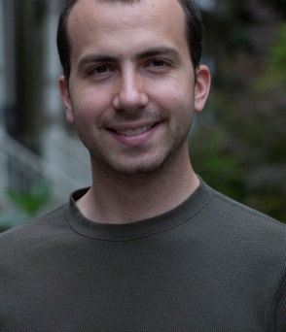



Parallel Gibbs Sampling From Colored Fields to Thin Junction Trees
Joseph Gonzalez
Yucheng Low
Arthur Gretton
Carlos Guestrin

Slide 2
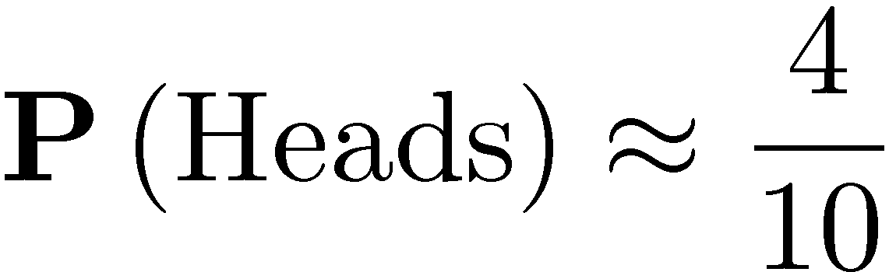
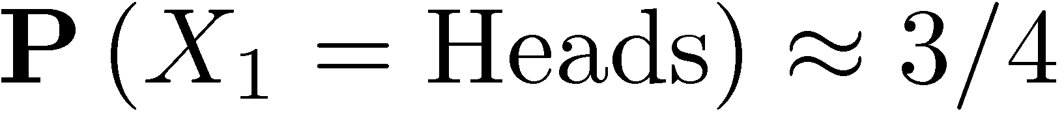
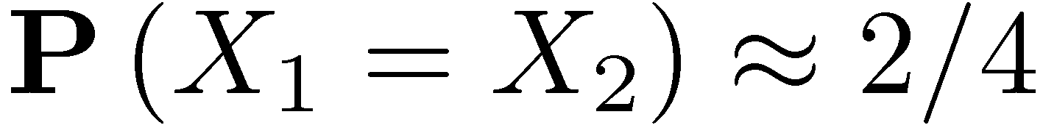
Sampling as an Inference Procedure
Suppose we wanted to know the probability that coin lands “heads”
We use the same idea for graphical model inference
Counts
“Draw
Samples”
4x Heads
6x Tails
X₁
X₂
Inference:
Inference:
X₃
X₄
Graphical
Model
X₅
X₆

Slide 3
Terminology: Graphical Models
Focus on discrete factorized models with sparse structure:
X₁
f_{1,2}
X₂
Factor
Graph
f_{1,3}
f_{2,4}
f_{2,4,5}
X₅
X₃
f_{3,4}
X₄
X₁
X₂
Markov
Random
Field
X₅
X₃
X₄

Slide 4
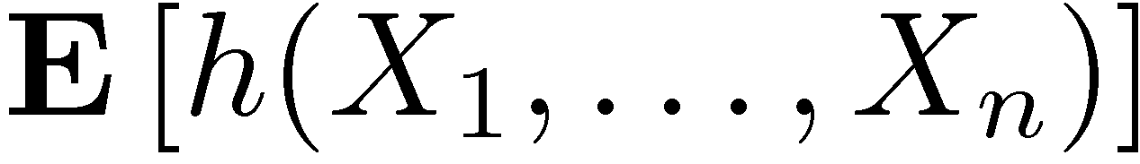
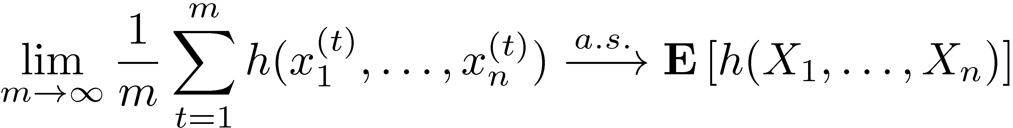
Terminology: Ergodicity
The goal is to estimate:
Example: marginal estimation
If the sampler is ergodic the following is true*:
*Consult your statistician about potential risks before using.

Slide 5
Gibbs Sampling [Geman & Geman, 1984]
Sequentially for each variable in the model
Select variable
Construct conditional given adjacent assignments
Flip coin and update assignment to variable
Initial Assignment

Slide 6
Why Study Parallel Gibbs Sampling?
“The Gibbs sampler ... might be considered the workhorse of the MCMC world.”
–Robert and Casella
Ergodic with geometric convergence
Great for high-dimensional models
No need to tune a joint proposal
Easy to construct algorithmically
WinBUGS
Important Properties that help Parallelization:
Sparse structure ➔ factorized computation

Slide 7
Is the Gibbs Sampler trivially parallel?

Slide 8

From the original paper on Gibbs Sampling:
“…the MRF can be divided into collections of [variables] with each collection assigned to an independently running asynchronous processor.”
-- Stuart and Donald Geman, 1984.
Converges to the wrong distribution!

Slide 9
The problem with Synchronous Gibbs
t=1
t=2
t=3
Strong Positive
Correlation
t=0
Sequential
Execution
Strong Positive
Correlation
Heads:
Tails:
Strong Negative
Correlation
Parallel
Execution
Adjacent variables cannot be sampled simultaneously.

Slide 10

How has the machine learning community solved this problem?

Slide 11
Two Decades later
Newman et al., Scalable Parallel Topic Models. Jnl. Intelligen. Comm. R&D, 2006.
Newman et al., Distributed Inference for Latent Dirichlet Allocation. NIPS, 2007.
Asuncion et al., Asynchronous Distributed Learning of Topic Models. NIPS, 2008.
Doshi-Velez et al., Large Scale Nonparametric Bayesian Inference: Data Parallelization in the Indian Buffet Process. NIPS 2009
Yan et al., Parallel Inference for Latent Dirichlet Allocation on GPUs. NIPS, 2009.
Same problem as the original Geman paper
Parallel version of the sampler is not ergodic.
Unlike Geman, the recent work:
Recognizes the issue
Ignores the issue
Propose an “approximate” solution

Slide 12
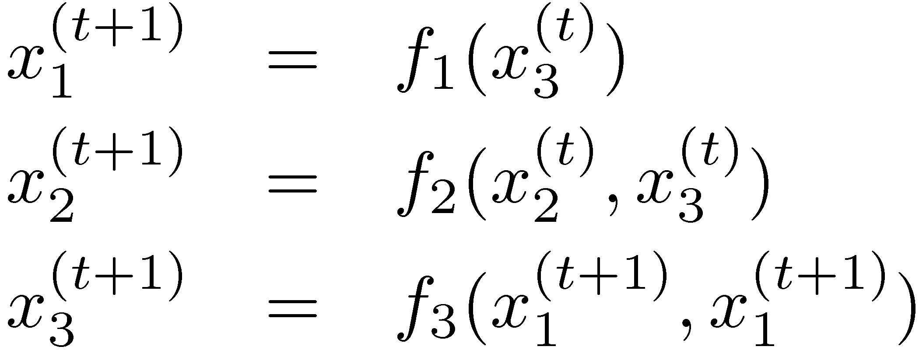
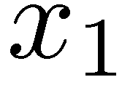
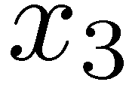
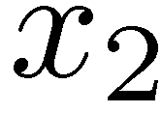
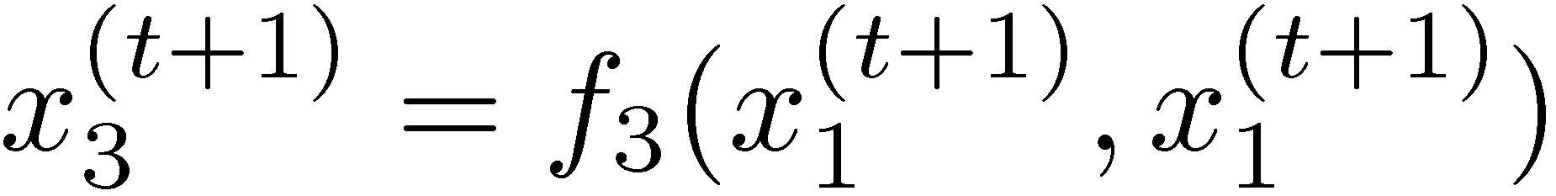
Two Decades Ago
Parallel computing community studied:
Sequential Algorithm
Directed Acyclic Dependency Graph
Time
Construct an Equivalent Parallel Algorithm
Using
Graph Coloring

Slide 13
Chromatic Sampler
Compute a k-coloring of the graphical model
Sample all variables with same color in parallel
Sequential Consistency:
Time

Slide 14
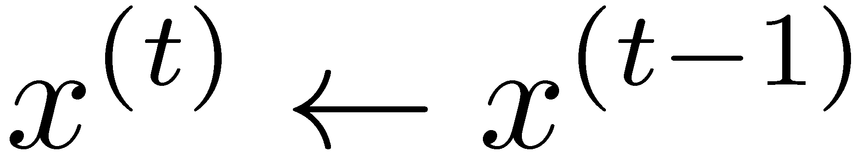
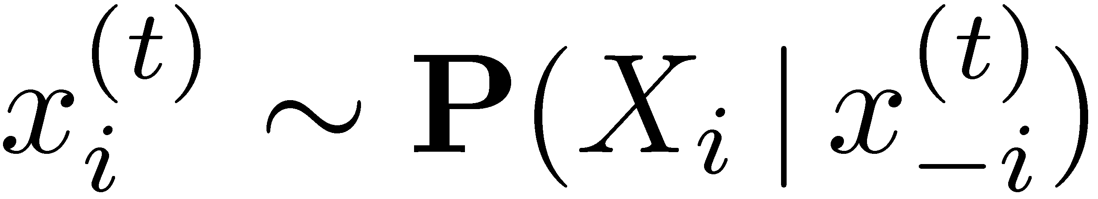
Chromatic Sampler Algorithm
For t from 1 to T do
For k from 1 to K do
Parfor i in color k:

Slide 15
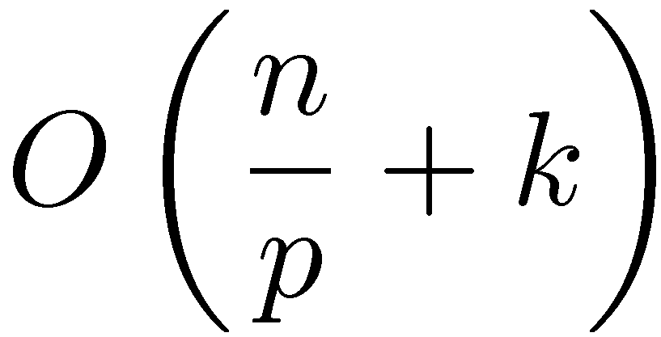
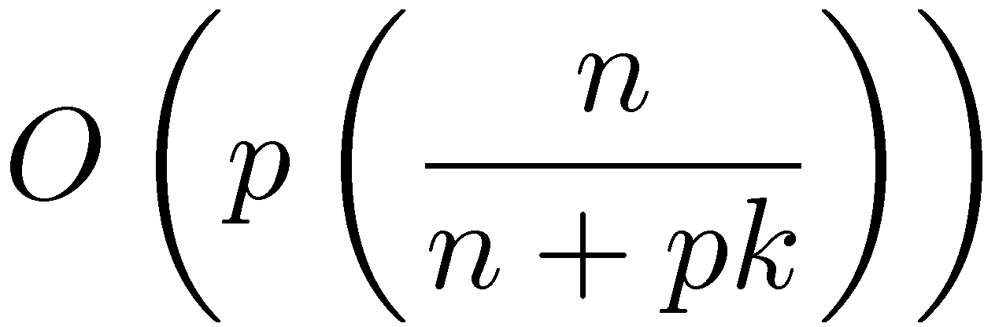

Asymptotic Properties
Quantifiable acceleration in mixing
Speedup:
Time to update all variables once
# Variables
# Colors
# Processors
Penalty Term

Slide 16
Proof of Ergodicity
Version 1 (Sequential Consistency):
Chromatic Gibbs Sampler is equivalent to a Sequential Scan Gibbs Sampler
Version 2 (Probabilistic Interpretation):
Variables in same color are Conditionally Independent ➔
Joint Sample is equivalent to Parallel Independent Samples
Time

Slide 17
Special Properties of 2-Colorable Models
Many common models have two colorings
For the [Incorrect] Synchronous Gibbs Samplers
Provide a method to correct the chains
Derive the stationary distribution

Slide 18
Correcting the Synchronous Gibbs Sampler
t=0
t=1
t=2
t=3
t=4
Invalid
Sequence
Strong Positive
Correlation
We can derive two valid chains:
t=0
t=1
t=2
t=3
t=4
t=5

Slide 19
Correcting the Synchronous Gibbs Sampler
t=0
t=1
t=2
t=3
t=4
Invalid
Sequence
Strong Positive
Correlation
We can derive two valid chains:
Chain 1
Converges to the Correct Distribution
Chain 2

Slide 20
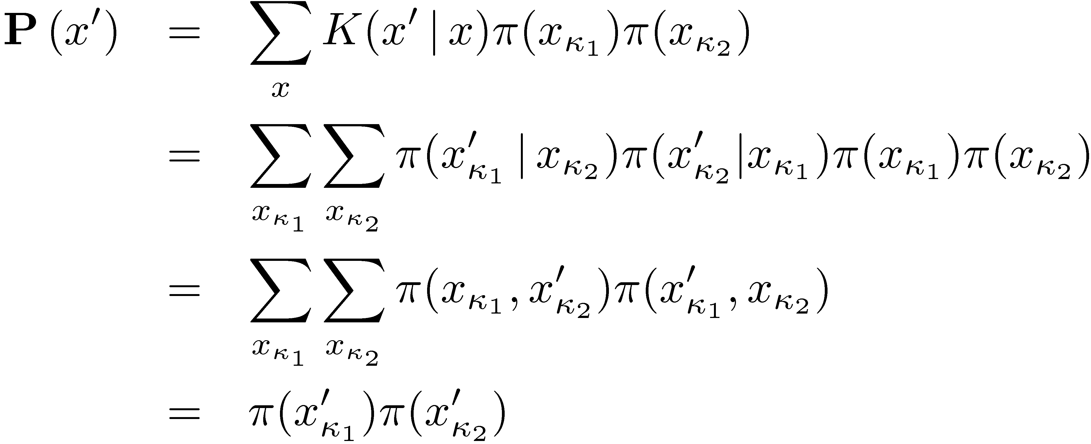
Theoretical Contributions on 2-colorable models
Stationary distribution of Synchronous Gibbs:
Variables in Color 1
Variables in Color 2

Slide 21
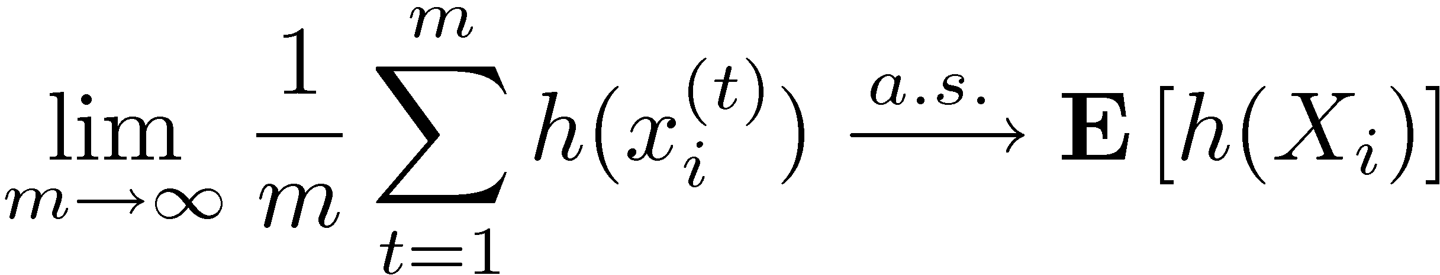
Theoretical Contributions on 2-colorable models
Stationary distribution of Synchronous Gibbs
Corollary: Synchronous Gibbs sampler is correct for single variable marginals.
Variables in Color 1
Variables in Color 2

Slide 22
From Colored Fields to Thin Junction Trees
Slowly Mixing Models
?
Chromatic Gibbs Sampler
Ideal for:
Rapid mixing models
Conditional structure does not admit Splash
Splash Gibbs Sampler
Ideal for:
Slowly mixing models
Conditional structure admits Splash
Discrete models

Slide 23
Models With Strong Dependencies
Single variable Gibbs updates tend to mix slowly:
Ideally we would like to draw joint samples.
Blocking
X₂
X₁
Single site changes move slowly with strong correlation.

Slide 24
Blocking Gibbs Sampler
Based on the papers:
Jensen et al., Blocking Gibbs Sampling for Linkage Analysis in Large Pedigrees with Many Loops. TR 1996
Hamze et al., From Fields to Trees. UAI 2004.

Slide 25
An asynchronous Gibbs Sampler that adaptively addresses strong dependencies.
Splash Gibbs Sampler

Slide 26
Splash Gibbs Sampler
Step 1: Grow multiple Splashes in parallel:
Conditionally Independent

Slide 27
Splash Gibbs Sampler
Step 1: Grow multiple Splashes in parallel:
Tree-width = 1
Conditionally Independent

Slide 28
Splash Gibbs Sampler
Step 1: Grow multiple Splashes in parallel:
Tree-width = 2
Conditionally Independent

Slide 29
Splash Gibbs Sampler
Step 2: Calibrate the trees in parallel

Slide 30
Splash Gibbs Sampler
Step 3: Sample trees in parallel

Slide 31
Higher Treewidth Splashes
Recall:
Tree-width = 2
Junction Trees

Slide 32
Junction Trees
Data structure used for exact inference in loopy graphical models
f_{AB}
A
f_{AB}
B
A
B
D
f_{AD}
f_{AD}
f_{BC}
f_{BC}
B
C
D
D
f_{CD}
C
f_{CD}
f_{DE}
f_{CE}
f_{DE}
C
D
E
E
f_{CE}
Tree-width = 2

Slide 33
Splash Thin Junction Tree
Parallel Splash Junction Tree Algorithm
Construct multiple conditionally independent thin (bounded treewidth) junction trees Splashes
Sequential junction tree extension
Calibrate the each thin junction tree in parallel
Parallel belief propagation
Exact backward sampling
Parallel exact sampling

Slide 34
Splash generation
Frontier extension algorithm:
Markov Random Field
Corresponding Junction tree
A
A

Slide 35
Splash generation
Frontier extension algorithm:
Markov Random Field
Corresponding Junction tree
A B
B
A

Slide 36
Splash generation
Frontier extension algorithm:
Markov Random Field
Corresponding Junction tree
A B
B C
C
B
A

Slide 37
Splash generation
Frontier extension algorithm:
Markov Random Field
Corresponding Junction tree
A B D
B C D
C
B
D
A

Slide 38
Splash generation
Frontier extension algorithm:
Markov Random Field
Corresponding Junction tree
A B D
B C D
C
B
A D E
D
A
E

Slide 39
Splash generation
Frontier extension algorithm:
Markov Random Field
Corresponding Junction tree
A B D
B C D
C
B
A D E
A E F
D
A
E
F

Slide 40
Splash generation
Frontier extension algorithm:
Markov Random Field
Corresponding Junction tree
A B D
B C D
C
B
A D E
A E F
D
A
G
E
F
A G

Slide 41
Splash generation
Frontier extension algorithm:
Markov Random Field
Corresponding Junction tree
A B D
B C D
C
B
H
A D E
A E F
D
A
G
E
F
A G
B G H

Slide 42
Splash generation
Frontier extension algorithm:
Markov Random Field
Corresponding Junction tree
A B D
B C D
C
B
H
A B D E
A B E F
D
A
G
E
F
A B G
B G H

Slide 43
Splash generation
Frontier extension algorithm:
Markov Random Field
Corresponding Junction tree
A B D
B C D
C
B
H
A D E
A E F
D
A
G
E
F
A G

Slide 44
Splash generation
Frontier extension algorithm:
Markov Random Field
Corresponding Junction tree
A B D
B C D
C
B
H
A D E
A E F
I
D
A
G
E
F
D I
A G

Slide 45
Splash generation
Challenge:
Efficiently reject vertices that violate treewidth constraint
Efficiently extend the junction tree
Choosing the next vertex
Solution Splash Junction Trees:
Variable elimination with reverse visit ordering
I,G,F,E,D,C,B,A
Add new clique and update RIP
If a clique is created which exceeds treewidth terminate extension
Adaptive prioritize boundary
C
B
H
I
D
A
G
E
F

Slide 46
Incremental Junction Trees
First 3 Rounds:
1
2
3
1
2
3
1
2
3
4
5
6
4
5
6
4
5
6
Junction Tree:
4
4
4,5
4
4,5
2,5
Elim. Order:
{4}
{5,4}
{2,5,4}

Slide 47
Incremental Junction Trees
Result of third round:
Fourth round:
1
2
3
{2,5,4}
4
4,5
2,5
4
5
6
4
4
1
2
3
Fix RIP
4,5
4,5
4
5
6
{1,2,5,4}
2,5
1,2,4
2,4,5
1,2,4

Slide 48
Incremental Junction Trees
Results from 4th round:
5th Round:
4
1
2
3
{1,2,5,4}
4,5
4
5
6
2,4,5
1,2,4
4
{6,1,2,5,4}
1
2
3
4,5
5,6
4
5
6
2,4,5
1,2,4

Slide 49
Incremental Junction Trees
Results from 5th round:
6th Round:
4
{6,1,2,5,4}
1
2
3
4,5
5,6
4
5
6
2,4,5
1,2,4
4
1,2,3, 6
1
2
3
{3,6,1,2,5,4}
4,5
5,6
4
5
6
2,4,5
1,2,4

Slide 50
Incremental Junction Trees
Finishing 6th round:
4
1,2,3, 6
1
2
3
{3,6,1,2,5,4}
4,5
5,6
4
5
6
2,4,5
1,2,4
4
1,2,3,6
4
1,2,3,6
4
1,2,3,6
4,5
1,2,5,6
4,5
1,2,5,6
4,5
1,2,5,6
2,4,5
1,2,4
2,4,5
1,2,4
2,4,5
1,2,4,5

Slide 51
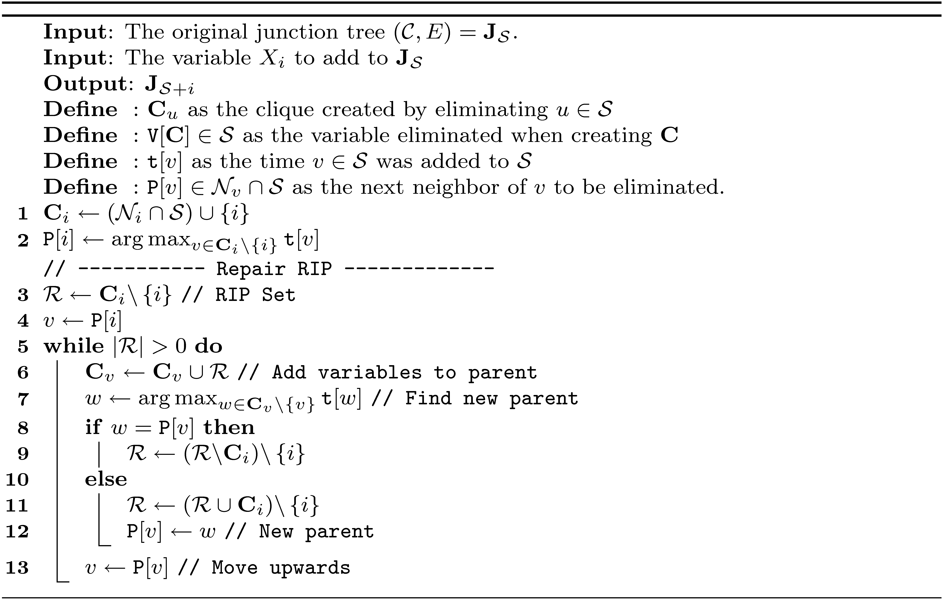
Algorithm Block [Skip]
Finishing 6th round:

Slide 52
Splash generation
Challenge:
Efficiently reject vertices that violate treewidth constraint
Efficiently extend the junction tree
Choosing the next vertex
Solution Splash Junction Trees:
Variable elimination with reverse visit ordering
I,G,F,E,D,C,B,A
Add new clique and update RIP
If a clique is created which exceeds treewidth terminate extension
Adaptive prioritize boundary
C
B
H
I
D
A
G
E
F

Slide 53
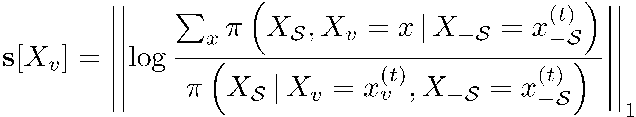
Adaptive Vertex Priorities
Assign priorities to boundary vertices:
Can be computed using only factors that depend on X_{v}
Based on current sample
Captures difference between marginalizing out the variable (in Splash) fixing its assignment (out of Splash)
Exponential in treewidth
Could consider other metrics …

Slide 54

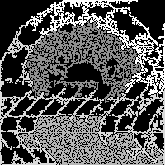

Adaptively Prioritized Splashes
Adapt the shape of the Splash to span strongly coupled variables:
Provably converges to the correct distribution
Requires vanishing adaptation
Identify a bug in the Levine & Casella seminal work in adaptive random scan
Noisy Image
BFS Splashes
Adaptive Splashes

Slide 55
Experiments
Implemented using GraphLab
Treewidth = 1 :
Parallel tree construction, calibration, and sampling
No incremental junction trees needed
Treewidth > 1 :
Sequential tree construction (use multiple Splashes)
Parallel calibration and sampling
Requires incremental junction trees
Relies heavily on:
Edge consistency model to prove ergodicity
FIFO/ Prioritized scheduling to construct Splashes
Evaluated on 32 core Nehalem Server

Slide 56
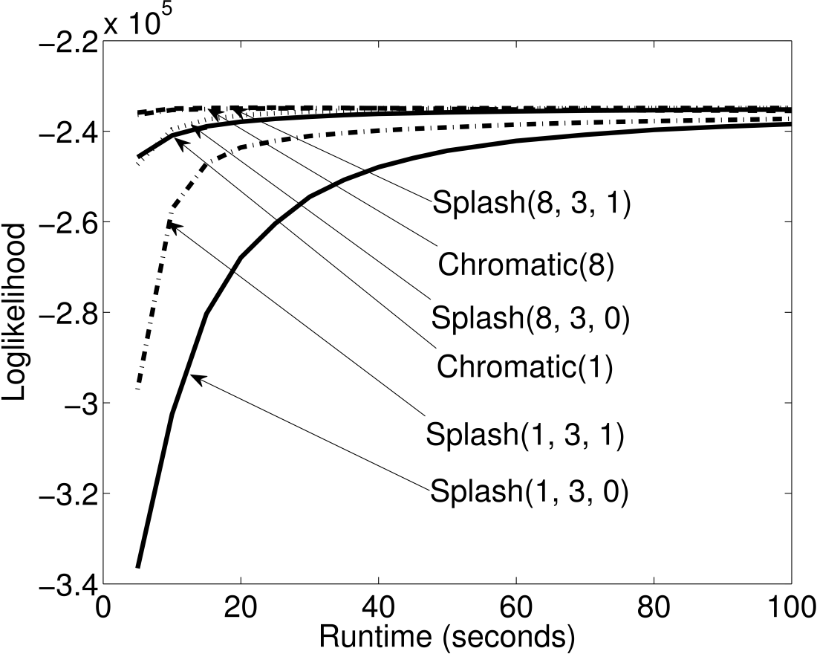
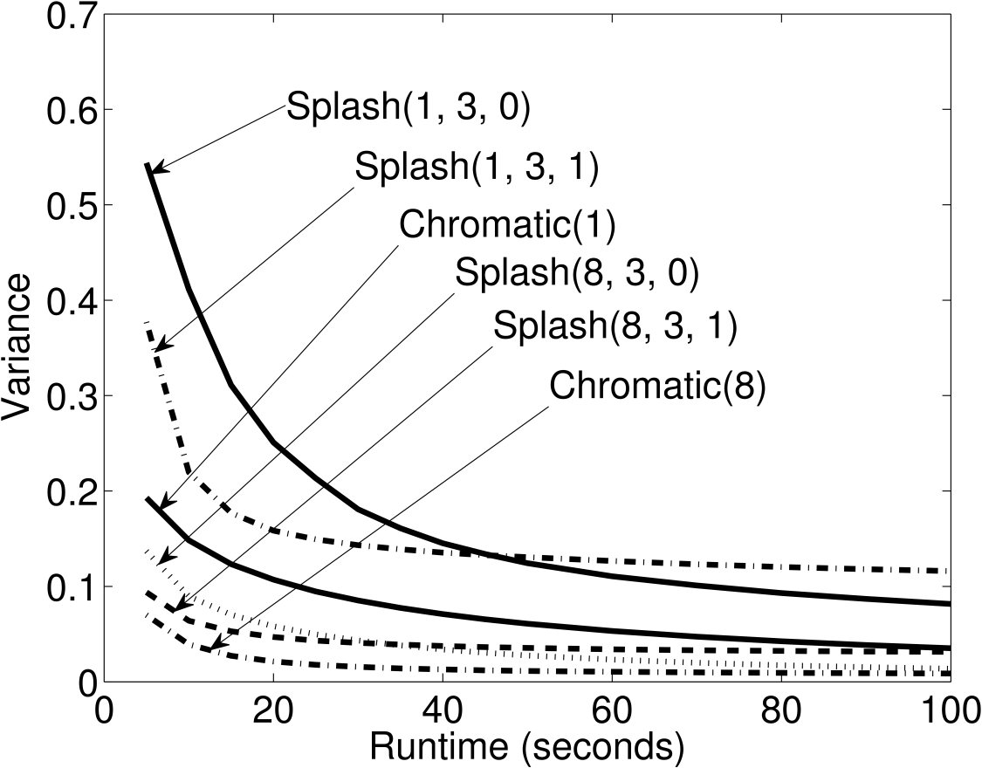
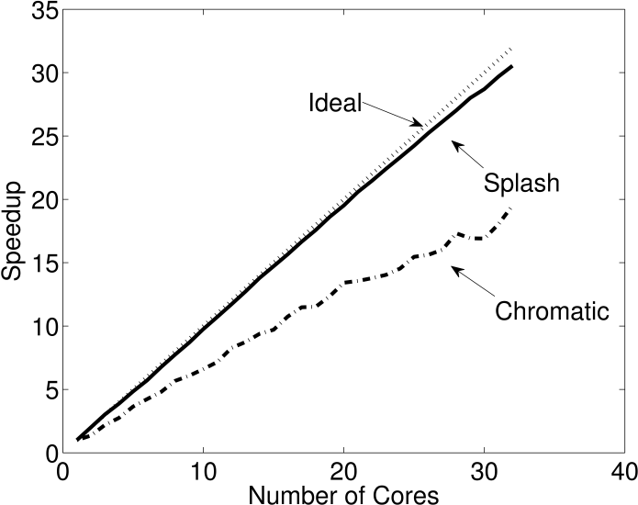
Rapidly Mixing Model
Grid MRF with weak attractive potentials
40K Variables 80K Factors
The Chromatic sampler slightly outperforms the Splash Sampler
Likelihood
Final Sample
“Mixing”
Speedup

Slide 57
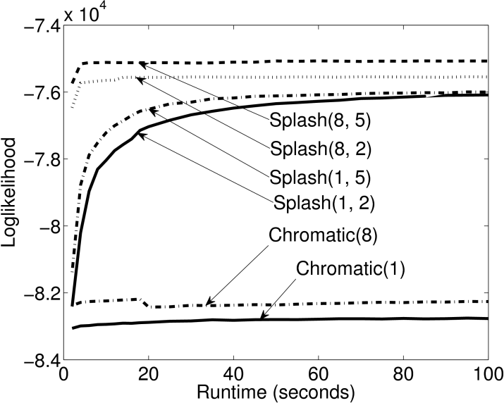
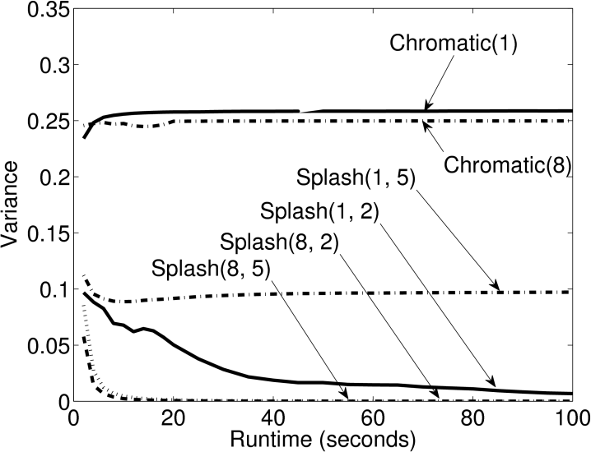
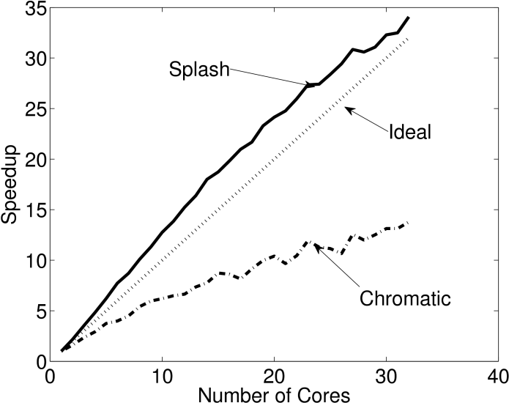
Slowly Mixing Model
Markov logic network with strong dependencies
10K Variables 28K Factors
The Splash sampler outperforms the Chromatic sampler on models with strong dependencies
Likelihood
Final Sample
Speedup in Sample Generation
“Mixing”

Slide 58
Conclusion
Chromatic Gibbs sampler for models with weak dependencies
Converges to the correct distribution
Quantifiable improvement in mixing
Theoretical analysis of the Synchronous Gibbs sampler on 2-colorable models
Proved marginal convergence on 2-colorable models
Splash Gibbs sampler for models with strong dependencies
Adaptive asynchronous tree construction
Experimental evaluation demonstrates an improvement in mixing

Slide 59
Future Work
Extend Splash algorithm to models with continuous variables
Requires continuous junction trees (Kernel BP)
Consider “freezing” the junction tree set
Reduce the cost of tree generation?
Develop better adaptation heuristics
Eliminate the need for vanishing adaptation?
Challenges of Gibbs sampling in high-coloring models
Collapsed LDA
High dimensional pseudorandom numbers
Not currently addressed in the MCMC literature

