Slide 1
Parallel Splash Belief Propagation
Joseph E. Gonzalez
Yucheng Low
Carlos Guestrin
David O’Hallaron
Computers which worked on this project:
BigBro1, BigBro2, BigBro3, BigBro4, BigBro5, BigBro6, BiggerBro, BigBroFS
Tashish01, Tashi02, Tashi03, Tashi04, Tashi05, Tashi06, …, Tashi30,
parallel, gs6167, koobcam (helped with writing)
TexPoint fonts used in EMF.
Read the TexPoint manual before you delete this box.: AAAAAAAAAAA
Notes:
Thank you. This is joint work with Yucheng Low, Carlos Guestrin, and David OHallaron

Slide 2
Change in the Foundation of ML
Future Parallel Performance
Why talk about parallelism now?
Past Sequential Performance
Log(Speed in GHz)
Future Sequential
Performance
Release Date
Notes:
The sequential performance of processors has been growing exponentially
Enabled us to build increasing complex machine learning techniques and still have then run in the same time
Recently processor manufacturers transitioned to exponentially increasing parallelism

Slide 3
Why is this a Problem?
Want to be
here
Nearest Neighbor
[Google et al.]
Basic Regression
[Cheng et al.]
Parallelism
Support Vector Machines
[Graf et al.]
Graphical Models
[Mendiburu et al.]
Sophistication

Slide 4
Why is it hard?
Algorithmic Efficiency
Parallel Efficiency
Eliminate wasted
computation
Expose independent
computation
Implementation
Efficiency
Map computation to
real hardware

Slide 5
The Key Insight
Statistical Structure
Computational Structure
Parallel Structure
Graphical Model Structure
Graphical Model Parameters
Chains of Computational Dependences
Decay of Influence
Parallel Dynamic Scheduling
State Partitioning for Distributed Computation

Slide 6
The Result
Splash Belief Propagation
Goal
Nearest Neighbor
[Google et al.]
Basic Regression
[Cheng et al.]
Parallelism
Support Vector Machines
[Graf et al.]
Graphical Models
[Mendiburu et al.]
Graphical Models
[Gonzalez et al.]
Sophistication

Slide 7
Outline
Overview
Graphical Models: Statistical Structure
Inference: Computational Structure
τ_{ε} - Approximate Messages: Statistical Structure
Parallel Splash
Dynamic Scheduling
Partitioning
Experimental Results
Conclusions

Slide 8
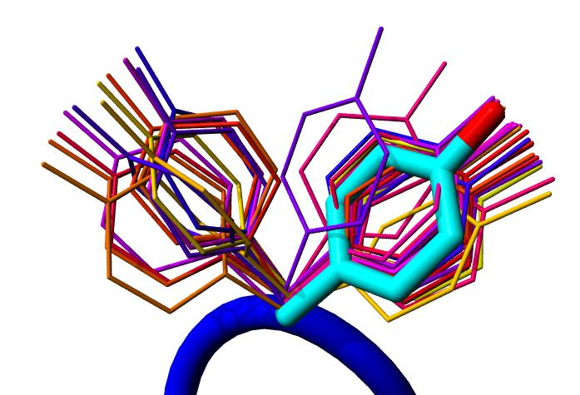

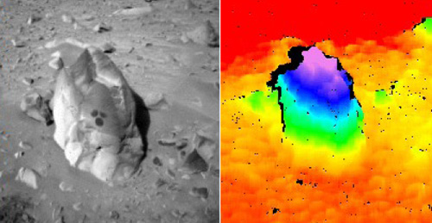
Graphical Models and Parallelism
Graphical models provide a common language for general purpose parallel algorithms in machine learning
A parallel inference algorithm would improve:
Protein Structure Prediction
Movie Recommendation
Computer Vision
Inference is a key step in Learning Graphical Models
Notes:
Ideally, we would like to make a large portion of machine learning run in parallel using only a few parallel algorithms.
Graphical models provide a common language for general purpose parallel algorithms in machine learning. By developing a general purpose parallel inference algorithm we can bring parallelism to tasks ranging from protein structure prediction to robotic SLAM and computer vision.
In this work we focus on approximate inference in factor graphs. <click>

Slide 9
Overview of Graphical Models
Graphical represent of local statistical dependencies
Observed Random Variables
Noisy Picture
“True” Pixel Values
Continuity Assumptions
Latent Pixel Variables
Local Dependencies
Inference
What is the probability
that this pixel is black?

Slide 10
Synthetic Noisy Image Problem
Noisy Image
Predicted Image
Overlapping Gaussian noise
Assess convergence and accuracy

Slide 11
Protein Side-Chain Prediction
Model side-chain interactions as a graphical model
Inference
What is the most likely orientation?
Side-Chain
Side-Chain
Side-Chain
Protein Backbone
Side-Chain
Side-Chain

Slide 12
Protein Side-Chain Prediction
276 Protein Networks:
Approximately:
700 Variables
1600 Factors
70 Discrete orientations
Strong Factors
Side-Chain
Side-Chain
Side-Chain
Protein Backbone
Side-Chain
Side-Chain

Slide 13
Markov Logic Networks
Represent Logic as a graphical model
A: Alice
B: Bob
Friends(A,B)
True/False?
Smokes(A)
Friends(A,B) And Smokes(A)
➔ Smokes(B)
Smokes(B)
Smokes(A) ➔ Cancer(A)
Smokes(B) ➔ Cancer(B)
Inference
Pr(Cancer(B) = True |
Smokes(A) = True & Friends(A,B) = True) = ?
Cancer(A)
Cancer(B)

Slide 14
Markov Logic Networks
UW-Systems Model
8K Binary Variables
406K Factors
Irregular degree distribution:
Some vertices with high degree
A: Alice
B: Bob
Friends(A,B)
True/False?
Smokes(A)
Friends(A,B) And Smokes(A)
➔ Smokes(B)
Smokes(B)
Smokes(A) ➔ Cancer(A)
Smokes(B) ➔ Cancer(B)
Cancer(A)
Cancer(B)

Slide 15
Outline
Overview
Graphical Models: Statistical Structure
Inference: Computational Structure
τ_{ε} - Approximate Messages: Statistical Structure
Parallel Splash
Dynamic Scheduling
Partitioning
Experimental Results
Conclusions

Slide 16
The Inference Problem
What is the probability
that Bob Smokes given
Alice Smokes?
What is the best
configuration of the
protein side-chains?
A: Alice
B: Bob
Friends(A,B)
True/False?
Side-Chain
Side-Chain
Smokes(A)
Friends(A,B) And Smokes(A)
➔ Smokes(B)
Smokes(B)
Side-Chain
Protein Backbone
Smokes(A) ➔ Cancer(A)
Smokes(B) ➔ Cancer(B)
Side-Chain
Side-Chain
Cancer(A)
Cancer(B)
What is the probability
that each pixel is black?
NP-Hard in General
Approximate Inference:
Belief Propagation

Slide 17
Belief Propagation (BP)
Iterative message passing algorithm
Naturally Parallel Algorithm
Notes:
Belief propagation is a message passing algorithm in which messages are sent <click> from variable to factor and then <click> from factor to variable and the processes is repeated. At each phase the new messages are computed using the old message from the previous phase leading to a naturally parallel algorithm known as synchronous Belief Propagation.

Slide 18
Parallel Synchronous BP
Given the old messages all new messages can be computed in parallel:
Old
Messages
CPU 1
New
Messages
CPU 2
CPU 3
CPU n
Map-Reduce Ready!
Notes:
The standard parallelization of synchronous belief propagation is the following. Given all the old messages <click> each new message is computed in parallel on a separate processor. While this may seem like the ideal parallel algorithm, we can show that there is a hidden sequential structure in the inference problem which makes this algorithm highly inefficient.

Slide 19
Sequential Computational Structure
Notes:
Consider the following cyclic factor graph. For simplicity lets collapse <click> the factors the edges. Although this model is highly cyclic, hidden in the structure and factors <click> is a sequential path or backbone of strong dependences among the variables. <click>

Slide 20
Hidden Sequential Structure
Notes:
This hidden sequential structure takes the form of the standard chain graphical model. Lets see how the naturally parallel algorithm performs on this chain graphical models <click>.

Slide 21
Hidden Sequential Structure
Evidence
Evidence
Running Time:
Time for a single
parallel iteration
Number of Iterations
Notes:
Suppose we introduce evidence at both ends of the chain. Using 2n processors we can compute one iteration of messages entirely in parallel. However notice that after two iterations of parallel message computations the evidence on opposite ends has only traveled two vertices. It will take n parallel iterations for the evidence to cross the graph.
<click> Therefore, using p processors it will take 2n / p time to complete a single iteration and so it will take 2n^2/p time to compute the exact marginals.
We might now ask “what is the optimal sequential running time on the chain.”

Slide 22
Optimal Sequential Algorithm
Running
Time
Naturally Parallel
2n²/p
Gap
p ≤ 2n
Forward-Backward
2n
p = 1
Optimal Parallel
n
p = 2
Notes:
Using p processors we obtain a running time of 2n^2/p.
Meanwhile <click> using a single processor the optimal message scheduling is the standard Forward-Backward schedule in which we sequentially pass messages forward and then backward along the chain. The running time of this algorithm is 2n, linear in the number of variables.
Surprisingly, for any constant number of processors the naturally parallel algorithm is actually slower than the single processor sequential algorithm. In fact, we need the number of processors to grow linearly with the number of elements to recover the original sequential running time.
Meanwhile, <click> the optimal parallel scheduling for the chain graphical model is to calculate the forward messages on one processor and the backward messages on a second processor resulting in <click> a factor of two speedup over the optimal sequential algorithm.
Unfortunately, we cannot use additional processors to further improve performance without abandoning the belief propagation framework.
However, by introducing slight approximation, we can increase the available parallelism in chain graphical models. <click>

Slide 23
Key Computational Structure
Running
Time
Naturally Parallel
2n²/p
p ≤ 2n
Gap
Inherent Sequential Structure
Requires Efficient Scheduling
Optimal Parallel
n
p = 2
Notes:
Using p processors we obtain a running time of 2n^2/p.
Meanwhile <click> using a single processor the optimal message scheduling is the standard Forward-Backward schedule in which we sequentially pass messages forward and then backward along the chain. The running time of this algorithm is 2n, linear in the number of variables.
Surprisingly, for any constant number of processors the naturally parallel algorithm is actually slower than the single processor sequential algorithm. In fact, we need the number of processors to grow linearly with the number of elements to recover the original sequential running time.
Meanwhile, <click> the optimal parallel scheduling for the chain graphical model is to calculate the forward messages on one processor and the backward messages on a second processor resulting in <click> a factor of two speedup over the optimal sequential algorithm.
Unfortunately, we cannot use additional processors to further improve performance without abandoning the belief propagation framework.
However, by introducing slight approximation, we can increase the available parallelism in chain graphical models. <click>

Slide 24
Outline
Overview
Graphical Models: Statistical Structure
Inference: Computational Structure
τ_{ε} - Approximate Messages: Statistical Structure
Parallel Splash
Dynamic Scheduling
Partitioning
Experimental Results
Conclusions

Slide 25
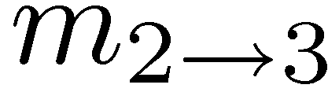
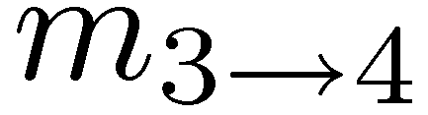
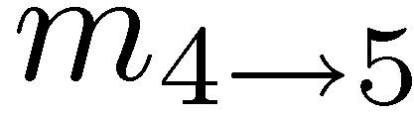
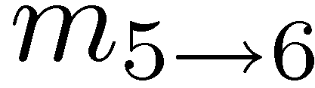
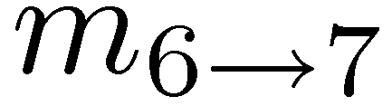
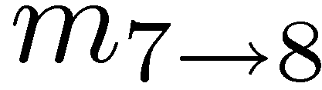
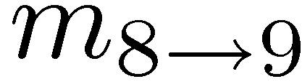
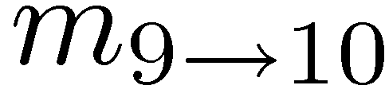
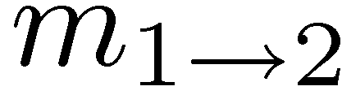
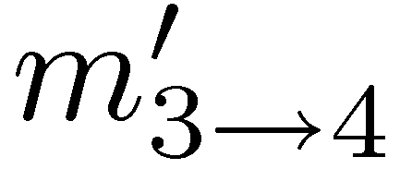
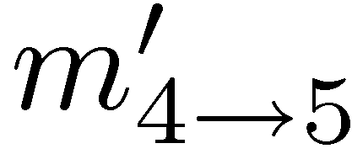
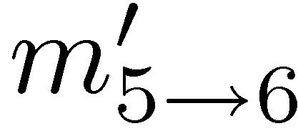
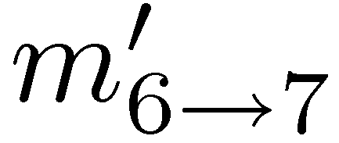
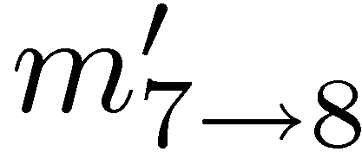
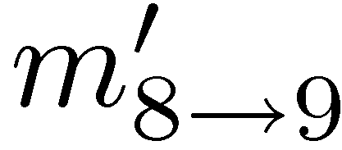
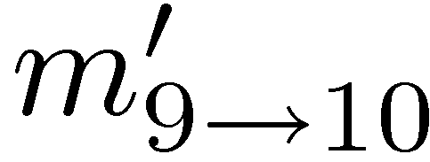
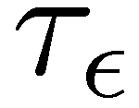
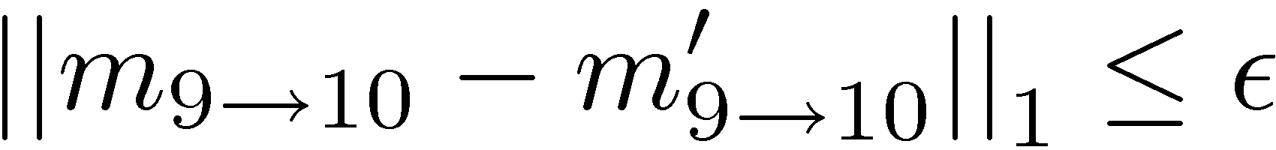
Parallelism by Approximation
True Messages
1
2
3
4
5
6
7
8
9
10
τ_{ε} -Approximation
τ_{ε} represents the minimal sequential structure
1
Notes:
Consider <click> the following sequence of messages passed sequentially from vertex 1 to 10 forming a complete forward pass. Suppose instead of sending the correct message from vertex 3 to vertex 4 <click>, I instead send a fixed uniform message from 3 to 4. If I then compute the new forward pass starting at vertex 4 <click> I might find in practice that the message that arrives at 10 <click> is almost identical to the original message. More precisely, for a fixed level of error epsilon there is some effective sequential distance tau-epsilon for which I must sequentially compute messages. Essentially, tau-epsilon represents the length of the hidden sequential structure and is a function of the factors.
Now I present an efficient parallel scheduling which can compute approximate marginals for all variables and for which we obtain greater than a factor of 2 speedup for smaller tau_epsilon.

Slide 26
Tau-Epsilon Structure
Often τ_{ε} decreases quickly:
Protein Networks
Message Approximation Error
in Log Scale
Markov Logic
Networks

Slide 27
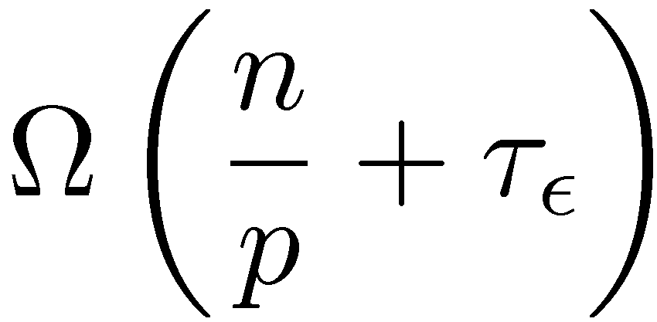
Running Time Lower Bound
Theorem:
Using p processors it is not possible to obtain a τ_{ε} approximation in time less than:
Parallel
Component
Sequential
Component

Slide 28
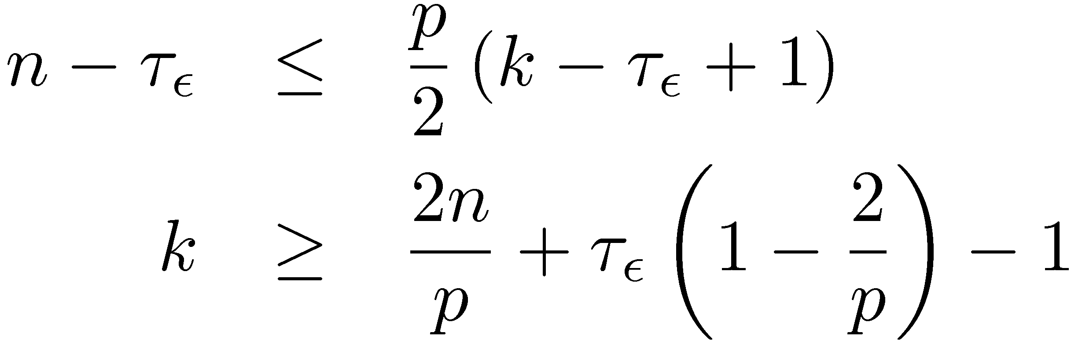
Proof: Running Time Lower Bound
Consider one direction using p/2 processors (p≥2):
τ_{ε}
n - τ_{ε}
1
…
n
τ_{ε}
τ_{ε}
τ_{ε}
τ_{ε}
τ_{ε}
τ_{ε}
τ_{ε}
We must make n - τ_{ε} vertices τ_{ε} left-aware
A single processor can only make k-τ_{ε} +1 vertices left aware in k-iterations

Slide 29
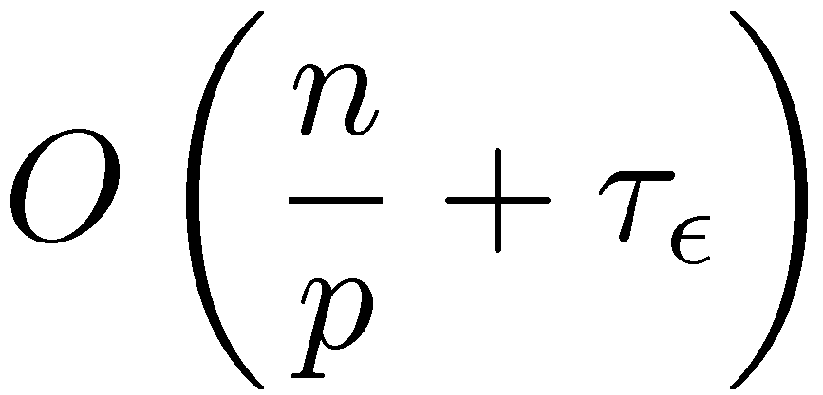
Optimal Parallel Scheduling
Processor 1
Processor 2
Processor 3
Theorem:
Using p processors this algorithm achieves a τ_{ε} approximation in time:
Notes:
We begin by evenly partitioning the chain over the processors <click> and selecting a center vertex or root for each partition. Then in parallel each processor sequentially computes messages inward to its center vertex forming forward pass. Then in parallel <click> each processor sequentially computes messages outwards forming the backwards pass. Finally each processor transmits <click> the newly computed boundary messages to the neighboring processors. In AIStats 09 we demonstrated that this algorithm is optimal for any given \epsilon. The running time of this new algorithm <click> isolates the parallel and sequential structure. Finally if we compare the running time of the optimal algorithm with that of the original naturally parallel algorithm <click> we see that the naturally parallel algorithm retains the multiplicative dependence on the hidden sequential component while the optimal algorithm has only an additive dependence on the sequential component.
Now I will show how to generalize this idea to arbitrary cyclic factor graphs in a way that retains optimality for chains.

Slide 30
Proof: Optimal Parallel Scheduling
All vertices are left-aware of the left most vertex on their processor
After exchanging messages
After next iteration:
After k parallel iterations each vertex is (k-1)(n/p) left-aware
Notes:
We begin by evenly partitioning the chain over the processors <click> and selecting a center vertex or root for each partition. Then in parallel each processor sequentially computes messages inward to its center vertex forming forward pass. Then in parallel <click> each processor sequentially computes messages outwards forming the backwards pass. Finally each processor transmits <click> the newly computed boundary messages to the neighboring processors. In AIStats 09 we demonstrated that this algorithm is optimal for any given \epsilon. The running time of this new algorithm <click> isolates the parallel and sequential structure. Finally if we compare the running time of the optimal algorithm with that of the original naturally parallel algorithm <click> we see that the naturally parallel algorithm retains the multiplicative dependence on the hidden sequential component while the optimal algorithm has only an additive dependence on the sequential component.
Now I will show how to generalize this idea to arbitrary cyclic factor graphs in a way that retains optimality for chains.

Slide 31
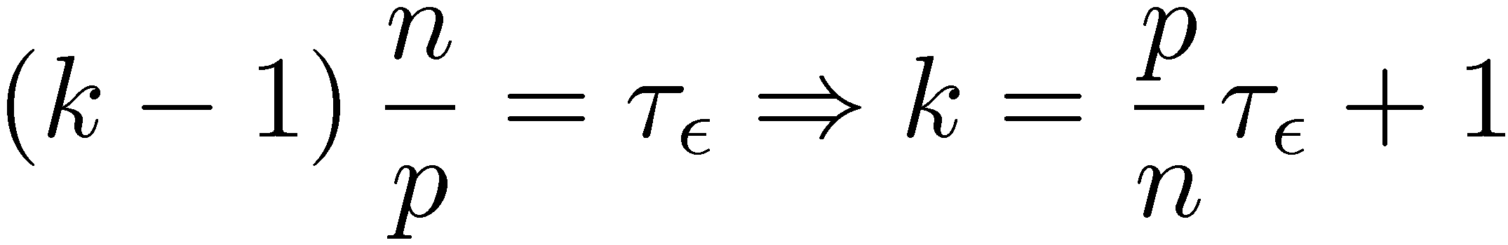
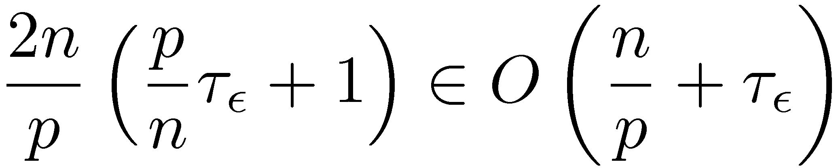
Proof: Optimal Parallel Scheduling
After k parallel iterations each vertex is (k-1)(n/p) left-aware
Since all vertices must be made τ_{ε} left aware:
Each iteration takes O(n/p) time:
Notes:
We begin by evenly partitioning the chain over the processors <click> and selecting a center vertex or root for each partition. Then in parallel each processor sequentially computes messages inward to its center vertex forming forward pass. Then in parallel <click> each processor sequentially computes messages outwards forming the backwards pass. Finally each processor transmits <click> the newly computed boundary messages to the neighboring processors. In AIStats 09 we demonstrated that this algorithm is optimal for any given \epsilon. The running time of this new algorithm <click> isolates the parallel and sequential structure. Finally if we compare the running time of the optimal algorithm with that of the original naturally parallel algorithm <click> we see that the naturally parallel algorithm retains the multiplicative dependence on the hidden sequential component while the optimal algorithm has only an additive dependence on the sequential component.
Now I will show how to generalize this idea to arbitrary cyclic factor graphs in a way that retains optimality for chains.

Slide 32
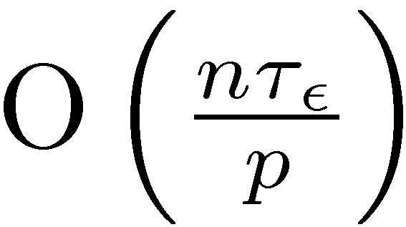
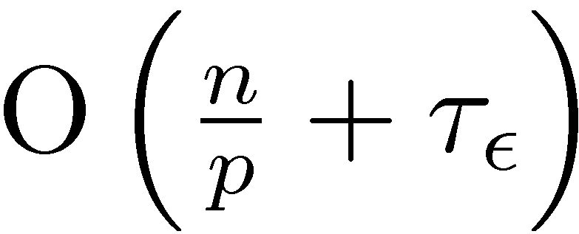
Comparing with SynchronousBP
Processor 1
Processor 2
Processor 3
Synchronous Schedule
Optimal Schedule
Gap
Notes:
We begin by evenly partitioning the chain over the processors <click> and selecting a center vertex or root for each partition. Then in parallel each processor sequentially computes messages inward to its center vertex forming forward pass. Then in parallel <click> each processor sequentially computes messages outwards forming the backwards pass. Finally each processor transmits <click> the newly computed boundary messages to the neighboring processors. In AIStats 09 we demonstrated that this algorithm is optimal for any given \epsilon. The running time of this new algorithm <click> isolates the parallel and sequential structure. Finally if we compare the running time of the optimal algorithm with that of the original naturally parallel algorithm <click> we see that the naturally parallel algorithm retains the multiplicative dependence on the hidden sequential component while the optimal algorithm has only an additive dependence on the sequential component.
Now I will show how to generalize this idea to arbitrary cyclic factor graphs in a way that retains optimality for chains.

Slide 33
Outline
Overview
Graphical Models: Statistical Structure
Inference: Computational Structure
τ_{ε} - Approximate Messages: Statistical Structure
Parallel Splash
Dynamic Scheduling
Partitioning
Experimental Results
Conclusions

Slide 34
The Splash Operation
Generalize the optimal chain algorithm: to arbitrary cyclic graphs:
~
Grow a BFS Spanning tree with fixed size
Forward Pass computing all messages at each vertex
Backward Pass computing all messages at each vertex
Notes:
We introduce the Splash operation as a generalization of this parallel forward backward pass.
Given a root <click> we grow <click> a breadth first spanning tree. Then starting at the leaves <click> we pass messages inward to the root in a “forward” pass. Then starting at the root <click> we pass messages outwards in a backwards pass.
It is important to note than when we compute a message from a vertex we also compute all other messages in a procedure we call updating a vertex. This both ensures that we update all edges in the tree and confers several scheduling advantages that we will discuss later.
To make this a parallel algorithm we need a method to select Splash roots in parallel and so provide a parallel scheduling for Splash operations. <click>

Slide 35
Running Parallel Splashes
Local State
Local State
Local State
CPU 1
CPU 2
CPU 3
Splash
Key Challenges:
How do we schedules Splashes?
How do we partition the Graph?
Splash
Splash
Partition the graph
Schedule Splashes locally
Transmit the messages along the boundary of the partition
Notes:
The first step to distributing the state is <click> partitioning the factor graph over the processors. Then we must assign messages and computational responsibilities to each processor. Having done that, we then schedule splashes in parallel on each processor automatically transmitting messages along the boundaries each partitions.
Because the partitioning depends on the later elements, we will first discuss the message assignment and splash scheduling and then return to the partitioning of the factor graph.

Slide 36
Where do we Splash?
Assign priorities and use a scheduling queue to select roots:
Splash
Local State
?
?
?
Splash
How do we assign priorities?
Scheduling Queue
CPU 1
Notes:
Show scheduling on a single cpu
Suppose for a moment that we have some method to assign priorities to each vertex in the graph.
Then we can introduce a scheduling <click> over all the factors and variables. Starting with the top elements on the queue <click> we run parallel splashes <click>. Afterward some of vertex priorities will change and so we <click> update the scheduling queue. Then we demote <click> the top vertices and repeat the procedure <click>.
How do we define the priorities of the factors and variables needed to construct this scheduling? <click>

Slide 37
Message Scheduling
Residual Belief Propagation [Elidan et al., UAI 06]:
Assign priorities based on change in inbound messages
Small Change
Large Change
Large Change
Small Change
Message
Message
1
2
Small Change:
Expensive No-Op
Large Change:
Informative Update
Message
Message
Message
Message
Notes:
There has been some important recent work in scheduling for belief propagation. In UAI 06 Elidan et al proposed Residual Belief propagation which uses change in messages (residuals) to schedule message updates.
To understand how residual scheduling works, consider the following two scenarios. In scenario 1, on the left, we introduce a single small change <click> in one of the input messages to some variable. If we then proceed to re-compute <click> the new output message show in red we find that it is almost identical to the previous version.
In scenario 2, on the right, we perturb a few messages <click> by a larger amount. If we then re-compute the red message <click> we see that it now also changes by a much larger amount.
If we examine the change in messages <click>, scenario 1 corresponds to an expensive NOP while scenario 2 produces a significant change. We would like to schedule the scenario with greatest residual first. In this case we would schedule scenario 2 first.
However, message based scheduling has a few problems.

Slide 38
Problem with Message Scheduling
Small changes in messages do not imply small changes in belief:
Large change in
belief
Small change in
all message
Message
Message
Message
Belief
Message
Notes:
Ultimately we are interested in the beliefs.
As we can see here small changes <click> in many messages can compound to produce a large change in belief <click> which ultimately leads to large changes in the outbound messages.

Slide 39
Problem with Message Scheduling
Large changes in a single message do not imply large changes in belief:
Large change in
a single message
Small change
in belief
Message
Message
Message
Belief
Message
Notes:
Conversely, a large change in a single message <click> to does not always imply a large change in the belief <click> .
Therefore, since we are ultimately interested in estimating the beliefs, we would like to define a belief based scheduling.

Slide 40
Belief Residual Scheduling
Assign priorities based on the cumulative change in belief:
r_{v} =
+
+
1
1
1
A vertex whose belief has
changed substantially
since last being updated
will likely produce
informative new messages.
Message
Change
Notes:
Here we define the priority of each vertex as the sum of the induced changes in its belief which we call its belief residual. As we change each inbound message <click> we record the cumulative change <click> in belief. Then <click> when the vertex is updated and all outbound messages are recomputed the belief residual is set to zero. Vertices with large belief residual are likely to produce significantly new outbound messages when updated. We use <click> the belief residual as the priorities to schedule the roots of each splash.
We also use the belief residual dynamically prune the BFS while construction of each splash. <click>

Slide 41
Message vs. Belief Scheduling
Belief Scheduling improves
accuracy and convergence
Better

Slide 42
Splash Pruning
Belief residuals can be used to dynamically reshape and resize Splashes:
Low
Beliefs
Residual
Notes:
When constructing a splash we exclude vertices with low belief residual. For example, the standard BFS splash <click> might include several vertices <click> which do not need to be updated. By automatically pruning <click> the BFS we are able to construct Splashes that dynamically adapt to irregular convergence patterns.
Because the belief residuals do not account for the computational costs of each splash, we want to ensure that all splashes have similar computational cost.

Slide 43
Splash Size
Using Splash Pruning our algorithm is able to dynamically select the optimal splash size
Better

Slide 44


Example
Many
Updates
Synthetic Noisy Image
Few
Updates
Vertex Updates
Algorithm identifies and focuses
on hidden sequential structure
Factor Graph
Notes:
In the denoising task our goal is to estimate the true assignment to every pixel in the synthetic noisy image in the top left using the standard grid graphical model shown in the bottom right. In the video <click> brighter pixels have been updated more often than darker pixels. Initially the algorithm constructs large rectangular Splashes. However, as the execution proceeds the algorithm quickly identifies and focuses on hidden sequential structure along the boundary of the rings in the synthetic noisy image.
So far we have provided the pieces of a parallel algorithm. To make this a distributed parallel algorithm we must now address the challenges of distributed state. <click>

Slide 45
Parallel Splash Algorithm
Fast Reliable Network
Local State
Local State
Local State
Theorem:
CPU 1
Scheduling
Queue
CPU 2
Scheduling
Queue
CPU 3
Scheduling
Queue
Given a uniform partitioning of the chain graphical model, Parallel Splash will run in time:
retaining optimality.
Splash
Splash
Splash
Partition factor graph over processors
Schedule Splashes locally using belief residuals
Transmit messages on boundary
Notes:
The distributed belief residual splash algorithm or DBRSplash begins by partitioning the factor graph over the processors then using separate local belief scheduling queues on each processor to schedule splashes in parallel. Messages on the boundary of partitions are transmitted after being updated. Finally, we assess convergence using a variant of the token ring algorithm proposed by Misra in Sigops 83 for distributed termination.
This leads to the following theorem <click> which says that given an ideal partitioning the DBRSplash algorithm will achieve the optimal running time on chain graphical models. Clearly the challenging problem that remains is partitioning <click> the factor graph.
I will now show how we partition the factor graph.

Slide 46
Partitioning Objective
The partitioning of the factor graph determines:
Storage, Computation, and Communication
Goal:
Balance Computation and Minimize Communication
CPU 1
CPU 2
Ensure
Balance
Comm.
cost
Notes:
By partitioning the factor graph we are determining the storage, computation, and communication requirements of each processor. To minimize the overall running time we want to ensure that no one processor has too much work and so we want to balance the computation. Meanwhile to minimize network congestion and ensure rapid convergence we want to minimize the total communication cost.
We can frame this as a standard graph partitioning problem.

Slide 47
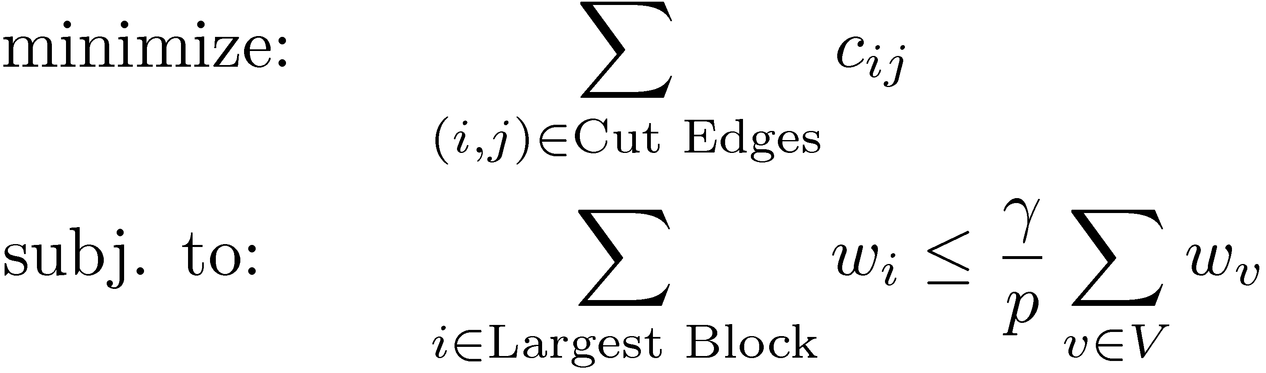
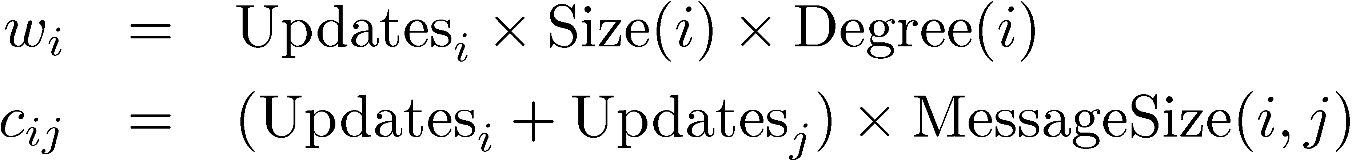
The Partitioning Problem
Minimize
Communication
Objective:
Depends on:
NP-Hard → METIS fast partitioning heuristic
Ensure Balance
Update counts are not known!
Work:
Comm:
Notes:
To ensure balance we want the running time of the processor with the most work to be less than some constant multiple of the average running time.

Slide 48
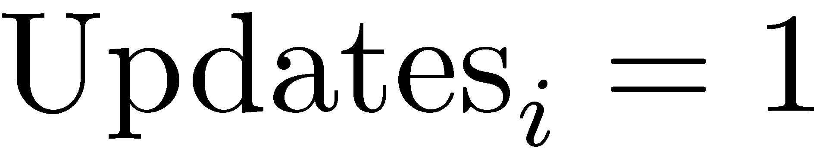
Unknown Update Counts
Determined by belief scheduling
Depends on: graph structure, factors, …
Little correlation between past & future update counts
Simple Solution:
Uninformed Cut
Noisy Image
Update Counts
Notes:
To make matters worse the update counts are determined by the dynamic scheduling which depends on the graph structure, factors, and progress towards convergence. In the denoising example the update counts depend on the boundaries of the true underlying image with some vertices being update order of magnitudes more often than others. Furthermore, there is no strong temporal consistency as past update counts do not predict future update counts.
To overcome this problem we adopt a surprisingly simple solution <click>. We define the uniformed cut in which we fix the number of updates to the constant 1 for all vertices.
Now we examine how this performs in practice.

Slide 49

Uniformed Cuts
Uninformed Cut
Update Counts
Optimal Cut
Too Much Work
Too Little Work
Greater imbalance & lower communication cost
Better
Better
Notes:
In the case of the denoising task, the uniformed partitioning evenly cuts the graph while the informed partitioning, computed using the true update counts, cuts the upper half of the image more finely and so achieves a better balance. Surprisingly, the communication costs of both the uninformed cut is often slightly lower than that of the informed cut. This is because the balance constraint forces the informed cut to accept a higher communication cost.
We now present a simple technique to improve the work balance of the uniformed cut without knowing the update counts.

Slide 50
Over-Partitioning
Over-cut graph into k*p partitions and randomly assign CPUs
Increase balance
Increase communication cost (More Boundary)
CPU 1
CPU 1
CPU 2
CPU 2
CPU 1
CPU 1
CPU 2
CPU 2
CPU 2
CPU 1
CPU 2
CPU 1
CPU 2
CPU 1
Without Over-Partitioning
k=6

Slide 51
Over-Partitioning Results
Provides a simple method to trade between work balance and communication cost
Better
Better

Slide 52
CPU Utilization
Over-partitioning improves CPU utilization:

Slide 53
Parallel Splash Algorithm
Fast Reliable Network
Local State
Local State
Local State
CPU 1
Scheduling
Queue
CPU 2
Scheduling
Queue
CPU 3
Scheduling
Queue
Splash
Splash
Splash
Over-Partition factor graph
Randomly assign pieces to processors
Schedule Splashes locally using belief residuals
Transmit messages on boundary
Notes:
The distributed belief residual splash algorithm or DBRSplash begins by partitioning the factor graph over the processors then using separate local belief scheduling queues on each processor to schedule splashes in parallel. Messages on the boundary of partitions are transmitted after being updated. Finally, we assess convergence using a variant of the token ring algorithm proposed by Misra in Sigops 83 for distributed termination.
This leads to the following theorem <click> which says that given an ideal partitioning the DBRSplash algorithm will achieve the optimal running time on chain graphical models. Clearly the challenging problem that remains is partitioning <click> the factor graph.
I will now show how we partition the factor graph.

Slide 54
Outline
Overview
Graphical Models: Statistical Structure
Inference: Computational Structure
τ_{ε} - Approximate Messages: Statistical Structure
Parallel Splash
Dynamic Scheduling
Partitioning
Experimental Results
Conclusions

Slide 55
Experiments
Implemented in C++ using MPICH2 as a message passing API
Ran on Intel OpenCirrus cluster: 120 processors
15 Nodes with 2 x Quad Core Intel Xeon Processors
Gigabit Ethernet Switch
Tested on Markov Logic Networks obtained from Alchemy [Domingos et al. SSPR 08]
Present results on largest UW-Systems and smallest UW-Languages MLNs

Slide 56


Parallel Performance (Large Graph)
UW-Systems
8K Variables
406K Factors
Single Processor Running Time:
1 Hour
Linear to Super-Linear up to 120 CPUs
Cache efficiency
Linear
Better
Notes:
Large
7951 Variables
406389 Factors
Small
1078 Variables
26598 Factors

Slide 57
Parallel Performance (Small Graph)
UW-Languages
1K Variables
27K Factors
Single Processor Running Time:
1.5 Minutes
Linear to Super-Linear up to 30 CPUs
Network costs quickly dominate short running-time
Linear
Better
Notes:
Large
7951 Variables
406389 Factors
Small
1078 Variables
26598 Factors

Slide 58
Outline
Overview
Graphical Models: Statistical Structure
Inference: Computational Structure
τ_{ε} - Approximate Messages: Statistical Structure
Parallel Splash
Dynamic Scheduling
Partitioning
Experimental Results
Conclusions

Slide 59
Summary
Algorithmic Efficiency
Parallel Efficiency
Splash Structure
+
Belief Residual
Scheduling
Independent
Parallel Splashes
Implementation
Efficiency
Distributed Queues
Asynchronous Communication
Over-Partitioning
Experimental results on large factor graphs:
Linear to super-linear speed-up using up to 120 processors

Slide 60
Conclusion
We are here
Parallel Splash
Belief Propagation
Parallelism
We were here
Sophistication

Slide 61
Questions

Slide 62
Protein Results

Slide 63
3D Video Task

Slide 64
Distributed Parallel Setting
Fast Reliable Network
Node
Node
CPU
Bus
Memory
CPU
Bus
Memory
Cache
Cache
Opportunities:
Access to larger systems: 8 CPUs → 1000 CPUs
Linear Increase:
RAM, Cache Capacity, and Memory Bandwidth
Challenges:
Distributed state, Communication and Load Balancing
Notes:
In this work we consider the distributed parallel setting in which each processor has its own cache, bus, and memory hierarchy as in a large cluster.
All processors are connected by a fast reliable network. We assume all transmitted packets eventually arrive at their destination and that nodes do not fail. The distributed parallel setting has several advantages over the standard multi-core shared memory setting. Not only does it provide access to orders of magnitude more parallelism it also provides a linear increase in memory and memory bandwidth which are crucial to data driven Machine Learning algorithms.
Unfortunately the distributed parallel setting introduces a few additional challenges, requiring distributed state reasoning and balanced communication and computation, challenges we will address in this work.

