Slide 1


Optimistic Concurrency Control in the Design and Analysis of Parallel Learning Algorithms
Joseph E. Gonzalez
Postdoc, UC Berkeley AMPLab
Co-founder, GraphLab Inc.
jegonzal@eecs.berkeley.edu

Slide 2
Serial Inference
Model
State
Data

Slide 3
Parallel Inference
Model
State
Data
Processor 1
Processor 2

Slide 4
Parallel Inference
?
Model
State
Data
Processor 1
Processor 2
Correctness:
serial equivalence
Concurrency:
more machines = less time

Slide 5
Coordination Free Parallel Inference
?
Model
State
Data
Processor 1
Processor 2
Correctness?
Depends on Assumptions
Concurrency:
(almost) free
Keep Calm and Carry On.

Slide 6
Serial
Correctness
Low
High

Slide 7
Concurrency
Coordination-
free
High
Low
Serial
Correctness
Low
High

Slide 8
Concurrency
Concurrency
Control
Coordination-
free
High
Database mechanisms
Guarantee correctness
Maximize concurrency
Mutual exclusion
Optimistic CC
Low
Serial
Correctness
Low
High

Slide 9

Mutual Exclusion Through Locking
Model
State
Data
Processor 1
Processor 2
Introducing locking (scheduling) protocols to prevent potential conflicts.

Slide 10
Mutual Exclusion Through Locking
Model
State
✗
Data
Processor 1
Processor 2
Enforce serialization of computation that could conflict.

Slide 11
Optimistic Concurrency Control
Model
State
Data
Processor 1
Processor 2
Allow computation to proceed without blocking.
Kung & Robinson. On optimistic methods for concurrency control. ACM Transactions on Database Systems 1981

Slide 12
Optimistic Concurrency Control
Model
State
✔
?
Valid outcome
Data
Processor 1
Processor 2
Validate potential conflicts.
Kung & Robinson. On optimistic methods for concurrency control. ACM Transactions on Database Systems 1981

Slide 13
Optimistic Concurrency Control
✗
Invalid Outcome
?
?
✗
Model
State
Data
Processor 1
Processor 2
Validate potential conflicts.
Kung & Robinson. On optimistic methods for concurrency control. ACM Transactions on Database Systems 1981

Slide 14
Optimistic Concurrency Control
✗
Amend the Value
✗
Model
State
Data
Processor 1
Processor 2
Take a compensating action.
Kung & Robinson. On optimistic methods for concurrency control. ACM Transactions on Database Systems 1981

Slide 15
Optimistic Concurrency Control
✗
Invalid Outcome
✗
Model
State
Data
Processor 1
Processor 2
Validate potential conflicts.
Kung & Robinson. On optimistic methods for concurrency control. ACM Transactions on Database Systems 1981

Slide 16
Optimistic Concurrency Control
✗
Rollback and Redo
✗
Model
State
Data
Processor 1
Processor 2
Take a compensating action.
Kung & Robinson. On optimistic methods for concurrency control. ACM Transactions on Database Systems 1981

Slide 17
Optimistic Concurrency Control
Rollback and Redo
Model
State
Data
Processor 1
Processor 2
Non-Blocking Computation
Concurrency
Validation: Identify Errors
Resolution: Correct Errors
Correctness

Slide 18
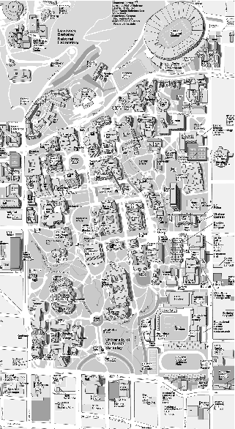
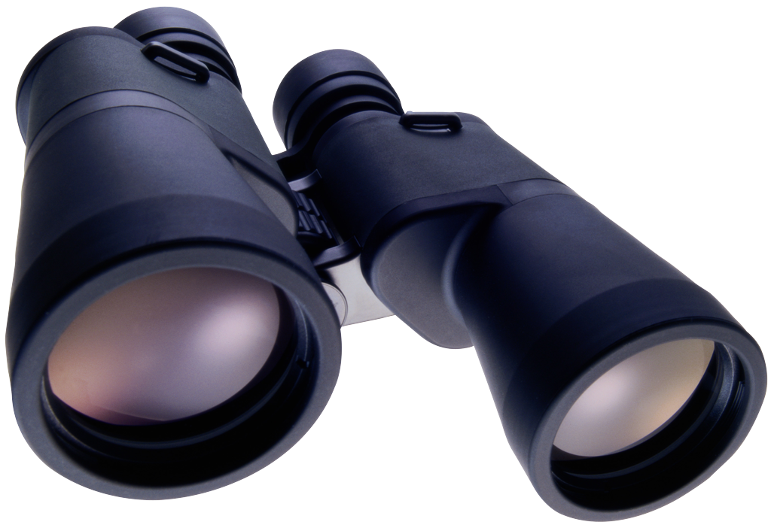
Optimistic Concurrency Control for Machine Learning
Non-parametric Clustering Distributed DP-Means
[NIPS’13]
Submodular Optimization Double Greedy Submodular Maximization
[NIPS’14]

Slide 19


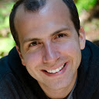
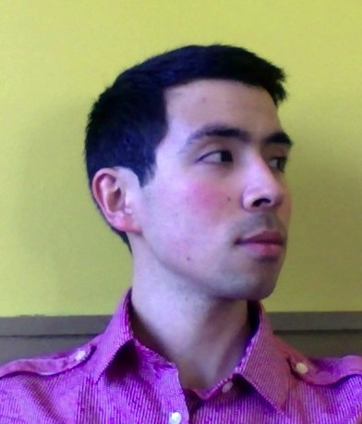

Optimistic Concurrency Control for Submodular Maxmization
Xinghao Pan, Stefanie Jegelka, Joseph Gonzalez, Joseph Bradley, Michael I. Jordan
Notes:
Today, talk about submodular maximization.
But doing so in a scalable way while preserving optimal approximation.

Slide 20
Submodular Set Functions
Diminishing Returns Property
F: 2^{V} → R, such that for all and

Slide 21
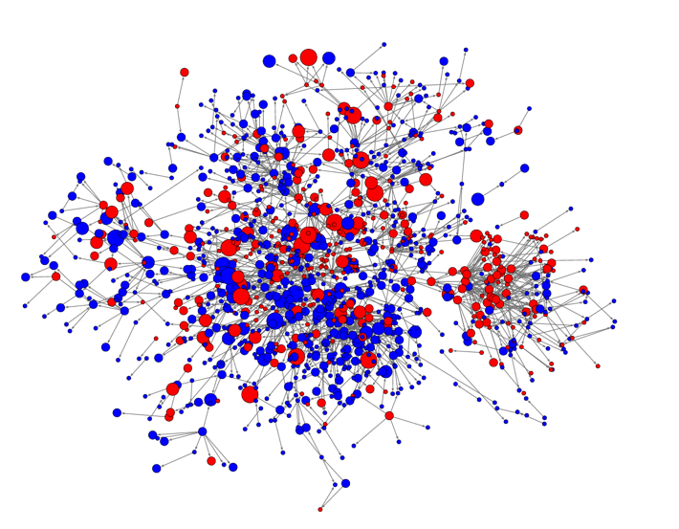
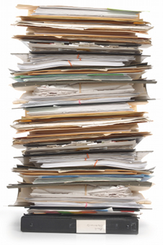
Submodular Examples
Sensing
Network Analysis
(Kempe, Kleinberg, Tardos 2003, Mossel & Roch 2007)
(Krause & Guestrin 2005)
Document
Summarization
Graph Algorithms
clustering
graph partitioning
S
Max Cut
(Lin & Bilmes 2011)

Slide 22
Submodular Maximization
max F(A), A ⊆ V
Monotone (increasing) functions
[ Positive marginal gains ]
Non-monotone functions
Greedy (Nemhauser et al, 1978)
(1-1/e) - approximation
Optimal polytime
Double Greedy (Buchbinder et al, 2012)
½ - approximation
Optimal polytime
Sequential
GREEDI (Mirzasoleiman et al, 2013)
(1-1/e)² / p – approximation
1 MapReduce round
(Kumar et al, 2013)
1 / (2+ε) – approximation
O(1/ε) MapReduce rounds
Concurrency Control Double Greedy
Optimal ½ - approximation
Bounded overhead
Coordination Free Double Greedy
Bounded error
Minimal overhead
?
Parallel / Distributed
Notes:
----- Meeting Notes (10/20/14 15:53) -----
Monotone -- positive marginal gains
Greedy is sequential, depends on what we have seen
Parallelization is non-trivial
People have done parallel
Non-monotone is important, for example if you have costs
What about the parallel setting?

Slide 23
Double Greedy Algorithm
u
v
w
x
y
z
Set A
Set B
u
v
w
x
y
z
Notes:
Maintain set A, initialized to empty.
Double greedy → maintain additional set B, initialized to the full set.
Sequentially process each element, greedily decide to either add each element to A or remove it from B.

Slide 24
Double Greedy Algorithm
u
v
w
x
y
z
Set A
Set B
u
v
w
x
y
z

Slide 25
Double Greedy Algorithm
v
w
x
y
z
Set A
Set B
Marginal gains
Δ₊(u|A) = F(A ∪ u) – F(A),
Δ₋(u|B) = F(B \ u) – F(B).
u
u
v
w
p( | A, B ) =
+ A
- B
u
x
0
1
rand
y
z
Notes:
Specifically, for each element, compute the marginal gains for
Adding to A
Removing from B
Random decision to either add u to A, or to remove u from B
Preference proportional to the marginal gains of each
We draw a random number, and if falls in the red region, we add the element to A.

Slide 26
Double Greedy Algorithm
v
w
x
y
z
Set A
Set B
Marginal gains
Δ₊(u|A) = F(A ∪ u) – F(A),
Δ₋(u|B) = F(B \ u) – F(B).
u
u
v
w
p( | A, B ) =
+ A
- B
u
x
0
1
rand
y
z

Slide 27
Double Greedy Algorithm
v
w
x
y
z
Set A
Set B
Marginal gains
Δ₊(v|A) = F(A ∪ v) – F(A),
Δ₋(v|B) = F(B \ v) – F(B).
u
u
v
v
w
p( | A, B ) =
+ A
- B
v
x
0
1
rand
y
z

Slide 28
Double Greedy Algorithm
w
x
y
z
Set A
Set B
u
u
w
x
y
z
Return A

Slide 29
Parallel Double Greedy Algorithm
u
v
w
x
y
z
Set A
Set B
CPU 1
u
v
w
CPU 2
x
y
z

Slide 30
Parallel Double Greedy Algorithm
Set A
Set B
CPU 1
u
w
y
Δ₊(u | ?) = ?
Δ₋(u | ?) = ?
?
u
?
u
u
v
v
v
w
CPU 2
v
x
z
x
Δ₊(v | ?) = ?
Δ₋(v | ?) = ?
y
z

Slide 31
Concurrency Control Double Greedy
Maintain bounds on A, B ➔ Enable threads to make decisions locally
Set A
Set B
CPU 1
u
w
y
u
u
u
v
w
CPU 2
v
x
z
x
v
v
y
z

Slide 32
Concurrency Control Double Greedy
Maintain bounds on A, B ➔ Enable threads to make decisions locally
Set A
Set B
CPU 1
w
y
u
Δ₊(u|A) ∈ [Δ₊^{min}(u|A), Δ₊^{max}(u|A)]
Δ₋(u|B) ∈ [Δ₋^{min}(u|B), Δ₋^{max}(u|B) ]
u
u
p( | A, B ) =
+ A
- B
u
Uncertainty
v
v
0
1
w
CPU 2
x
z
x
v
Δ₊(v|A) ∈ [Δ₊^{min}(v|A), Δ₊^{max}(v|A)]
Δ₋(v|B) ∈ [Δ₋^{min}(v|B), Δ₋^{max}(v|B) ]
y
p( | A, B ) =
+ A
- B
z
v
Uncertainty
0
1

Slide 33
Concurrency Control Double Greedy
Maintain bounds on A, B ➔ Enable threads to make decisions locally
Set A
Set B
CPU 1
w
y
u
Δ₊(u|A) ∈ [Δ₊^{min}(u|A), Δ₊^{max}(u|A)]
Δ₋(u|B) ∈ [Δ₋^{min}(u|B), Δ₋^{max}(u|B) ]
u
u
u
p( | A, B ) =
+ A
- B
u
Uncertainty
v
v
0
1
rand
w
CPU 2
x
z
x
v
Δ₊(v|A) ∈ [Δ₊^{min}(v|A), Δ₊^{max}(v|A)]
Δ₋(v|B) ∈ [Δ₋^{min}(v|B), Δ₋^{max}(v|B) ]
y
p( | A, B ) =
+ A
- B
z
v
Uncertainty
0
1

Slide 34
Concurrency Control Double Greedy
Maintain bounds on A, B ➔ Enable threads to make decisions locally
Set A
Set B
CPU 1
w
y
Common,
Fast
Δ₊(u|A) ∈ [Δ₊^{min}(u|A), Δ₊^{max}(u|A)]
Δ₋(u|B) ∈ [Δ₋^{min}(u|B), Δ₋^{max}(u|B) ]
u
u
p( | A, B ) =
+ A
- B
u
Uncertainty
v
v
0
1
rand
w
CPU 2
x
z
Rare,
Slow
x
Δ₊(v|A) ∈ [Δ₊^{min}(v|A), Δ₊^{max}(v|A)]
Δ₋(v|B) ∈ [Δ₋^{min}(v|B), Δ₋^{max}(v|B) ]
v
Δ₊(v|A) = F(A ∪ v) – F(A)
Δ₋(v|B) = F(B \ v) – F(B)
v
y
p( | A, B ) =
+ A
- B
z
v
Uncertainty
0
1
rand

Slide 35
Properties of CC Double Greedy
Theorem: CC double greedy is serializable.
Corollary: CC double greedy preserves optimal approximation guarantee of ½OPT.
Lemma: CC has bounded overhead. Expected number of blocked elements
set cover with costs: < 2τ sparse max cut: < 2τ |E| / |V|
Correctness
Set A
Set B
u
u
Concurrency
w
w
x
x
τ
D
y
y
E
z

Slide 36
Change in Analysis
Coordination Free:
Provably fast and correct under key assumptions.
Concurrency Control:
Provably correct and fast under key assumptions.
Correctness
Easy Proof
Scalability
Challenging Proof

Slide 37
Empirical Validation
Multicore up to 16 threads
Set cover, Max graph cut
Real and synthetic graphs
Graph |  | Vertices | Edges
IT-2004 | Italian web-graph | 41 Million | 1.1 Billion
UK-2005 | UK web-graph | 39 Million | 0.9 Billion
Arabic-2005 | Arabic web-graph | 22 Million | 0.6 Billion
Friendster | Social sub-network | 10 Million | 0.6 Billion
Erdos-Renyi | Synthetic random | 20 Million | 2.0 Billion
ZigZag | Synthetic expander | 25 Million | 2.0 Billion

Slide 38
CC Double Greedy Coordination
Increase in Coordination
% elements failed + blocked
Only 0.01% needs blocking!

Slide 39
Runtime and Strong-Scaling
Concurrency Ctrl.
Sequential
Notes:
----- Meeting Notes (10/20/14 16:14) -----
Remove CF

Slide 40
Conclusion
Scalability
Approximation
Sequential
Double Greedy
Always slow
Always optimal
Concurrency Control
Double Greedy
Usually fast
Always optimal
Coordination Free
Double Greedy
Always fast
Near optimal
Paper @ NIPS 2014:
Parallel Double Greedy Submodular Maximization.
Notes:
Algorithms developed in the context of broader research that
looks into applying concurrency control to sequential algorithms
guarantees an equivalent outcome
and provides scalability

Slide 41
Backup Slides

Slide 42
Concurrency Control
Coordination Free
Theorem: serializable. preserves optimal approximation bound ½OPT.
Lemma: bounded overhead.
Lemma: approximation bound ½OPT - error
Correctness
Correctness
set cover with costs:
sparse maxcut:
Set A
Set B
u
u
w
w
x
x
τ
D
y
y
E
z
from same dependencies
(uncertainty region)
no overhead
Concurrency
Concurrency
set cover with costs:
sparse maxcut:

Slide 43
Adversarial Setting
Processing order
Overlapping covers
➔ Increased coordination

Slide 44
Adversarial Setting – Ring Set Cover
Faster
Larger Error
Coord Free
Always fast
Possibly wrong
Conc Ctrl
Possibly slow
Always optimal

