Slide 1





PowerGraph
Distributed Graph-Parallel Computation on Natural Graphs
Joseph Gonzalez
Joint work with:
Yucheng
Low
Haijie
Gu
Danny
Bickson
Carlos
Guestrin

Slide 2
Graphs are ubiquitous..

Slide 3

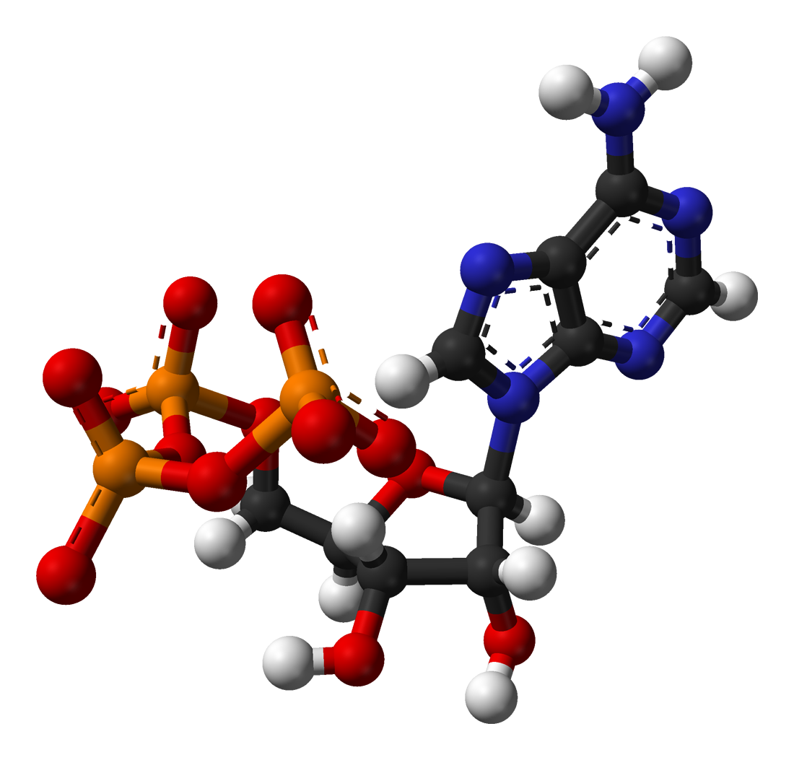

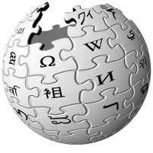




Social Media
Science
Advertising
Web
Graphs encode relationships between:
Big: billions of vertices and edges and rich metadata
People
Products
Ideas
Facts
Interests

Slide 4
Graphs are Essential to Data-Mining and Machine Learning
Identify influential people and information
Find communities
Target ads and products
Model complex data dependencies

Slide 5
Natural Graphs Graphs derived from natural phenomena

Slide 6
Existing distributed graph computation systems perform poorly on Natural Graphs.
Problem:

Slide 7
PageRank on Twitter Follower Graph
Natural Graph with 40M Users, 1.4 Billion Links
Order of magnitude by exploiting properties of Natural Graphs
PowerGraph
Hadoop results from [Kang et al. '11]
Twister (in-memory MapReduce) [Ekanayake et al. ‘10]

Slide 8
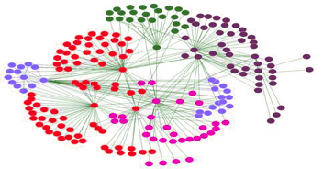
Properties of Natural Graphs
Power-Law Degree Distribution

Slide 9
Power-Law Degree Distribution
More than 10⁸ vertices have one neighbor.
High-Degree
Vertices
Top 1% of vertices are adjacent to
50% of the edges!
Number of Vertices
AltaVista WebGraph
1.4B Vertices, 6.6B Edges
Degree

Slide 10

Power-Law Degree Distribution
“Star Like” Motif
President
Obama
Followers

Slide 11
Power-Law Graphs are Difficult to Partition
CPU 1
CPU 2
Power-Law graphs do not have low-cost balanced cuts [Leskovec et al. 08, Lang 04]
Traditional graph-partitioning algorithms perform poorly on Power-Law Graphs. [Abou-Rjeili et al. 06]

Slide 12
Properties of Natural Graphs
High-degree
Vertices
Power-Law
Degree Distribution
Low Quality
Partition

Slide 13
PowerGraph
Program
For This
Run on This
Machine 1
Machine 2
Split High-Degree vertices
New Abstraction → Equivalence on Split Vertices

Slide 14
How do we program graph computation?
“Think like a Vertex.”
-Malewicz et al. [SIGMOD’10]

Slide 15
The Graph-Parallel Abstraction
A user-defined Vertex-Program runs on each vertex
Graph constrains interaction along edges
Using messages (e.g. Pregel [PODC’09, SIGMOD’10])
Through shared state (e.g., GraphLab [UAI’10, VLDB’12])
Parallelism: run multiple vertex programs simultaneously

Slide 16









Example
Depends on the popularity their followers
Depends on popularity of her followers
What’s the popularity
of this user?
Popular?

Slide 17
PageRank Algorithm
Rank of user i
Weighted sum of neighbors’ ranks
Update ranks in parallel
Iterate until convergence

Slide 18
The Pregel Abstraction
Vertex-Programs interact by sending messages.
Pregel_PageRank(i, messages) :
// Receive all the messages
total = 0
foreach( msg in messages) :
total = total + msg
// Update the rank of this vertex
R[i] = 0.15 + total
// Send new messages to neighbors
foreach(j in out_neighbors[i]) :
Send msg(R[i] * w_{ij}) to vertex j
i
Malewicz et al. [PODC’09, SIGMOD’10]

Slide 19
The GraphLab Abstraction
Vertex-Programs directly read the neighbors state
GraphLab_PageRank(i)
// Compute sum over neighbors
total = 0
foreach( j in in_neighbors(i)):
total = total + R[j] * w_{ji}
// Update the PageRank
R[i] = 0.15 + total
// Trigger neighbors to run again
if R[i] not converged then
foreach( j in out_neighbors(i)):
signal vertex-program on j
i
Low et al. [UAI’10, VLDB’12]

Slide 20

Challenges of High-Degree Vertices
Sequentially process edges
Sends many
messages
(Pregel)
Touches a large
fraction of graph
(GraphLab)
Edge meta-data too large for single machine
Asynchronous Execution requires heavy locking (GraphLab)
Synchronous Execution prone to stragglers (Pregel)

Slide 21
Communication Overhead for High-Degree Vertices
Fan-In vs. Fan-Out

Slide 22
Pregel Message Combiners on Fan-In
Machine 1
Machine 2
A
Sum
B
+
D
C
User defined commutative associative (+) message operation:

Slide 23
Pregel Struggles with Fan-Out
Machine 1
Machine 2
A
B
D
C
Broadcast sends many copies of the same message to the same machine!

Slide 24
Fan-In and Fan-Out Performance
PageRank on synthetic Power-Law Graphs
Piccolo was used to simulate Pregel with combiners
High Fan-Out Graphs
High Fan-In Graphs
More high-degree vertices

Slide 25
GraphLab Ghosting
Machine 1
Machine 2
A
A
B
D
B
D
C
Ghost
C
Changes to master are synced to ghosts

Slide 26
GraphLab Ghosting
Machine 1
Machine 2
A
A
B
D
B
D
C
C
Ghost
Changes to neighbors of high degree vertices creates substantial network traffic

Slide 27
Fan-In and Fan-Out Performance
PageRank on synthetic Power-Law Graphs
GraphLab is undirected
Pregel Fan-Out
GraphLab Fan-In/Out
Pregel Fan-In
More high-degree vertices

Slide 28
Graph Partitioning
Graph parallel abstractions rely on partitioning:
Minimize communication
Balance computation and storage
Y
Data transmitted
across network
O(# cut edges)
Machine 1
Machine 2

Slide 29
Random Partitioning
Both GraphLab and Pregel resort to random (hashed) partitioning on natural graphs
Machine 1
Machine 2
10 Machines → 90% of edges cut
100 Machines → 99% of edges cut!

Slide 30
In Summary
GraphLab and Pregel are not well suited for natural graphs
Challenges of high-degree vertices
Low quality partitioning

Slide 31
PowerGraph
GAS Decomposition: distribute vertex-programs
Move computation to data
Parallelize high-degree vertices
Vertex Partitioning:
Effectively distribute large power-law graphs

Slide 32
A Common Pattern for Vertex-Programs
GraphLab_PageRank(i)
// Compute sum over neighbors
total = 0
foreach( j in in_neighbors(i)):
total = total + R[j] * w_{ji}
// Update the PageRank
R[i] = 0.1 + total
// Trigger neighbors to run again
if R[i] not converged then
foreach( j in out_neighbors(i))
signal vertex-program on j
Gather Information About Neighborhood
Update Vertex
Signal Neighbors &
Modify Edge Data

Slide 33
GAS Decomposition
Gather (Reduce)
Apply
Scatter
Accumulate information about neighborhood
Apply the accumulated value to center vertex
Update adjacent edges and vertices.
User Defined:
User Defined:
User Defined:
Gather( ) → Σ
Apply( , Σ) →
Scatter( ) →
Y
Y
Y’
Y’
Σ₁ + Σ₂ → Σ₃
Σ
Y’
Y
Y’
Y
Update Edge Data &
Activate Neighbors
Parallel Sum
+
+ … + →
Y
Y
Y

Slide 34
PageRank in PowerGraph
PowerGraph_PageRank(i)
Gather( j → i ) : return w_{ji} * R[j]
sum(a, b) : return a + b;
Apply(i, Σ) : R[i] = 0.15 + Σ
Scatter( i → j ) : if R[i] changed then trigger j to be recomputed

Slide 35
Distributed Execution of a PowerGraph Vertex-Program
Machine 1
Machine 2
Master
Gather
Y’
Y’
Y’
Y’
Σ₁
Σ
Σ₂
+ + +
Mirror
Apply
Y
Y
Y
Y
Machine 3
Machine 4
Scatter
Σ₃
Σ₄
Mirror
Mirror

Slide 36
Minimizing Communication in PowerGraph
Communication is linear in the number of machines each vertex spans
Y
Y
Y
A vertex-cut minimizes machines each vertex spans
Percolation theory suggests that power law graphs have good vertex cuts. [Albert et al. 2000]

Slide 37
New Approach to Partitioning
Rather than cut edges:
we cut vertices:
CPU 1
CPU 2
Must synchronize
many edges
New Theorem: For any edge-cut we can directly construct a vertex-cut which requires strictly less communication and storage.
Y
Y
CPU 1
CPU 2
Y
Must synchronize a single vertex
Y

Slide 38
Constructing Vertex-Cuts
Evenly assign edges to machines
Minimize machines spanned by each vertex
Assign each edge as it is loaded
Touch each edge only once
Propose three distributed approaches:
Random Edge Placement
Coordinated Greedy Edge Placement
Oblivious Greedy Edge Placement

Slide 39
Random Edge-Placement
Randomly assign edges to machines
Machine 1
Machine 2
Machine 3
Balanced Vertex-Cut
Y
Spans 3 Machines
Y
Y
Y
Y
Y
Z
Y
Z
Y
Y
Y
Z
Z
Spans 2 Machines
Not cut!

Slide 40
Analysis Random Edge-Placement
Expected number of machines spanned by a vertex:
Twitter Follower Graph
41 Million Vertices
1.4 Billion Edges
Accurately Estimate Memory and Comm. Overhead

Slide 41
Random Vertex-Cuts vs. Edge-Cuts
Expected improvement from vertex-cuts:
Order of Magnitude
Improvement

Slide 42
Greedy Vertex-Cuts
Place edges on machines which already have the vertices in that edge.
Machine1
Machine 2
A
B
B
C
A
B
D
E

Slide 43
Greedy Vertex-Cuts
De-randomization → greedily minimizes the expected number of machines spanned
Coordinated Edge Placement
Requires coordination to place each edge
Slower: higher quality cuts
Oblivious Edge Placement
Approx. greedy objective without coordination
Faster: lower quality cuts

Slide 44
Partitioning Performance
Twitter Graph: 41M vertices, 1.4B edges
Cost
Construction Time
Random
Oblivious
Better
Oblivious
Coordinated
Coordinated
Random
Oblivious balances cost and partitioning time.

Slide 45
Greedy Vertex-Cuts Improve Performance
Greedy partitioning improves computation performance.

Slide 46
Other Features (See Paper)
Supports three execution modes:
Synchronous: Bulk-Synchronous GAS Phases
Asynchronous: Interleave GAS Phases
Asynchronous + Serializable: Neighboring vertices do not run simultaneously
Delta Caching
Accelerate gather phase by caching partial sums for each vertex

Slide 47
System Evaluation

Slide 48
System Design
PowerGraph (GraphLab2) System
MPI/TCP-IP
PThreads
HDFS
EC2 HPC Nodes
Implemented as C++ API
Uses HDFS for Graph Input and Output
Fault-tolerance is achieved by check-pointing
Snapshot time < 5 seconds for twitter network

Slide 49
Implemented Many Algorithms
Collaborative Filtering
Alternating Least Squares
Stochastic Gradient Descent
SVD
Non-negative MF
Statistical Inference
Loopy Belief Propagation
Max-Product Linear Programs
Gibbs Sampling
Graph Analytics
PageRank
Triangle Counting
Shortest Path
Graph Coloring
K-core Decomposition
Computer Vision
Image stitching
Language Modeling
LDA

Slide 50
Comparison with GraphLab & Pregel
PageRank on Synthetic Power-Law Graphs:
Communication
Runtime
Pregel (Piccolo)
Pregel (Piccolo)
GraphLab
GraphLab
PowerGraph
PowerGraph
High-degree vertices
High-degree vertices
PowerGraph is robust to high-degree vertices.
Notes:
All use random cuts

Slide 51
PageRank on the Twitter Follower Graph
Natural Graph with 40M Users, 1.4 Billion Links
Communication
Runtime
Total Network (GB)
Seconds
Reduces Communication
Runs Faster
32 Nodes x 8 Cores (EC2 HPC cc1.4x)

Slide 52


PowerGraph is Scalable
Yahoo Altavista Web Graph (2002):
One of the largest publicly available web graphs
1.4 Billion Webpages, 6.6 Billion Links
7 Seconds per Iter.
1B links processed per second
30 lines of user code
64 HPC Nodes
1024 Cores (2048 HT)

Slide 53
Topic Modeling
English language Wikipedia
2.6M Documents, 8.3M Words, 500M Tokens
Computationally intensive algorithm
100 Yahoo! Machines
Specifically engineered for this task
64 cc2.8xlarge EC2 Nodes
200 lines of code & 4 human hours

Slide 54
Triangle Counting on The Twitter Graph
Identify individuals with strong communities.
Counted: 34.8 Billion Triangles
Hadoop [WWW’11]
1536 Machines
423 Minutes
64 Machines
1.5 Minutes
282 x Faster
PowerGraph
Why? Wrong Abstraction → Broadcast O(degree²) messages per Vertex
S. Suri and S. Vassilvitskii, “Counting triangles and the curse of the last reducer,” WWW’11
Notes:
S. Suri and S. Vassilvitskii, “Counting triangles and the curse of the last reducer,” presented at the WWW '11: Proceedings of the 20th international conference on World wide web, 2011.

Slide 55
Summary
Problem: Computation on Natural Graphs is challenging
High-degree vertices
Low-quality edge-cuts
Solution: PowerGraph System
GAS Decomposition: split vertex programs
Vertex-partitioning: distribute natural graphs
PowerGraph theoretically and experimentally outperforms existing graph-parallel systems.

Slide 56
Machine Learning and Data-Mining Toolkits
Graph Analytics
Graphical Models
Computer Vision
Clustering
Topic Modeling
Collaborative Filtering
PowerGraph (GraphLab2) System

Slide 57
Future Work
Time evolving graphs
Support structural changes during computation
Out-of-core storage (GraphChi)
Support graphs that don’t fit in memory
Improved Fault-Tolerance
Leverage vertex replication to reduce snapshots
Asynchronous recovery

Slide 58
is GraphLab Version 2.1 Apache 2 License
PowerGraph
http://graphlab.org
Documentation… Code… Tutorials… (more on the way)

