Slide 1
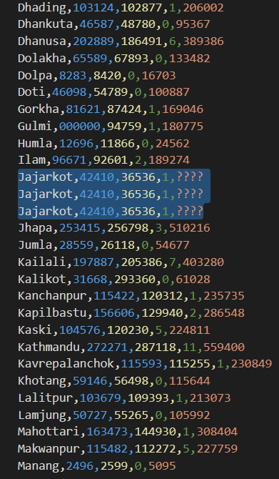
RAW DATA

Slide 2
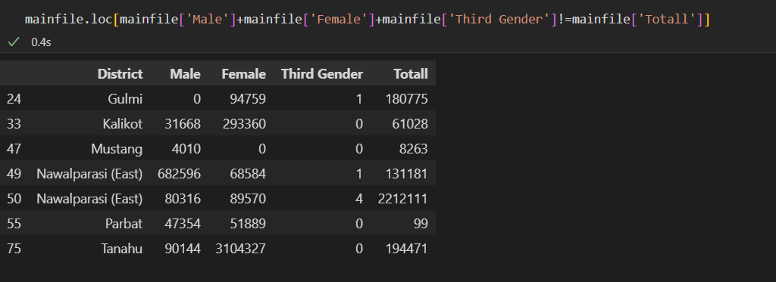
ERROR IN DATA

Slide 3
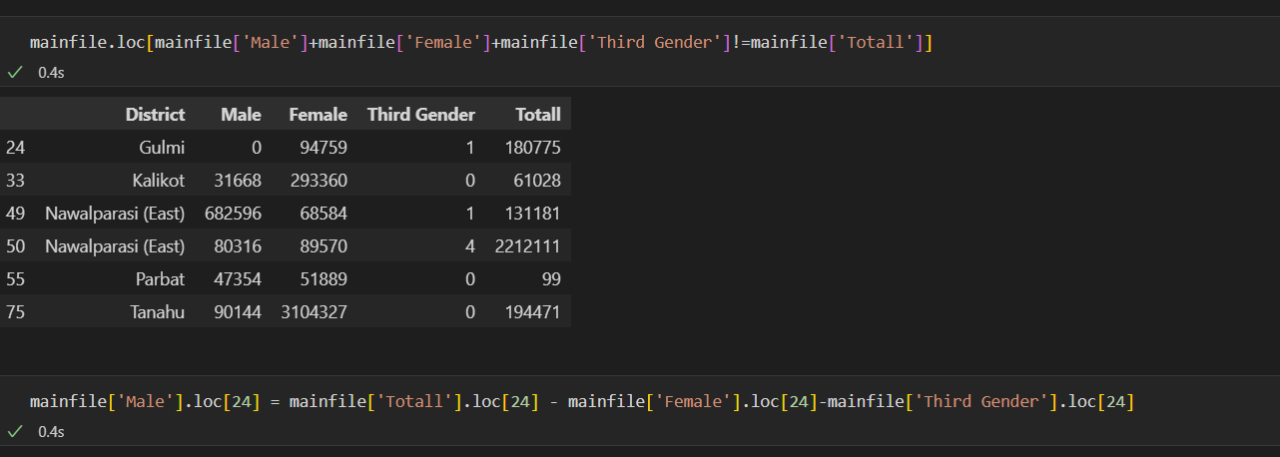
CORRECTING DATA

Slide 4
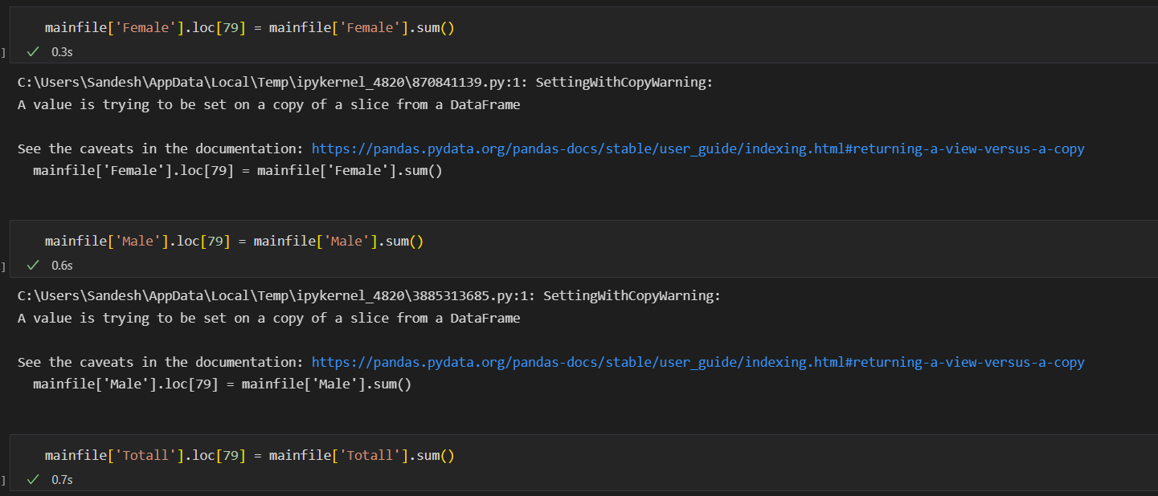
SUMMING UP COLUMN

Slide 5
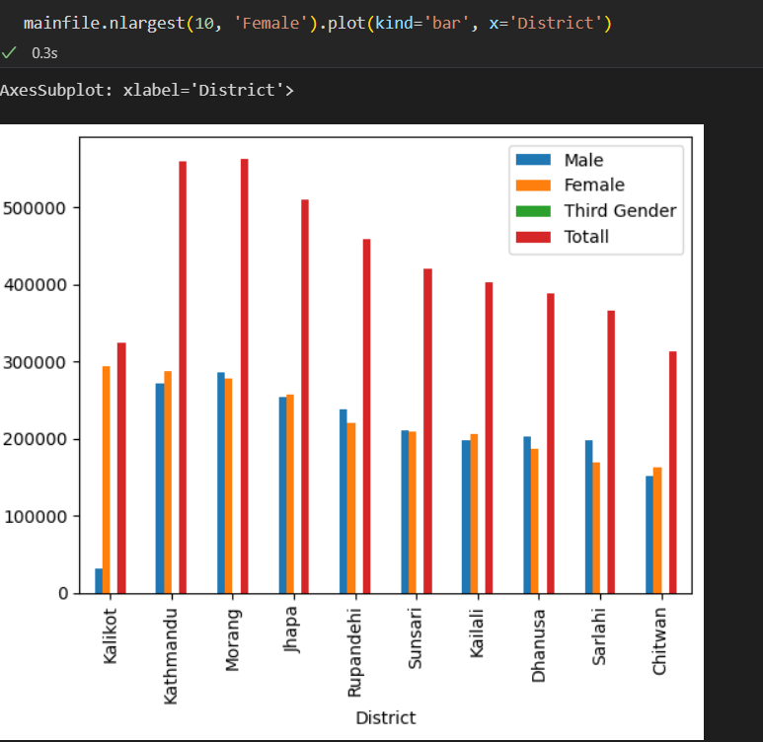
TOP 10 DISTRICTS WITH HIGHEST FEMALE VOTERS

Slide 6
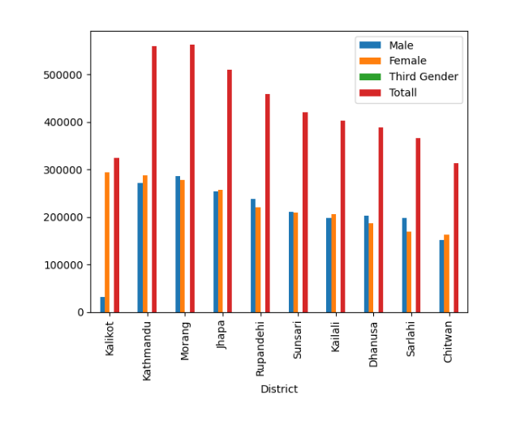
DISTRICTS WITH ACCLAIMED FEMALES

