Slide 1
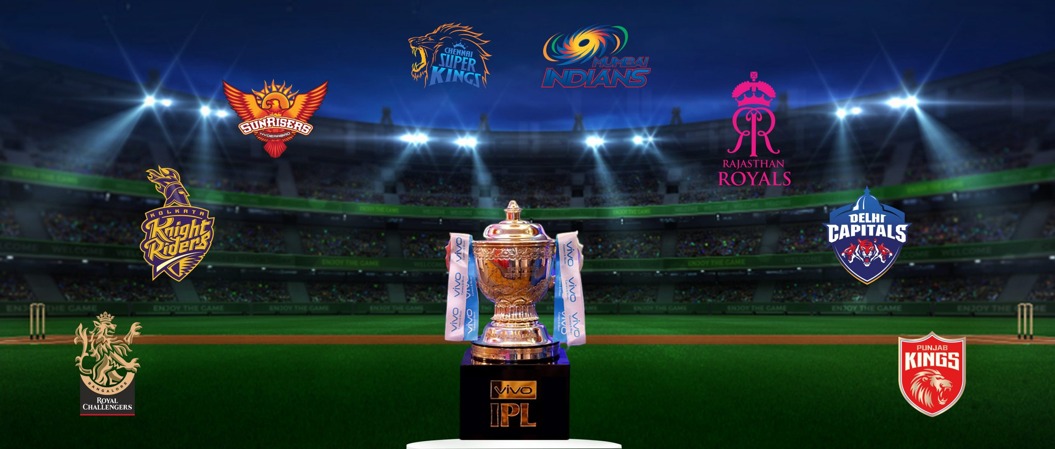
IPL Cricket Match Prediction using MERN Stack, Machine or Deep Learning
NAME:P SHISHIR
Roll:23BD1A6747

Slide 2
Main Components of the Solution and Their Communication
Frontend (React): Displays the user interface where users input data (e.g., team names, venue, match details) and view predictions.
Backend (Express & Node.js): Handles API requests from the frontend and communicates with the Flask middleware, which processes machine learning predictions.
Flask Middleware: Acts as a bridge between the Node.js backend and the machine learning model. It receives requests from Express, uses the model to generate predictions, and sends responses back.
Machine Learning Model (Python): Built to predict match outcomes using preprocessed IPL datasets. It generates predictions based on features like teams, players, venue, and scores.
Database (MongoDB): Stores historical data, user inputs, and potentially model results to improve accuracy over time.

Slide 3
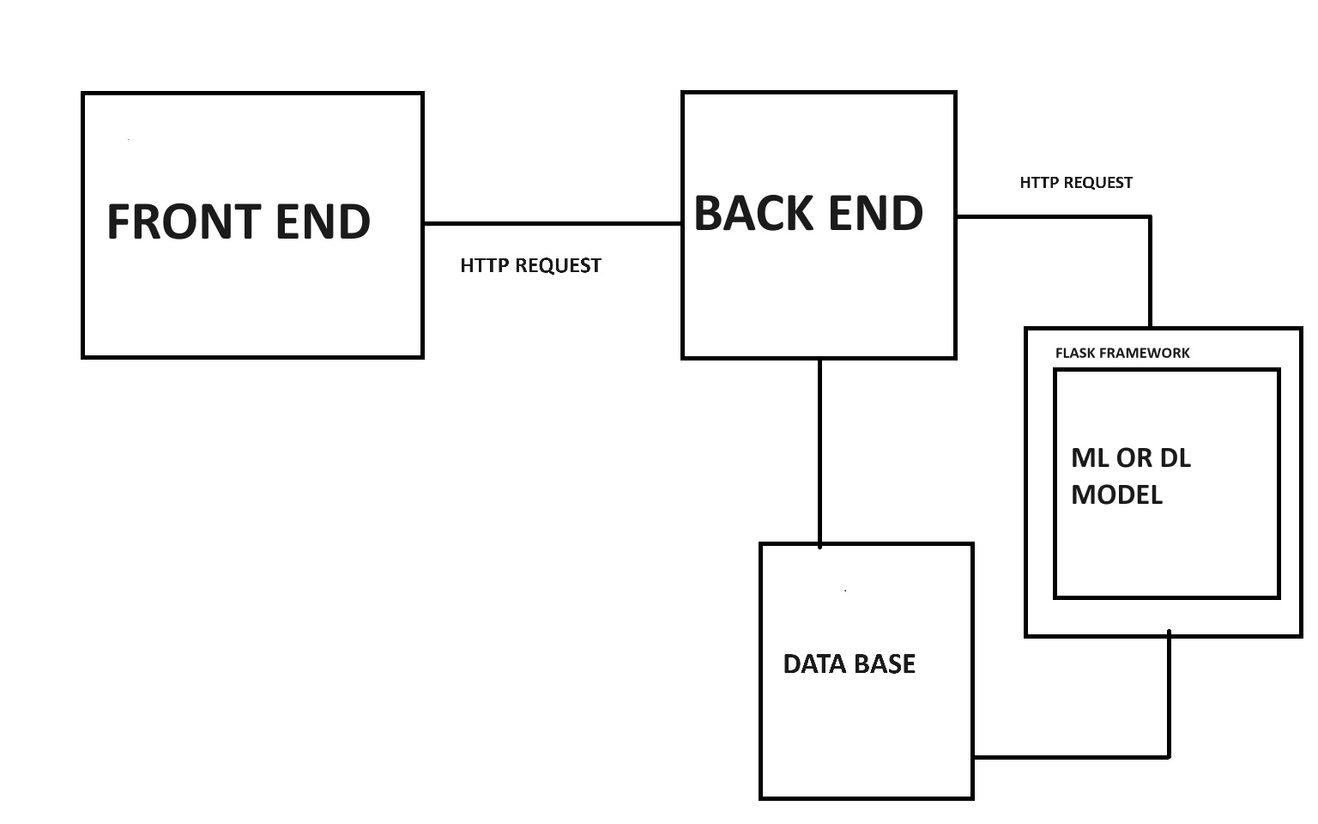
COMMUNICATION FLOW

Slide 4
Underlying Data Structures in the App
DataFrames (Python): Used within the ML component to handle tabular data efficiently.
JSON: For transferring data between frontend, backend, and middleware components.
Dictionaries: For label encoding in Python to convert categorical data like teams and venues into coded values for model input.

Slide 5
Tech Stack Used (MERN Stack)
MongoDB: Database to store historical match data and user details.
Express: Backend framework for handling routes, API requests, and middleware.
React: Frontend library for building dynamic user interfaces.
Node.js: Server environment to run JavaScript code on the backend.
Python (with Flask): For machine learning model deployment.
Machine Learning Libraries (e.g., scikit-learn): Used to build and train the prediction model.

Slide 6
Roles in the App
Administrator: Can manage datasets, monitor model performance, and interact with users and implement rules for upgrading project.
Data Analyst: Reviews prediction accuracy and performs data analysis.
User: Accesses the prediction system to make IPL match predictions and view results.

Slide 7
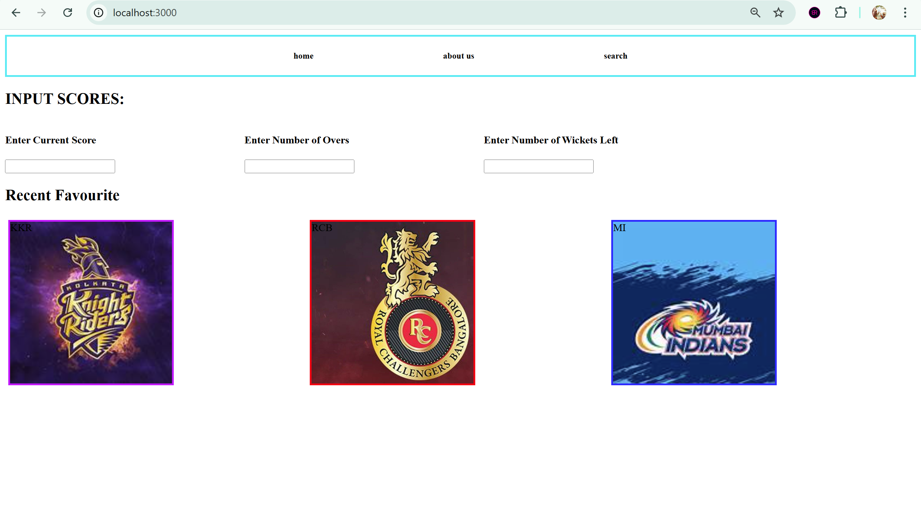
Interfaces to be Developed
User Input Screen: For users to enter match details, teams, and venue information.
Prediction Output Screen: Displays match predictions with details such as win probability.
UI :

Slide 8
Datasets and Processing
The datasets for this IPL prediction project were sourced from Kaggle. They include:
Deliveries Dataset: Contains ball-by-ball data for each match, capturing details like runs, wickets, and other in-game events.
Matches Dataset: Contains match-level data, such as match outcomes, winning team, venue, and toss details.
Data Preprocessing:
To prepare the data for machine learning, several preprocessing steps were performed:
Handling Missing Values: Columns with null values were removed to ensure data consistency.
Encoding Categorical Variables: One-Hot Encoding was applied to categorical features, such as teams, venues, and toss outcomes, to make the data suitable for model training.

Slide 9
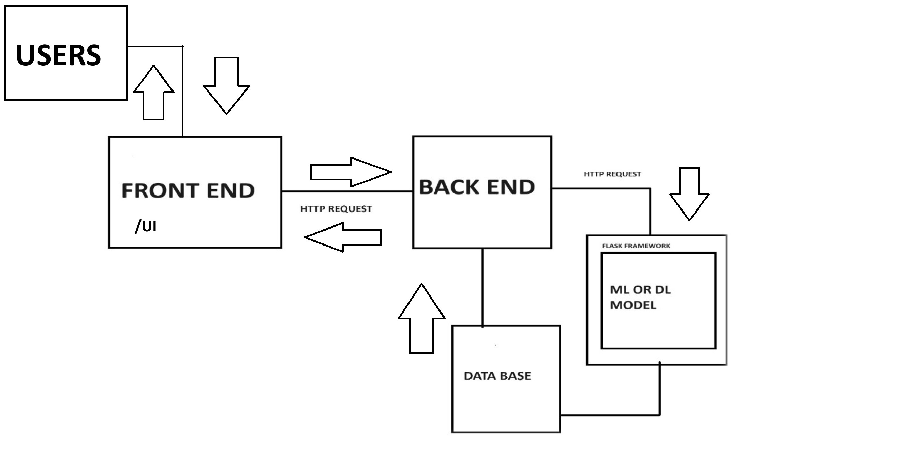
Workflow

Slide 10
Business Logic for Predicting Match Outcomes
Toss Decision and Venue Conditions: Certain venues may have characteristics (e.g., pitch conditions, weather) that favor batting or bowling first. The model considers the toss decision and historical outcomes at that venue to determine how the toss might influence the game’s outcome.
Player Performance Stats: Historical statistics of players are factored into the prediction, including batting and bowling averages, strike rates, and recent match performances. Strong performances from key players increase the team's chances of winning.
Team's Recent Form: Recent form is a critical indicator of a team’s momentum. The model takes into account the win/loss record of each team in recent matches, giving more weight to recent performance as an indicator of current strength.
Head-to-Head Records: Performance history between the two competing teams provides insights into their relative strengths and weaknesses, which are also factored into the prediction.
Each of these factors is encoded into numerical features and used to train the machine learning model to recognize patterns that indicate higher probabilities of winning for a team.

