Slide 1
MUSIC & MENTAL HEATH EXPLORATORY DATA ANALYSIS
INSIGHT FROM A SURVEY

Slide 2
INTRODUCTION
-Music is not just a form of entertainment; it's a reflection of our identities, emotions, and cultural influences.
-By analyzing data we understand the relationship between individuals and their preferred music genres, streaming platforms, and the impact of music on mental well-being.
-streaming services have become an integral part of our daily lives, offering us a vast array of music genres at our fingertips.

Slide 3
OVERVIEW OF THE DATA SET
Kaggle as data source.
has 736 rows and 33 columns.
Participants' responses regarding their age, preferred music genres, frequency of discovering new genres, primary streaming service, hours spent daily streaming, music-related activities (like composing and playing instruments), foreign language proficiency, and mental health factors (like anxiety, depression, insomnia, and OCD) are all included in the dataset.

Slide 4
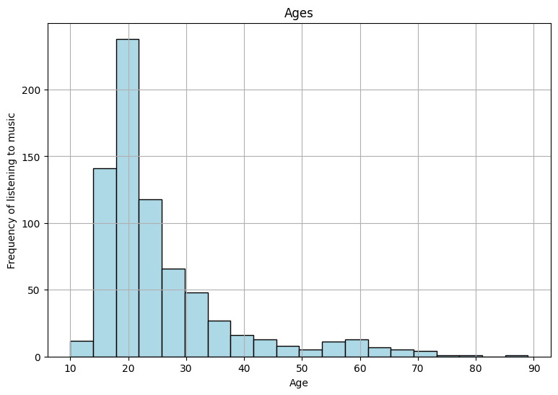
Most respondents are in their late teens or early twenties.

Slide 5
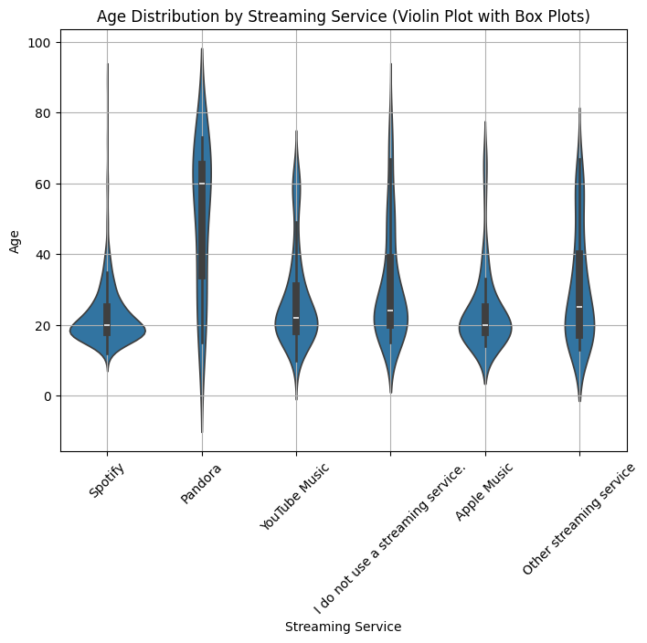
. Spotify, along with Apple Music, has a marginally younger userbase than other streaming platforms. Pandora has the oldest user base by far, with the median user age at ~60 years old.

Slide 6
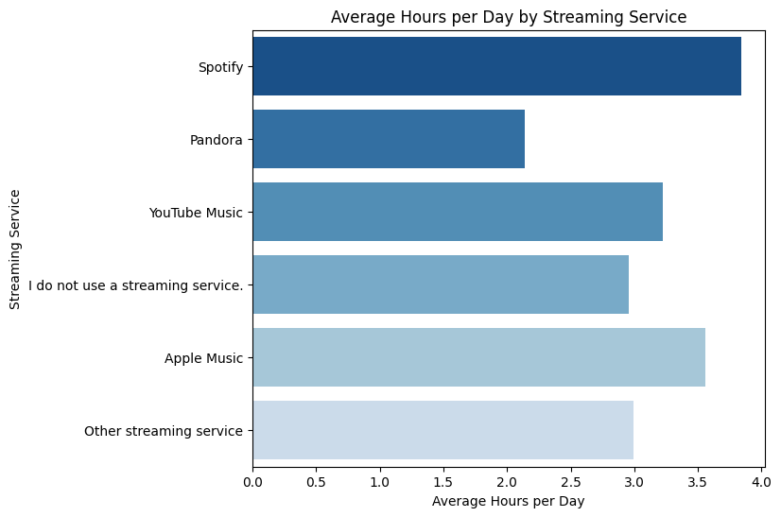
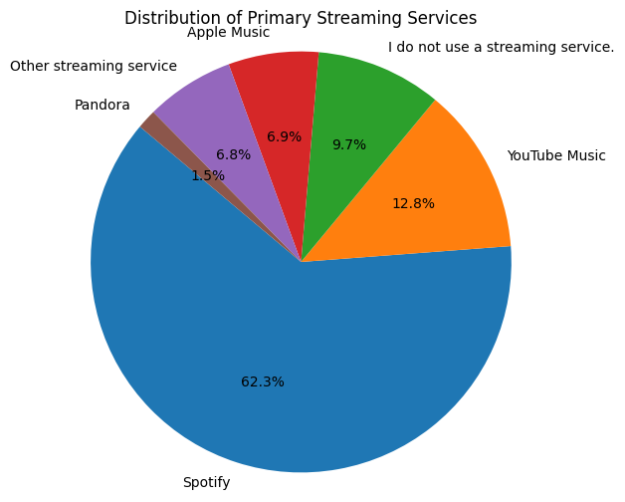
Spotify is the most popular music streaming service, accounting for 62% of all respondents

Slide 7
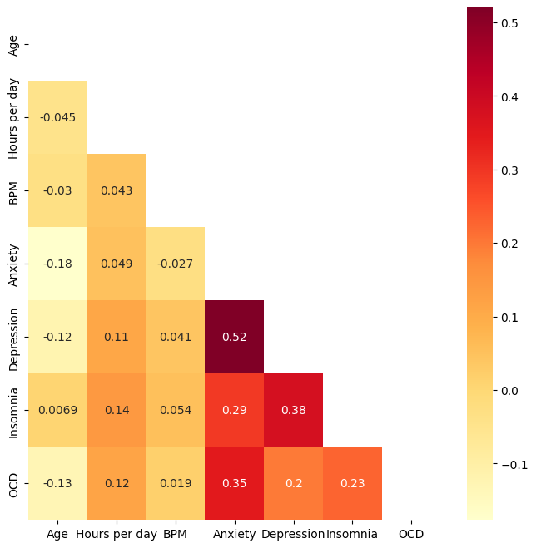
-significant correlation between individuals that play music and individuals that compose music.
-strong relationship between the total hours listening per day and hours listening while working.

Slide 8
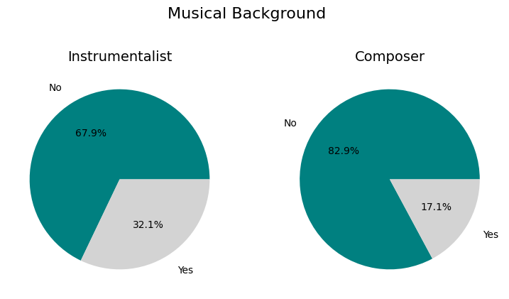
Most respondents do not play an instrument. It is even rarer for a respondent to compose music.

Slide 9
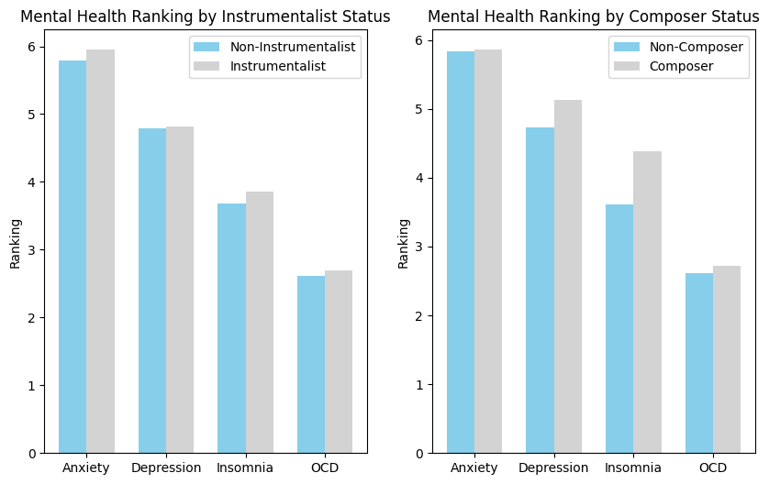

Slide 10
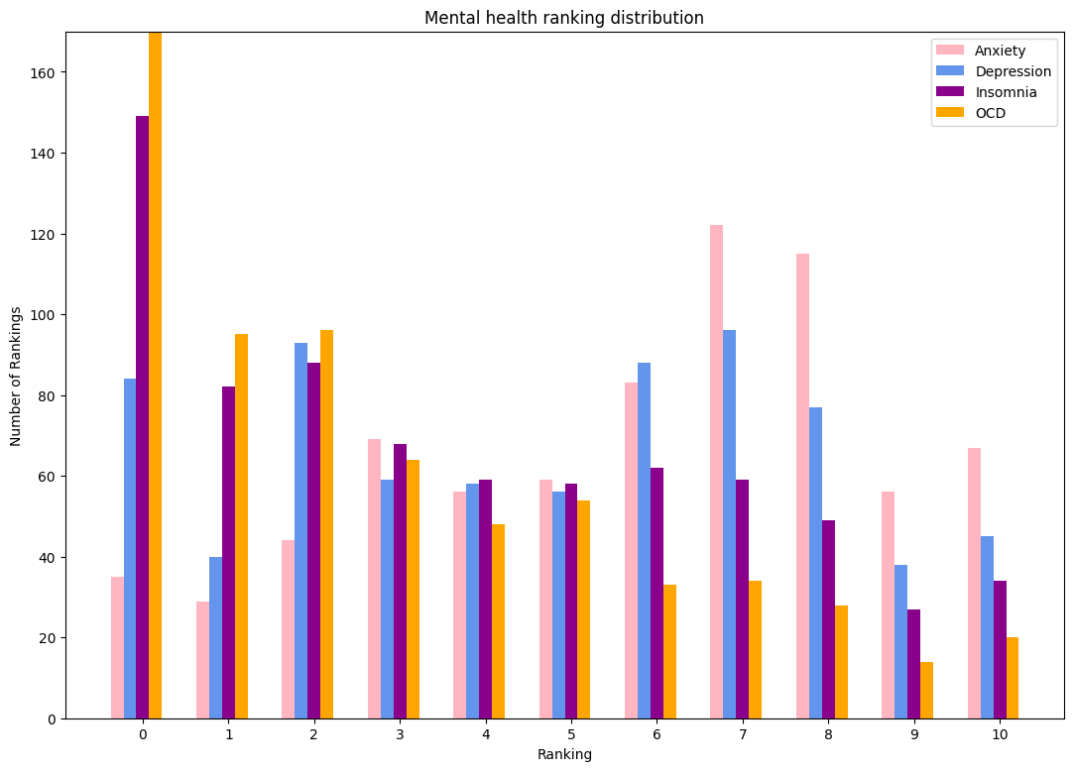
Elevated rankings for depression and anxiety are very common
OCD is the least common disorder.

Slide 11
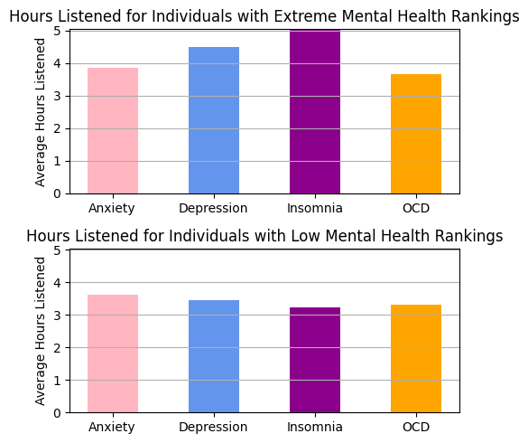
individuals with low insomnia saw a decline in average hours listened compared to their extreme counterparts. This was also the case for individuals with low depression

Slide 12
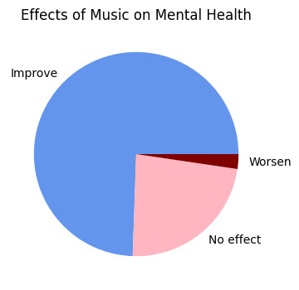
The majority of respondents find that music has a positive impact on their mental health.

Slide 13
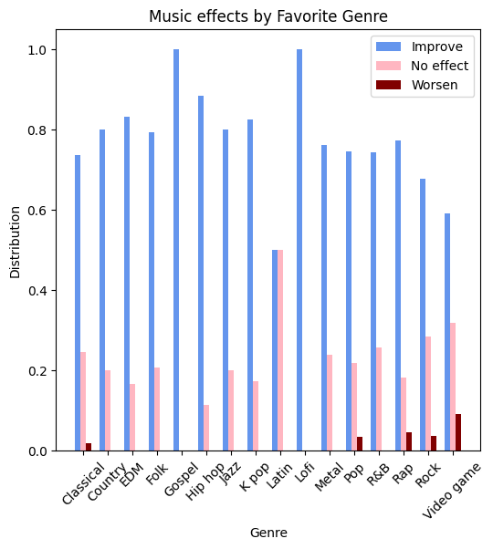
vast majority of respondents agree that music has a positive impact on mental health.

Slide 14
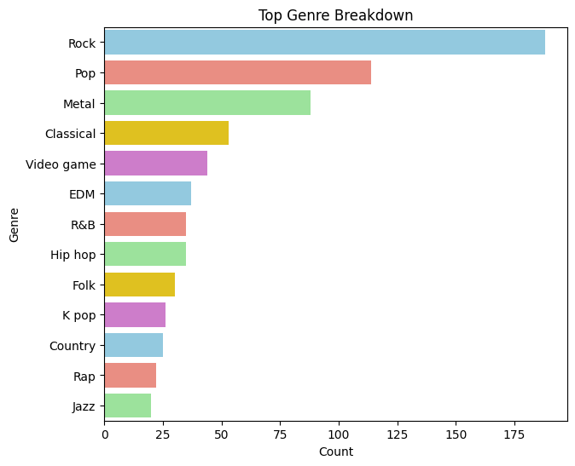
Rock is the most popular genre

Slide 15
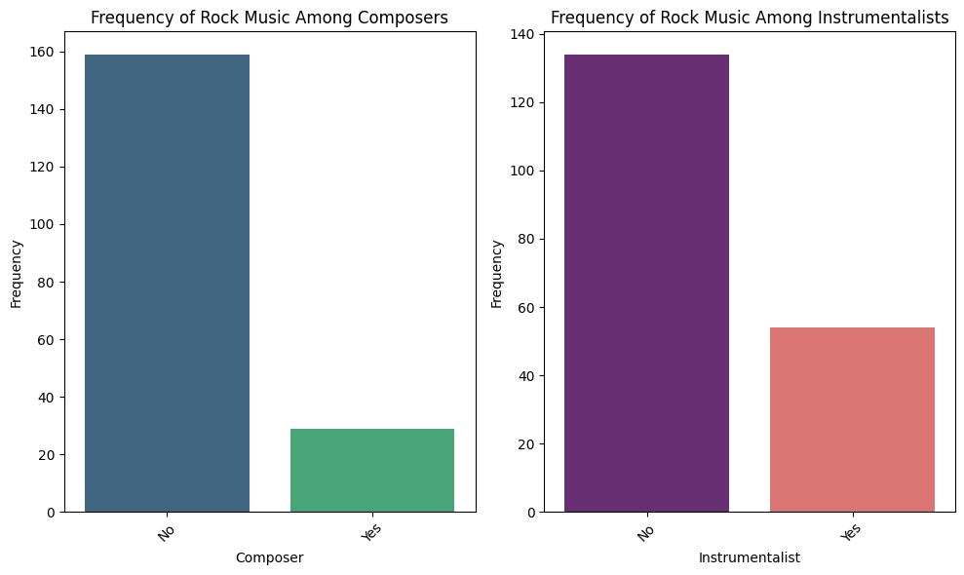

Slide 16
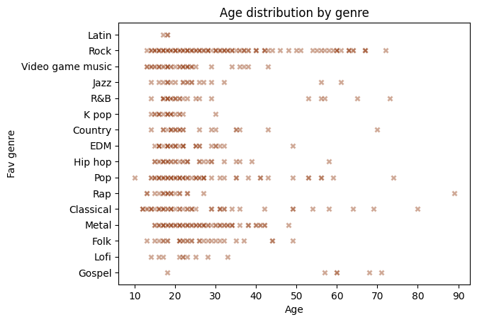
Rock has the most diverse range of ages.
Classical and Pop listeners also have a wider range of ages compared to other genres.
K pop and Lofi appear to attract a more specific and younger age group.

Slide 17
