Slide 1
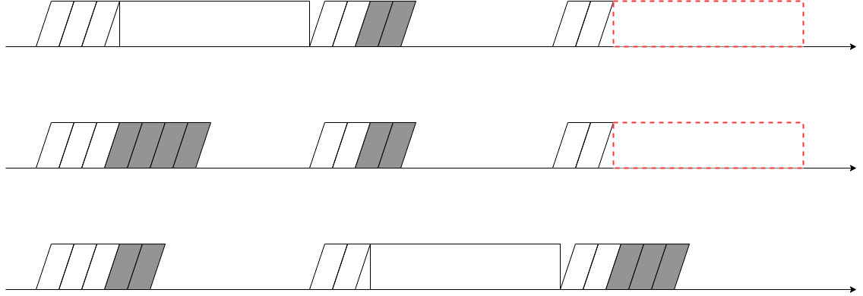
Packet
Conflict
Packet

Slide 2


