Slide 1
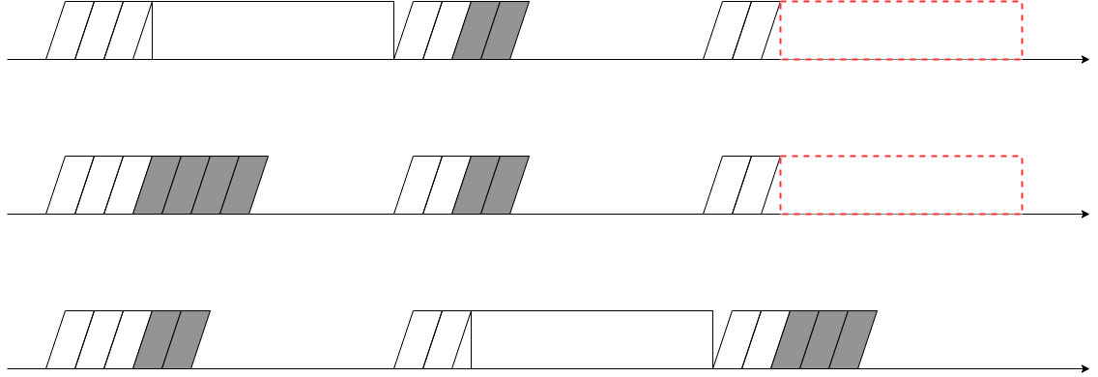
Packet
Conflict
Packet

