Slide 1
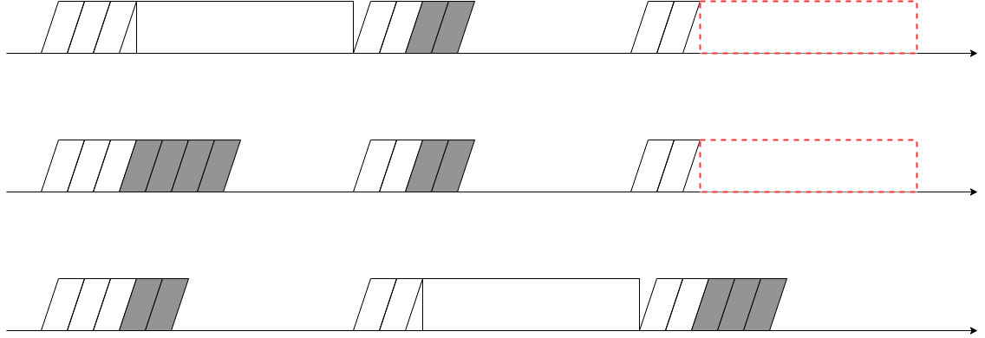
Packet
Conflict
Packet

Slide 2
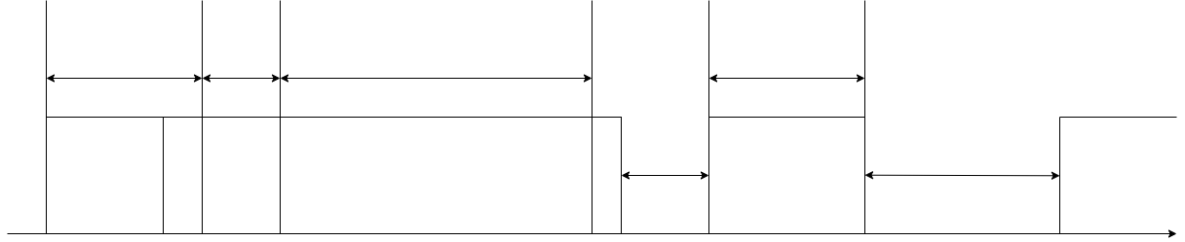
20 [μs]
24[B]

