Slide 1
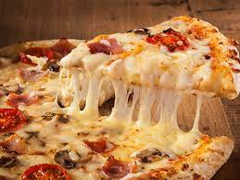
Pizza Sales Report
Overview:
Its small project of pizza place sales where some analysis of questions
done. Revenue, Customer Visits on day basis, pizzas typically in order
and peak hours etc.
Recommended Analysis
How many customers do we have each day? Are there any peak hours?

Slide 2
In range between 55 to 65 customers visit each day.

Slide 3
Peak hours between 12 to 1 pm and 5 pm to 7 pm.

Slide 4
3 pizzas in an order. Revenue of the year is 801944.7 USD.
How many pizzas are typically in an order? Do we have any bestsellers?
By using count and average function answer is 2.28 means we can say 3. Typically, 3 pizzas in
an order. we have bestsellers is big_meat_s pizza.
How much money did we make this year? Can we identify any seasonality in the sales?
--Total Revenue of the year is 801944.7 USD.
--26 November had maximum sales occurred on the occasion of Thanks Giving day.

Slide 5
Are there any pizzas we should take off the menu, or any promotions we could leverage?
The pizzas type- greek_xxl we should take off the menu for promotions as this is having lowest
selling pizza from all.
Methodology & Project scope Used:
Count and average
Sorting
VLookup

Slide 6
Conclusion
Pizza place sales record given so from all the details we can conclude some type of pizza like calabrese_s, ckn_alfredo_s, green_garden_l, the_greek_xxl need to some kind of offer like by one get one or buy one pizza with get free cold drinks etc.
Project owner
Name: Shital Atul Powar
Date: June 21st, 2023

