Slide 1
SQL PROJECT ON
COVID LIVE CSV
FROM KAGGLE
MADE BY SHITAL JADHAV

Slide 3
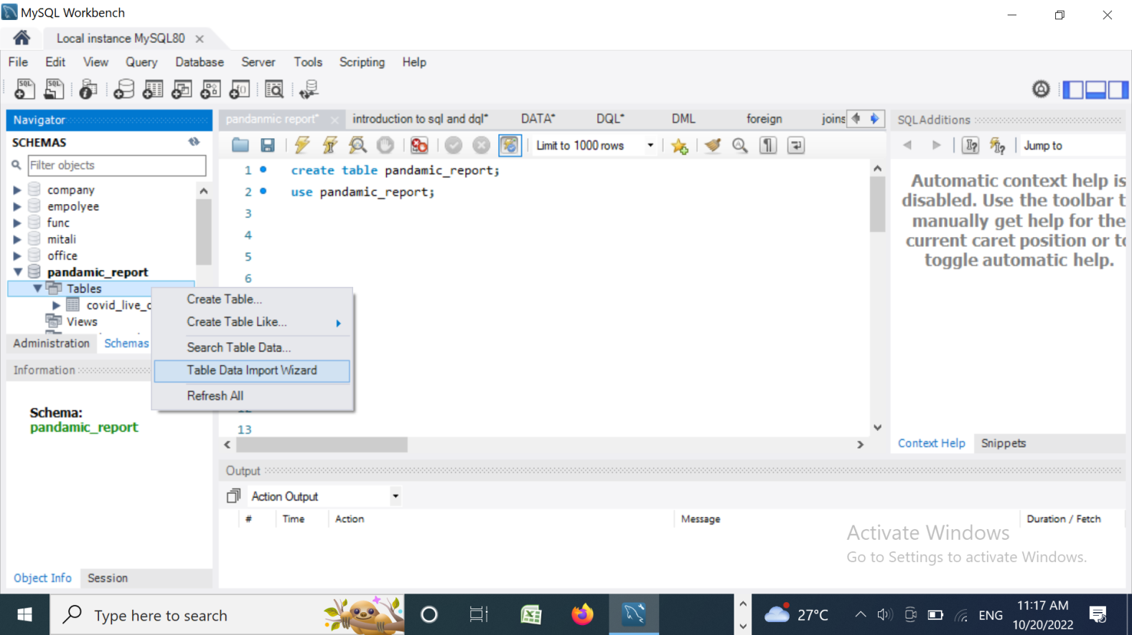
How to import the dataset to mysql workbench?
Step 1: create a dataset in mysql workbench

Slide 4
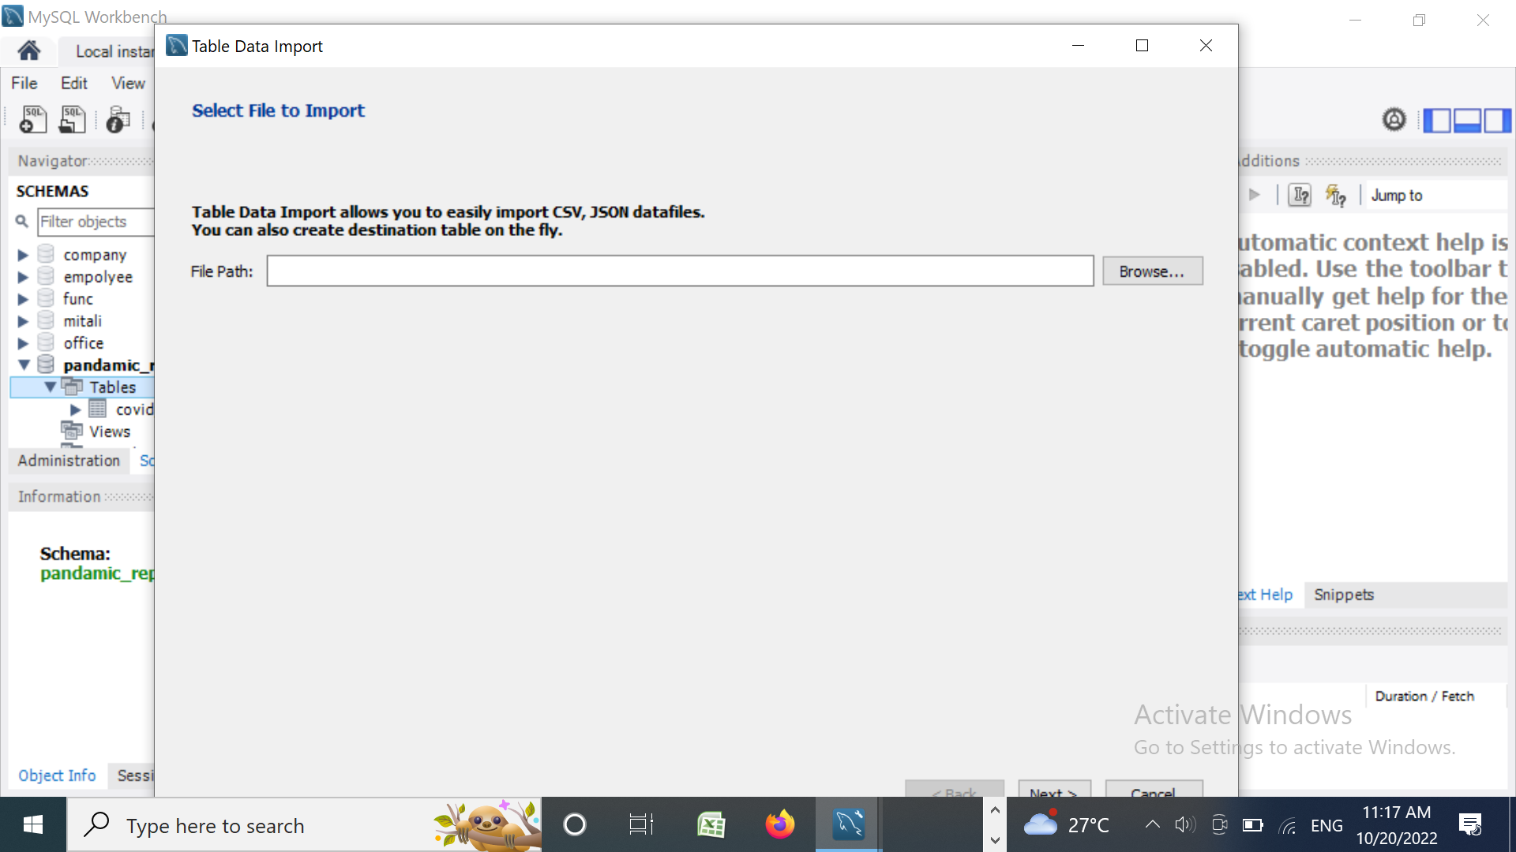
Step 2: use the database.

Slide 5

Step 3: go to the schemes section and right click on tables -> select table data import wizard.

Slide 6
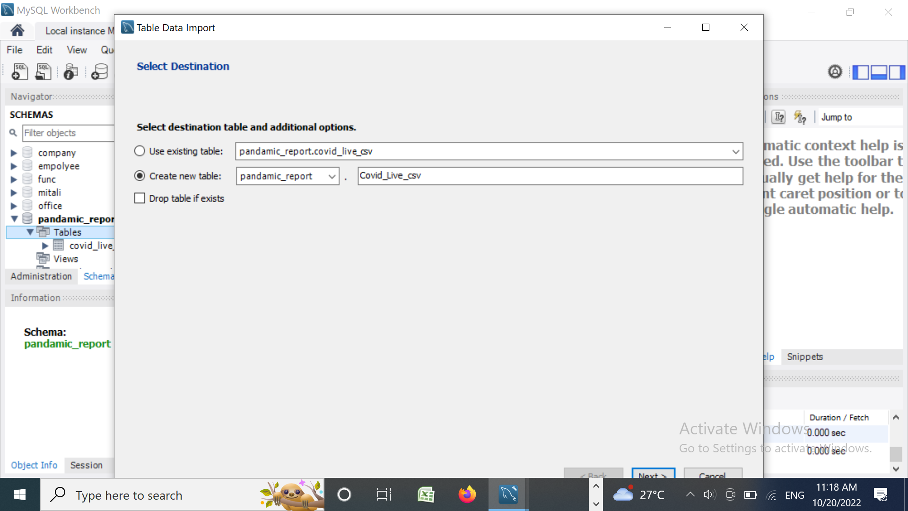
Step 4: click on next till it is finished.

Slide 7
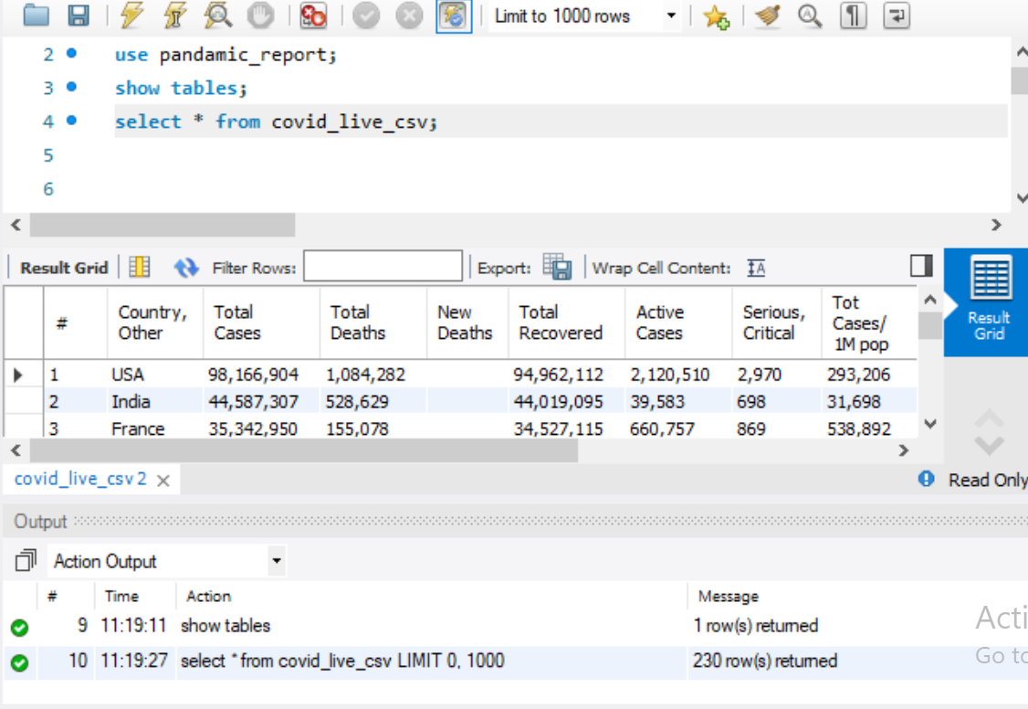
To see the imported table covid live csv in my sql workbench.
The code in the row DQL command is used see the complete table that is stored the data.
Syntax : select * from table_name;

Slide 8
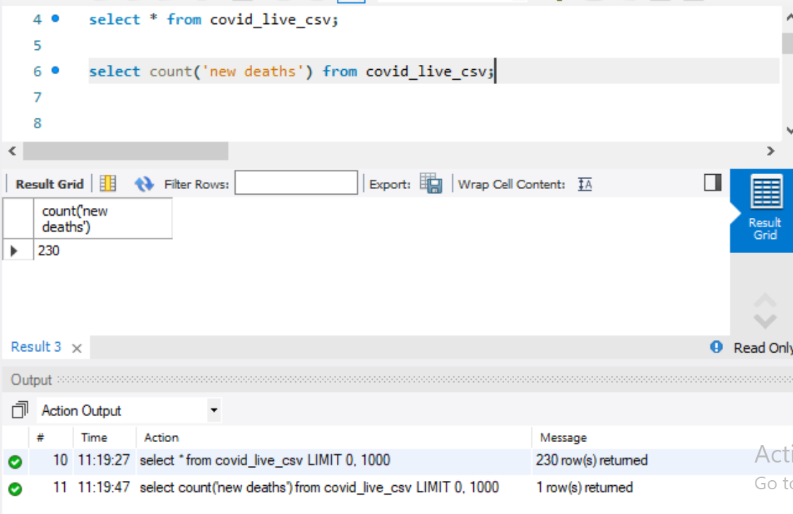
To count the new deaths in the dataset .
To know about your table structure use below query.
Syntax : Select count() from table_name;
* New deaths = 230

Slide 9
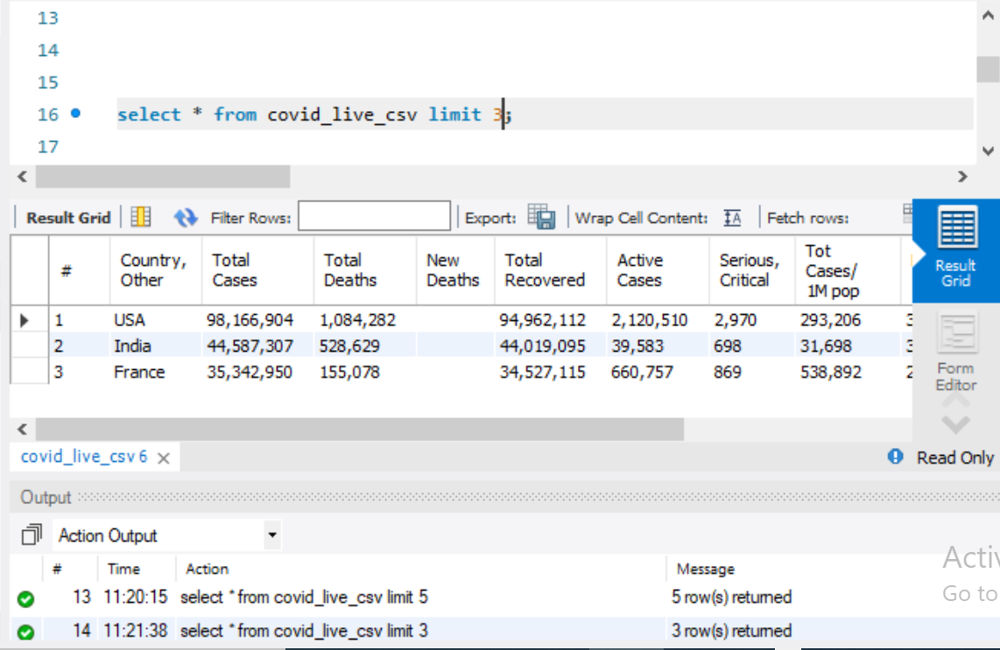
The select limit statement is used to return only limited rows.
Syntax : select * from table_name limit 3;
Only shows 3 rows when limit is apply.

Slide 10
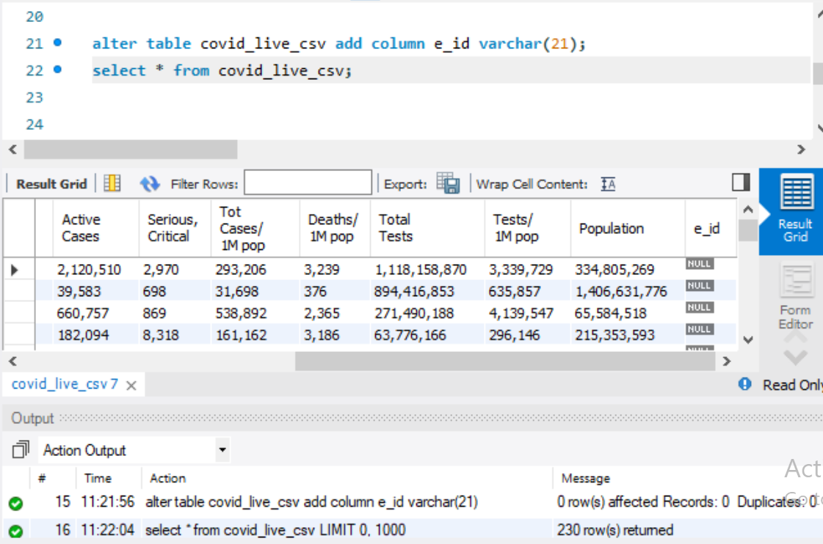
The alter table statement is used to add column in existing table.
Syntax : alter table table_name add column column_name datatype;

Slide 11
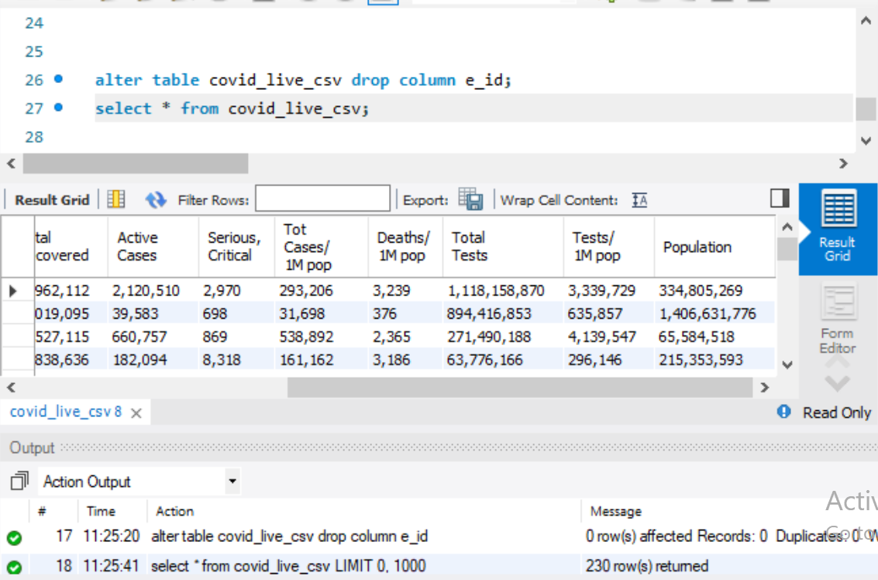
The drop column command is used to delete a column in an existing table
Syntax : alter table table_name drop column column_name;

Slide 12
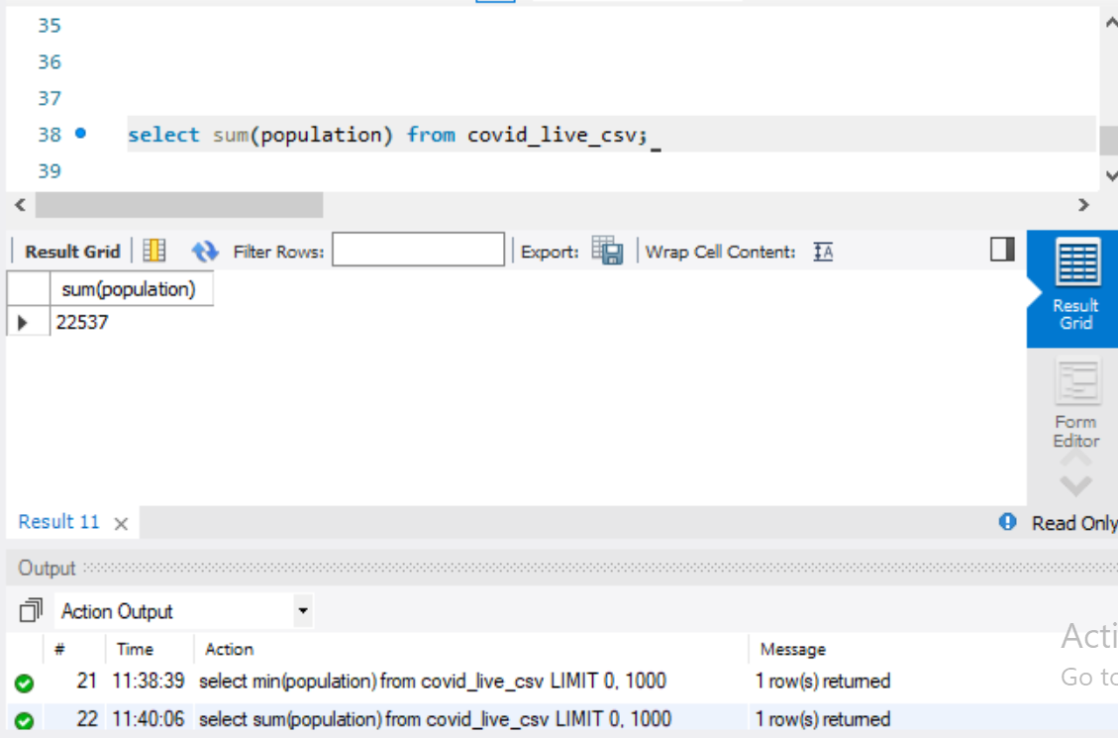
The sum() function returns the total sum of a numeric column.
Syntax : select sum() from table_name;
Sum = 22537

Slide 13
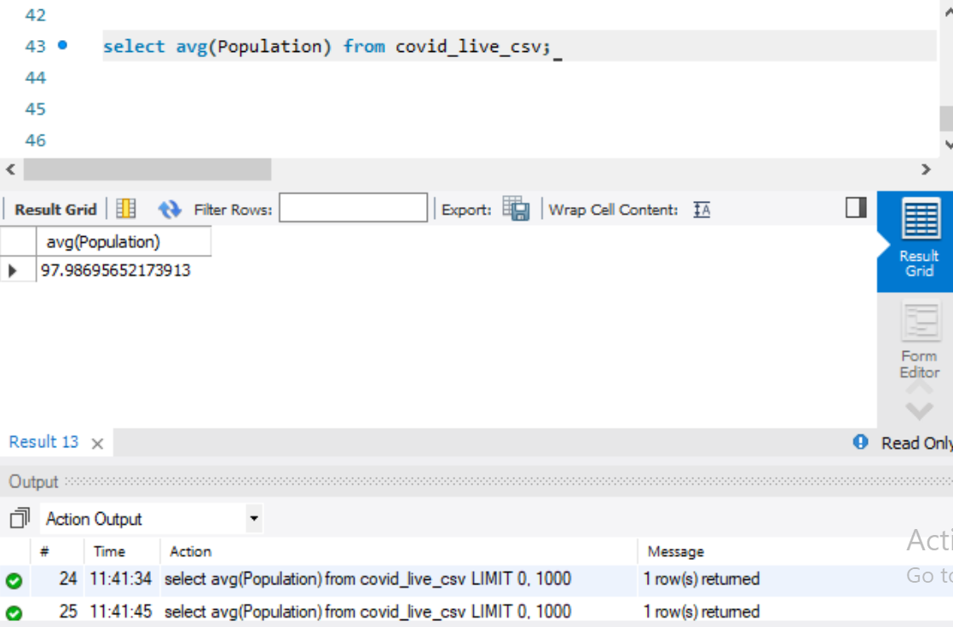
The avg() function returns the average value of an expression
Note : null values are ignored.
Syntax : select avg() from table_name;
avg = 97.9869565217

Slide 14
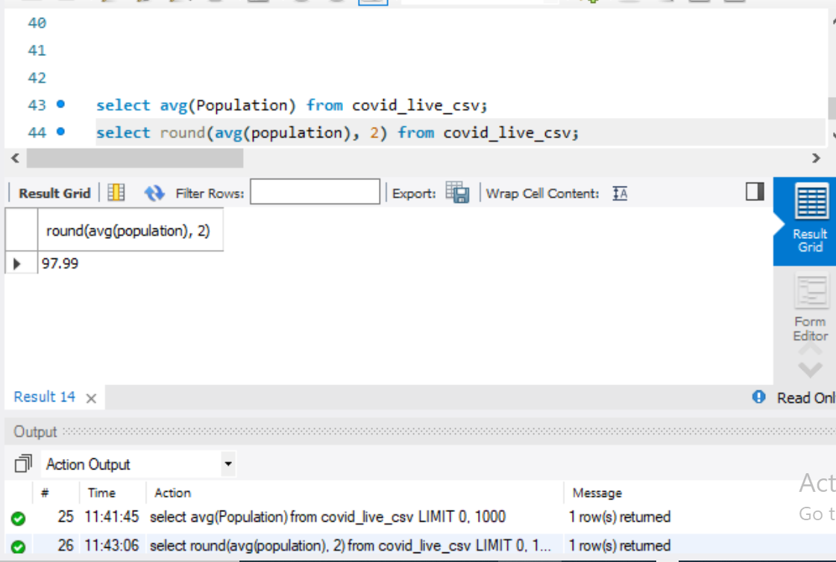
The SQL round () function us used to round the value up to a specific decimal places.
Syntax : select round(avg(), 3) from table_name;
Round() = 97.99.

Slide 15
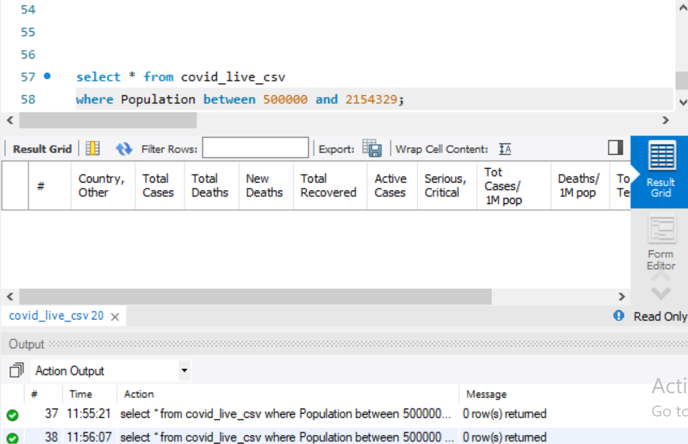
The where clause is used to filter records.
In this condition between operator is used
The between operator selects values within a given range. The values can be number.
The between operator is inclusive : begin and end values are included.
Syntax : select column_name from table_name where column_ name between value 1 and value 2;

Slide 16
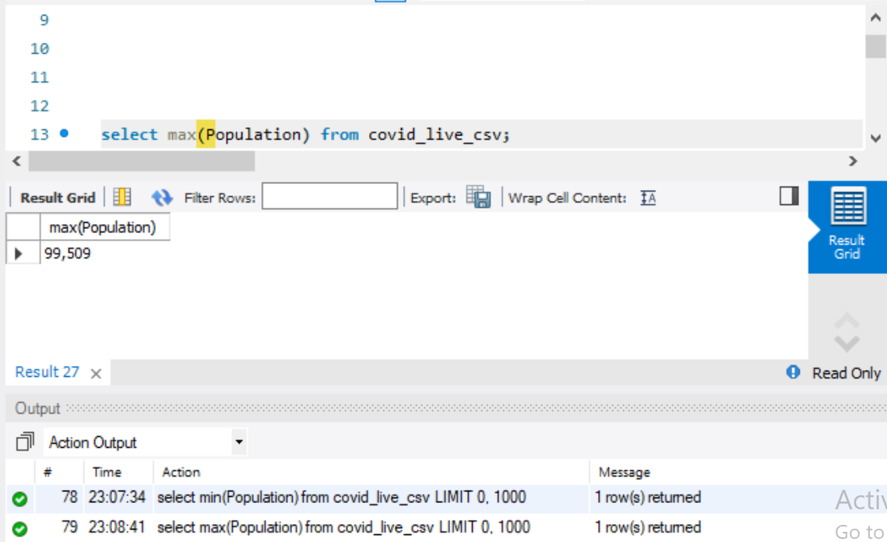
The SQL max() function returns the largest value of the selected column.
Syntax : select max() from table _name where condition;
Max = 99,509

Slide 17
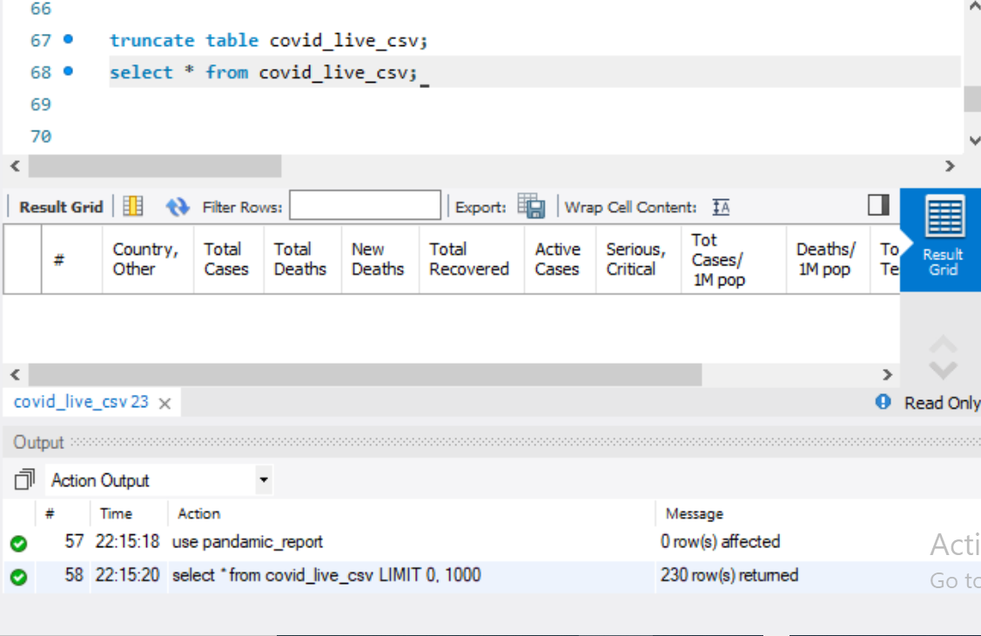
The truncate table command deletes the data inside a table, but not the table itself.
Syntax : truncate table table_name;

Slide 18
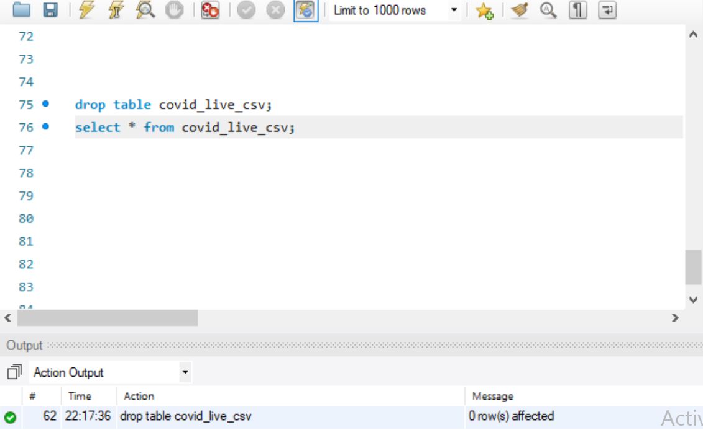
The drop table command deletes a table in the database.
Syntax : drop table table_name;

Slide 19
CONCLUSION
We have performed various filterings or analysis on covid live csv dataset using sql queries.
THANK YOU!

