Slide 1

f
PIZZA SALES ANALYSIS
By Using SQL Queries
Presented By : Shital Yadav

Slide 2
Introduction and Project Overview
Objective : Analyze and manage pizza sales data to gain insights about customer behavior, popular pizzas, order trends, and more.
Tools Used : MySQL for database management and query execution

Slide 3
Project Overview :
This SQL project revolves around a database schema designed to manage and analyse data for a pizza store. The database consists of four primary tables given as following :
Order_details, pizzas, orders and pizza_types
Each table plays a crucial role in storing different facts of the business operations, from individual orders to the types of pizzas offered. Below is a detailed description of each table and its columns:

Slide 4
Data Source and Tables
Here’s a concise description of each table in the dataset:
order_details
Stores details about each item (pizza) in an order, such as the specific pizza (pizza_id), the order it belongs to (order_id), and the quantity ordered.
Links to the “orders” table via order_id and to the pizza_types table via pizza_id.
orders
Contains information about customer orders, including the unique order_id, the date (date), and time (time) the order was placed.
Links to the “order_details” table via order_id.

Slide 5
pizza_types
Describes the types of pizzas available, with a unique pizza_type_id, name, category (e.g., Chicken, Veg), and ingredients.
Links to the “order_details” table via pizza_id (though there may be differences in ID format that need mapping).
Pizzas
This table has information about pizza size and price of each pizza types
Links to the “ pizza_types” via pizza_type_id and with “order_details” via pizza_id

Slide 6
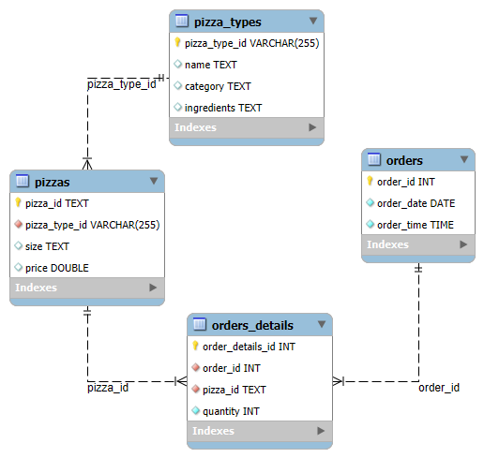
Entity-Relationship Diagram (ERD)
Created following diagram using MYSQL :

Slide 7
Here are some key points for discussing the Entity-Relationship Diagram (ERD)
Entities and Their Attributes:
Orders :
Attributes
order_id (primary key)
date
Time
Description : Represents an order placed by a customer, including when the order was made and the order's unique identifier.

Slide 8
Order_details :
Attributes
Order_details_id (primary key)
Order_id (foreign key to orders)
Pizza_id (foreign key to pizza_types)
Quantity
Description : Contains details of individual items in each order, including the type of pizza and the quantity ordered.
Pizza_types :
Attributes
Pizza_type_id (primary key)
Name

Slide 9
Categories
Ingradients
Description : Describes the available pizza types with relevant information like pizza name, category (e.g., Chicken, Veg), and ingredients.
Pizzas :
Attributes
Pizza_id (primary key)
Pizza_type_id (foreign key)
Size
Price
Description : This table has information about pizza size and price of each pizza types

Slide 10
Key Insights and Analysis
Popular Pizza Types: Query results showing the most ordered pizza types.
Order Trends: Number of orders per day or time of day (e.g., peak order times).
Quantity Trends: Most commonly ordered quantities for different pizza types.
Sales by Category: Analysis of which pizza categories (e.g., Chicken, Veg) are most popular.

Slide 11
SQL Queries and Results
Retrieve the total number of orders placed.
Calculate the total revenue generated from pizza sales.
Identify the highest-priced pizza.
Identify the most common pizza size ordered.
List the top 5 most ordered pizza types along with their quantities.
Join the necessary tables to find the total quantity of each pizza category ordered.
Determine the distribution of orders by hour of the day.
Join relevant tables to find the category-wise distribution of pizzas.
Group the orders by date and calculate the average number of pizzas ordered per day.

Slide 12
Group the orders by date and calculate the average number of pizzas ordered per day.
Determine the top 3 most ordered pizza types based on revenue.
Calculate the percentage contribution of each pizza type to total revenue.
Analyze the cumulative revenue generated over time.
Determine the top 3 most ordered pizza types based on revenue for each pizza category.

Slide 13
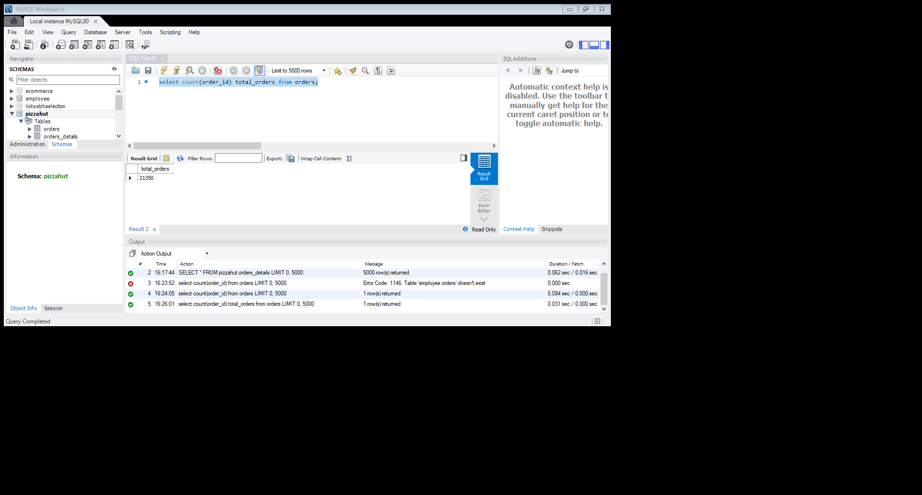

Retrieve the total number of orders placed.
select count(order_id) from orders;
Result :
Calculate the total revenue generated from pizza sales.
select round(sum(pizzas.price*orders_details.quantity),0) revenue from orders_details join pizzas on orders_details.pizza_id = pizzas.pizza_id;
Result :

Slide 14
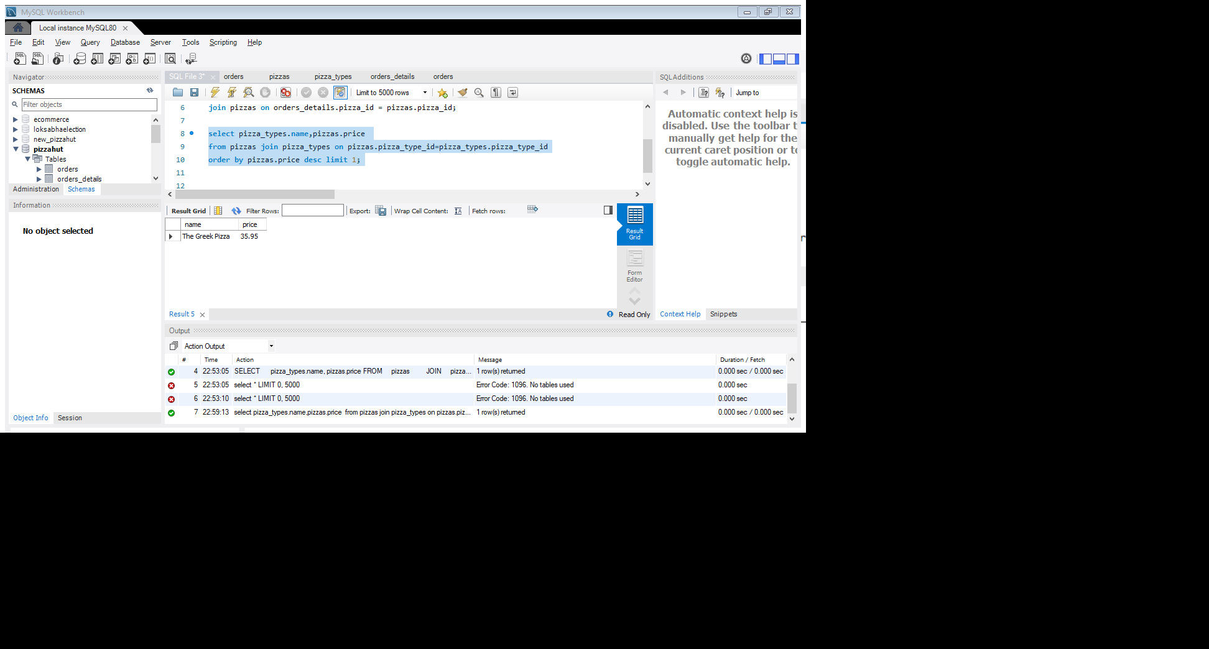
Identify the highest-priced pizza by using limit also without using limit function.
select pizza_types.name, pizzas.price from pizzas
join pizza_types on pizzas.pizza_type_id = pizza_types.pizza_type_id
order by pizzas.price desc limit 1;
Result :
By Using Window Function :

Slide 15
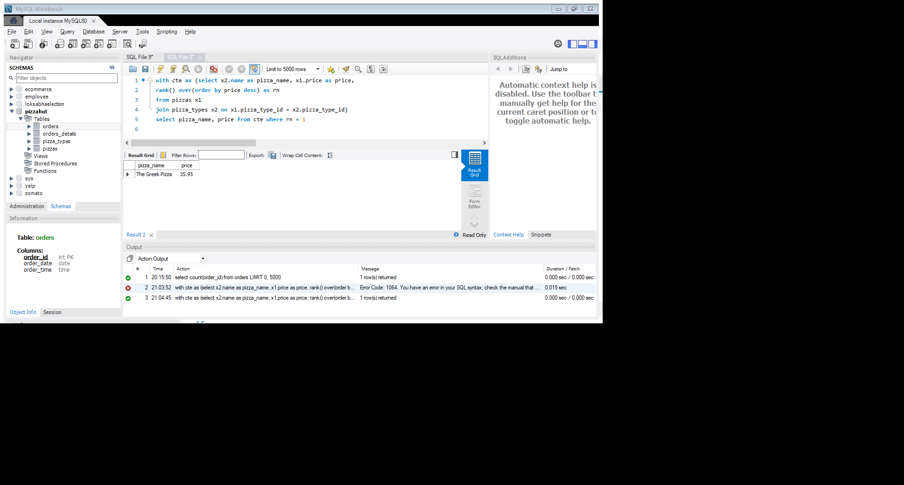
with cte as (select x2.name as pizza_name, x1.price as price,
rank() over(order by price desc) as rn
from pizzas x1
join pizza_types x2 on x1.pizza_type_id = x2.pizza_type_id)
select pizza_name, price from cte
where rn = 1
Result :
Identify the most common pizza size ordered.
select x1.size pizza_size, sum(x2.quantity) most_ordered_pizza
from pizzas x1
join orders_details x2 on x1.pizza_id = x2.pizza_id
group by x1.size;

Slide 16
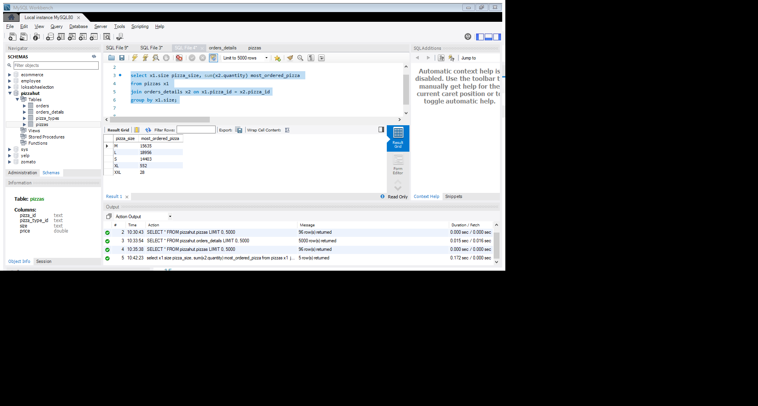
Results :
List the top 5 most ordered pizza types along with their quantities.
select x1.name, sum(x3.quantity) quantity
from pizza_types x1
join pizzas x2 on x1.pizza_type_id = x2.pizza_type_id
join orders_details x3 on x3.pizza_id = x2.pizza_id
group by x1.name order by quantity desc limit 5;

Slide 17
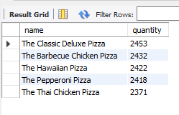
Result :
Join the necessary tables to find the total quantity of each pizza category ordered.
SELECT x1.category, SUM(x3.quantity) total_quantity
FROM pizza_types x1
JOIN pizzas x2 ON x1.pizza_type_id = x2.pizza_type_id
JOIN orders_details x3 ON x2.pizza_id = x3.pizza_id
GROUP BY x1.category;

Slide 18
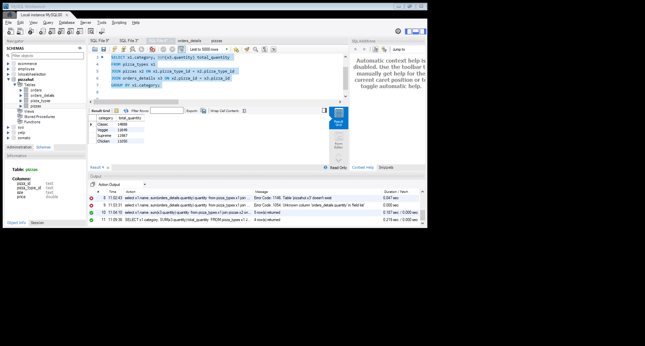
Result :
Top 5 most ordered day timings out of 24 hours
select hour(order_time) hour, count(order_id) order_count
from orders
group by hour(order_time) order by order_count desc limit 5;
Result :

Slide 19
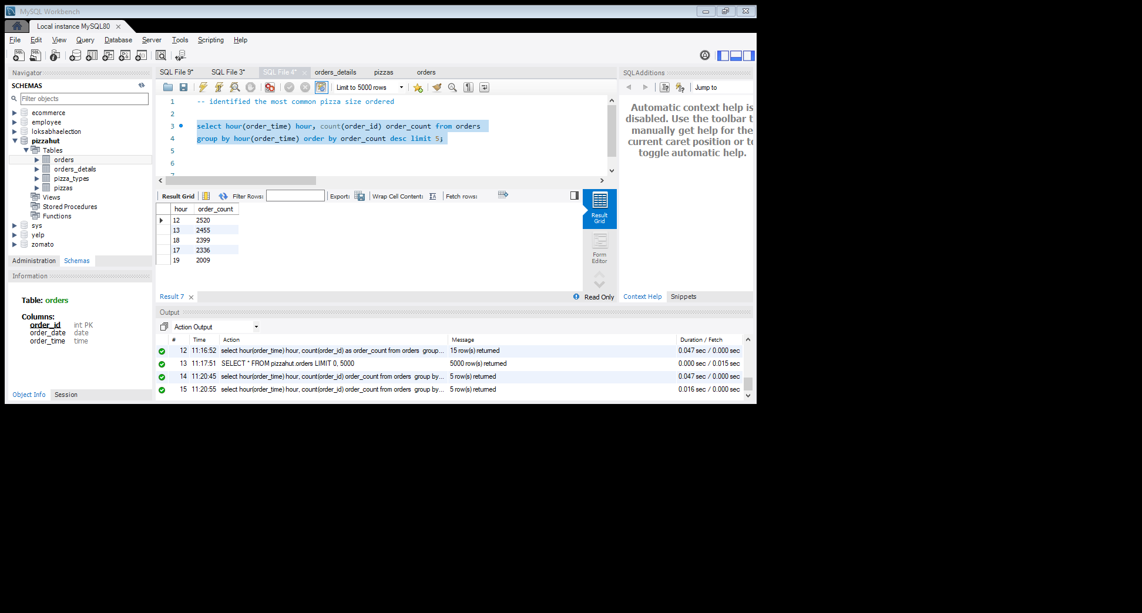
Result : as we can see from result people mostly orders at (12, 1 ) pm in afternoon
and at evening (5,6 and 7) pm
Join relevant tables to find the category-wise distribution of pizzas.
select x1.category, sum(x3.quantity) total_quantity
from pizza_types x1
join pizzas x2 on x1.pizza_type_id = x2.pizza_type_id
join orders_details x3 on x2.pizza_id = x3.pizza_id
group by x1.category

Slide 20
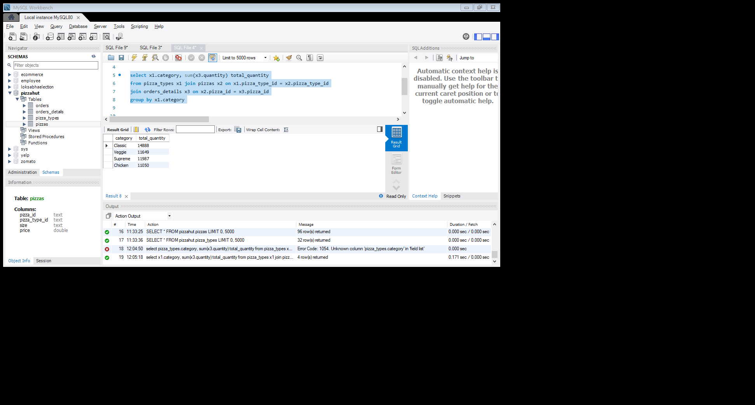
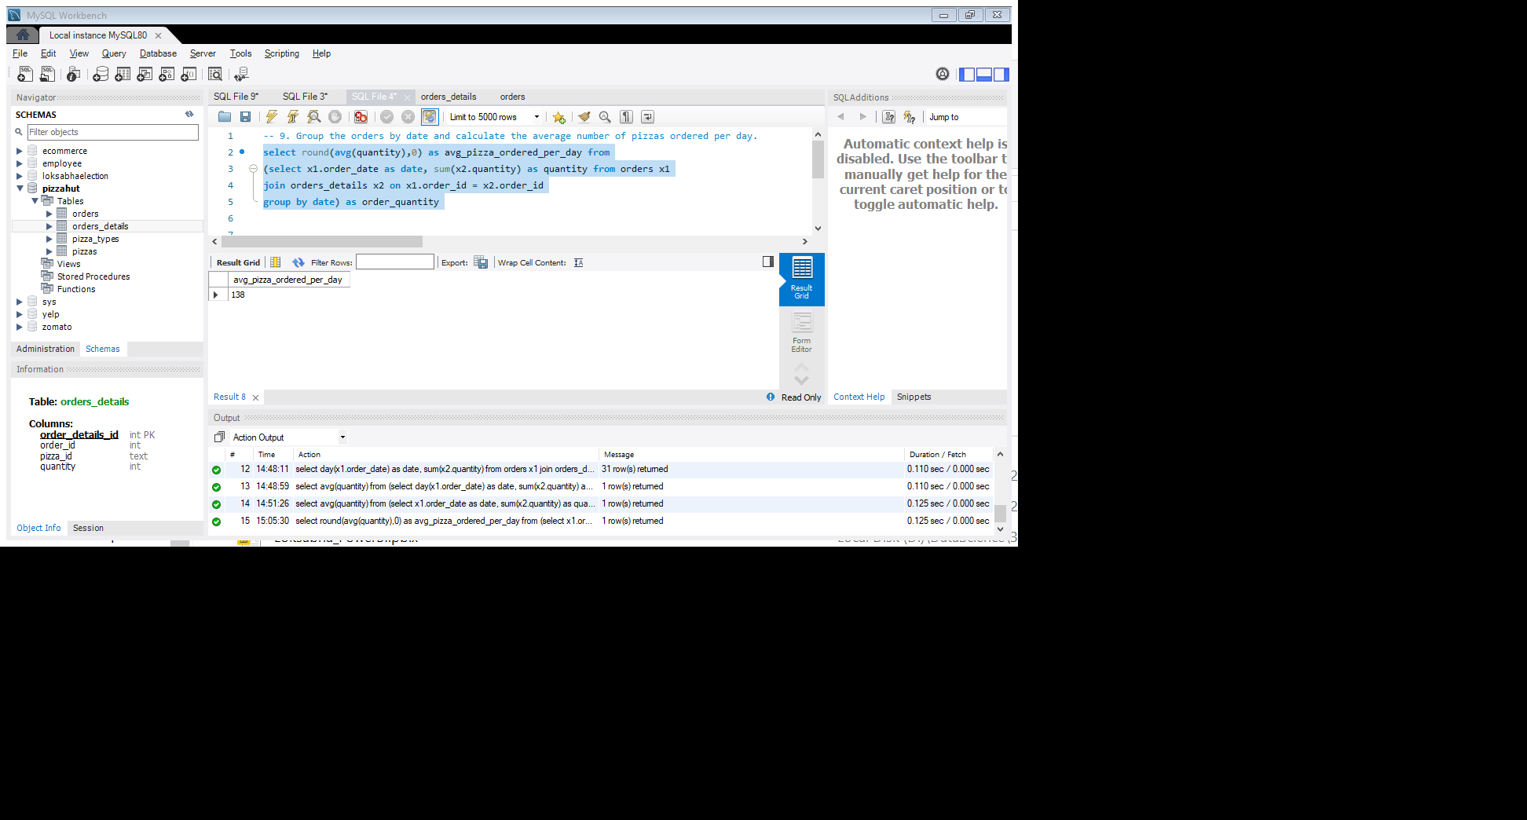
Result :
Group the orders by date and calculate the average number of pizzas ordered per day.
select round(avg(quantity),0) as avg_pizza_ordered_per_day
from(select x1.order_date as date, sum(x2.quantity) as quantity from orders x1
join orders_details x2 on x1.order_id = x2.order_id
group by date) as order_quantity
Result :

Slide 21
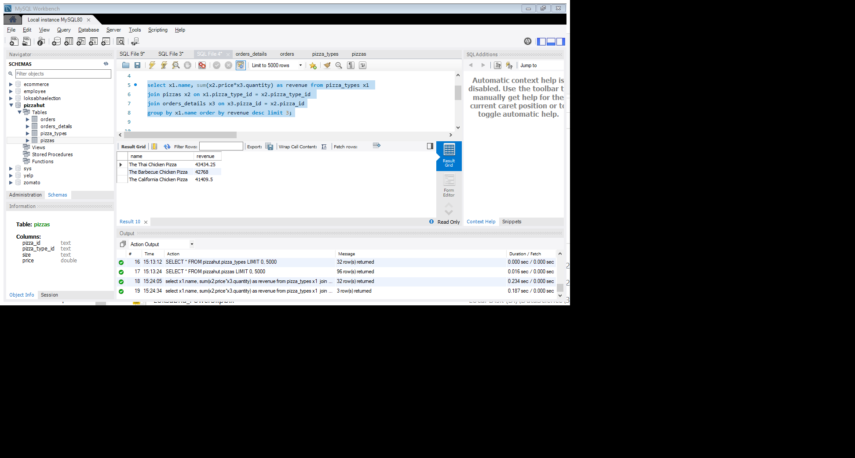
Determine the top 3 most ordered pizza types based on revenue.
select x1.name, sum(x2.price*x3.quantity) as revenue
from pizza_types x1
join pizzas x2 on x1.pizza_type_id = x2.pizza_type_id
join orders_details x3 on x3.pizza_id = x2.pizza_id
group by x1.name order by revenue desc limit 3;
Result :

Slide 22
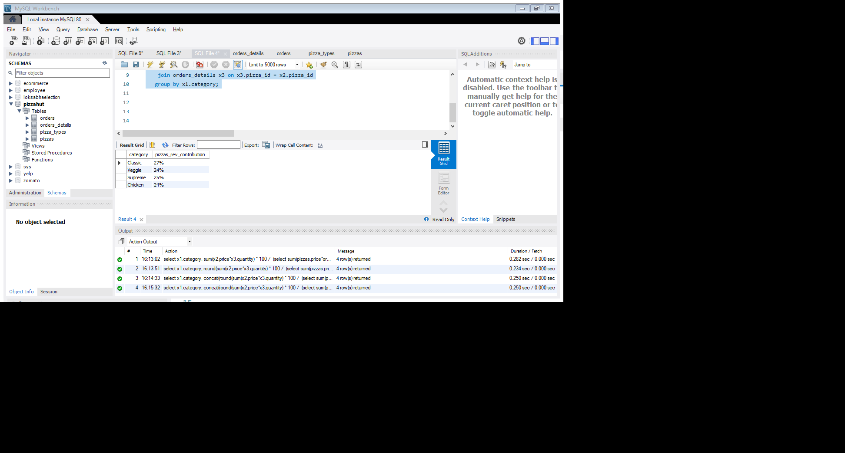
Calculate the percentage contribution of each pizza type to total revenue.
Select x1.category, concat(round(sum(x2.price*x3.quantity) * 100 / (select sum(pizzas.price*orders_details.quantity)
from pizzas join orders_details on pizzas.pizza_id = orders_details.pizza_id),0),'%’)
as pizzas_rev_contribution
from pizza_types x1
join pizzas x2 on x1.pizza_type_id = x2.pizza_type_id
join orders_details x3 on x3.pizza_id = x2.pizza_id
group by x1.category;
Result :

Slide 23
Analyze the cumulative revenue generated over time.
Used aggragate of window function (to get the cumulative sum)
with cte as (
select x1.order_date as date, sum(x3.price*x2.quantity) as revenue
from orders x1
join orders_details x2 on x1.order_id = x2.order_id
join pizzas x3 on x2.pizza_id = x3.pizza_id
group by date
)
select time, revenue, sum(revenue) over(order by date) cum_sum
from cte
Result : query output is given in file format at right bottom corner

Slide 24
Determine the top 3 most ordered pizza types based on revenue for each pizza category.
select category, name, revenue from
(select category, name, revenue,
rank() over(partition by category order by revenue desc) as ranking
from(
select x1.category, x1.name, sum(x2.price*x3.quantity) as revenue
from pizza_types x1
join pizzas x2 on x1.pizza_type_id = x2.pizza_type_id
join orders_details x3 on x2.pizza_id = x3.pizza_id
group by x1.category, x1.name) as temp_table) as a
where ranking <= 3;
Result : query output is given in file format at right bottom corner

Slide 25
THE END

