Slide 1
Networking Basics
Chapter-4

Slide 2
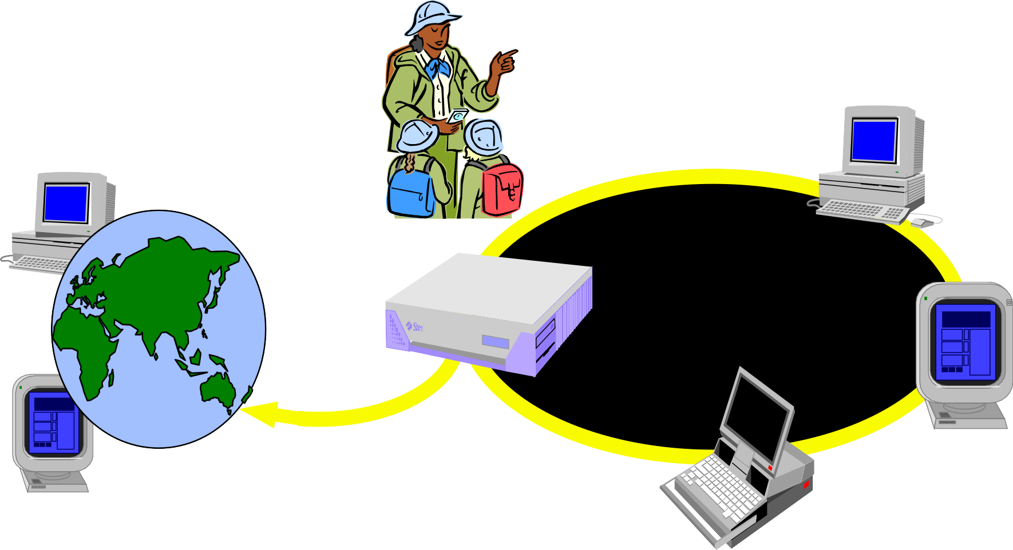

“The Network is Computer”
PC client
Internet Server
Local Area Network
PDA

Slide 3
Increased demand for Internet applications
To take advantage of opportunities presented by the Internet, businesses are continuously seeking new and innovative ways and means for offering their services via the Internet.
This created a huge demand for software designers with skills to create new Internet-enabled applications or migrate existing/legacy applications on the Internet platform.
Object-oriented Java technologies- Sockets, threads, RMI, clustering, Web services have emerged as leading solutions for creating portable, efficient, and maintainable large and complex Internet applications.

Slide 4
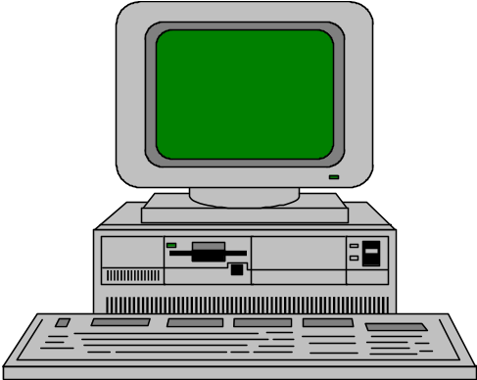


Elements of C-S Computing
a client, a server, and network
Client
Request
Server
Network
Result
Client machine
Server machine

Slide 5
Client/Server
A server is anything that has some resource that can be shared.
There are compute servers, which provide computing power; print servers, which manage a collection of printers; disk servers, which provide networked disk space; and web servers, which store web pages.
A client is simply any other entity that wants to gain access to a particular server.

Slide 6
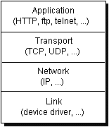
Networking Basics
Computers running on the Internet communicate with each other using either the Transmission Control Protocol (TCP) or the User Datagram Protocol (UDP)

Slide 7
DNS - Domain name system
The Domain Name system (DNS) associates various sorts of information with so-called domain names.
Most importantly, it serves as the "phone book" for the Internet by translating human-readable computer hostnames, e.g. www.example.com, into the IP addresses, e.g. 208.77.188.166, that networking equipment needs to deliver information.
It also stores other information such as the list of mail exchange servers that accept email for a given domain.

Slide 8
Understanding Ports
The TCP and UDP protocols use ports to map incoming data to a particular process running on a computer.
server
P
o
r
t
TCP
Client
app
app
app
app
port
port
port
port
TCP or UDP
Packet
Data
port#
data

Slide 9
Ports
Data transmitted over the Internet is accompanied by addressing information that identifies the computer and the port for which it is destined.
The computer is identified by its 32-bit IP address, which it uses to deliver data to the right computer on the network.
Ports are identified by a 16-bit number, which TCP and UDP use to deliver the data to the right application.

Slide 10
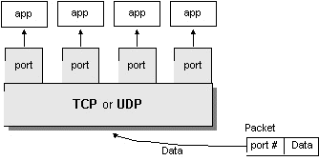
Port
Port numbers range from 0 to 65,535 (16-bit)
  Ports 0 - 1023 are called well-known ports. They are reserved for use by well-known services:
    20, 21: FTP
    23: TELNET
    25: SMTP
    110: POP3
    80: HTTP

Slide 11
Introduction to Sockets

Slide 12
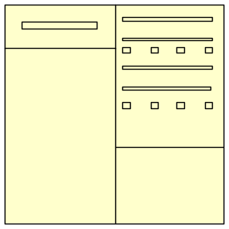
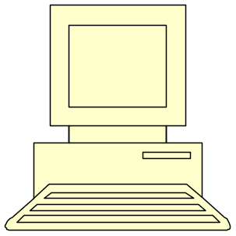
Socket
sockets (end points)
logical connection
A socket is an endpoint for communication between two machines.
The combination of an IP address and a port number.

Slide 13
Socket Communication
A server (program) runs on a specific computer and has a socket that is bound to a specific port.
The server waits and listens to the socket for a client to make a connection request.
server
port
Connection request
Client

Slide 14
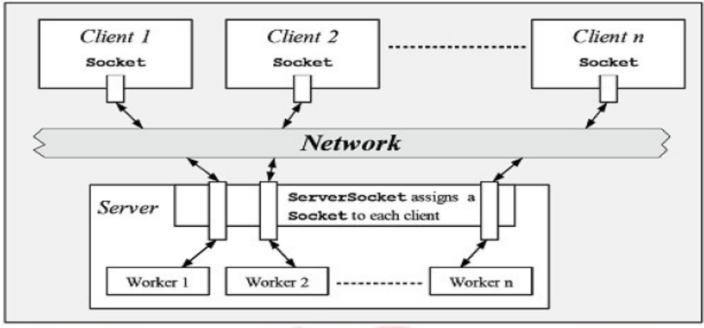
The notion of a socket allows a single computer to serve many different clients at once.
This feat is managed by the introduction of a port, which is a numbered socket on a particular machine.
A server process is said to listen to a port until a client connects to it

Slide 15
Why Sockets?
  Used for Interprocess communication.
The Client-Server model
  Client & Server are two processes that wants to communicate with each other
  The Client process connects to the Server process, to make a request for services own by the Server.
  Once the connection is established between Client process and Server process, they can start sending / receiving information.
What are Sockets?
  End-point of inter-process communication.
  An interface through which processes can
  send / receive information

Slide 16
What exactly creates a Socket?
  <IP address, Port #> tuple
What makes a connection?
  {Source<IP address, Port #> , Destination <IP address, Port #>} i.e. source socket – destination socket pair uniquely identifies a connection.
Example
Client
1343
Server
192.168.0.2
80
Client
1343
192.168.0.1
192.168.0.3
Client
5488
192.168.0.2

Slide 17
Socket Types
  STREAM – uses TCP which is reliable, stream oriented protocol,
  DATAGRAM – uses UDP which is unreliable, message oriented protocol
  RAW – provides RAW data transfer directly over IP protocol (no transport layer)
Sockets can use
  “unicast” ( for a particular IP address destination)
  “multicast” ( a set of destinations – 224.x.x.x)
  “broadcast” (direct and limited)
  “Loopback” address i.e. 127.x.x.x

Slide 18
Transmission Control Protocol
A connection-based protocol that provides a reliable flow of data between two computers.
Provides a point-to-point channel for applications that require reliable communications.
  The Hypertext Transfer Protocol (HTTP), File Transfer Protocol (FTP), and Telnet are all examples of applications that require a reliable communication channel
Guarantees that data sent from one end of the connection actually gets to the other end and in the same order it was sent. Otherwise, an error is reported.

Slide 19
User Datagram Protocol
A protocol that sends independent packets of data, called datagrams, from one computer to another with no guarantees about arrival. UDP is not connection-based like TCP and is not reliable:
  Sender does not wait for acknowledgements
  Arrival order is not guaranteed
  Arrival is not guaranteed
Used when speed is essential, even in cost of reliability
  e.g. streaming media, games, Internet telephony, etc.

Slide 20
Proxy Server
A proxy server is a dedicated computer or a software system running on a computer that acts as an intermediary between client and server from which a user or client is requesting a service.
The proxy server may exist in the same machine as a firewall server or it may be on a separate server, which forwards requests through the firewall.

Slide 21
Working of Proxy Server
When a proxy server receives a request for an Internet resource (such as a Web page), it looks in its local cache of previous pages.
If it finds the page, it returns it to the user without needing to forward the request to the Internet.
If the page is not in the cache, the proxy server, acting as a client on behalf of the user, uses one of its own IP addresses to request the page from the server out on the Internet.
When the page is returned, the proxy server relates it to the original request and forwards it on to the user.

Slide 22
Proxy Server
Proxy servers are related to firewalls. If a firewall prevents hosts on a network from making direct connections to the outside world, a proxy server can act as a go-between.
Thus, a machine that is prevented from connecting to the external network by a firewall would make a request for a web page from the local proxy server instead of requesting the web page directly from the remote web server.

Slide 23
One of the security advantages of using a proxy server is that external hosts only find out about the proxy server.
They do not learn the names and IP addresses of the internal machines, making it more difficult to hack into internal systems.

Slide 24
Internet Addressing
Every computer on the Internet has an address.
An Internet address is a number that uniquely identifies each computer on the Net.
Originally, all Internet addresses consisted of 32-bit values.
This address type was specified by IPv4 (Internet Protocol, version 4).
However, a new addressing scheme, called IPv6 (Internet Protocol, version 6) has come into play.
IPv6 uses a 128-bit value to represent an address.
The main advantage of IPv6 is that it supports a much larger address space than does IPv4.
IPv4 is the most widely used scheme, but this situation is likely to change over time.

Slide 25
Internet Addressing
There are 32 bits in an IPv4 IP address, and we often refer to them as a sequence of four numbers between 0 and 255 separated by dots (.).
The first few bits define which class of network, letter A, B, C, D, or E, the address represents.
Most Internet users are on a class C network, since there are over two million networks in class C.
The first byte of a class C network is between 192 and 224, with the last byte actually identifying an individual computer among the 256 allowed on a single class C network.
This scheme allows for half a billion devices to live on class C networks.

Slide 26
Java and the Net

Slide 27
Internet Addressing
Handling internet addresses (domain names, and IP addresses) is made easy with Java.
Internet addresses are represented in Java by the InetAddress class.
InetAddress provides simple methods to convert between domain names, and numbered addresses.

Slide 28
InetAddress
The InetAddress class is used to encapsulate both the numerical IP address and the domain name for that address.
We interact with this class by using the name of an IP host, which is more convenient and understandable than its IP address.
The InetAddress class hides the number inside.

Slide 29
InetAddress class
static methods you can use to create new InetAddress objects.
  getByName(String host)
  getAllByName(String host)
  getLocalHost()
  getByAddress(Byte[] addr)
  getByAddress(String host, Byte[] addr)
InetAddress x = InetAddress.getByName( “msbte.com”);
throws UnknownHostException

Slide 30
Factory Methods
static InetAddress getLocalHost( )
  returns the IP address of the localhost machine.
static InetAddress getByName(String hostName)
  returns an InetAddress instance representing the hostname.
static InetAddress[ ] getAllByName(String hostName)
  returns an array of InetAddress instances representing the hostname.
static InetAddress getByAddress(byte[] addr)
  Returns an InetAddress object given the raw IP address.
static InetAddress getByAddress(String host, byte[] addr)
  Creates an InetAddress based on the provided host name and IP address.
*Note each methiod: throws UnknownHostException

Slide 31
Factory Methods Example
class InetAddressTest {
public static void main(String args[]) throws UnknownHostException {
InetAddress Address = InetAddress.getLocalHost();
System.out.println(Address);
Address = InetAddress.getByName("www.javatpont.com");
System.out.println(Address);
InetAddress SW[]=InetAddress.getAllByName("www.yahoo.com");
for (int i=0; i<SW.length; i++)
System.out.println(SW[i]); }}
D:\jdk1.7.0_17\bin>java InetAddressTest
DESKTOP-OJIM16I/192.168.0.5
google.com/172.217.166.46
www.yahoo.com/106.10.250.11
www.yahoo.com/106.10.250.10

Slide 32
Instance Methods
boolean equals(Object obj)
  Compares two IP addresses, returns true if there is a match.
byte[ ] getAddress( )
  Returns the IP address in byte format.
String getHostAddress( )
  Returns the IP address in dotted decimal format.
String getHostName( )
  Returns the hostname of the InetAddress.
boolean isMulticastAddress( )
  Returns true if the InetAddress is a multicast address (class D address).
  String toString()
  Converts this IP address to a String.

Slide 33
Instance Methods
import java.net.*;
class InetAddressTest1{
public static void main(String args[])throws UnknownHostException {
InetAddress Address = InetAddress.getByName("www.google.com");
System.out.println(Address.getHostAddress());
System.out.println(Address.getHostName());
if(Address.isMulticastAddress())
System.out.println("It is multicast address");
} }
D:\jdk1.7.0_17\bin>javac InetAddressTest1.java
D:\jdk1.7.0_17\bin>java InetAddressTest1
216.58.203.164
www.google.com

Slide 34
TCP/IP Sockets
Server sockets
  Wait for requests to come in over the network
  Implemented by java.net.ServerSocket class
Client sockets
  Used to send and receive data
  Can be thought of as a pair of input and output streams.
  Implemented by java.net.Socket class

Slide 35
Server vs Client Socket
Server socket: waiting for connection requests
Client socket: transmission of data
server socket
connection request
client socket

Slide 36
Server socket
The constructors used to create server socket are given below. All of them throw IOException
ServerSocket (int port) throws BindException, IOException
  creates a server socket bounded to the specified port with a queue length 50.
ServerSocket (int port, int maxQueue) throws BindException, IOException
  creates a server socket bounded to the specified port with a queue length of maxQueue.
ServerSocket (int port, int maxQ, InetAddress ip) throws IOException
  creates a server socket bounded to the specified port with a queue length of maxQueue. On a multihomed host, ip specifies the IP Address to which this socket binds.

Slide 37
Client socket
The constructors used to server socket are given below. All of them throw IO Exception
public Socket(String host, int port) throws UnknownHostException, IOException.
  Creates a socket connecting to the local host to the named host and port
public Socket(InetAddress host, int port) throws IOException
  Creates a socket using a preexisting InetAddress and port

Slide 38
Server socket
Methods
Some method defined in the Server Socket are:
Methods | Description
public Socket accept() throws IOException | Waits for a connection request and returns a Socket
public void setSoTimeout(int timeout) | Sets the time-out value for how long the server socket waits for a client during the accept().
public int getLocalPort() | Returns the port number on which this socket is listening

Slide 39
Methods used by both Server and Client Sockets
Methods | Description
public int getPort() | Returns the remote port to which this socket is bound.
public int getLocalPort() | Returns the port the socket is bound to on the local machine.
public InetAddress getInetAddress() | Returns IP address to which socket are connected.
public SocketAddress getLocalAddress() | Returns local address to which socket are connected.
public SocketAddress getRemoteSocketAddress() | Returns the address of the remote socket.
public InputStream getInputStream() throws IOException | Returns an InputStream for receiving data.
public OutputStream getOutputStream() throws IOException | Returns an OutputStream to send data.
public void close() throws IOException | Closes the socket connection.

Slide 40
Programming TCP Client-Server in Java
All the classes related to sockets are in the java.net package.
All the input/output stream classes are in the java.io package.
How to open a socket?
  If you are programming a client, then create object of Socket class.
  Machine name is the machine you are trying to open a connection to,
  PortNumber is the port (a number) on which the server you are trying to connect to is running. select one that is greater than 1,023.
      Socket MyClient;
      try {
      MyClient = new Socket("Machine name", PortNumber);
      }
      catch (IOException e) {
      System.out.println(e);
      }

Slide 41
Programming TCP Client-Server in Java
If you are programming a server, then this is how you open a socket:
When implementing a server you also need to create a socket object from the ServerSocket in order to listen for and accept connections from clients.
      ServerSocket MyService;
      try {
      MyServerice = new ServerSocket(PortNumber);
      }
      catch (IOException e) {
      System.out.println(e);
      }
      Socket clientSocket = null;
      try {
      clientSocket = MyService.accept();
      }
      catch (IOException e) {
      System.out.println(e);
      }

Slide 42
Programming TCP Client-Server in Java
How to create an input stream?
  On the client side, you can use the DataInputStream class to create an
  input stream to receive response from the server:
  The class DataInputStream allows you to read lines of text and Java
  primitive data types. It has methods such as read, readChar, readInt, readDouble, and readLine,.
  On the server side, you can use DataInputStream to receive input from
  the client:
      DataInputStream input;
      try {
      input = new DataInputStream(MyClient.getInputStream());
      }
      catch (IOException e) {
      System.out.println(e);
      }
      DataInputStream input;
      try {
      input = new DataInputStream(clientSocket.getInputStream());
      }
      catch (IOException e) {
      System.out.println(e);
      }

Slide 43
Programming TCP Client-Server in Java
How to create an output stream?
  On the client side, you can create an output stream to send information
  to the server socket using the class PrintStream or DataOutputStream
  of java.io:
  The class PrintStream has methods for displaying textual representation
  of Java primitive data types. Its write and println methods are important.
  Also, you may want to use the DataOutputStream:
  Many of its methods write a single Java primitive type to the output stream.
  The method writeBytes is a useful one.
      PrintStream output;
      try {
      output = new PrintStream(MyClient.getOutputStream());
      }
      catch (IOException e) {
      System.out.println(e);
      }
      DataOutputStream output;
      try {
      output = new DataOutputStream(MyClient.getOutputStream());
      }
      catch (IOException e) {
      System.out.println(e);
      }

Slide 44
Programming TCP Client-Server in Java
On the server side
  you can use the class PrintStream to send information to the client.
Note: You can use the class DataOutputStream as mentioned previously.
      PrintStream output;
      try {
      output = new PrintStream(clientSocket.getOutputStream());
      }
      catch (IOException e) {
      System.out.println(e);
      }

Slide 45
Programming TCP Client-Server in Java
How to close sockets?
  You should always close the output and input stream before you close
  the socket.
  On the client side:
  On the server side:
      try {
      output.close();
      input.close();
      MyClient.close();
      }
      catch (IOException e) {
      System.out.println(e);
      }
      try {
      output.close();
      input.close();
      clientSocket.close();
      MyService.close();
      }
      catch (IOException e) {
      System.out.println(e);
      }

Slide 46
File: MyServer.java
import java.io.*;
import java.net.*;
public class MyServer
{
public static void main(String[] args)
{
try
{
ServerSocket ss=new ServerSocket(6666);
Socket s=ss.accept();//establishes connection
DataInputStream dis=new DataInputStream(s.getInputStream());
String str=(String)dis.readUTF();
System.out.println("message= "+str);
ss.close();
}
catch(Exception e)
{
System.out.println(e);
}
}
}

Slide 47
MyClient.java
import java.io.*;
import java.net.*;
public class MyClient
{
public static void main(String[] args)
{
try
{
Socket s=new Socket("localhost",6666);
DataOutputStream dout=new DataOutputStream(s.getOutputStream());
dout.writeUTF("Hello Server");
dout.flush();
dout.close();
s.close();
}
catch(Exception e)
{
System.out.println(e);
}
}
}

Slide 48
Example of Java Socket Programming (Read-Write both side)

Slide 49
MyServer.java
import java.net.*;
import java.io.*;
class MyServer{
public static void main(String args[])throws Exception{
ServerSocket ss=new ServerSocket(3333);
Socket s=ss.accept();
DataInputStream din=new DataInputStream(s.getInputStream());
DataOutputStream dout=new DataOutputStream(s.getOutputStream());
BufferedReader br=new BufferedReader(new InputStreamReader(System.in));
String str="",str2="";
while(!str.equals("stop")){
str=din.readUTF();
System.out.println("client says: "+str);
str2=br.readLine();
dout.writeUTF(str2);
dout.flush();
}
din.close();
s.close();
ss.close();
}}

Slide 50
MyClient.java
import java.net.*;
import java.io.*;
class MyClient{
public static void main(String args[])throws Exception{
Socket s=new Socket("localhost",3333);
DataInputStream din=new DataInputStream(s.getInputStream());
DataOutputStream dout=new DataOutputStream(s.getOutputStream());
BufferedReader br=new BufferedReader(new InputStreamReader(System.in));
String str="",str2="";
while(!str.equals("stop")){
str=br.readLine();
dout.writeUTF(str);
dout.flush();
str2=din.readUTF();
System.out.println("Server says: "+str2);
}
dout.close();
s.close();
}}

Slide 51
DatagramSocket and DatagramPacket
Java DatagramSocket and DatagramPacket classes are used for connection-less socket programming.

Slide 52
DatagramSocket class
DatagramSocket class represents a connection-less socket for sending and receiving datagram packets.
A datagram is basically an information but there is no guarantee of its content, arrival or arrival time.

Slide 53
Constructors of DatagramSocket class
DatagramSocket() throws SocketException:
  it creates a datagram socket and binds it with the available Port Number on the localhost machine.
DatagramSocket(int port) throws SocketException:
  it creates a datagram socket and binds it with the given Port Number.
DatagramSocket(int port, InetAddress address) throws SocketException:
  it creates a datagram socket and binds it with the specified port number and host address.

Slide 54
Methods
public void bind(SocketAddress addr)
  Binds this socket to specified address and port number.
public void connect(InetAddress address, int port)
  Connects to the specified address and port.
public void send(DatagramPacket p)
  Sends a datagram packet from this socket.
public void receive(DatagramPacket p)
  It is used to receive the packet from a sender.

Slide 55
DatagramPacket class
DatagramPacket is a message that can be sent or received. If you send multiple packet, it may arrive in any order.
Constructors
DatagramPacket(byte[] barr, int length):
  This constructor is used to receive the packets.
DatagramPacket(byte[] barr, int length, InetAddress address, int port):
  This constructor is used to send the packets.

Slide 56
import java.net.*;
public class DSender{
public static void main(String[] args) throws Exception {
DatagramSocket ds = new DatagramSocket();
String str = "Welcome java";
InetAddress ip = InetAddress.getByName("127.0.0.1");
DatagramPacket dp = new DatagramPacket(str.getBytes(), str.length(), ip, 3000);
ds.send(dp);
ds.close();
}
}

Slide 57
import java.net.*;
public class DReceiver{
public static void main(String[] args) throws Exception {
DatagramSocket ds = new DatagramSocket(3000);
byte[] buf = new byte[1024];
DatagramPacket dp = new DatagramPacket(buf, 1024);
ds.receive(dp);
String str = new String(dp.getData(), 0, dp.getLength());
System.out.println(str);
ds.close();
}
}

Slide 58
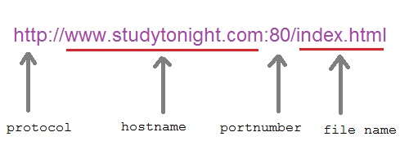
URL Class
Java URL Class present in java.net package, deals with URL (Uniform Resource Locator) which uniquely identify or locate resources on internet.
Format:

Slide 59
Constructors of URL class
URL (String urlspecifier)
  Creates a URL object from the String representation.
URL (String protocol, String host, int port, String file)
  Creates a URL object from the specified protocol, host, port number, and file.
URL (String protocol, String host, String file)
  Creates a URL from the specified protocol name, host name, and file name.
URL (URL urlObj, String urlspecifier)
  Creates a URL by parsing the given spec within a specified context.

Slide 60
Important Methods of URL class
getProtocol()
  Returns protocol of URL
getHost()
  Returns hostname(domain name) of URL
getPort()
  Returns port number of URL
getFile()
  Returns filename of URL
public URLConnection openConnection() throws IOException
  Creates a URLConnection object that contains a connection to the remote object referred to by the URL.
public final Object getContent() throws IOException
  Gets the contents from this opened connection.

Slide 61
Protocol: https
Host Name: www.google.com
Port Number: -1
Default Port Number: 443
Query String: q=javatpoint&oq=javatpoint&sourceid=chrome&ie=UTF-8
Path: /search
File: /search?q=javatpoint&oq=javatpoint&sourceid=chrome&ie=UTF-8
import java.net.*;
public class URLDemo{
public static void main(String[] args){
try{
URL url=new URL("https://www.google.com/search?q=javatpoint&oq=javatpoint& sourceid=chrome&ie=UTF-8");
  System.out.println("Protocol: "+url.getProtocol());
  System.out.println("Host Name: "+url.getHost());
  System.out.println("Port Number: "+url.getPort());
  System.out.println("Default Port Number: "+url.getDefaultPort());
  System.out.println("Query String: "+url.getQuery());
  System.out.println("Path: "+url.getPath());
  System.out.println("File: "+url.getFile());
} catch(Exception e){System.out.println(e);}
} }

Slide 62
URLConnection Class
URLConnection is an abstract class that represents an active connection to a resource specified by a URL.
  It provides more control over the interaction with a server (HTTP server) than the URL class.
  With a URLConnection, we can inspect the header sent by the server.
  We can set the header fields used in the client request.
  A URLConnection lets us send data back to a web server with POST or PUT and use other HTTP request methods.

Slide 63
Constructor of URLConnection class
protected URLConnection(URL url)
  Constructs a URL connection to the specified URL.

Slide 64
Methods of URLConnection class
public abstract void connect()throws IOException
  Opens a communications link to the resource referenced by this URL.
public URL getURL()
  Returns the value of this URLConnection's URL field.
public int getContentLength()
  Returns the value of the content-length header field.
public String getContentType()
  Returns the value of the content-type header field.
public long getDate()
  Returns the value of the date header field.
public Object getContent()throws IOException
  Retrieves the contents of this URL connection.
public InputStream getInputStream()throws IOException
  Returns an input stream that reads from this open connection.
public OutputStream getOutputStream()throws IOException
  Returns an output stream that writes to this connection.

Slide 65
<!DOCTYPE HTML PUBLIC "-//IETF//DTD HTML 2.0//EN">
<html><head>
<title>302 Found</title>
</head><body>
<h1>Found</h1>
<p>The document has moved <a href="https://www.javatpoint.com/java-tutorial">here</a>.</p>
</body></html>
import java.io.*;
import java.net.*;
public class URLConnectionExample {
public static void main(String[] args){
try{
URL url=new URL("http://www.javatpoint.com/java-tutorial");
URLConnection urlcon=url.openConnection();
InputStream stream=urlcon.getInputStream();
int i;
while((i=stream.read())!=-1){
System.out.print((char)i);
} }catch(Exception e){System.out.println(e);}
} }

