Slide 1
Interacting with Database

Slide 2
ODBC
ODBC stands for Open Database Connectivity
A standard or open application programming interface (API) for accessing a database.
ODBC provides a C interface for database access on Windows environment.

Slide 3
JDBC
JDBC stands for Java Database Connectivity.
It is a standard Java API for connecting programs written in Java to the data in relational databases.
JDBC works with Java on a variety of platforms, such as Windows, Mac OS, and the various versions of UNIX.

Slide 4
JDBC Driver
JDBC Driver is a software component that enables java application to interact with the database. There are 4 types of JDBC drivers:
JDBC-ODBC bridge driver
Native-API driver (partially java driver)
JDBC-Net pure Java/ Network-Protocol driver (fully java driver)
Pure Java Driver /Thin driver / Database-Protocol driver(fully java driver)

Slide 5
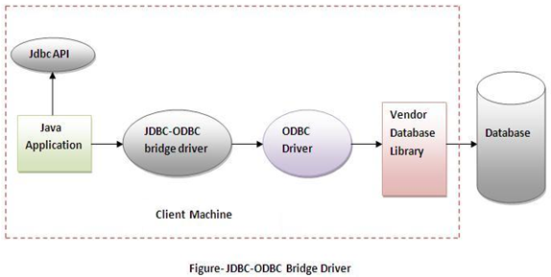
JDBC-ODBC bridge driver
The JDBC type 1 driver, also known as the JDBC-ODBC bridge driver.
The JDBC-ODBC bridge driver uses ODBC driver to connect to the database. The JDBC-ODBC bridge driver converts JDBC method calls into the ODBC function calls.

Slide 6
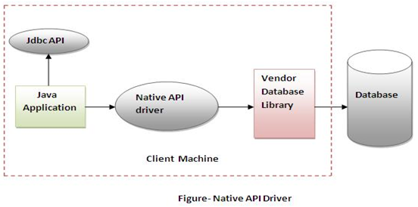
Native API driver
The JDBC type 2 driver, also known as the Native-API driver
The Native API driver uses the client-side libraries of the database. The driver converts JDBC method calls into native calls of the database API. It is not written entirely in java.

Slide 7
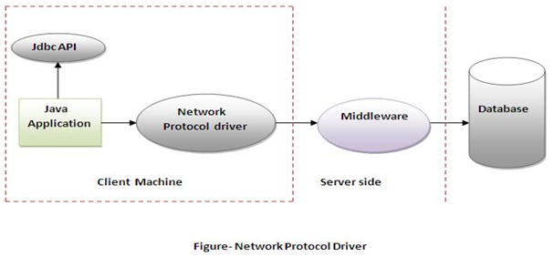
JDBC-Net pure Java Driver
The JDBC type 3 driver, also known as the Pure Java driver for database middleware. It is a database driver implementation which makes use of a middle tier between the calling program and the database.
The middle-tier (application server) converts JDBC calls directly or indirectly into a vendor-specific database protocol. It is fully written in java.

Slide 8
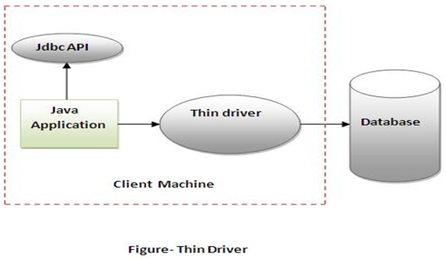
Thin driver
The JDBC type 4 driver, also known as the Direct to Database Pure Java Driver, is a database driver implementation that converts JDBC calls directly into a vendor specific database protocol.
That is why it is known as thin driver. It is fully written in Java language.

Slide 9
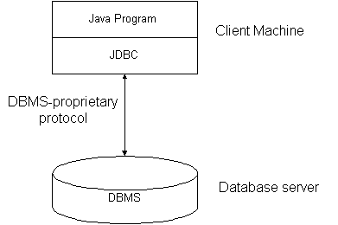
JDBC two tier model
In a two-tier model, a Java application communicates directly with the database, via the JDBC driver.

Slide 10
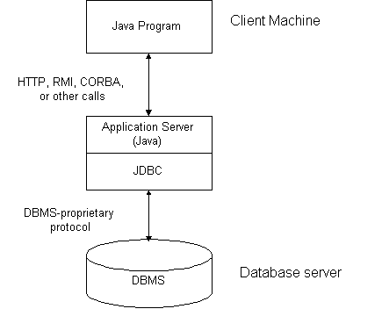
JDBC three tier model
In a three-tier model, a Java application communicates with a middle tier component that functions as an application server. The application server talks to a given database using JDBC.

Slide 11
Common JDBC Components
The JDBC API provides the following interfaces and classes −
DriverManager Class
Driver Interface
Connection Interface
Statement Interface
ResultSet Interface

Slide 12
Common JDBC Components
DriverManager Class
The DriverManager class acts as an interface between user and drivers.
It keeps track of the drivers that are available and handles establishing a connection between a database and the appropriate driver.
The DriverManager class maintains a list of Driver classes that have registered themselves by calling the method DriverManager.registerDriver().

Slide 13
Commonly used methods of DriverManager class
Method | Description
public static void registerDriver( Driver driver); | is used to register the given driver with DriverManager.
public static void deregisterDriver( Driver driver); | is used to deregister the given driver (drop the driver from the list) with DriverManager.
public static Connection getConnection ( String url); | is used to establish the connection with the specified url.
public static Connection getConnection( String url, String userName, String password); | is used to establish the connection with the specified url, username and password.

Slide 14
Driver Interface
This interface handles the communications with the database server.
You will very rarely interact directly with Driver objects.
Instead, you use DriverManager objects, which manages objects of this type.

Slide 15
Connection Interface
A Connection is the session between java application and database.
The Connection interface provide many methods for transaction management like commit(), rollback() etc.
When getConnection() method is called, it returns a connection object.
Connection con=DriverManager.getConnection(URL);

Slide 16
Commonly used methods of Connection interface
Method | Description
public Statement createStatement(); | creates a statement object that can be used to execute SQL queries.
public void setAutoCommit(boolean status); | It is used to set the commit status. By default it is true.
public void commit(); | It saves the changes made since the previous commit/rollback permanent.
public void rollback(); | Drops all changes made since the previous commit/rollback.
public void close(); | closes the connection and Releases a JDBC resources immediately.

Slide 17
Statement Interface
The Statement interface provides methods to execute queries with the database.
It provides factory method to get the object of ResultSet.

Slide 18
Commonly used methods of Statement interface
Method | Description
public ResultSet executeQuery(String sql); | used to execute SELECT query. It returns the object of ResultSet.
public int executeUpdate(String sql); | used to execute specified query, it may be create, drop, insert, update, delete etc.
public boolean execute(String sql); | used to execute queries that may return multiple results.
public int[] executeBatch(); | used to execute batch of commands.
void close() | Close the statement object

Slide 19
ResultSet Interface
A ResultSet object provides access to a table of data.
ResultSet object is usually generated by executing a statement.
The object of ResultSet maintains a cursor pointing to a particular row of data.
Initially, cursor points before the first row.

Slide 20
Commonly used methods of ResultSet interface
Method | Description
public boolean next(); | is used to move the cursor to the one row next from the current position.
public boolean previous(); | is used to move the cursor to the one row previous from the current position.
public boolean first(); | is used to move the cursor to the first row in result set object.
public boolean last(); | is used to move the cursor to the last row in result set object.
public boolean absolute(int row); | is used to move the cursor to the specified row number in the ResultSet object.
public int getInt(int columnIndex); | is used to return the data of specified column index of the current row as int.
public int getInt(String columnName); | is used to return the data of specified column name of the current row as int.
public String getString(int columnIndex); | is used to return the data of specified column index of the current row as String.
public String getString(String columnName); | is used to return the data of specified column name of the current row as String.

Slide 21
Connecting to Database
There are 5 steps to connect any java application with the database in java using JDBC. They are as follows:
Register the driver class
Creating connection
Creating statement
Executing queries
Closing connection

Slide 22
1.Register the driver class
The Class.forName() method is used to register the driver class. This method is used to dynamically load the driver class.
Syntax of forName() method
public static void forName(String className)throws ClassNotFoundException
Example to register with JDBC-ODBC Driver
Class.forName("sun.jdbc.odbc.JdbcOdbcDriver");

Slide 23
2. Creating connection
The DriverManager.getConnection() method is used to establish connection with the database.
Example establish connection with Oracle Driver
Connection con = DriverManager.getConnection ("jdbc:odbc:DemoDB","username","password");

Slide 24
3. Creating statement
The createStatement() method of Connection interface is used to create statement. The object of statement is responsible to execute queries with the database.
Example to create the statement object
Statement stmt=con.createStatement();

Slide 25
4. Executing queries
The executeQuery() method of Statement interface is used to execute queries to the database.
This method returns the object of ResultSet that can be used to get all the records of a table.
Example to execute query
ResultSet rs=stmt.executeQuery("select * from emp");
while(rs.next())
{
System.out.println(rs.getInt(1)+" "+rs.getString(2));
}

Slide 26
5. Closing connection
By closing connection object statement and ResultSet will be closed automatically.
The close() method of Connection interface is used to close the connection.
Example to close connection
con.close();

Slide 27
Example to Connect Java Application with mysql database

Slide 28
import java.sql.*;
class MysqlCon{
public static void main(String args[])
{
Try{
Class.forName("com.mysql.jdbc.Driver");
Connection con=DriverManager.getConnection("jdbc:mysql://localhost:3306/Emp","root","root");
Statement stmt=con.createStatement();
ResultSet rs=stmt.executeQuery("select * from emp");
while(rs.next())
System.out.println(rs.getInt(1)+" "+rs.getString(2)+" "+rs.getString(3));
con.close();
}
catch(Exception e) {
System.out.println(e); }
}

Slide 29
Connection with Access Database

Slide 30
import java.sql.*;
public class JdbcAccessTest {
public static void main(String[] args) {
String databaseURL = "jdbc:ucanaccess://e://Contacts.accdb";
try (
Connection connection = DriverManager.getConnection(databaseURL)) {
String sql = "INSERT INTO Contacts (Full_Name, Email, Phone) VALUES (?, ?, ?)";
PreparedStatement preparedStatement = connection.prepareStatement(sql);
preparedStatement.setString(1, "Rohit");
preparedStatement.setString(2, "rohit@mi.com");
preparedStatement.setString(3, "0919989998");
int row = preparedStatement.executeUpdate();
if (row > 0) {
System.out.println("A row has been inserted successfully.");
}

Slide 31
sql = "SELECT * FROM Contacts";
Statement statement = connection.createStatement();
ResultSet result = statement.executeQuery(sql);
while (result.next()) {
int id = result.getInt("Contact_ID");
String fullname = result.getString("Full_Name");
String email = result.getString("Email");
String phone = result.getString("Phone");
System.out.println(id + ", " + fullname + ", " + email + ", " + phone);
}
} catch (SQLException ex) {
ex.printStackTrace();
}
}
}

