Slide 1
Simple Chat Client Server

Slide 2
Actors wise Use Cases :
Client Server • Enter Server details • Create Chatroom • Join Chatroom • Authenticate server details • User details • Notifications (or) Client Status • Notifications (or) Client Status • Display messages • Leave Chatroom • Leave Chatroom
• Send messages

Slide 3
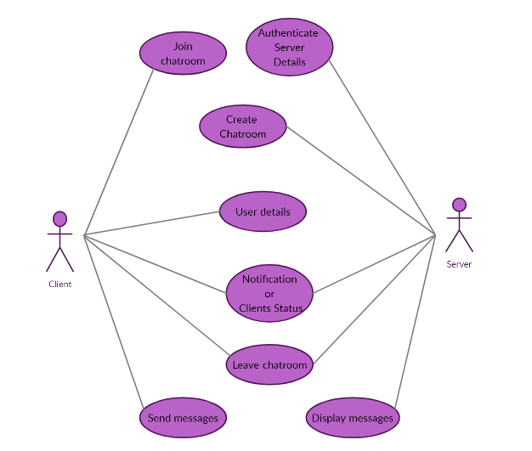
Use-Case Diagram

Slide 4
Use-Case Descriptions
Use Case ID: CS01
Name: Chat room creation
Actors: SERVER
Description: Creating a chatroom server
Pre-conditions: None
Post-conditions: A chatroom is created with a port address
Main Flow:
Client | Server
 | 1. Create a chat room with a significant port address.

Slide 5
Use Case ID: CS02
Name: Joining the chat room
Actors: CLIENT
Description: Client tries to join the chat room and server allows the client member to join the server
Pre-conditions: A server which is available
Post-conditions: Client has successfully joined the server
Main Flow:
Client | Server
1. Join the chatroom by using correct port number
 | 2. Allows the client to join the server if port entered by client is correct.

Slide 6
Use Case ID: CS03
Name: User details
Actors: CLIENT
Description: Prompts the user to enter the name
Pre-conditions: Client should be in that server
Post-conditions: Client is now able to chat and room participants gets a new client name as a message
Main Flow:
Client | Server
 | 1. Prompts the user to enter name
2.User need to enter his/her name
 | 3. Displays name of new client to all chat clients.

Slide 7
Use Case ID: CS04
Name: Send message
Actors: CLIENT
Description: Message entered by the user is sent to chat clients
Pre-conditions: User need to be a client of that server.
Post-conditions: The message client wanted to send is successfully received by the server.
Main Flow:
Client | Server
1. Text the message to share
 | 2. Receives the message of the client.

Slide 8
Use Case ID: CS05
Name: Display message
Actors: Server
Description: Message entered by the particular client Is shared to all clients
Pre-conditions: User need should a client of that server
Post-conditions: Message is posted to the clients
Main Flow:
Client | Server
 | 1. Message entered by the client is shared/displayed to clients
2. The clients present in the server are able to read this message.

Slide 9
Use Case ID: CS06
Name: Notification (or) client status
Actors: Server
Description: Display of a new message as name of the new client
Pre-conditions: The client should join the server
Post-conditions: Name is shared to all clients
Main Flow:
Client | Server
1. The client joins the server.
 | 2. Display the name of new client.

Slide 10
Use Case ID: CS07
Name: Authenticate server details
Actors: Server
Description: Verifies the port address entered by the new user
Pre-conditions: None
Post-conditions: Enters the chat-client server
Main Flow:
Client | Server
 | 1. Prompts the user to enter the port address
2. Enters port address
 | 3. Verifies the port address and allows the new client to enter the room

Slide 11
Use Case ID: CS08
Name: LEAVING THE CHAT-ROOM
Actors: Server and client
Description: To exit from the chat server
Pre-conditions: User need to be a client of that server
Post-conditions: Exits / disconnects from server
Main Flow:
Client | Server
1. User enters some special characters that is used to exit from the server.
 | 2. Removes the client from the server.

Slide 12
Thank You
Notes:
Thank You

