Slide 1


Prediction of Flight Delay
Jean Louis Jonilyto

Slide 2
Table of contents :
Introduction
Data
Data Preprocessing
Methodology
EDA
Modeling
5. Conclusion

Slide 3

Project Description
This is Shito.
Shito is a CEO of a multi-national company, he has to travel regularly, and has to fly a lot, his biggest problem is being late for his appointments since every second he is late can be a big problem. Because of this he asked me to do a study on different airports and to tell which ones have the reputation of being on time.

Slide 4

A company, which constantly has delays in its flights either on departure or arrival, could lose its customers or contracts, because a customer who is not satisfied with its services is almost lost, the loss of customers results in a decrease in revenue. The primary objective of a company is to maximize its profits while satisfying the needs of its customers, a need to move and arrive on time without any problem.
This project, I have carried out primarily for airlines who wish to optimize their delays in order to better manage their services, with the goal of increasing the confidence and loyalty of their customers. Secondly, this project affects travellers who want to know the best time according to their requirements to travel without expecting too many flight delays.

Slide 5

In my work, I will try to, over a period of about three years :
*1) Look at the number of flights made through Haiti that will be divided into delays and non_delays while grouping them by :
* A) Company
* B) Time
* C) Day
* D) Month
* E) Quarter
2) With the Learning Machine to predict flight delays,verification of the accuracy of the prediction as well as the ROC curve.

Slide 6
Data
The data used for the realization of this project can be found at the following address https://www.flightera.net/fr/airport/Port-au-Prince/MTPP/arrival.
and the way to get them is in this notebook.
https://github.com/Shito3/Airplanes_Analysis

Slide 7
Data Preprocessing
First of all we did a scrapping and saved the results in CSV format.
At the first glance on the dataset, we can see that there are some columns that are not removable. With a df = df.drop(), the magic is done, they are not there anymore. Second task, check if there are no null values, the df[df[''].isna()] and df.isnull().sum() will identify them all and add them together to remove them df.dropna(inplace = True) .
Below we will see that there are Google ADS present in our dataset, to remove them, just look at the common pattern that is window, with the code df2 = df[~df[''].str.contains('window.')], they are all gone.

Slide 8
Data Preprocessing
Still in data preprocessing. In order to separate the flight dates and the status of the flights, we will create functions to do so, the columns that are not important to our study must be deleted.
Once again, to better manipulate the date, we will create a new function to convert it. Then after new functions have been created to convert the time to minutes, one to tell if there is a delay or not. A cols variable is created for the features.
And voila, now our dataset is really ready to do EDA and Modeling.

Slide 9
EDA
The methodology in this project consists of two parts:
-Exploratory Data Analysis: Consists of visualizing air traffic per day
- Modeling: With the Learning Machine to predict flight delays

Slide 10
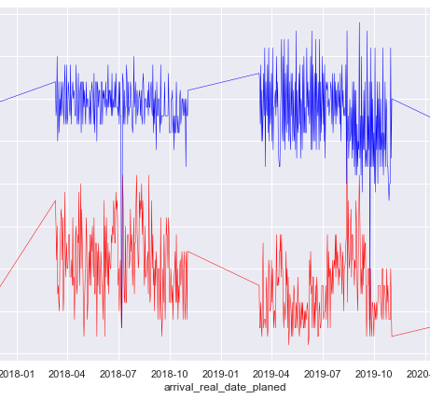
EDA
As the graph shows, we can see that from October 2017 to April 2018, the number of delays and the number of flights have the same trend, they are increasing.
During the same period for the years 2018-2019, delays are inversely proportional to the number of flights, as long as the number of flights decreases the amount of delay increases and for the period 2019-2020 it is always proportional, the number of flights increases and decreases.

Slide 11
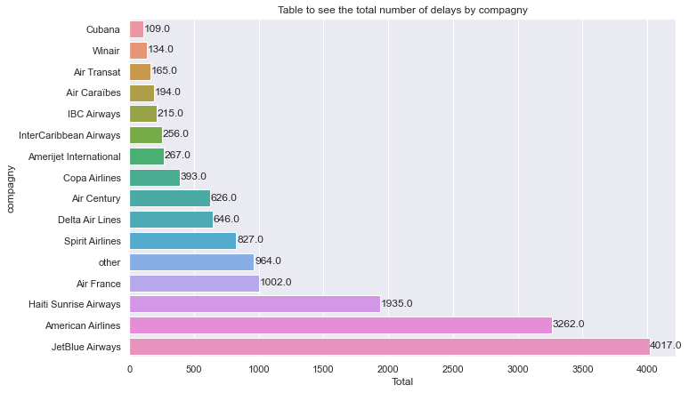
EDA
We can notice that the majority of airlines that make fewer flights are more likely to produce delays, even if JetBlue Airway, despite these many flights, remains the leader in terms of flights and delays.

Slide 12
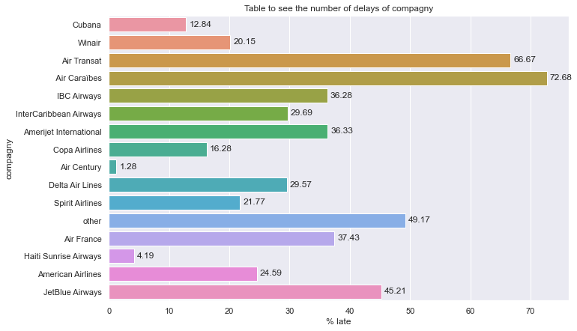
EDA
We can notice that the majority of airlines that make fewer flights are more likely to produce delays

Slide 13
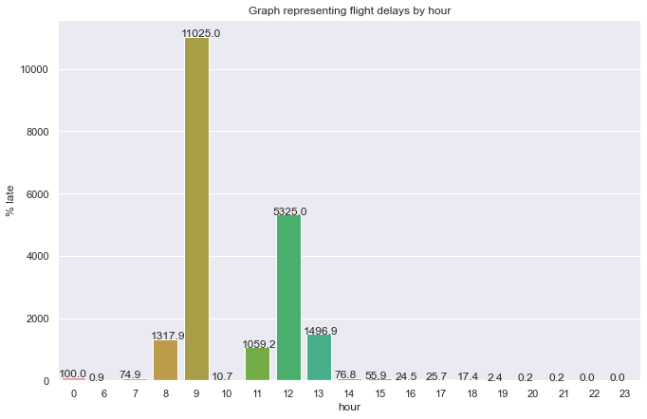
EDA
Even if JetBlue Airway, despite these many flights, remains the leader in terms of flights and delays.

Slide 14
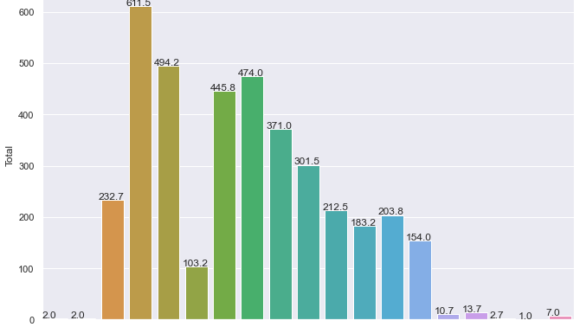
EDA
A lot of flights are made around eight o'clock, nine o'clock, and eleven o'clock to fourteen o'clock, but around nine o'clock and twelve o'clock there are a lot of delays.

Slide 15
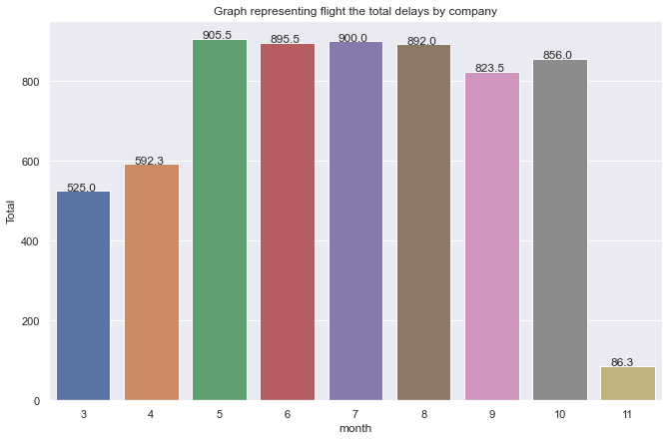
EDA
During the months of June, July, August, September, October and November, the majority of flights are made, June and August in particular,

Slide 16
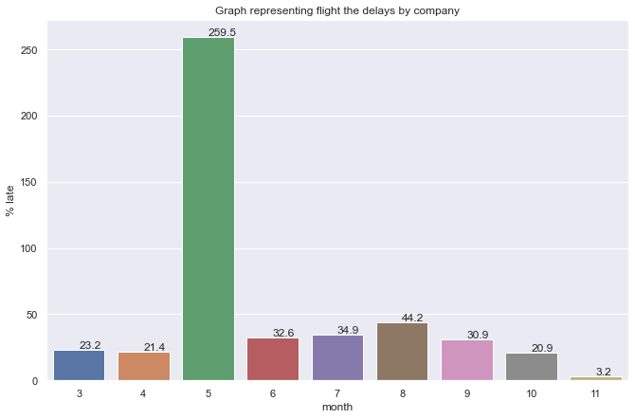
EDA
June in particular, and August, in May, the greatest number of delays are there.

Slide 17
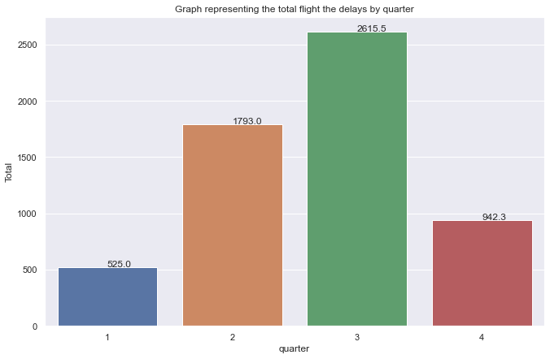
EDA
The third and second trimester are the two trismetres where there is a great peak of flight,

Slide 18
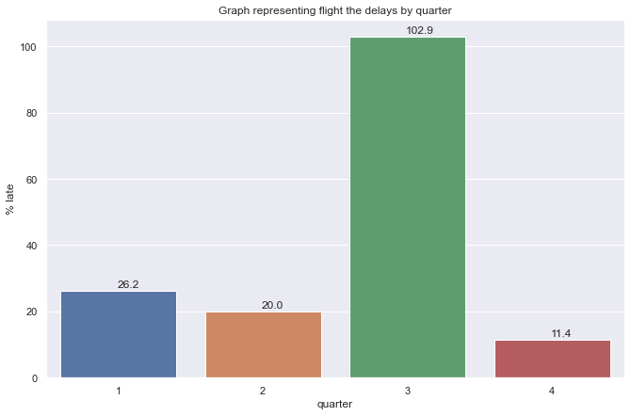
EDA
In theme of delay, the third trimester is in function of delay is crowned champion, it surpasses all the others.

Slide 19
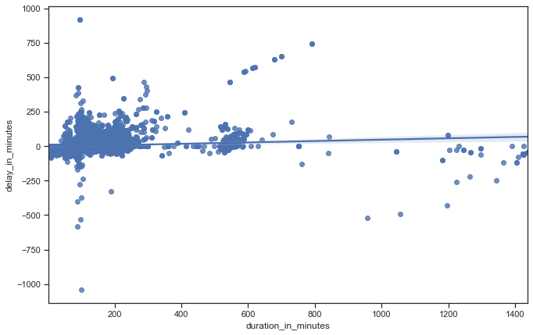
EDA
As the graph shows, the longer the flight lasts the more it tends to increase the delay.

Slide 20
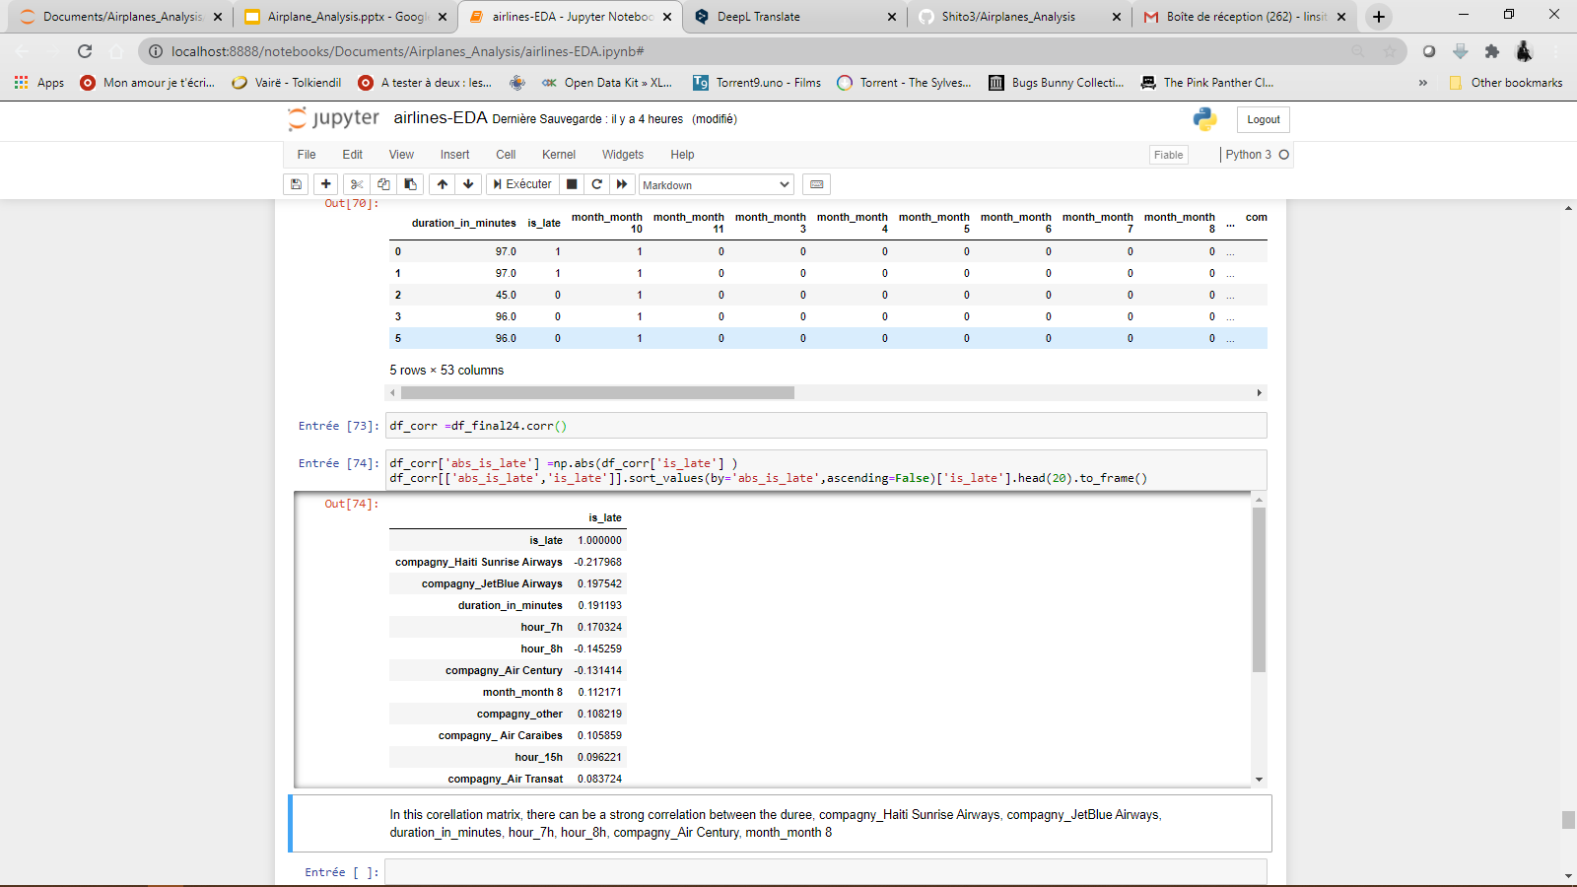
EDA

Slide 21
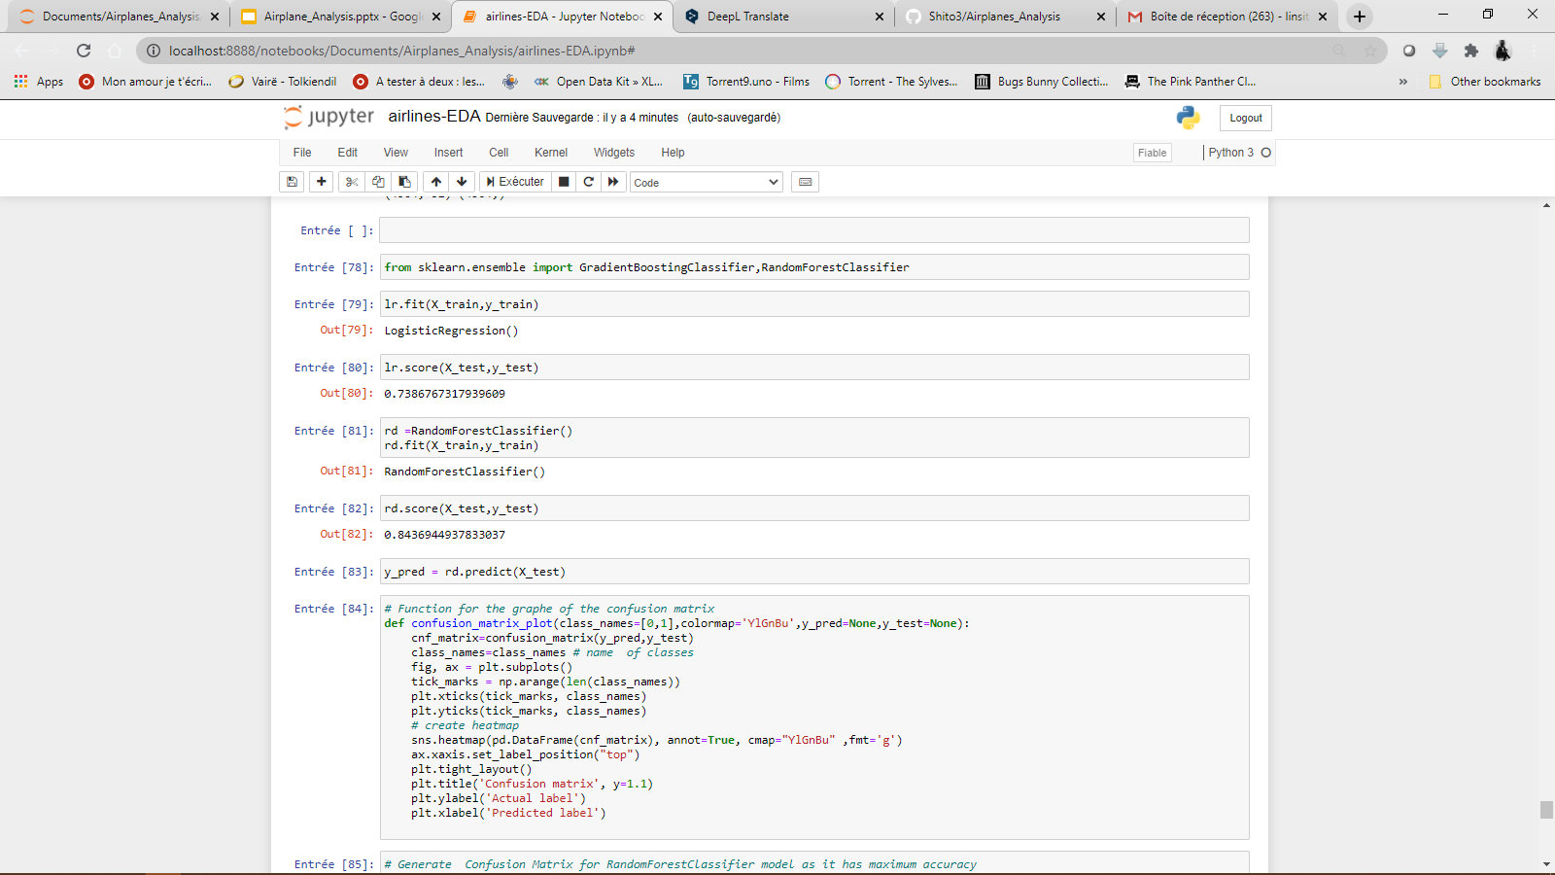
EDA
For our prediction RandomForestClassifier gives the best accuracy, with a total accuracy of 84.36944937833037%.

Slide 22
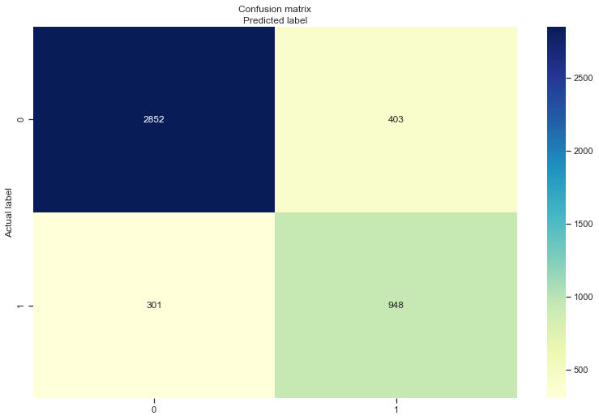
MODELING
In the confusion we can see that our prediction was right 2852 times predicting that there will be flight delays and it was wrong 403, for the predictions of no delay it is 301 times bad predictions against 948 times good predictions.

Slide 23
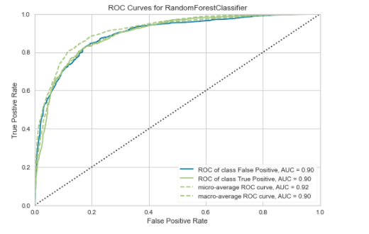
modeling
A receiver operating characteristic (ROC) curve is a graph representing the performance of a classification model for all classification thresholds. This curve plots the rate of true positives versus the rate of false positives.

Slide 24
modeling
A receiver operating characteristic (ROC) curve is a graph representing the performance of a classification model for all classification thresholds. This curve plots the rate of true positives versus the rate of false positives.

Slide 25
modeling
Among the good students who are on time, Air Century, Haiti Sunrise Airways are the ones with the lowest percentage of delay, with respectively 1.28 and 4.2 and for the most delayed we have Air Caraibes, AIr Transat and JetBlue Airways.

Slide 26
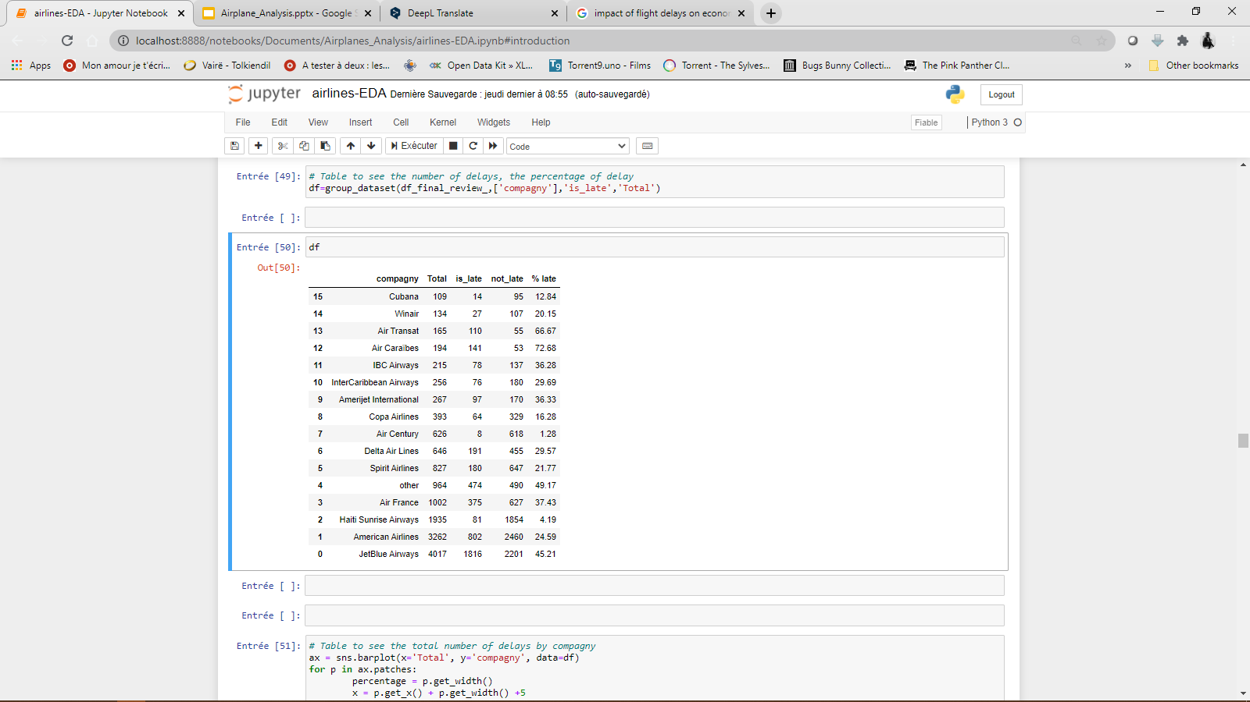
modeling
Here we can better see the figure of each company, according to their flights as well as their number of delays and the number of times they are on time.
JetBlue Airways and American Airlines have made a lot of flights but they have a very high number of delays.

Slide 27

See the link here : https://github.com/Shito3/Airplanes_Analysis
Thank you!

