Slide 1


Interpretable Machine Learning
Shin-Han Shiu
Michigan State University
East Lansing, MI 48824, USA
shius@msu.edu
Notes:
Image credit:
https://www.pinterest.com/pin/292945150756287202/
https://www.pinterest.com/pin/549509592004746347/

Slide 2

Logistics
Resource for today’s workshop:
Instruction
The pre-workshop Jupyter notebook
The workshop Jupyter notebook and dataset
This PowerPoint
Avallabile from: https://github.com/ShiuLab/ML_workshop
Code of conduct - behaviors that will not be tolerated:
Any form of discrimination, e.g., based on gender, race, sexual orientation, age, or others.
Any form of harassment, e.g., sexual, verbal, bullying or others
Offensive language or behavior
Deliberate intimidation, sustained disruption.
All those online will be in one group.
Ask directly or use the chat function to raise questions

Slide 3
Goals of this workshop
At the end of this, you should be able to:
Blah
Bleh
Blo
Blu

Slide 4
Workshop schedule
Components | Duration | Details
Introduction | 5 min | What is machine learning (ML) and why?
Part A review | 10 min | ML workflow revisited
Step 1 | 5 min | Define ML problem
Step 2 | 10 min | Conduct exploratory data analysis
Step 3/4 | 15 min | Split training/testing data and engineer features
Break | 10 min
Step 5 | 15 min | Select model
Step 6 | 15 min | Repeat 2~5 to get the optimal model
Step 7 | 15 min | Evaluate model
Step 8 | 15 min | Interpret model
Wrap-up | 10 min | What we have done today

Slide 5
A typical ML workflow
Global & local
interpre-tation
9 steps
Step 8:
Interpret
model
Step 4:
Engineer
features
Step 5:
Select
models
Step 1:
What is the question?
Step 3:
Split train/test
Answers
Good
enough?
Training
data
Training
Data
(engineered)
ML
model
Model
Performance
training
instances
80%
Step 2:
How does the data look like?
Data
Step 6: Repeat 2-5
No!
Testing
data
Model
Performance
testing
data
Yes!
20%
Step 9:
deploy
model
New data
Predictions
Step 7:
Evaluate
best performing
model

Slide 6

Our focus here
Interpretable ML
Why?
Scientific understanding
$$y=1.2x_{1}+0.4x_{2}−0.1x_{1}x_{2}−0.3$$
What does interpretable mean?
Your favorite trait
Explainable or
Able to be presented in a way human can understand
Expression level of gene 1
Expression level of gene 2
Interaction between gene 1 and 2 expression
Finale Doshi-Velez, Been Kim (2017) arXiv

Slide 7

Why models should be interpretable
Knowledge & novel insights
Trust
$$y=1.2x_{1}+0.4x_{2}−0.1x_{1}x_{2}−0.3$$
Your favorite trait
Interaction between gene 1 and 2 expression
Expression level of gene 1
Expression level of gene 2
AI 'outperforms' doctors diagnosing breast cancer
Finale Doshi-Velez, Been Kim (2017) arXiv
https://nature.com/articles/s41586-019-1799-6

Slide 8
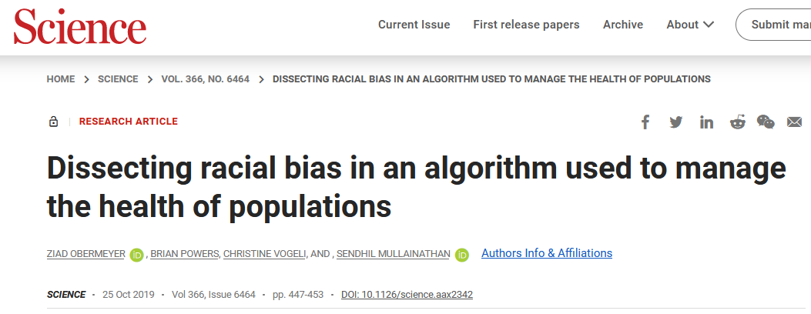
Why models should be interpretable
Safety, troubleshooting
What if something is wrong with the model at a certain step?
Ethics
What if there are biases?
https://www.science.org/doi/10.1126/science.aax2342

Slide 9
Scope of interpretability
Algorithm transparency
Global interpretability
Local Interpretability
How does the algorithm create the model?
How does the trained model make predictions?
Why did the model make a certain prediction for an instance?
Azodi, Tang, Shiu (2020) Trends in Genetics

Slide 10
Examples of interpretable models
Linear regression
Logistic regression

Slide 11
Approaches for not-so-interpretable models
Shapley value and SHAP

Slide 12
Thanks for coming…
Any question?

