Slide 1
Customer Churn & Segmentation Analysis
Analyzing Customer Behavior & Reducing Churn in Telecom
By Shivani Nirmal

Slide 2
Project Overview
Goal
Tools Used
Predict customer churn and segment telecom users
Business Value
Python, Power BI, Scikit-learn, ELI5, SHAP
Reduce churn, boost retention, and personalize strategy

Slide 3
Dataset & Preparation
Rows: 7032 | Columns: 24
Removed nulls, dropped irrelevant columns
Encoded features (Payment, Internet, Contract)
Engineered Churn Score, Segment Labels

Slide 4
Churn Prediction Modeling
Algorithm: Logistic Regression
Feature Scaling: StandardScaler
Model Accuracy: ~73%
Top Drivers: Churn Score, Total Charges, Internet Service

Slide 5
Model Explainability (ELI5/SHAP)
SHAP confirms early churn, low tenure, and e-check payment as key churn indicators
Helps build trust and transparency
ELI5 shows 'Churn Score' as most influential feature

Slide 6
Customer Segmentation (KMeans)
Used features like Churn Score, CLTV, Charges, etc.
Segments Identified: General, Churned, Loyal, Dormant, At-Risk
Enables targeted retention and campaign strategies

Slide 7
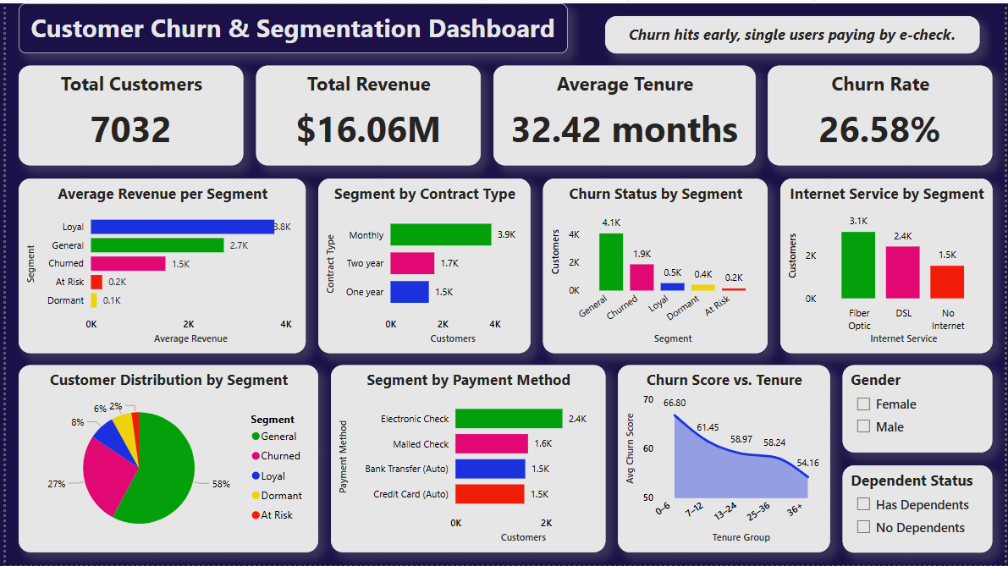
Power BI Dashboard Overview

Slide 8
Key Insights
Churn is highest in first 6 months
Users paying by e-check churn the most
Dependents reduce churn risk
Loyal customers bring highest average revenue

Slide 9
Final Recommendations
Improve onboarding for 0–6 month users
Migrate customers from e-check to auto-pay
Incentivize long-term contracts
Launch targeted offers for At-Risk and Dormant segments

Slide 10
Conclusion
Full cycle churn solution from data to insights
Used predictive modeling and segmentation
Built an interactive Power BI dashboard for decision-making

