Slide 1
EventFlow AI
Traffic Intelligence & Orchestration Platform
Proactive, AI-driven urban mobility management

Slide 2
The Motive: The Problem
Current traffic management solutions are REACTIVE
Political rallies, festivals, sports events, construction activities, and sudden VIP movements create localized traffic breakdowns.
Police only respond to congestion AFTER it happens.

Slide 3
The Solution: EventFlow AI
A PROACTIVE full-stack intelligence platform
Fuses Machine Learning with Operations Research
Predicts traffic disruptions BEFORE they peak
Automatically calculates congestion severity, duration, and the exact resource deployment plan (Police & Barricades).

Slide 4
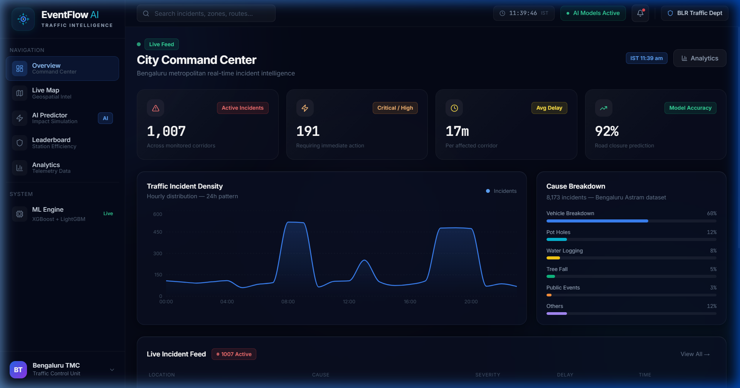
Command Center / Overview
Real-time tracking of active incidents with high-level KPIs for city managers.

Slide 5
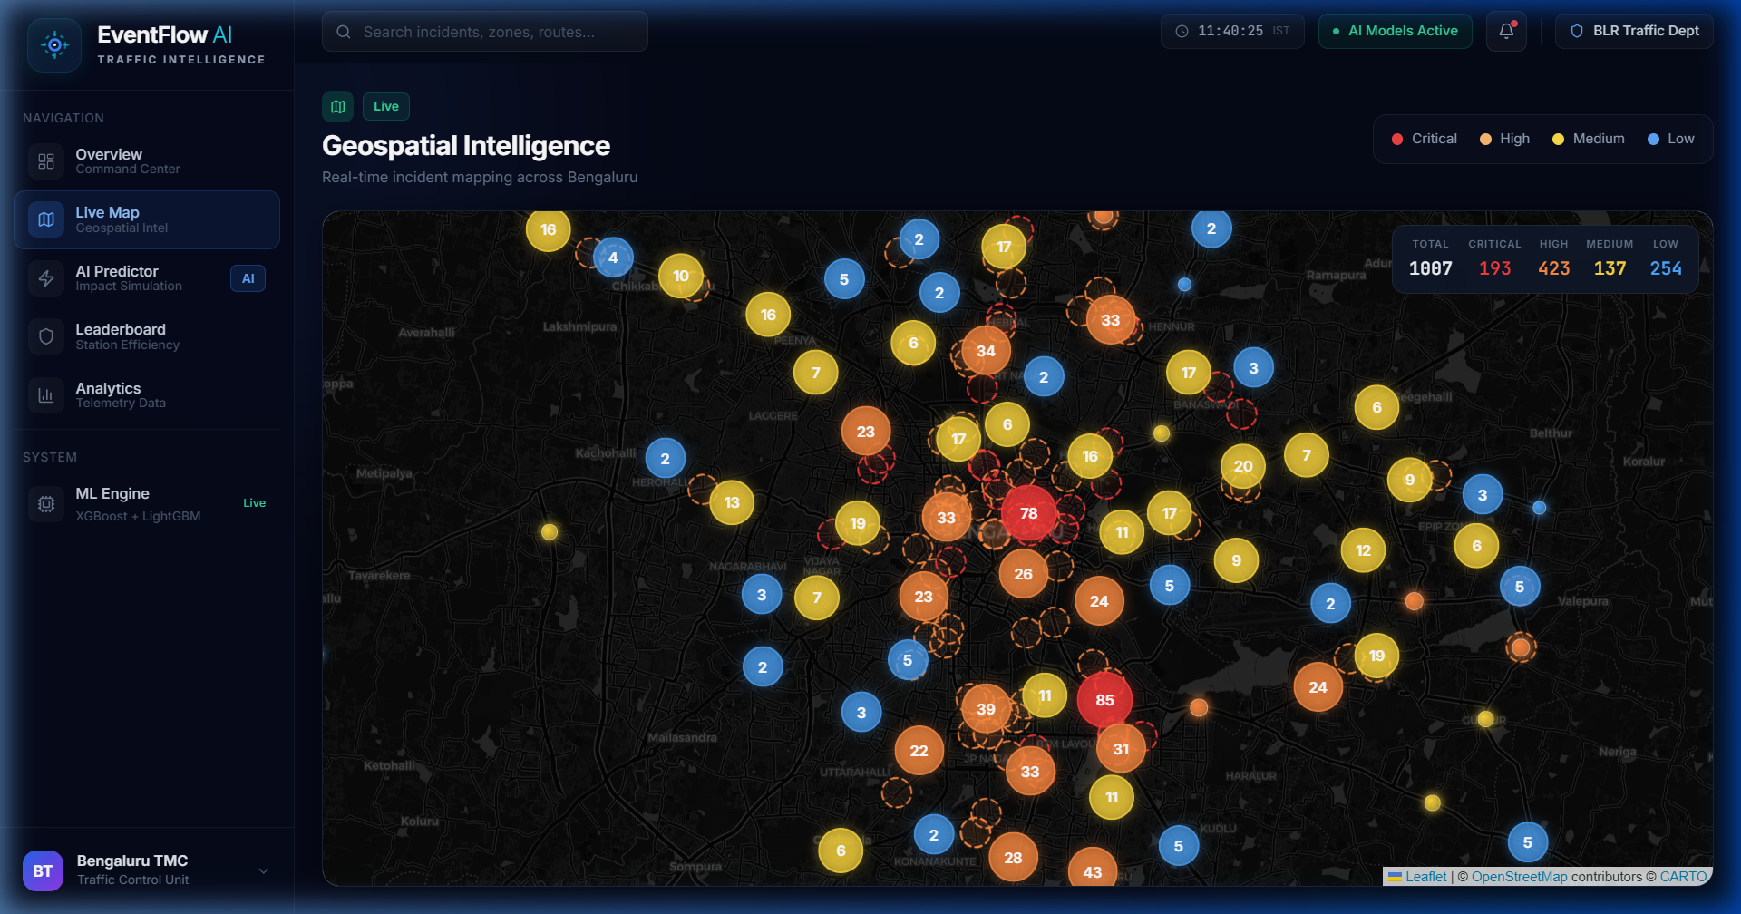
Geospatial Intel & Route Diversion
A*/Dijkstra algorithms calculate fastest alternative routes around incidents to prevent cascade jams.

Slide 6
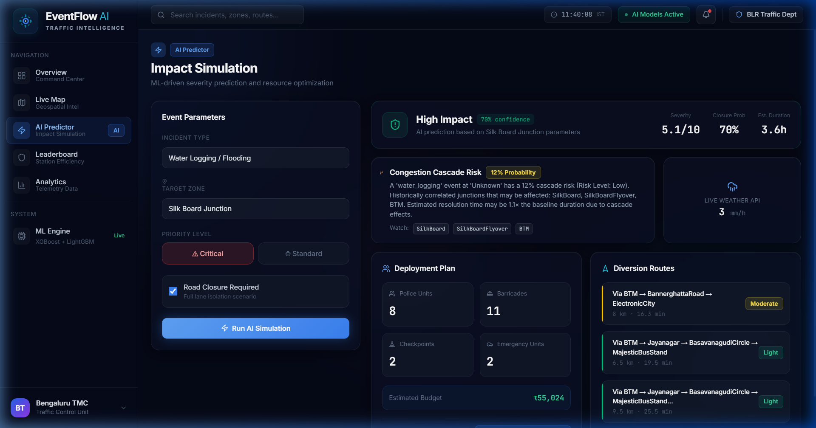
AI Predictor (Impact Simulation)
XGBoost v3.0 calculates Severity Score, Est. Duration, and Resource Plan based on event parameters.

Slide 7
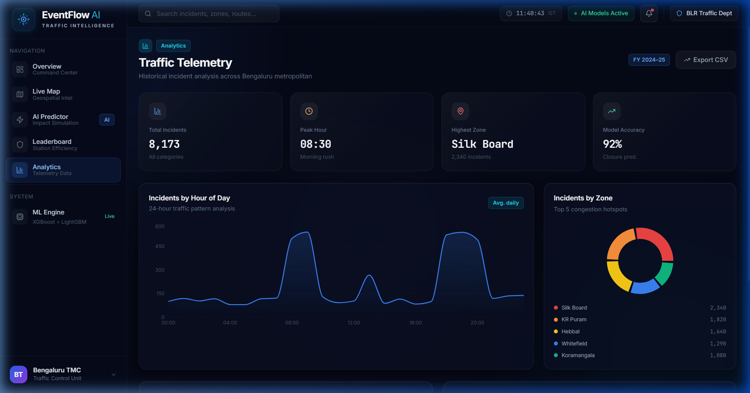
Jurisdiction Leaderboard & Analytics
Gamified tracking for Police Stations based on dynamic Efficiency Score.

Slide 8
Under The Hood
Data-Driven & Dynamic
Nothing is hard-coded. XGBoost v3.0 ML models trained on 8,173 real-world traffic records.
Dynamic Efficiency Score = (Actual Resolution Time) / (AI Baseline Predicted Time)
Location Variance: Predictions change purely based on geographical features (e.g. MG Road vs small side street).

Slide 9
Team: techy Boys
Shiv Patel (Leader)
Saahil Saitwal
Ronak Rathod

Slide 10
Thank You
EventFlow AI - Redefining Urban Mobility

