Slide 1

Six Ways to Improve Your Health

Slide 2
“Health is not simply the absence of sickness.” ~ Hannah Green

Slide 3

Healthy Behaviors
Don’t smoke
Eat a healthy diet
Maintain a healthy weight
Exercise regularly
Drink alcohol in moderation
Get adequate sleep
Notes:
These six healthy behaviors are known to positively influence health.
Ask participants: If you had to put them in order of importance, which would you say is most important for good health? Which would you put 2nd, 3rd, etc.? Which would be least important? Let’s take a few minutes and choose where to rank each factor, from 1 through 6.

Slide 4
Which healthy behaviors are most important?
Don’t smoke
Exercise regularly
Moderate alcohol
Eat a healthy diet
Maintain a healthy weight
Sleep
Notes:
We hear more about certain behaviors than others. We know that being at a healthy weight, eating right, and regular exercise are important. If you smoke you should quit. You might say that being at a healthy weight is most important, because it relates to a few of the other factors.
The truth is that these factors have a cumulative effect on health. One factor doesn’t outrank the others. Researchers looking at these factors say that what’s important is that you have a combination of these behaviors, not that you pick the most important one and focus on that. A person may be at a healthy weight, but if he or she smokes, doesn’t exercise, has a terrible diet, drinks too much and doesn’t get enough sleep, overall health will suffer. On the other hand, an overweight person practicing several of the other behaviors may experience increased wellness, despite carrying a few extra pounds.
We’ll talk today about how many of the six factors you need to experience the greatest impact on health.

Slide 5

Stop Smoking
Tobacco is most preventable cause of death in US.
1/3 of all cancer deaths related to smoking cigarettes
Risk factor for lung cancer. Associated with other types of cancer
Increased risk of heart disease and chronic lung disease
Quitting the best gift you can give yourself and loved ones
Notes:
According to the Surgeon General, quitting smoking is the single most important step a smoker can take to improve the length and quality of his or her life. As soon as you quit, your body begins to repair the damage caused by smoking. It's best to quit early in life but even someone who quits later in life will improve their health.
According to a recent study, quitting smoking can show health benefits in as little as a few weeks. This study showed that college students who smoked and did not have chronic respiratory illness coughed less and had fewer respiratory symptoms within weeks of quitting smoking. This means that quitting will benefit your health in days, not decades.
Quitting will also improve your finances. Cigarettes are expensive. If a pack costs $5.00, smoking one pack per day adds up to $1,825.00 each year.

Slide 6

What to do
Arkansas Tobacco Quit Line: 1-800-QUIT-NOW
Notes:
One of the most important calls a tobacco user can make is to the Arkansas Tobacco Quit line at 1-800-QUIT-NOW (1-800-784-8669). It is confidential, and it is free.
When tobacco users call, they will receive:
Free, confidential, non-judgmental expert support from a Quit Coach® to help make a plan to quit tobacco.
Ongoing Quit Coach® support via phone or online, tailored to the specific needs of all tobacco users, including smokeless tobacco users. Women who are pregnant are eligible for a specialized cessation program with additional benefits.
Unlimited access to Web Coach™, an interactive, online community that offers tools to quit, social support and information about quitting.
Customized, motivational e-mails sent throughout the quitting process.
Help with identifying the best cessation aid, as well as dose and duration. Some aids can be mailed directly to the tobacco user’s home, including free patches and lozenges (while supplies last).
Referral to local community resources and/or benefits offered through employers or health plans.
Printed Quit Guides – a series of workbooks that offer guidance and support throughout the quitting process.
The Arkansas Tobacco Quit line is available seven days a week, 24 hours a day. Services are available in English, Spanish and additional languages as needed, including Marshallese.

Slide 7

Healthy Diet
Balancing Calories
Enjoy your food, but eat less
Avoid oversized portions
Notes:
MyPlate is the eating pattern recommended for most Americans. It’s fairly new. There are three main ideas behind the MyPlate graphic. We’ll discuss each of them now.
The first idea is balancing calories. (Read bullets)

Slide 8
Healthy Diet
Foods to Increase
Make half your plate fruits and vegetables
Make at least half your grains whole grains
Switch to fat-free or low-fat (1%) milk.
Notes:
The second concept in MyPlate is to increase certain types foods in the diet. (Read bullets on slide, and relate them to the MyPlate graphic)

Slide 9
Healthy Diet
Foods to Reduce
Choose foods with lower sodium
Drink water instead of sugary drinks
Notes:
The third concept is to reduce certain types of food. (Read bullets)
Compare sodium in foods like soup, bread, and frozen meals—and choose the foods with lower numbers.
MyPlate is a simple symbol or picture that you can use to guide your healthy eating habits.

Slide 10
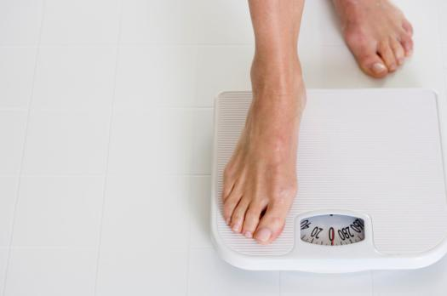
Reach and Maintain a Healthy Weight
Extra weight increases risk of:
Type 2 diabetes
Hypertension
Heart disease and stroke
Some types of cancer
Sleep apnea
Osteoarthritis
Notes:
It’s been well-established that carrying extra weight has a negative effect on health. Even if you haven’t been diagnosed with the conditions on this slide, you likely know that extra weight affects how you feel, or your sense of well-being.
We often think of the increased chronic disease and cancer rate that comes with being overweight. But carrying extra weight also increase risk of sleep apnea and osteoarthritis.

Slide 11
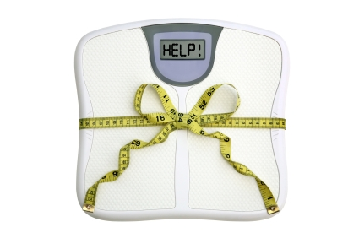
Healthy Weight
Small weight loss matters a lot
5-15% of body weight can improve health
Notes:
There’s good news! You don’t have to lose a ton of weight to see health benefits.
Studies show that a small decrease in weight can help reduce risk of chronic diseases like diabetes. If you’ve already been diagnosed with diabetes, losing as little as 5% of your body weight can help you manage blood sugar levels.
For example, a person weighing 200 pounds will see health benefits from losing as little as 10 pounds (5% of 200 pounds). Of course, losing more weight to reach the healthy BMI range offers additional health benefits. The main point here is that losing just a little is helpful, and a good jump-start if your goal is to lose more.

Slide 12
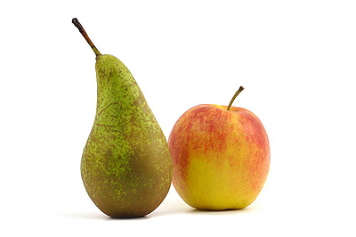
Where you wear your weight matters
Notes:
You may have heard people described as having a pear-shaped body, or a body shaped like an apple. When it comes to health, where you wear extra body fat makes a difference.
All fat is not created equal.

Slide 13
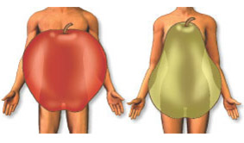
Apples and Pears
Notes:
Risk for disease, like heart disease, increases when extra fat is carried around the mid-section (like an apple). In comparison, fat carried in the hips and lower body (like a pear) is associated with lower risk.

Slide 14
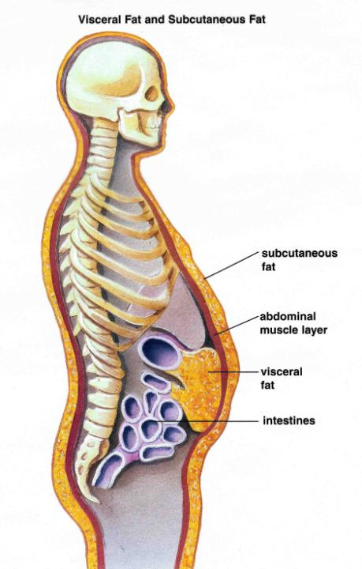
Fat on the inside
Surface (subcutaneous) fat
Visceral fat
Notes:
It’s often said that it’s what’s on the inside that counts. That is absolutely true, even with where you carry extra body fat
Some people may be carrying hidden fat. Some fat you can see—this is called subcutaneous fat. But there is another, more dangerous type of fat—visceral fat—which is underneath the muscle, surrounding your organs.
Carrying extra fat in the belly puts you at increased risk for diabetes and heart disease. But studies suggest that exercise, even if you don’t lose any weight, can help to reduce this risk by reducing inflammation (obese people have higher levels of circulating inflammatory markers, like CRP—C-reactive protein—which are produced and secreted by fat tissue. The inflammation triggers the diseases associated with metabolic disorder, like diabetes and heart disease).
You can literally look slim but be fat on the inside. Stress can be a factor affecting storage of this visceral or internal fat in the body.
Visceral fat is harder to lose than subcutaneous fat.
Subcutaneous—on the surface; fat you can pinch
Visceral—on the inside; “invisible” or “vicious”

Slide 15
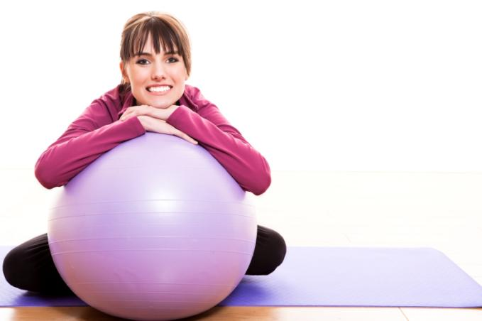
Exercise
150 minutes a week of moderate-intensity aerobic activity
Strength training at least 2x per week
Balance exercises for senior adults
Notes:
The minimum exercise recommendation for adults is 150 minutes of moderate-intensity aerobic activity each week. If you exercise vigorously, 75 minutes weekly is required. You can break the exercise requirement down into chunks as small as ten minutes. As long as the cumulative amount over the week adds up to 150 minutes, you’re in good shape (no pun intended!).
In addition to exercises that increase your heart rate (aerobic), you also should try to strength train at least twice a week, performing strengthening exercises for each major muscle group. These exercises might involve dumbbells, ankle weights, stretch tubes or resistance bands, or even your own body weight. Exercises like squats, lunges, and push-ups are examples of moves using your own body weight for resistance. Strength training is often referred to as resistance training.
If you’re an older adult (those age 60 and older are usually said to fall in this category), balance exercises are also important. These exercises will help to prevent falls, and the broken bones and disability that often result from falls. Examples: walking heel-to-toe and standing on one leg.

Slide 16

Don’t drink too much
Why?
Increased risk for certain cancers
Liver, esophagus, throat, larynx
Cirrhosis
Immune system problems
Brain damage
Moderate use isn’t harmful for most adults
Up to 2 drinks per day for men
One drink per day for women
Standard drink: 12-oz beer or wine cooler, 5-oz wine, 1.5-oz of liquor
Notes:
(Read slide)
Drinking too much increases your risk for certain cancers and other health problems. However, moderate alcohol use, for most adults, has been linked to some positive health outcomes.

Slide 17

Sleep
7 to 8 hours a night for most adults
Negative health effects for:
Oversleeping
Too little sleep
Notes:
Sleep affects your health in a big way. There is some evidence suggesting that people eat more when they are sleep deprived, meaning that not getting enough sleep can lead to weight gain.
Most adults need 7 to 8 hours a night for the best amount of sleep, although some people may need as few as 5 hours or as many as 10 hours of sleep each day.
Sleeping too much has been linked to negative health effects, like depression and heart disease. Multiple studies have found that people who sleep nine or more hours a night have significantly higher death rates than people sleeping seven to eight hours a night. No specific reason for this correlation has been determined.
Too few hours of sleep can weaken the immune system and cause memory problems and depression.

Slide 18

Healthy Behaviors
Don’t smoke
Eat a healthy diet
Maintain a healthy weight
Exercise regularly
Drink alcohol in moderation
Get adequate sleep
Notes:
There is strong evidence that practicing a combination of these six healthy behaviors lengthens life. One study found a 66% reduction in all-cause mortality (death from all causes) among people who practiced 4 or more of the behaviors, while another study found reduced risk with three factors.
The main point is this: the more healthy behaviors you practice, the better your health. The combined effect of these healthy behaviors is stronger than practicing one or two alone.

Slide 19

Which of the 6 will you make a priority for improving health?

