Slide 1
Dodger’s Case Study
BAN 840
January 23, 2024
Shiv Walecha

Slide 2
Background and Objectives
Uses one season of LA Dodger’s home game attendance
Company wants to know how well the bobblehead promotion works
Want to know how predictive the regression model can be using
Week
Temperature
Day/night
Whether there was a bobblehead promotion that night
Predict attendance for a Tuesday night game including confidence and prediction intervals
With bobbleheads
Without bobbleheads

Slide 3
Case Process and plan
Summarize the case
Determine the case objectives
Summarize the data using
Descriptive summary
Scatter plots (matrix plots)
Boxplots with qualitative predictors
Propose a regression model
Regression model and R-squared interpretation
Assess the usefulness of the regression model
VIF validity discussion (should be dropping Friday)
Validity checks
Discuss sigma estimate and p-values for coefficients and overall model
Discuss confidence and prediction intervals
Discuss forecasted confidence and prediction intervals for specific conditions
Give overall summary and recommendation based on fitted regression model

Slide 4
Data Summary
X month day attend day_of_week
Min. : 1 Length:81 Min. : 1.00 Min. :24312 Length:81
1st Qu.:21 Class :character 1st Qu.: 8.00 1st Qu.:34493 Class :character
Median :41 Mode :character Median :15.00 Median :40284 Mode :character
Mean :41 Mean :16.14 Mean :41040
3rd Qu.:61 3rd Qu.:25.00 3rd Qu.:46588
Max. :81 Max. :31.00 Max. :56000
opponent temp skies day_night cap
Length:81 Min. :54.00 Length:81 Length:81 Length:81
Class :character 1st Qu.:67.00 Class :character Class :character Class :character
Mode :character Median :73.00 Mode :character Mode :character Mode :character
Mean :73.15
3rd Qu.:79.00
Max. :95.00
shirt fireworks bobblehead
Length:81 Length:81 Length:81
Class :character Class :character Class :character
Mode :character Mode :character Mode :character
This is the data summary of attendance, days, month, and temperature. This summary gives us the minimum, 1st quartile, median, 3rd quartile, and maximum values of each variable. For the month, it characterizes the variable as qualitative so it doesn’t give numeric values. There is a high variation in the temperature.
R code for the above:
library(readr)
dodgers <- read.csv("D:/MBAN/Predictive Analytics/Group Assignment 2/dodgers.csv")
summary(dodgers)

Slide 5
Data Summary
We can check the min, max and quartile values in the database
R code for that would be: fivenum(dodgers$attend)
We can see a lot of variation in the attendance across the year, with min attendance being around 24k and maximum attendance was around 56k
Min 25% 50% 75% Max
24312 34493 40284 46588 56000

Slide 6
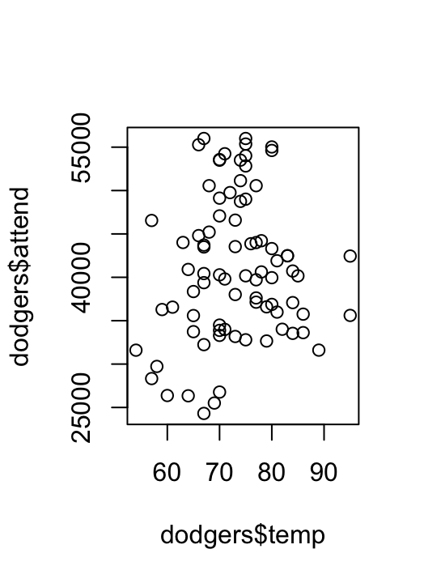
Attendance vs. Temp Plot Correlation
This graph plots the attendance versus the temperature. We can see that the days with the highest attendance have mid-range temperatures.
They aren’t too cold or too hot
Most attendance is for 70-80 degrees
R code: plot(dodgers$temp, dodgers$attend)

Slide 7
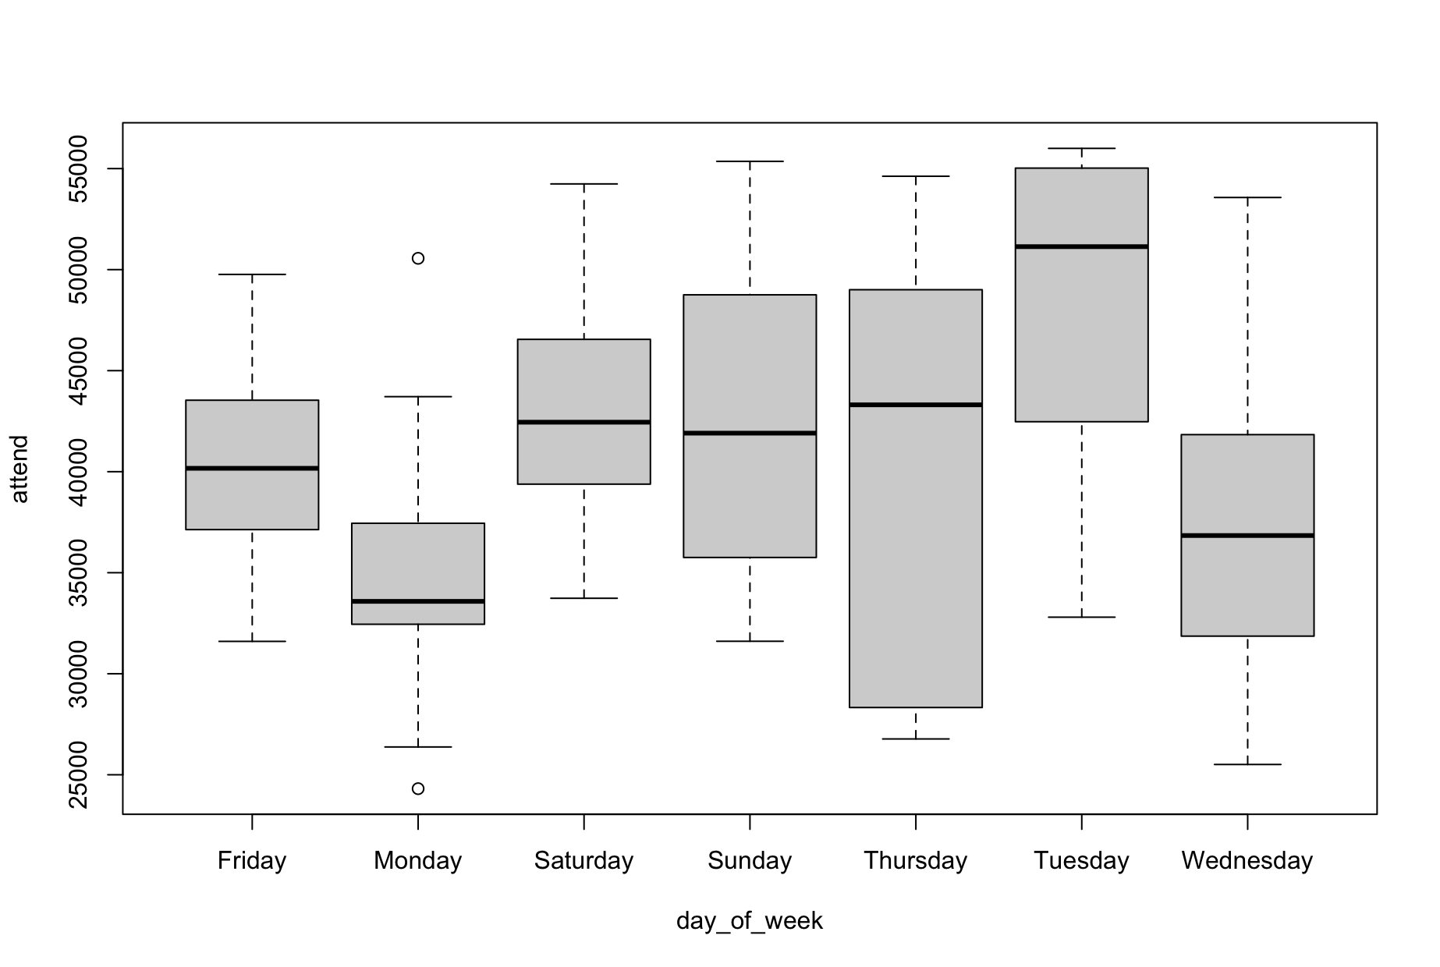
Attendance vs. Day of Week Box Plot
This shows the min, 1st quartile, median, 3rd quartile and max for each day of the week
We can see that Tuesday has the most attendance
The minimum for Tuesday is most likely an outlier due to bad weather
and Monday and Wednesday have the least
Wednesday and Thursday, however, have the highest ranges of attendance
R code: boxplot(attend~day_of_week,data=dodgers)

Slide 8
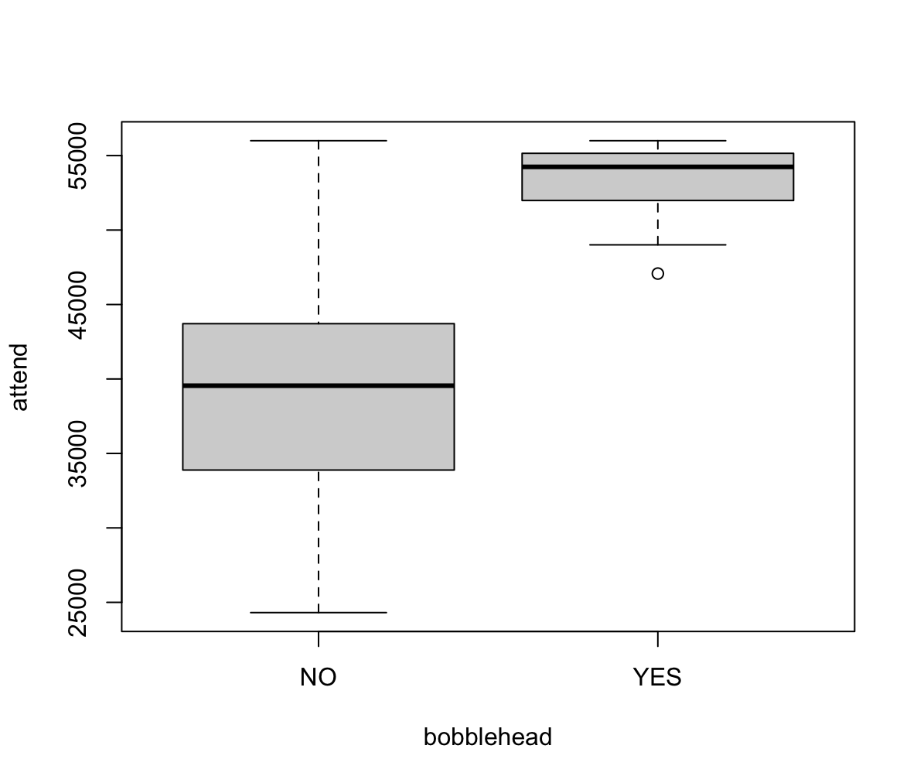
Bobblehead vs. Attendance Boxplot
This boxplot shows that if bobbleheads are given out as an incentive, attendance is greater
The range for “no” is large
This could be due to outliers since the ”yes” average is so much higher
R code: boxplot(attend ~bobblehead , data = dodgers)

Slide 9
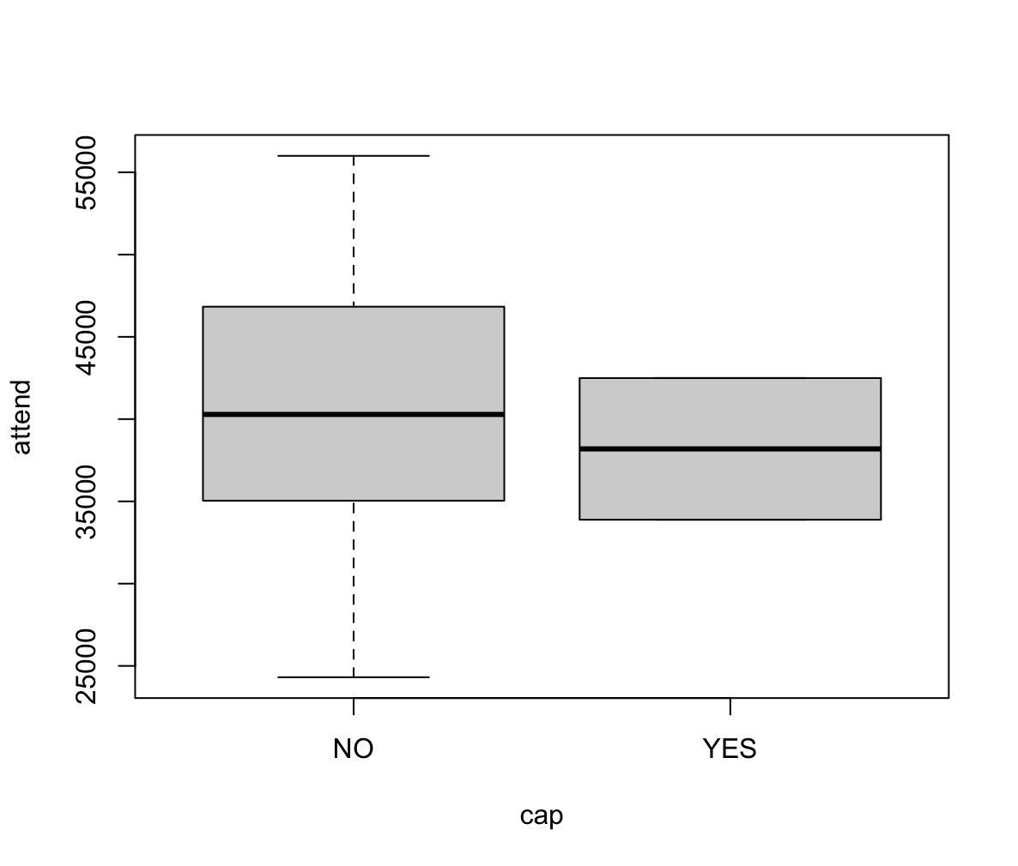
Cap vs. Attendance Boxplot
Based on this data, it appears that cap doesn’t have a significant impact on the attendance
We only have two observations for caps, however, so we cannot come to a solid conclusion on this
R code: boxplot(attend~cap, data = dodgers)

Slide 10
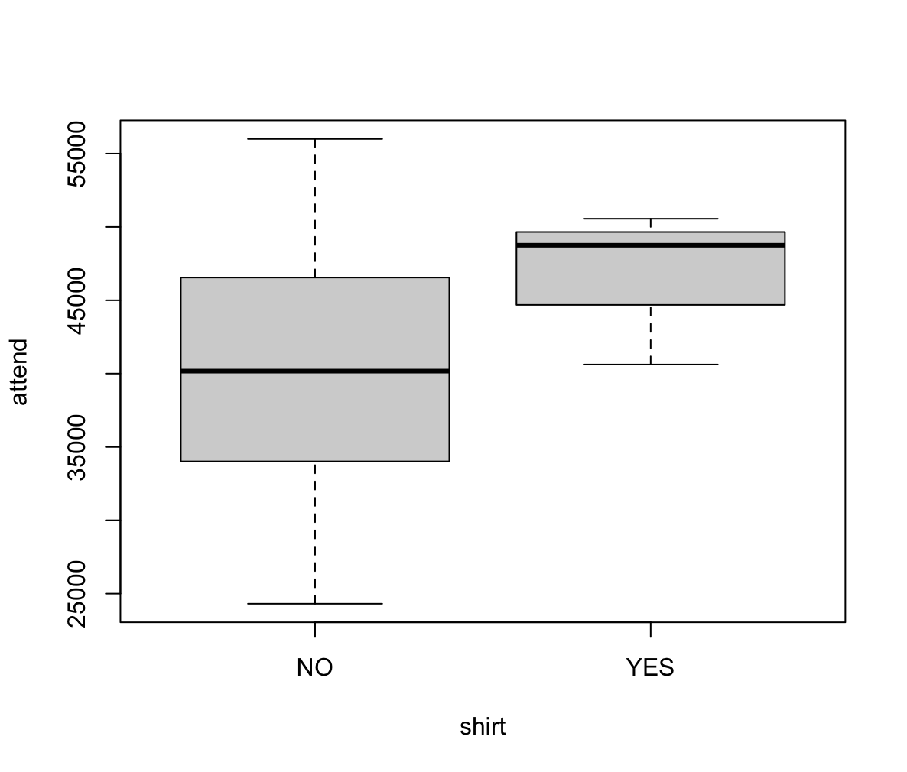
Shirt vs. Attendance Boxplot
Based on this data, it appears that shirt does have a small impact on the attendance
We only have three observations for shirts, however, so we cannot come to a solid conclusion on this
R code: boxplot(attend~shirt, data = dodgers

Slide 11
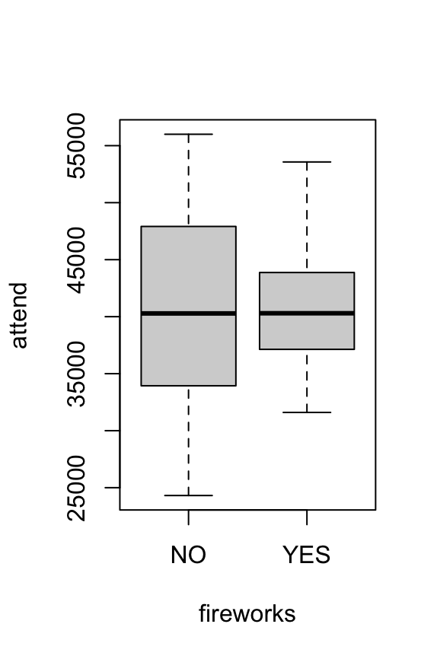
Fireworks vs. Attendance
Based on this data, fireworks do not have a significant effect on the attendance
The average attendance didn’t change much based on whether there were fireworks or not
R code: boxplot(attend~fireworks, data = dodgers)

Slide 12
Justification for Quadratic Temp Term and the Need for Scaling
Based on the observed graph, it's evident that there is curvature in the relationship between temperature and attendance
Specifically, attendance tends to increase within a temperature range of 70 to 80 degrees, but decreases on either side of this range
To accurately capture these curvatures and account for the non-linear relationships, it's necessary to include a quadratic term in the regression model
Scaling the variables appropriately ensures that the model effectively captures the magnitude and direction of the effects
Scaling ensures that all variables in the model are on a comparable scale
R code:
scalpm1 = function (x ){( x -( min (x )+ max ( x ))/2)/(.5*( max ( x)- min (x )))}
stemp = scalpm1(dodgers$temp)

Slide 13
Coding of Qualitative Variables
R code:
# Create the dummy variables for day_night cap shirt fireworks
# (dummy for bobblehead already done)
dodgers$cBob = ifelse(dodgers$bobblehead=="YES",1,0)
dodgers = dodgers[,!names(dodgers)%in% c("bobblehead")]
#Create the dummy variable for day_night
dodgers$cDay_Night = ifelse(dodgers$day_night=="Day",1,0)
dodgers = dodgers[,!names(dodgers)%in% c("day_night")]
#Create the dummy variable for cap
dodgers$ccap = ifelse(dodgers$cap=="YES",1,0)
dodgers = dodgers[,!names(dodgers)%in% c("cap")]
#Create the dummy variable for shirt
dodgers$cshirt = ifelse(dodgers$shirt=="YES",1,0)
dodgers = dodgers[,!names(dodgers)%in% c("shirt")]
#Create the dummy variable for fireworks
dodgers$cfireworks = ifelse(dodgers$fireworks=="YES",1,0)
dodgers = dodgers[,!names(dodgers)%in% c("fireworks")]

Slide 14
Coding of Qualitative Variables
R code:
# Create the day_of_week dummy variables
dodgers$Sun = ifelse(dodgers$day_of_week=="Sunday",1,0)
dodgers$Mon = ifelse(dodgers$day_of_week == "Monday", 1, 0)
dodgers$Tue = ifelse(dodgers$day_of_week == "Tuesday", 1, 0)
dodgers$Wed = ifelse(dodgers$day_of_week == "Wednesday", 1, 0)
dodgers$Thu = ifelse(dodgers$day_of_week == "Thursday", 1, 0)
dodgers$Fri = ifelse(dodgers$day_of_week == "Friday", 1, 0)
For binary qualitative variables (e.g., bobblehead promotion, caps given), use a 1 for "Yes" and 0 for "No" in your regression model.
For categorical variables like the day of the week (e.g., Saturday), we capture them by using binary indicators for the other categories. For example, we use a binary indicators for each day of the week (e.g., Sun, Mon, Tue, etc.), when all other indicators are 0, it automatically implies that it’s the remaining day, which in our model is Saturday. So, Saturday would be our reference value.

Slide 15
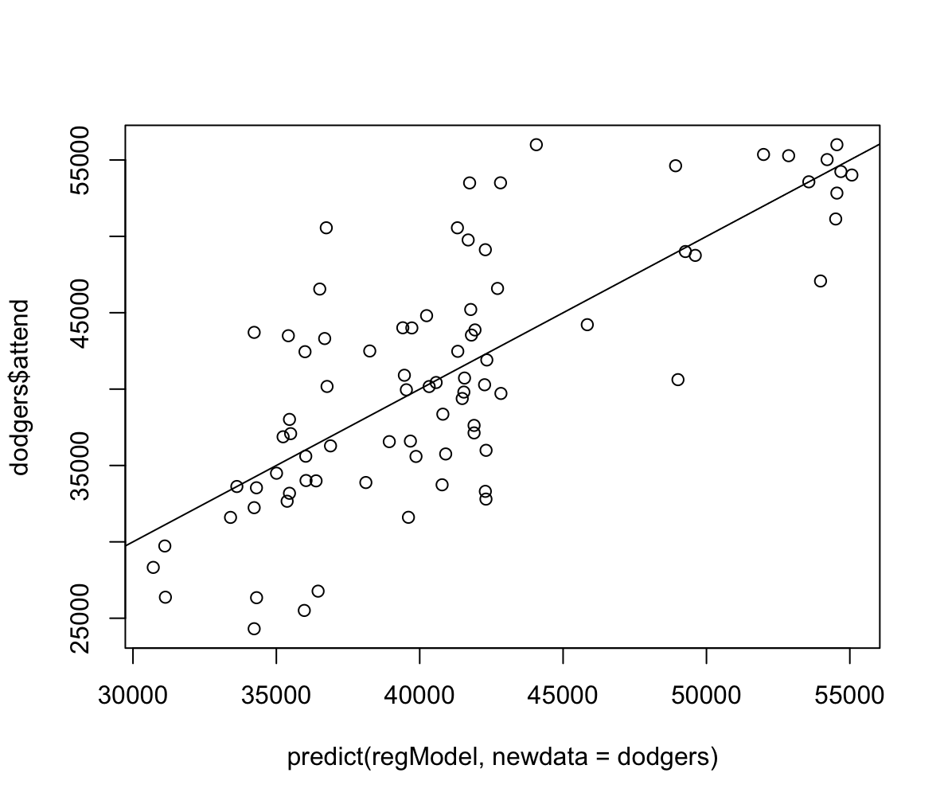
Proposed Regression Model
This is our fitted regression line for the data. The fit of line is decent. This is also supported by a good R square of 0.5732287. However, we need to check the VIF.
R code:
# Fitting the regression model
regModel <- lm(attend ~ stemp + I(stemp^2) + cBob + cDay_Night + ccap + cshirt + cfireworks + Sun + Mon + Tue + Wed + Thu + Fri, data = dodgers)
summary(regModel)$coefficients[,1]
plot(predict(regModel, newdata = dodgers), dodgers$attend)
abline(0,1)
R code:
Summary(regModel)$r.squared

Slide 16
Proposed Regression Model
Based on the plot and practical experience, we hypothesize a model that predicts attendance as a linear function of the day of week, temperature, day/night, bobbleheads, etc :
Y=β0​+β1​×x1​+β2​×x2​+β3​×x3​+β4​×x4​+β5​×x5​+β6​×x6​+β7​×x7​+β8​×x8​+β9​×x9​+β10​×x10​+β11​×x11​+β12​×x12​+β13​×x13​+ϵ
Where x1​: Temperature, x2​: DayOfWeek (using dummy variables), x3​: DayNight, x4​: BobbleheadPromotion, x5​: cap, x6​: cshirt, x7​: cfireworks, x8​: Monday, x9​: Tuesday, x10​: Wednesday, x11​: Thursday, x12​: Friday
The model coefficients are unknown and will be estimated by fitting a regression model in R.
In this case DayOfWeek, DayNight, BobbleheadPromotion, cap, shirt, fireworks will be converted to dummy variables as they are qualitative variables.
Remember we are using dummy variables as per the justification given in the previous slides.
R commands for the regression and resulting coefficient estimates:
regModel <- lm(attend ~ stemp + I(stemp^2) + cBob + cDay_Night + ccap + cshirt + cfireworks + Sun + Mon + Tue + Wed + Thu + Fri, data = dodgers)
summary(regModel)$coefficients[,1]
plot(predict(regModel, newdata = dodgers), dodgers$attend)
abline(0,1)

Slide 17
Regression Model Fitted Coefficients
The result is:
(Intercept) stemp I(stemp^2) cBob cDay_Night ccap cshirt cfireworks
42816.5791 843.6659 -7660.8572 12238.1599 3106.6360 -3618.2377 6791.8395 17371.9002
Sun Mon Tue Wed Thu Fri
-3080.2664 -7256.0703 -522.4612 -6064.1413 -5806.1606 -18281.7909
Attendance=42816.5791+843.6659×Temperature−7660.8572×(Temperature)^2+12238.1599×BobbleheadPromotion+3106.6360×DayNight−3618.2377×CapPromotion+6791.8395×ShirtPromotion+17371.9002×FireworksPromotion−3080.2664×Sunday−7256.0703×Monday−522.4612×Tuesday−6064.1413×Wednesday−5806.1606×Thursday−18281.7909×Friday
Illustrative Interpretation for bobblehead: On days with a bobblehead promotion, attendance is expected to increase by 12238.1599 units compared to days without a bobblehead promotion, holding all other variables constant.

Slide 18
VIF Validity Discussion and Decision to Drop Friday
R Code:
install.packages("rms")
library(rms)
vif(regModel)
stemp I(stemp^2) cBob cDay_Night ccap cshirt cfireworks Sun Mon
1.133151 1.128278 1.578393 2.548605 1.093824 1.085580 12.766795 3.039228 1.748993
Tue Wed Thu Fri
1.966801 1.793625 1.342213 13.642125
When doing the VIF validity check, we found that all our variables other than Friday had values under 10
We can use all these variables
Since Friday’s VIF value is above 10, we decided to remove Friday from the variables used
R Code to Remove Friday:
regModel <- lm(attend ~ stemp + I(stemp^2) + cBob + cDay_Night + ccap + cshirt + cfireworks + Sun + Mon + Tue + Wed + Thu, data = dodgers)

Slide 19

Regression Model After Removing Friday
After removing Friday, our regression model looks like this
We will next check the validity of this regression model to ensure that it will be a good predictor for attendance
R squared = 0.52
Deleting Friday did lower our R squared value a little, but it is still a decent fit and a moderate predictive power.
R code:
plot(predict(regModel, newdata = dodgers), dodgers$attend)
abline(0,1)
summary(regModel)$r.squared

Slide 20
Regression Model Validity Check
We need to check the validity of the regression model before moving forward
To do this we will check:
Equal variance
Normal distribution of errors
Ensure there are no unduly outliers affecting the regression coefficient estimates
Compare the residuals with the independent variable (attendance)
Independence of error

Slide 21
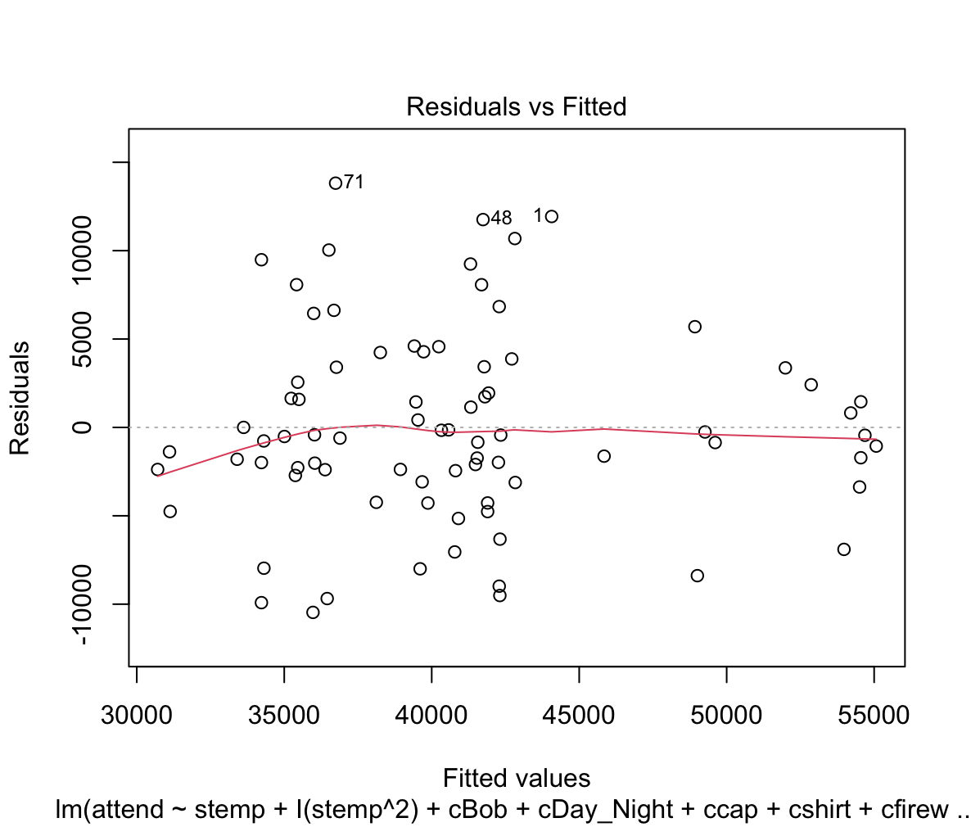
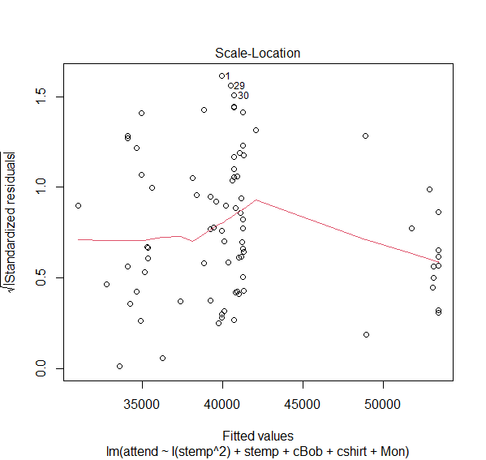
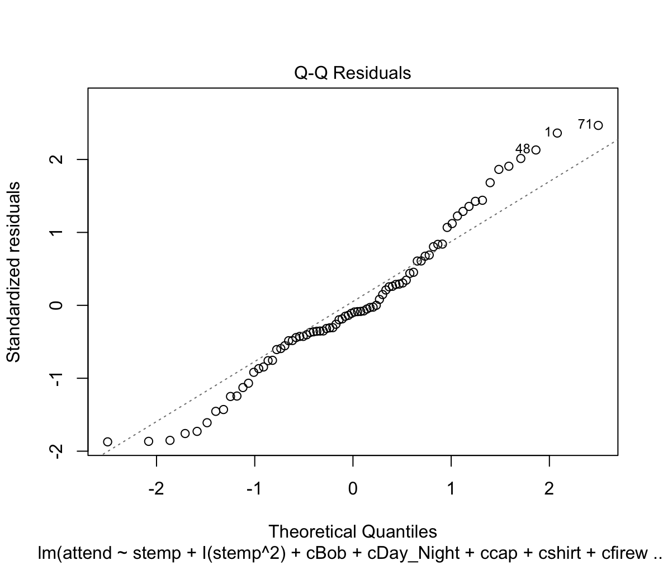
Validity Checks: plot(regModel)
Equal Variance:
The majority of the points are closer to the middle of the equal variance graph
There are a few outlier off towards the extreme values
With equal variance, less spread is natural if there is fewer data in that region, so equal variance is supported by this plot
Normal Distribution of Error:
We need to ensure that the residuals have a normal distribution for errors
There is a little variation from the line, however, you can see that the middle part which is the darkest, falls on the line
This means that most points fall on the line
This supports normal distribution
With equal variance, less spread is natural if fewer data in that region, so equal variance also supported by this plot

Slide 22
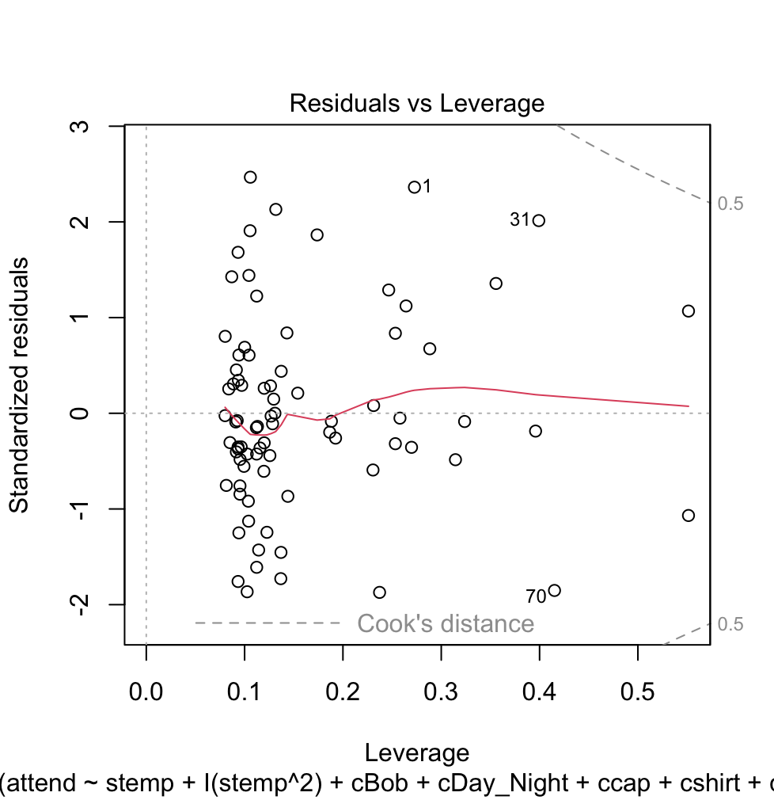
Validity Check: No Unduly Influential Outliers
In cook’s distance plot we are looking for outliers.
In this validity check, we have no outliers
Note:
Had we not removed the Friday variable already we would’ve received this error message if we check for the cook’s plot.
Warning message:
not plotting observations with leverage one:
43
However, after we eliminate Friday (due to VIF test) from the model, the outlier does appear any more

Slide 23
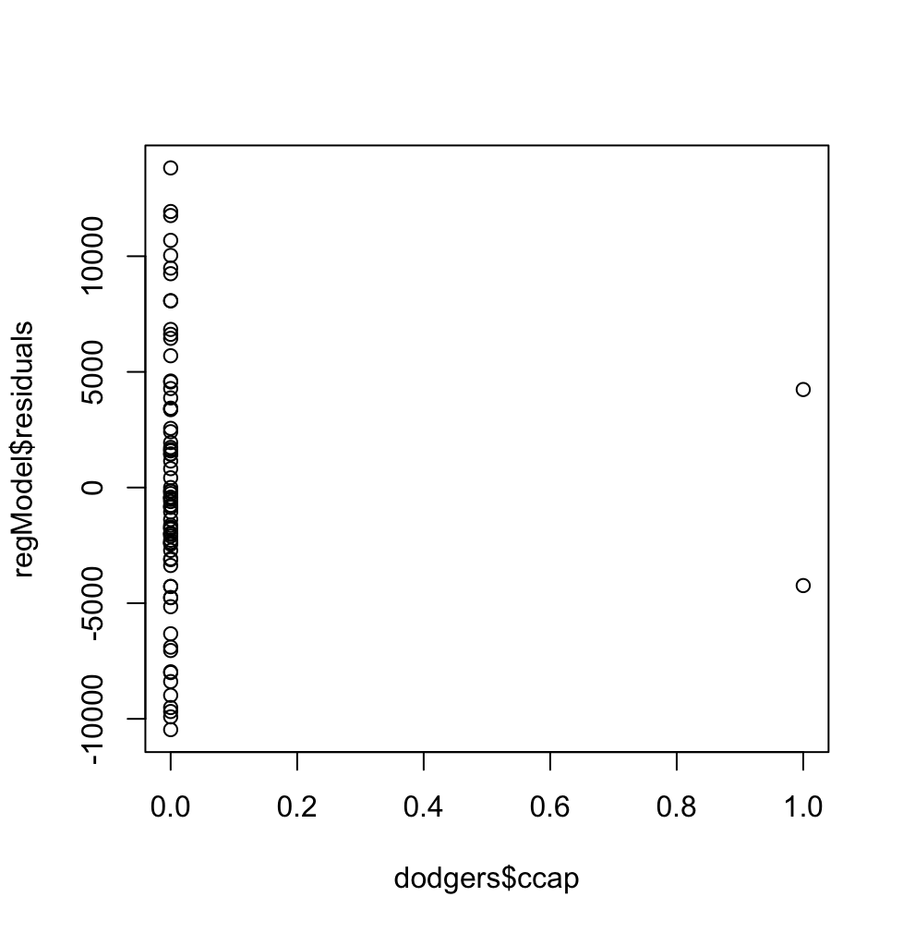
Validity Check: Residual vs. Cap
plot(dodgers$ccap, regModel$residuals)
This shows the instances where caps were given out
The days caps were given out are represented by the column of 1.0
We are going to ignore the column of 0.0 since this is where caps were not handed out
There were only two instances recorded, so it is hard to tell whether this variable significantly affected the attendance or not
One instance seems to have positively attendance, and the other instance seems to have negatively affected attendance

Slide 24

Validity Check: Residual vs. Shirt
plot(dodgers$cshirt, regModel$residuals)
This shows the instances where shirts were given out
The instances where shirts were handed out is in the column 1.0
We are going to ignore the points in column 0.0 since this is where shirts weren’t handed out
There were only three instances recorded, so it is hard to tell whether this variable significantly affected the attendance or not
One instance seems to have positively attendance, and the other two instance seems to have negatively affected attendance

Slide 25
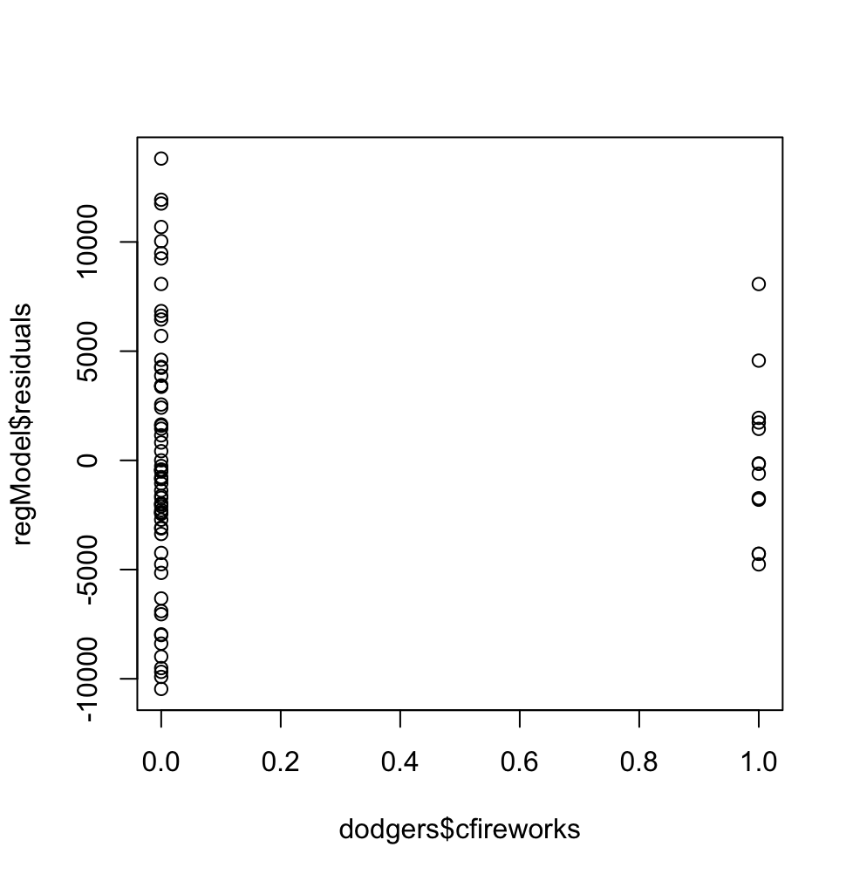
Validity Check: Residual vs. fireworks
plot(dodgers$cfireworks, regModel$residuals)
This graph shows the instances where fireworks were displayed.
The column over 1.0 is for when fireworks were displayed
The column over 0.0 is for when fireworks were not displayed

Slide 26
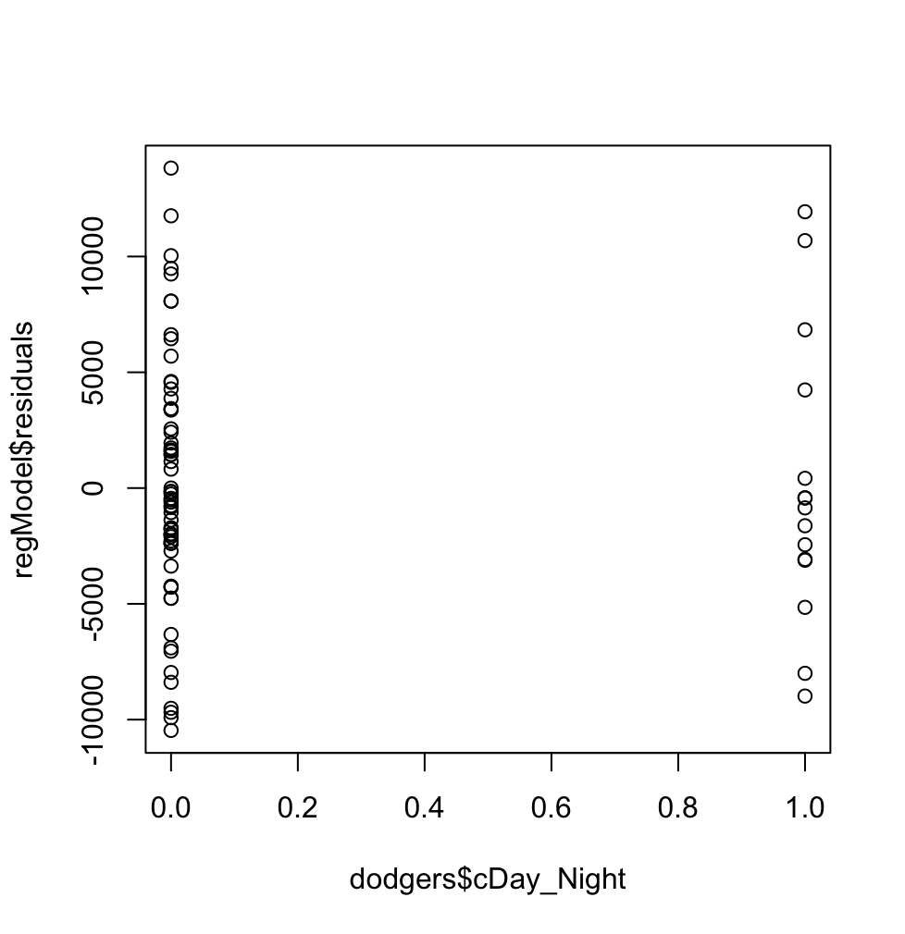
Validity Check: Residual vs. day_night
plot(dodgers$cDay_Night, regModel$residuals)
This graph shows the instances where fireworks were displayed.
The column over 1.0 is for when fireworks were displayed
The column over 0.0 is for when fireworks were not displayed
Which shows day and which shows night?

Slide 27
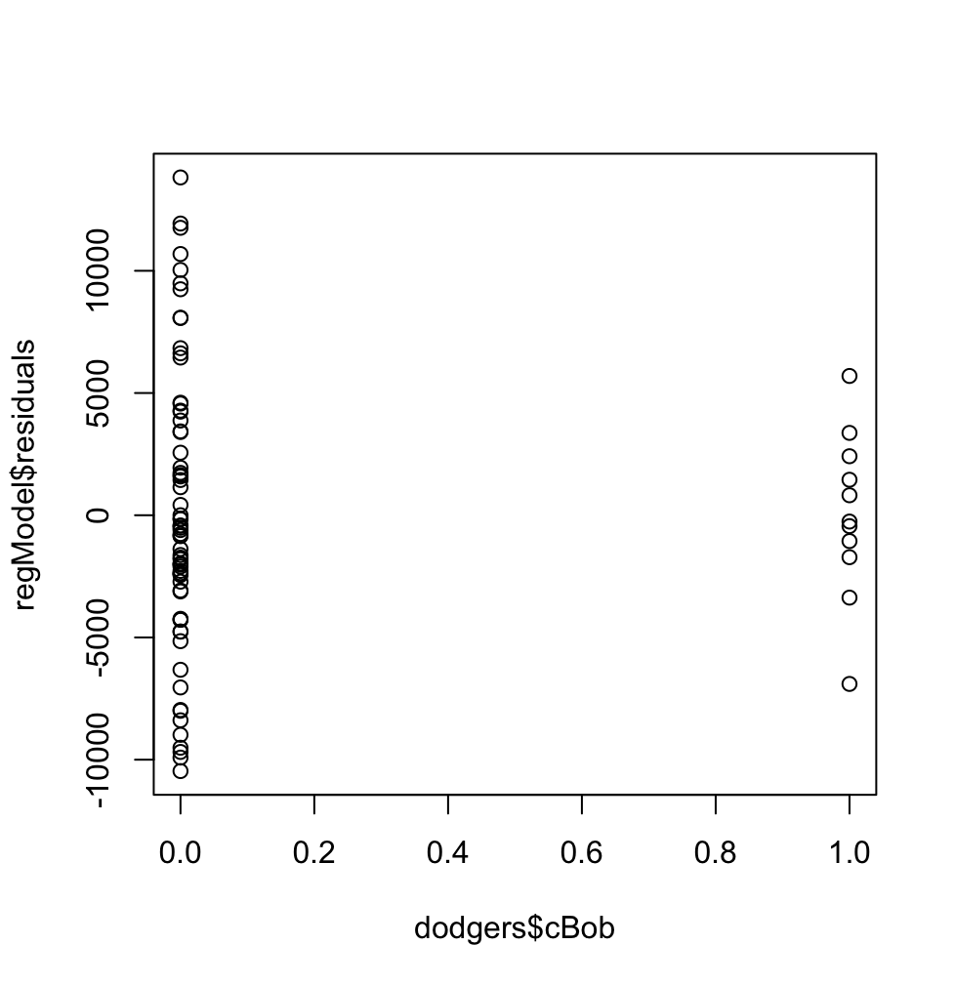
Validity Check: Residual vs. bobblehead
plot(dodgers$cBob, regModel$residuals)
This graph shows the instances where bobbleheads were given out
The column over 1.0 is for when bobbleheads were given out
The column over 0.0 is for when bobbleheads were not given out

Slide 28
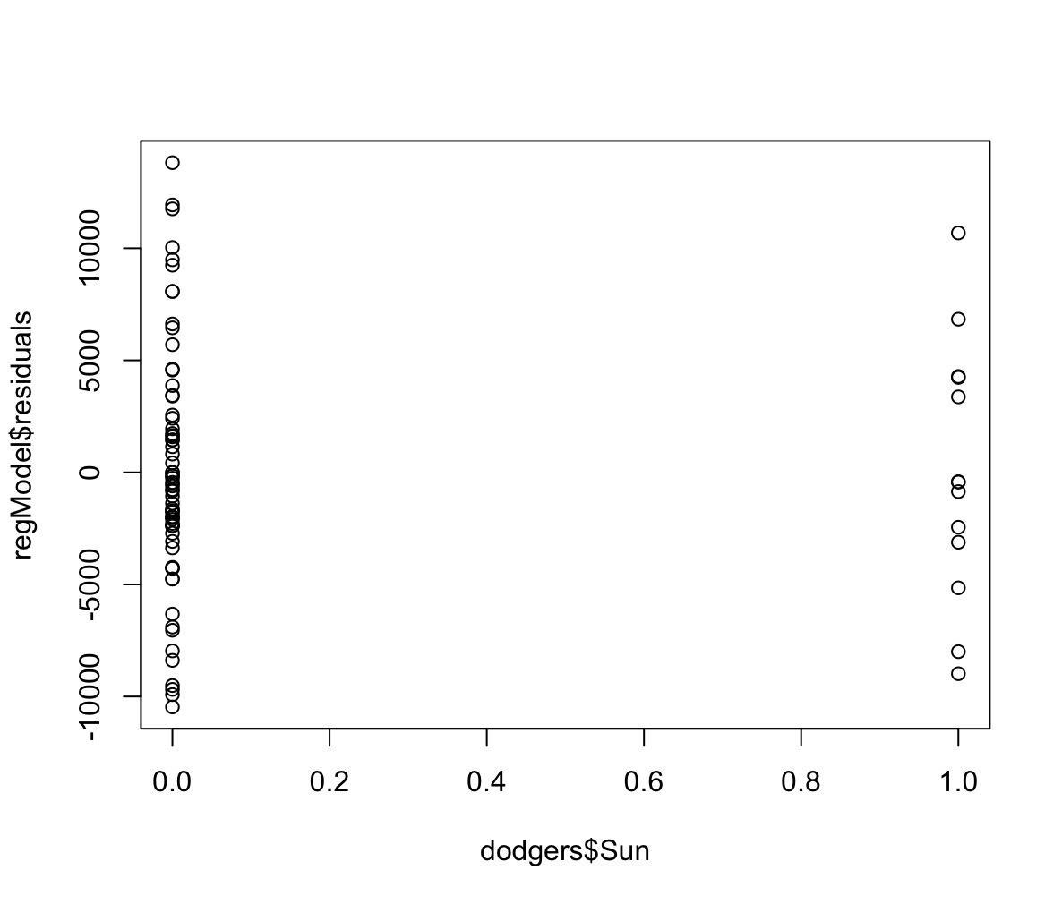
Validity Check: Residual vs. Sunday
plot(dodgers$Sun, regModel$residuals)
This shows all the Sunday games
Column 1.0 shows the instances where the games were on Sunday
Column 0.0 shows games that were not on Sunday; we will be ignoring these here

Slide 29
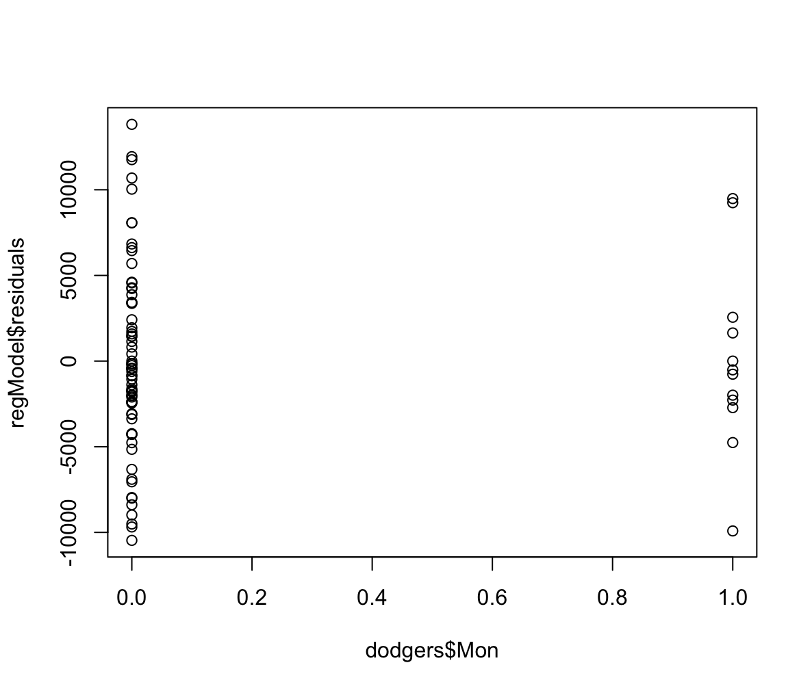
Validity Check: Residual vs. Monday
plot(dodgers$Mon, regModel$residuals)
This shows all the Monday games
Column 1.0 shows the instances where the games were on Monday
Column 0.0 shows games that were not on Monday; we will be ignoring these here

Slide 30
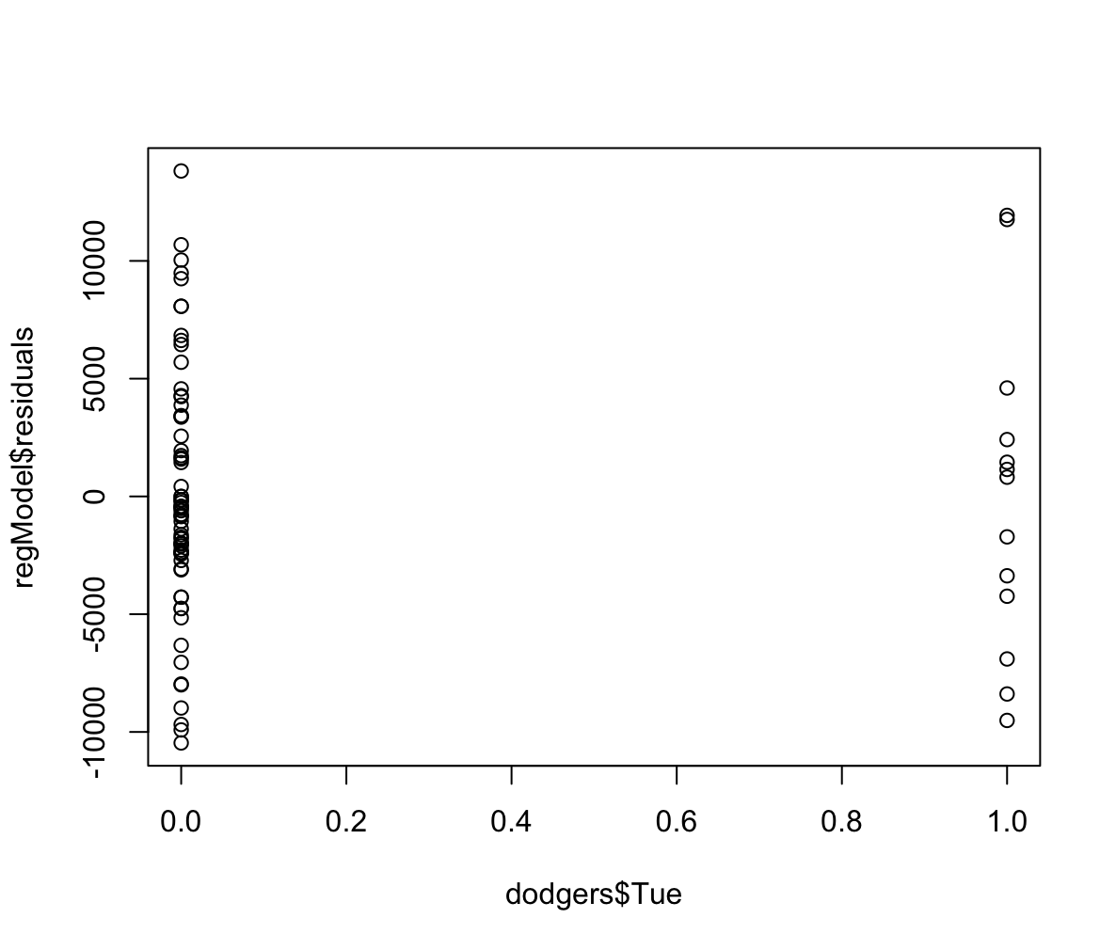
Validity Check: Residual vs. Tuesday
plot(dodgers$Tue, regModel$residuals)
This shows all the Tuesday games
Column 1.0 shows the instances where the games were on Tuesday
Column 0.0 shows games that were not on Tuesday; we will be ignoring these here

Slide 31
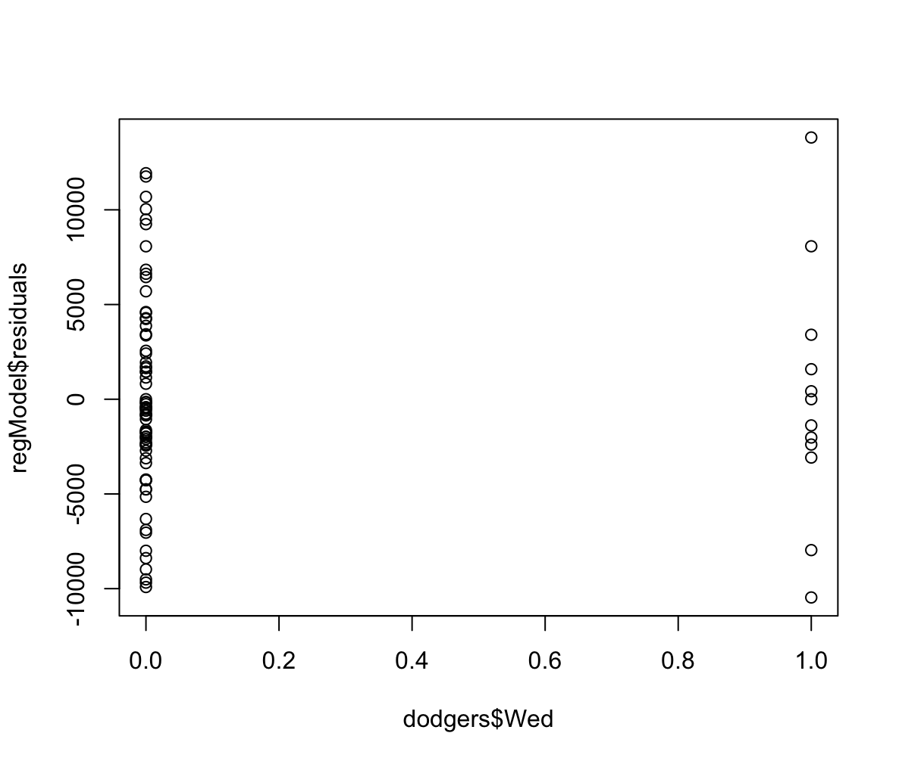
Validity Check: Residual vs. Wednesday
plot(dodgers$Tue, regModel$residuals)
This shows all the Wednesday games
Column 1.0 shows the instances where the games were on Wednesday
Column 0.0 shows games that were not on Wednesday; we will be ignoring these here

Slide 32
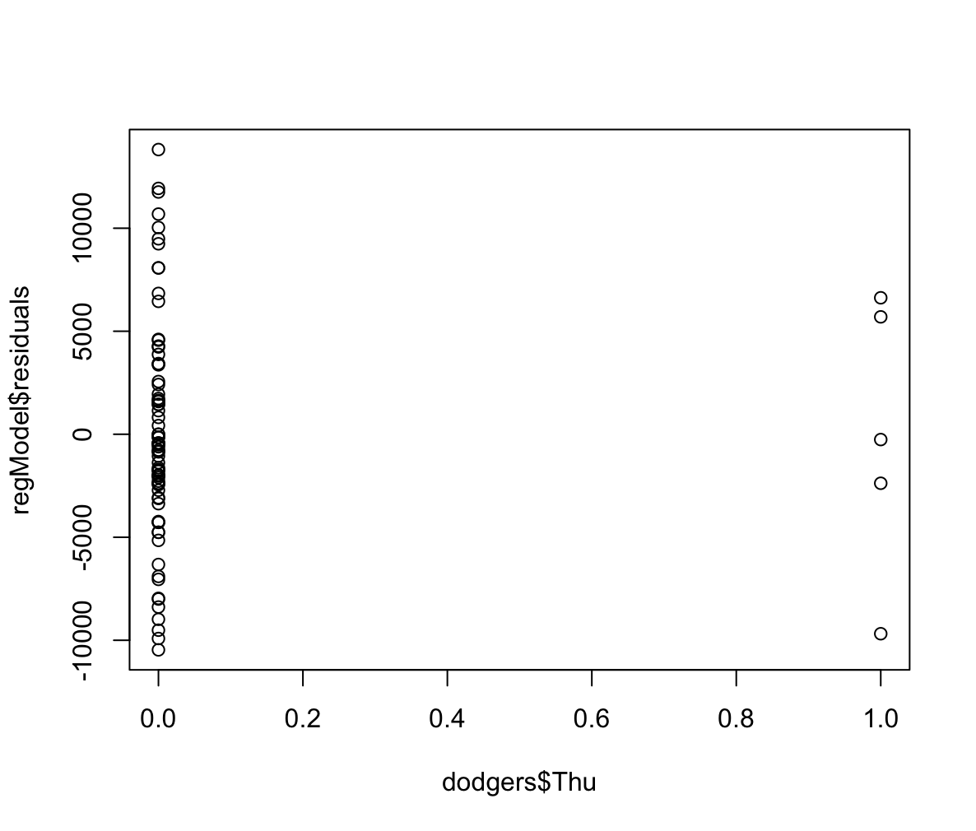
Validity Check: Residual vs. Thursday
plot(dodgers$Thu, regModel$residuals)
This shows all the Thursday games
Column 1.0 shows the instances where the games were on Thursday
Column 0.0 shows games that were not on Thursday; we will be ignoring these here

Slide 33
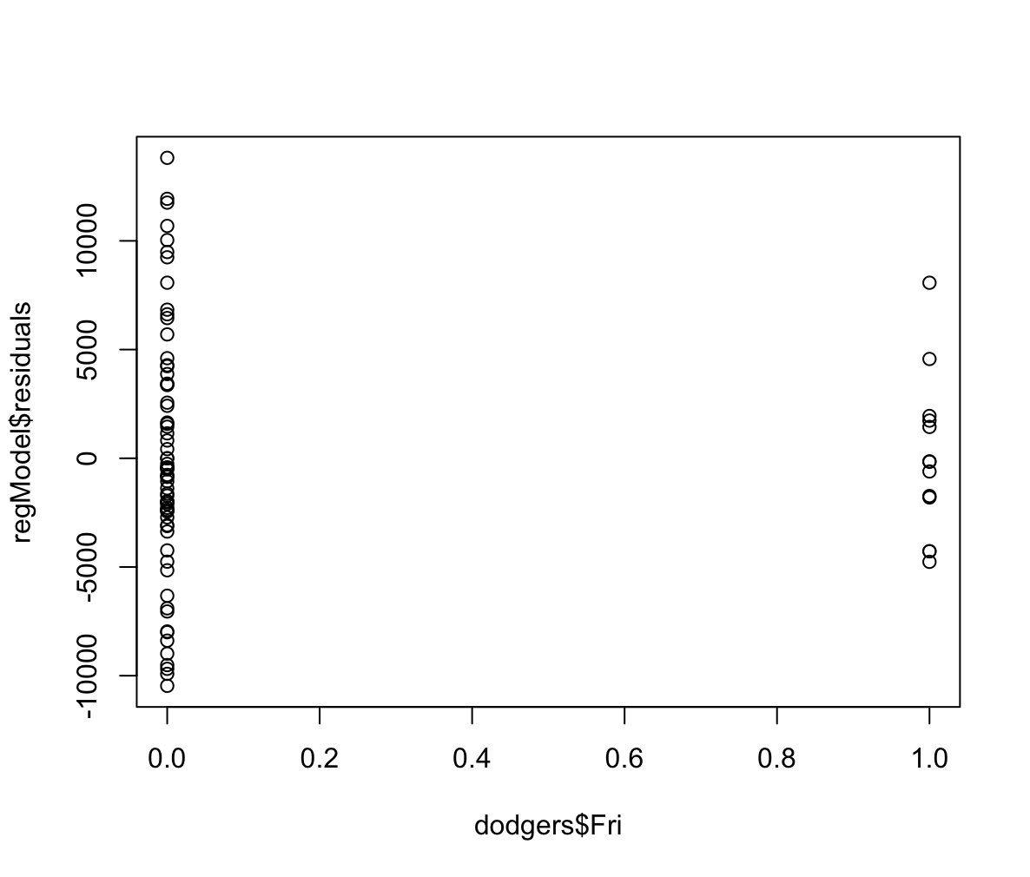
Validity Check: Residual vs. Friday
plot(dodgers$Fri, regModel$residuals)
This shows all the Friday games
Column 1.0 shows the instances where the games were on Friday
Column 0.0 shows games that were not on Friday; we will be ignoring these here

Slide 34
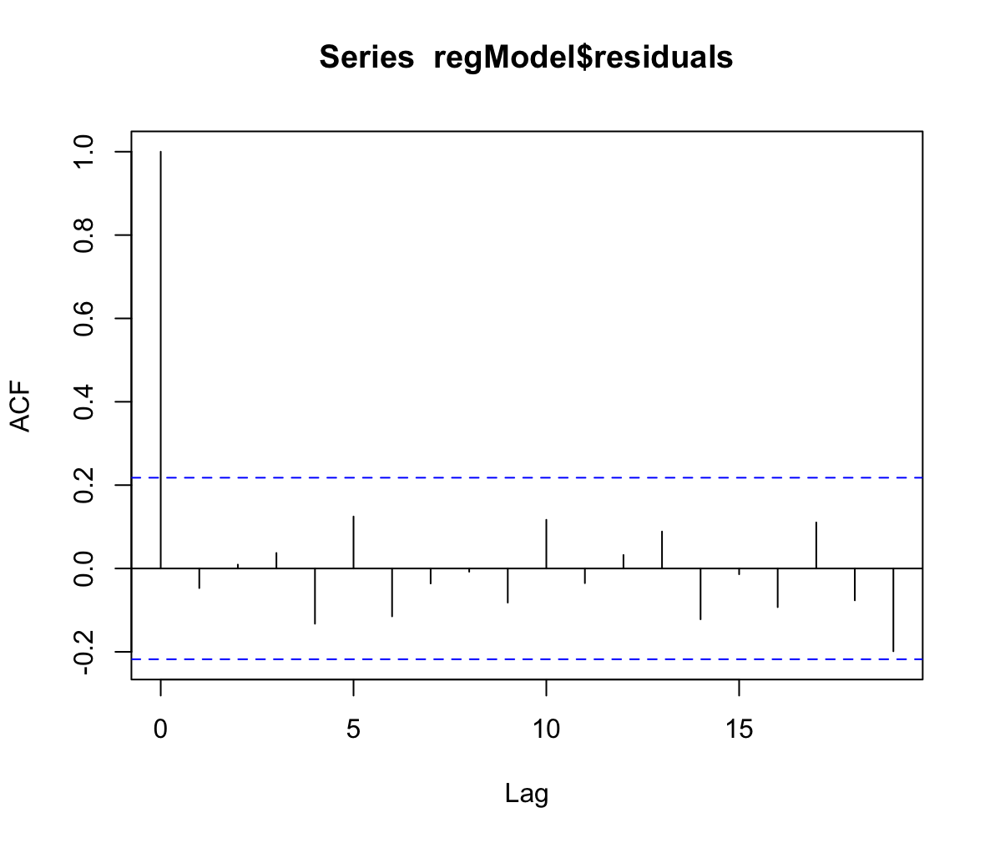
Validity Check: Independence of Error (Auto Correlation Check)
acf(RegressionModelx$residuals)
Autocorrelation checks if the errors in our predictions are related to nearby errors in the dataset. We look at up to 20 positions behind each error.
The dashed lines show bounds for autocorrelations indistinguishable from zero with 95% confidence.
The dash lines give us a range, if the auto correlation fall within this range, it is likely due to random chance.
One important thing to note is that the correlation of each data point with itself is always 1, so we don't include it in this check.
In our case, only one of the other 20 autocorrelations falls outside the expected range. So, 5% (1 out of 20) could expected to fall outside the bounds when the population correlation is 0.
Therefore, the independence assumption is supported by the data.

Slide 35
Uncertainty Characterization Valid
Since the regression model has passed all the validity checks, we can confirm the assumption of independence and identical distribution is valid
This allows us to use this regression model to predict attendance going forward

Slide 36
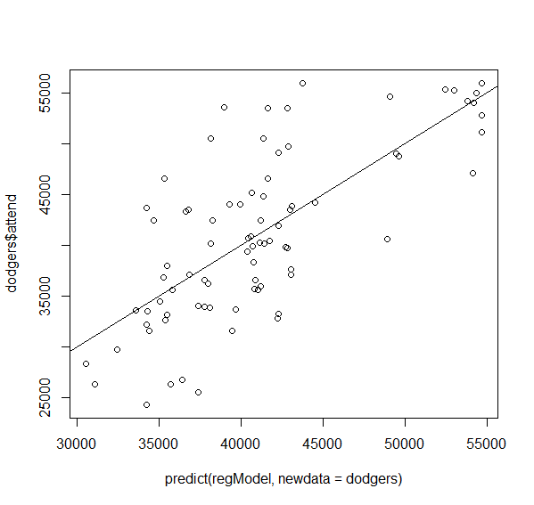
Summary of the regModel (after removing Friday)
The result is:
(Intercept) stemp I(stemp^2) cBob cDay_Night ccap cshirt cfireworks
41711.8191 817.2185 -7852.4152 12492.9487 2885.5433 -3534.8444 6831.1798 1353.4929
Sun Mon Tue Wed Thu
-1776.9462 -6129.4277 485.3684 -3562.8210 -4770.7222
After removing Friday from the model, we get the above coefs.
The fit of the new model is also good and is supported by the new R2 of 0.52, which moderately good.
Illustrative Interpretation for bobblehead: On days with a bobblehead promotion, attendance is expected to increase by 12,492 units compared to days without a bobblehead promotion, holding all other variables constant.

Slide 37
Characterizing Uncertainty and Significance for Regression Model Coefficients
Regression model validity established: we trust the statistical characterizations of model terms and uncertainty. These are examined through the following R commands:
anova(regModel) # print ANOVA table for regression model
summary(regModel) # used to show standard deviation estimates and p-values
confint(regModel) # compute confidence intervals for model coefficients

Slide 38
Summary of the regModel (after removing Friday)
Summary(regModel)
Residuals:
Min 1Q Median 3Q Max
-11855.5 -3382.9 -531.6 2915.9 14625.3
Coefficients:
Estimate Std. Error t value Pr(>|t|)
(Intercept) 41711.8 1929.1 21.623 < 2e-16 ***
stemp 817.2 1820.1 0.449 0.6549
I(stemp^2) -7852.4 3146.6 -2.495 0.0150 *
cBob 12492.9 2526.5 4.945 5.26e-06 ***
cDay_Night 2885.5 2832.2 1.019 0.3119
ccap -3534.8 4646.3 -0.761 0.4494
cshirt 6831.2 3803.6 1.796 0.0769 .
cfireworks 1353.5 2344.8 0.577 0.5657
Sun -1776.9 3236.8 -0.549 0.5848
Mon -6129.4 2530.7 -2.422 0.0181 *
Tue 485.4 2606.2 0.186 0.8528
Wed -3562.8 2419.6 -1.472 0.1455
Thu -4770.7 3295.5 -1.448 0.1523
---
Signif. codes: 0 ‘***’ 0.001 ‘**’ 0.01 ‘*’ 0.05 ‘.’ 0.1 ‘ ’ 1
Residual standard error: 6205 on 68 degrees of freedom
Multiple R-squared: 0.5247, Adjusted R-squared: 0.4408
F-statistic: 6.255 on 12 and 68 DF, p-value: 2.725e-07
This function checks the t statistic and p value for the following hypothesis tests:
H₀: β₀ = 0 vs. H₁: β₀ ≠ 0.
H₀: β₁ = 0 vs. H₁: β₁ ≠ 0.
H₀: β₂ = 0 vs. H₁: β₂ ≠ 0.
And so on
The are p values which are higher than 5% and hence we need to eliminate variables which have a higher p value and then refit the model.
The r square is moderately good, however as per above we need to eliminate variables from the model and then recalculate the values..
Further, the sigma estimate is 6205 at 68 degrees of freedom. It is basically the std. deviation (sigma estimate) of the residuals.

Slide 39
Anova of the regModel (after removing Friday)
Analysis of the variance table:
Response: attend
Df Sum Sq Mean Sq F value Pr(>F)
stemp 1 53929532 53929532 1.4008 0.2407166
I(stemp^2) 1 597826776 597826776 15.5279 0.0001943 ***
cBob 1 1478534609 1478534609 38.4034 3.835e-08 ***
cDay_Night 1 115808402 115808402 3.0080 0.0873854 .
ccap 1 13058505 13058505 0.3392 0.5622283
cshirt 1 111849009 111849009 2.9052 0.0928617 .
cfireworks 1 164520308 164520308 4.2732 0.0425260 *
Sun 1 142754 142754 0.0037 0.9516236
Mon 1 172767523 172767523 4.4875 0.0378014 *
Tue 1 54890245 54890245 1.4257 0.2366132
Wed 1 45919626 45919626 1.1927 0.2786367
Thu 1 80681719 80681719 2.0956 0.1523161
Residuals 68 2618003881 38500057
Predictor variables such as I(stemp^2), cBob, cfireworks, and Mon, have low p-values (< 0.05), indicating that they are statistically significant predictors of attendance.
Other variables, such as cDay_Night and cshirt, have p-values close to 0.05, suggesting marginal significance.
The remaining variables, such as stemp, ccap, and the days of the week, do not appear to be statistically significant predictors of attendance.
However, if temp square has a significance, we need to keep the temp value even if it is not significant as its quadratic term is significant.

Slide 40
Confint of the regModel (after removing Friday)
confint(regModel)
2.5 % 97.5 %
(Intercept) 37862.4012 45561.237
stemp -2814.7199 4449.157
I(stemp^2) -14131.4203 -1573.410
cBob 7451.4164 17534.481
cDay_Night -2765.9265 8537.013
ccap -12806.4163 5736.728
cshirt -758.7523 14421.112
cfireworks -3325.4658 6032.452
Sun -8235.9046 4682.012
Mon -11179.3753 -1079.480
Tue -4715.1426 5685.879
Wed -8391.0500 1265.408
Thu -11346.8798 1805.435
Again, there is no use checking the confidence intervals for the current model as the there are certain values which have a very high p value.

Slide 41
Step wise process to get the final model
As discussed, before we need to eliminate variables with a higher p value.
For that we use the backward approach the rcode for the same:
install.packages("olsrr")
library(olsrr)
beModel = ols_step_backward_p(regModel, details = TRUE, prem = 0.06)
We set the desired p value to 6% so instances just above 5% are kept in the model.
The variables remaining in the model if we were to maintain the above p value criteria are the following:
Parameter Estimates
--------------------------------------------------------------------------------------------------
model Beta Std. Error Std. Beta t Sig lower upper
--------------------------------------------------------------------------------------------------
(Intercept) 41260.089 1031.669 39.994 0.000 39205.341 43314.836
I(stemp^2) -7740.332 3072.739 -0.218 -2.519 0.014 -13860.223 -1620.441
cBob 12163.754 2107.394 0.505 5.772 0.000 7966.514 16360.993
cshirt 7662.855 3703.875 0.175 2.069 0.042 285.948 15039.763
Mon -5829.424 1981.806 -0.251 -2.941 0.004 -9776.532 -1882.316

Slide 42
Step wise process to get the final model (cont.)
The sequence of elimination was as follows:
Variables Removed:
x Tue
x stemp
x cfireworks
x Sun
x cDay_Night
x ccap
x Thu
x Wed

Slide 43
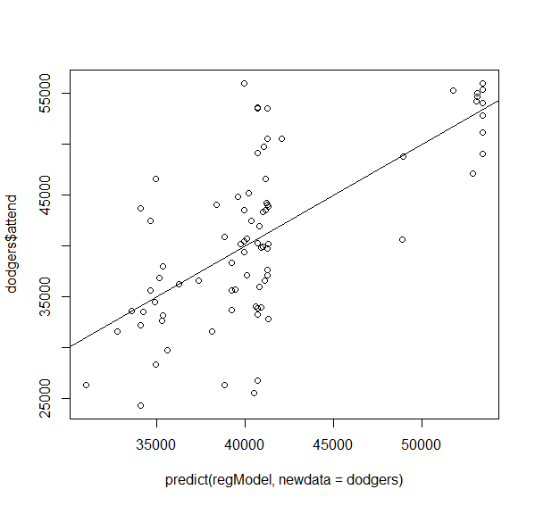
Step wise process to get the final model (cont.)
But we are to keep the temp^2 in the model which is a quadratic term for temp, we cannot eliminate the base term. Thus, the r code for the Final Regression model would be as follows:
regModel <- lm(attend ~ I(stemp^2) + stemp + cBob + cshirt + Mon, data = dodgers)

Slide 44
Final model, R square and confidence intervals
The r code is:
regModel <- lm(attend ~ I(stemp^2) + stemp + cBob + cshirt + Mon, data = dodgers)
summary(regModel)$coefficients[,1]
plot(predict(regModel, newdata = dodgers), dodgers$attend)
abline(0,1) summary(regModel)$r.squared
summary(regModel)
confint(regModel)
Final R model would have the following variables: stemp^2, stemp, cBob, cshirt and Mon.
Based on the above run code we get an r square of 47.05% which moderate. Further, there has not been much change in the previous value of 52% which indicates that variables that were removed did not significantly contribute to the explanatory power of the model.

Slide 45
Final model, R square and confidence intervals
The confidence intervals are as follows:
> summary(regModel)
Coefficients:
Estimate Std. Error t value Pr(>|t|)
(Intercept) 41293.5 1038.4 39.768 < 2e-16 ***
I(stemp^2) -7568.3 3103.6 -2.439 0.01711 *
stemp 933.1 1729.7 0.539 0.59119
cBob 12138.6 2117.8 5.732 1.96e-07 ***
cshirt 7669.3 3721.3 2.061 0.04278 *
Mon -5812.0 1991.4 -2.919 0.00464 **
---
Signif. codes: 0 ‘***’ 0.001 ‘**’ 0.01 ‘*’ 0.05 ‘.’ 0.1 ‘ ’ 1
Residual standard error: 6236 on 75 degrees of freedom
Multiple R-squared: 0.4705, Adjusted R-squared: 0.4352
F-statistic: 13.33 on 5 and 75 DF, p-value: 2.694e-09
Now we just values with p-value less than 5% to 6%. The estimates show that increase/decrease in the attendance for each variable.

Slide 46
Final model, R square and confidence intervals
The confidence intervals are as follows:
> confint(regModel)
2.5 % 97.5 %
(Intercept) 39224.9784 43362.039
I(stemp^2) -13751.0141 -1385.654
stemp -2512.7263 4378.845
cBob 7919.7242 16357.499
cshirt 256.0765 15082.470
Mon -9779.0676 -1845.019
Following are the confidence intervals with 95% confidence:
Intercept: The expected attendance, when all predictor variables are zero, is estimated to be between 39,224.98 and 43,362.04
I(stemp^2): Each one unit change in the squared scaled temperature term is associated with a decrease in attendance between -13,751.01 and -1,385.65
stemp: For each one unit change in the scaled temperature the attendance varies between -2,512.73 and 4,378.85
cBob: Including the Bobblehead promotion is estimated to increase attendance between 7,919.72 and 16,357.50 compared to not including it.
cshirt: The shirt promotion could potentially increase attendance between 256.08 and 15,082.47 as compared to when it is not present.
Mon: Holding a game on Monday, compared to Saturday (reference variable), may lead to a decrease in attendance between -9,779.07 and -1,845.02

Slide 47
Characterizing Uncertainty for Regression Model Forecasts
Regression model validity established, and R² (47.05%)moderately good.
Can use it to predict the confidence and prediction intervals for Tuesday night game with and without bobblehead promotion
R code:
#When bob was given
new_data <- data.frame(cBob = 1, 'I(stemp^2)' = 0, stemp = 0, cshirt = 0, Mon = 0)
#confidence and prediction intervals for the given criteria
predict(regModel, newdata = new_data, interval = 'confidence’)
predict(regModel, newdata = new_data, interval = 'prediction’)
#When bob was not given
new_data <- data.frame(cBob = 0, 'I(stemp^2)' = 0, stemp = 0, cshirt = 0, Mon = 0)
#confidence and prediction intervals for given criteria
predict(regModel, newdata = new_data, interval = 'confidence’)
predict(regModel, newdata = new_data, interval = 'prediction’)
Output:
> predict(regModel, newdata = new_data, interval = 'confidence')
fit lwr upr
1 53432.12 49680.04 57184.2
> predict(regModel, newdata = new_data, interval = 'prediction')
fit lwr upr
1 53432.12 40455.78 66408.46
> new_data <- data.frame(cBob = 0, 'I(stemp^2)' = 0, stemp = 0, cshirt = 0, Mon = 0)
> predict(regModel, newdata = new_data, interval = 'confidence')
fit lwr upr
1 41293.51 39224.98 43362.04
> predict(regModel, newdata = new_data, interval = 'prediction')
fit lwr upr
1 41293.51 28700.41 53886.61

Slide 48
Characterizing Uncertainty for Regression Model Forecasts
Based on the output we can say the following:
Forecasted mean attendance for Tuesday night game when bobblehead was given is – 53,432 and taking the sampling error into account it will range in between: 49,680 to 57,184. Further, we should note that we don’t have values day/night and Tuesday in our regression model, due to their low significance (it suggests that there's no statistically significant difference in attendance between Tuesday and base day or between day and night games). Since these variables don't significantly contribute to explaining attendance variations, it's reasonable to predict attendance without them. Further, we have assumed that no shirts were given (defining shirt = 0 and scaled temp and temp^2 also as 0) and the scaled temperature was 0 (average).
Given that all other things as mentioned in the first point remain constant, we predict the attendance for a given specific individual Tuesday night game when bobblehead was given would is – 53,432 taking the sampling error into account it will range in between: 40,455 to 66,408.
Given all other things as mentioned in first point remain constant (Tuesday night) except that the bobblehead was not given, the mean attendance foes down to– 41,293 and range between 39,224 to 43,362.
Given all other things as mentioned in first point remain constant (Tuesday night) except that the bobblehead was not given, the specific individual attendance would go down to – 41,293 and range between 28,700 to 53,886.

Slide 49
Recommendations
We were provided with the attendance records for dodgers games, with factors such as daynight, caps given, bobs given, days of the week, etc.
Objective: determine dependence of attendance on various factors as mentioned above and assess usefulness of predictive analytics tool.
Result: valid predictive model showing that attendance is indeed affected by bobs, caps, temperature,.
If shirts are given, attendance increases by 7,669 on average.
If bobbleheads are given, attendance increases by 12,138 on average.
If the day is Monday, attendance would be less by 5,812 on average, as compared to Saturday.
Over 47% of the variation is explained by the model, so useful for prediction.
Example: individual attendance for Tuesday night when bobbleheads are given forecast between 40,455 and 66,408 with 95% confidence.
However, it is important to note that there's no statistically significant difference in attendance between Tuesday and base day or between day and night games. Further, we get the attendance values considering shirts were not given, and assuming average temperature(0, as the variable was scaled).
Recommendation: These forecasts can be used as a rough guide to management if they want to introduce bobbleheads or shirt giveaways. The management can compare the giveaway cost with the anticipated increase revenue through increased attendance and if the marginal revenue is higher than the marginal cost, bobblehead or shirts can be given away in more number of matches so as to increase the net profit.

