Slide 1
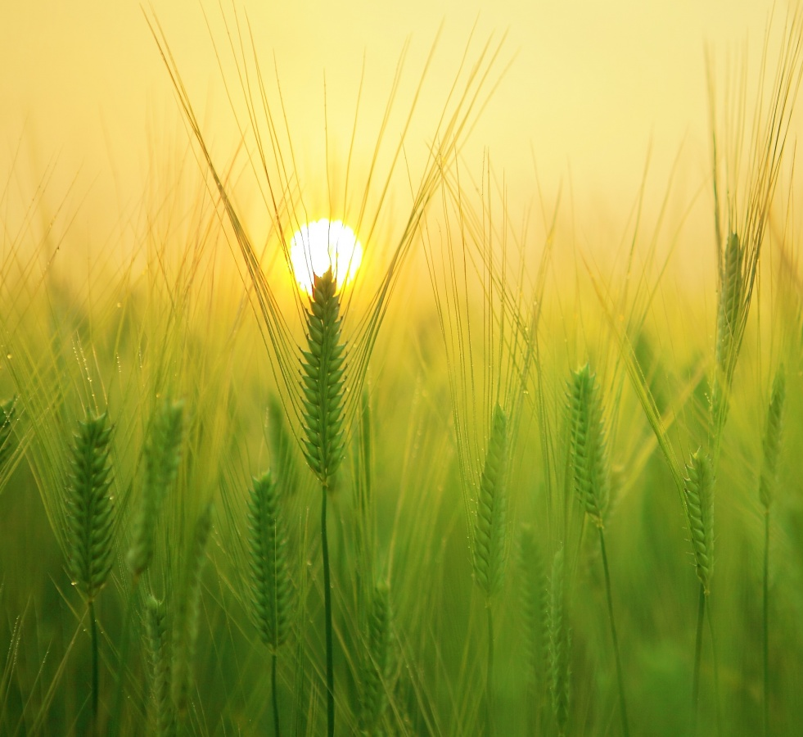
Crop
Recommendation System
Improving Crop Selection through Data
Analysis and Machine Learning

Slide 2
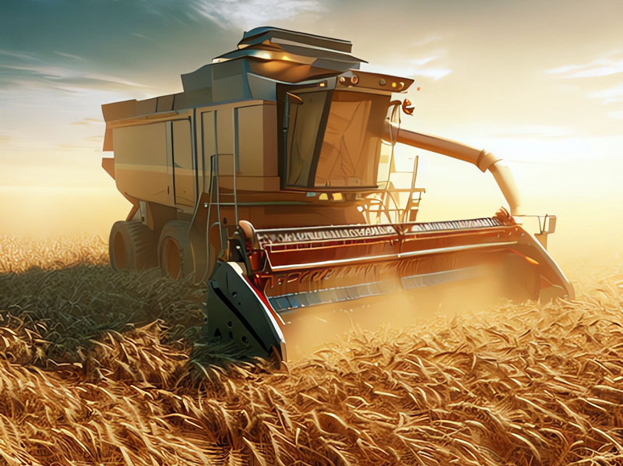
Objective
Our goal is to empower farmers with data-driven insights, enabling them to make informed decisions about which crops to cultivate based on various factors.

Slide 3
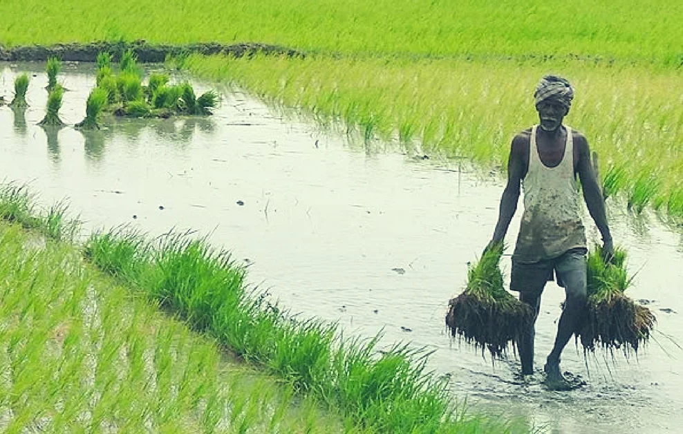
Challenges in Agriculture
• Unpredictable Weather
• Soil Degradation
• Pest Outbreaks
• Optimal Crop Selection

Slide 4

Data And It’s Features
• We have total of 22 crops in Our Dataset
• Features Affecting the crop Growth
03
Main components of Soil (Nitrogen, Phosphorus, Potassium)
04
Environmental factors affecting Crop yield and production (Temperature, Humidity, ph, Rainfall)

Slide 5

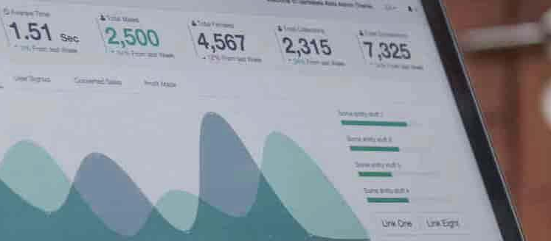

Effective Data Collection
Data Collection And Analysis
Data Preprocessing
Data Visualization

Slide 6
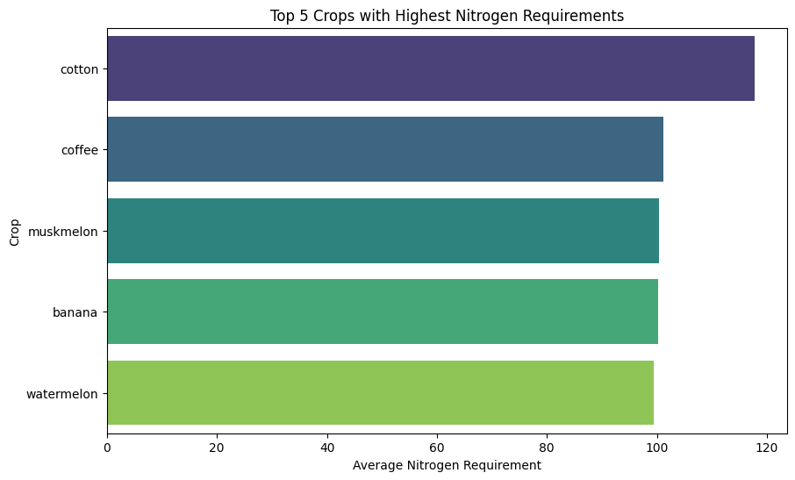
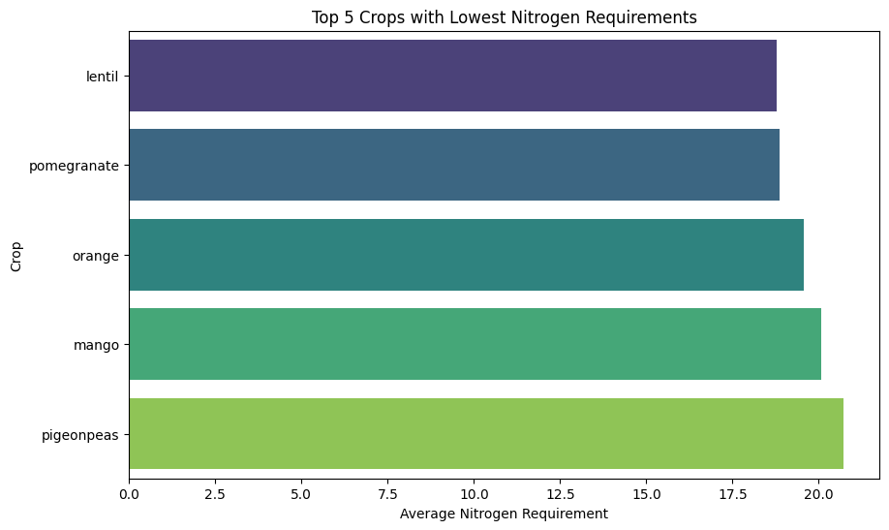

Slide 7
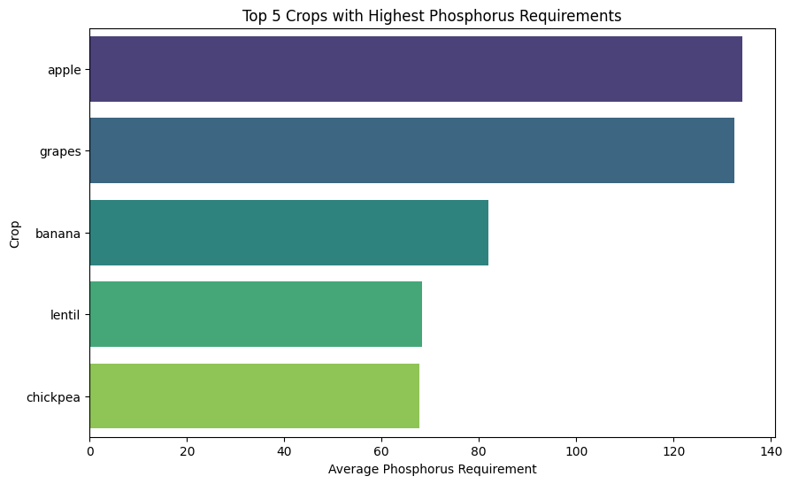
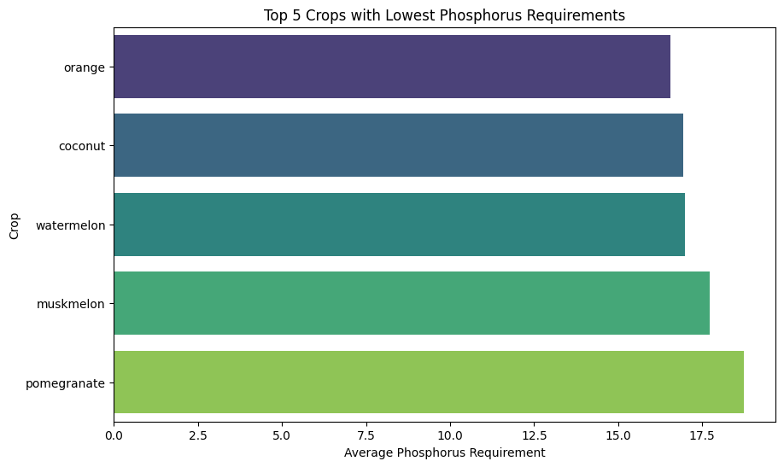

Slide 8
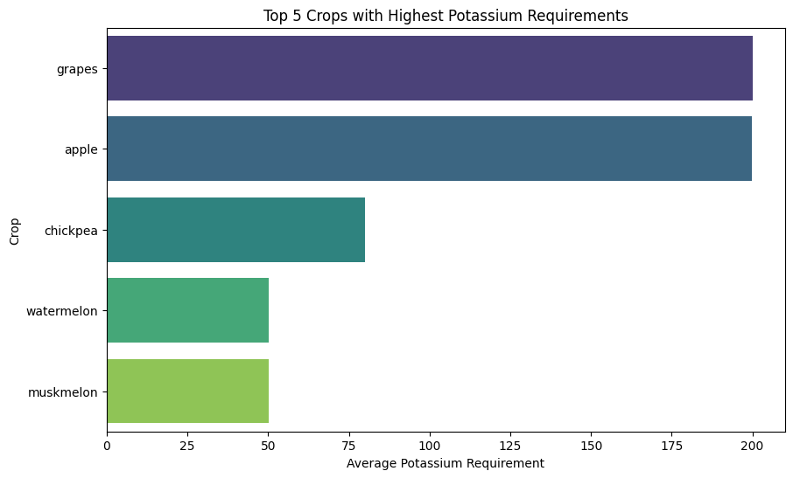
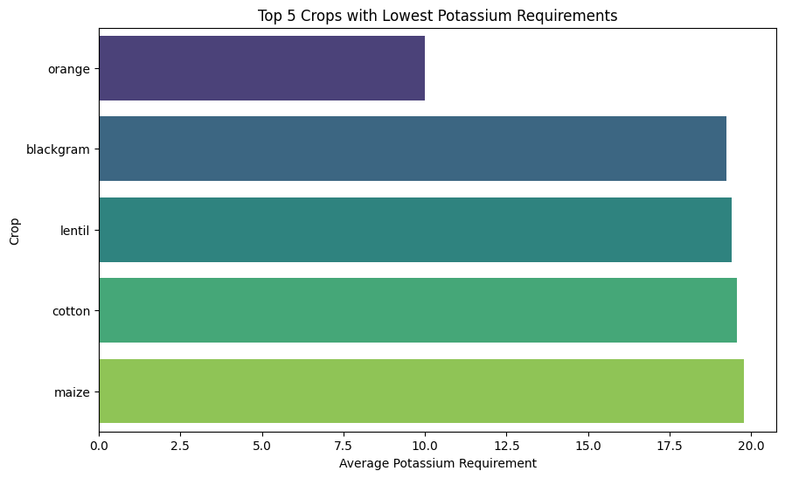

Slide 9
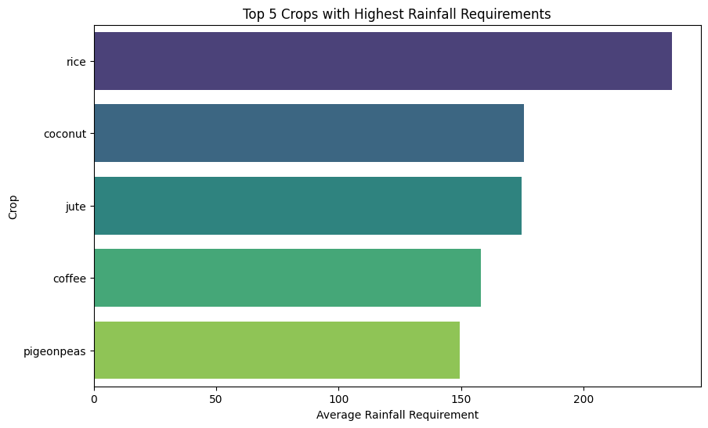
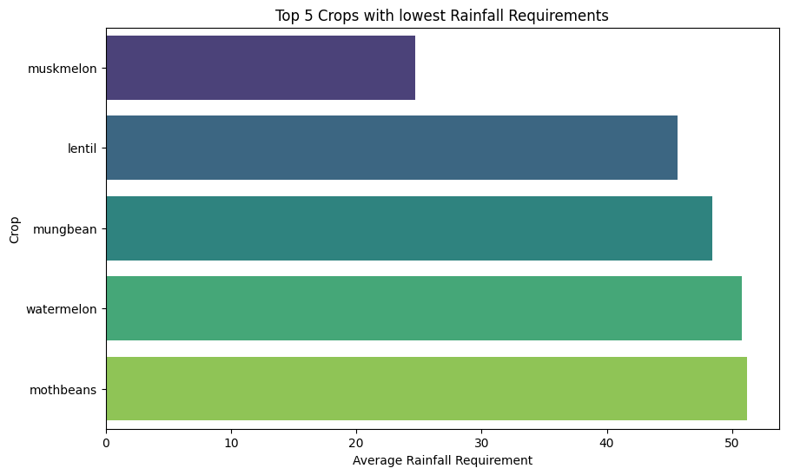

Slide 10
Selection of Machine Learning Algorithm
In this dataset we include the following machine learning algorithms for selection and accuracy comparison
1.Random Forest Classifier – 99.75%
2.Decision Tree Classifier – 98.63%
3.Naive Bayes – 98.80%
By stacking this 3 ML Models together we Created a Meta model With 100% accuracy

Slide 11

Future Development
Fertilizer Recommendation
Plant Diseases Identification

Slide 12
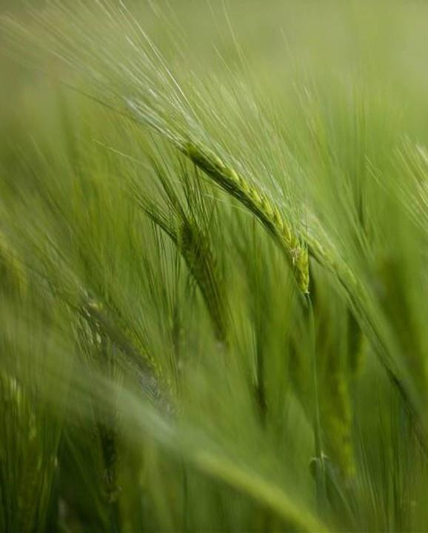
Conclusion
• Minimizes Risk
• Reduces Resource Waste
• Enhances Crop Productivity

Slide 13
Thank You
Shiv Sonwane
shivsonwane07@gmail.com

