Slide 1
AI Security Pilot
Evidence-backed phishing risk classification
Secure AI Hackathon Track 1: Security Reasoning Agent
Contributed: Atchyut (github.com/ShivVIT2019) Shreya (github.com/ssb1506)

Slide 2
Main Problem
Non technical users receive phishing and suspicious emails constantly, and often can't tell whether a message is dangerous.
The gap
Our approach
The safeguard
People guess, or ignore warning signs entirely.
Paste an email, get a clear risk level with visible evidence.
The system says "uncertain" rather than forcing a wrong answer.

Slide 3
Working Methodology
User
→
FastAPI
→
Gemini
→
Response
Pastes email text
into Streamlit UI
POST /analyze
endpoint
Structured JSON
risk classification
risk_level, evidence,
confidence, flagged
Required trust & safety layer
If the model can't find enough signal to be confident, it returns "Uncertain" with low confidence instead of forcing a Low/Medium/High verdict.

Slide 4
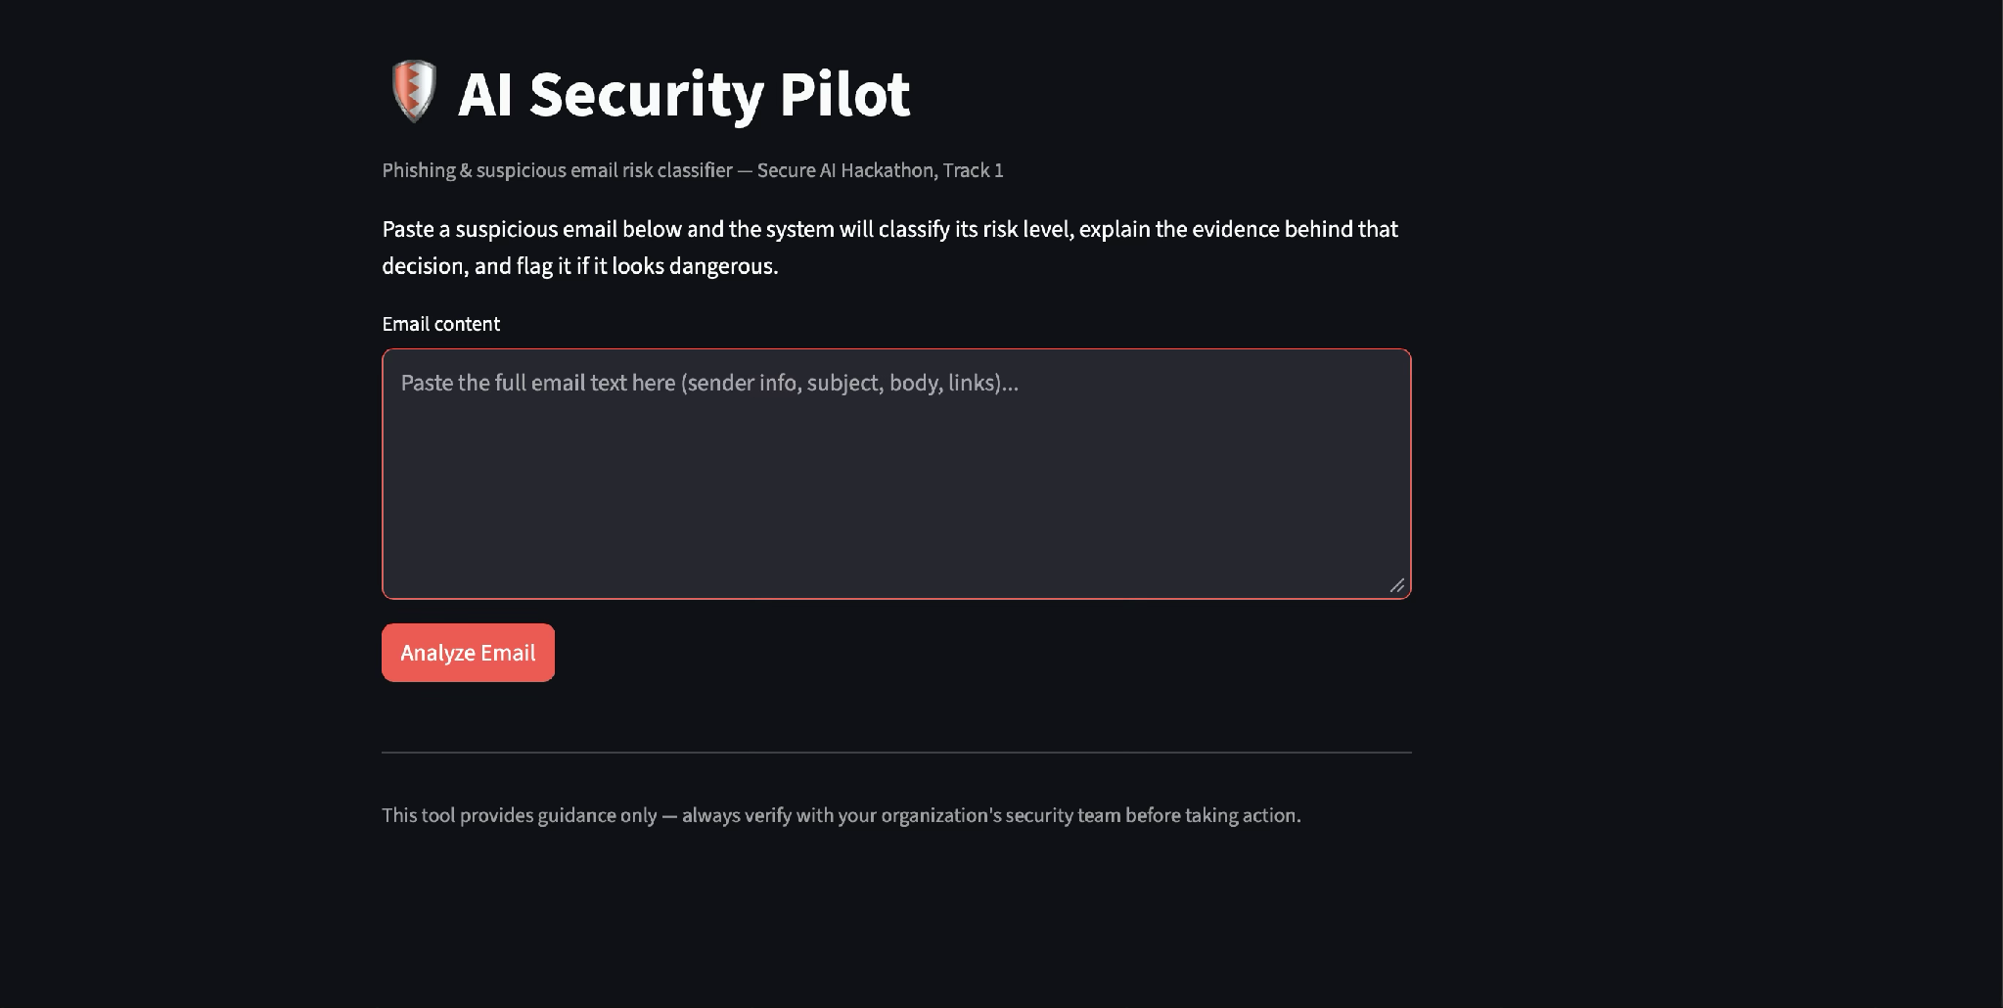
Demo (Flagged phishing email)
Input email (excerpt)
Risk Level: HIGH
"Your account has been suspended due to unusual activity. Click here immediately to verify your identity within 24 hours or your account will be permanently deleted: http://secure-bank-verify.tk/login..."
Confidence: High
🚩 Flagged as potentially dangerous
Evidence & reasoning:
Live UI, tested and working
Uses urgent, threatening language to create panic and demands immediate action. Directs the recipient to a suspicious .tk domain — commonly associated with malicious activity — to "verify identity," indicating a credential-harvesting attempt.

Slide 5
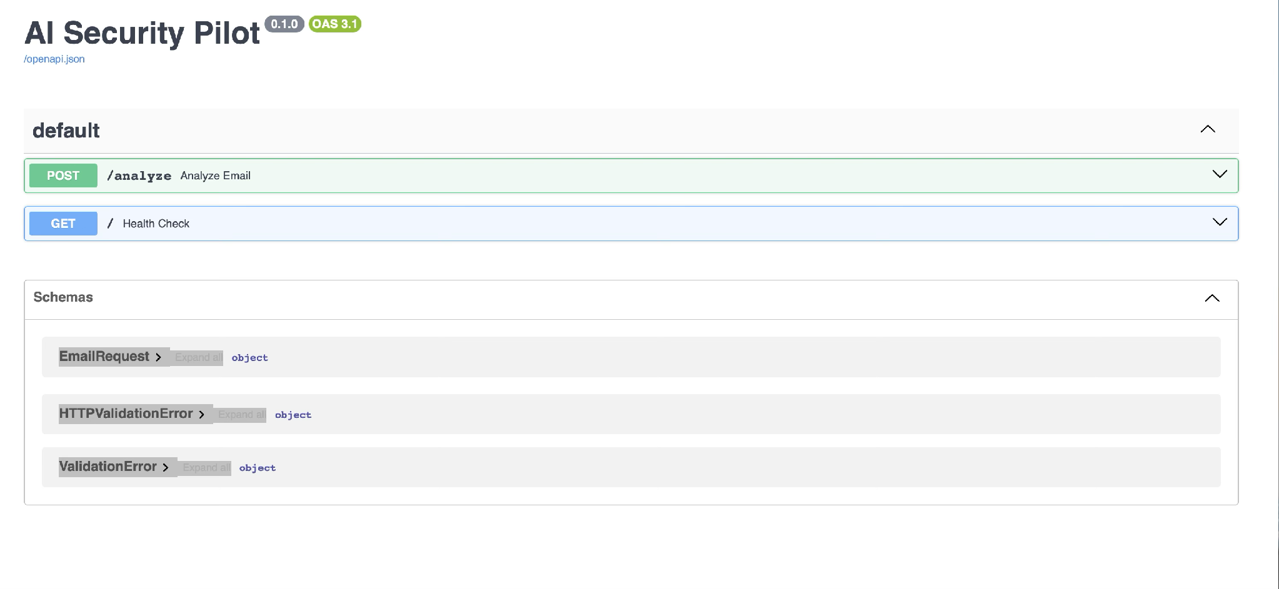
Demo (Safety layer)
When there isn't enough evidence, the system refuses to force a verdict it says so instead of guessing.
Test input: "string" (placeholder / low-signal text)
Risk Level: UNCERTAIN
Confidence: Low Flagged: false
"The email content provided contains no discernible information such as sender, subject, body, or links to analyze for phishing risk."
This is the required trust/safety mechanism for Track 1 — tested and confirmed working.

Slide 6
Result & Next Steps
What it delivers
Limitations
A fast, evidence-backed way to triage suspicious emails
Clear risk level, confidence, and reasoning not a black box
Refuses to guess when evidence is insufficient
Evidence currently comes from the LLM's own reasoning rather than an independent rules/regex layer. A strong next iteration would add deterministic signal detection (sender-domain checks, link analysis) alongside the AI explanation, plus an audit log of every decision.
github.com/ShivVIT2019/ai-security-pilot

