Slide 1
SmartShelfX: AI-Based Inventory Forecast & Auto-Restock System Team Members: Shiva Kumar Muthe Ram Charan Bhanu Prakash Bharath K H VennilaGnanavel

Slide 2
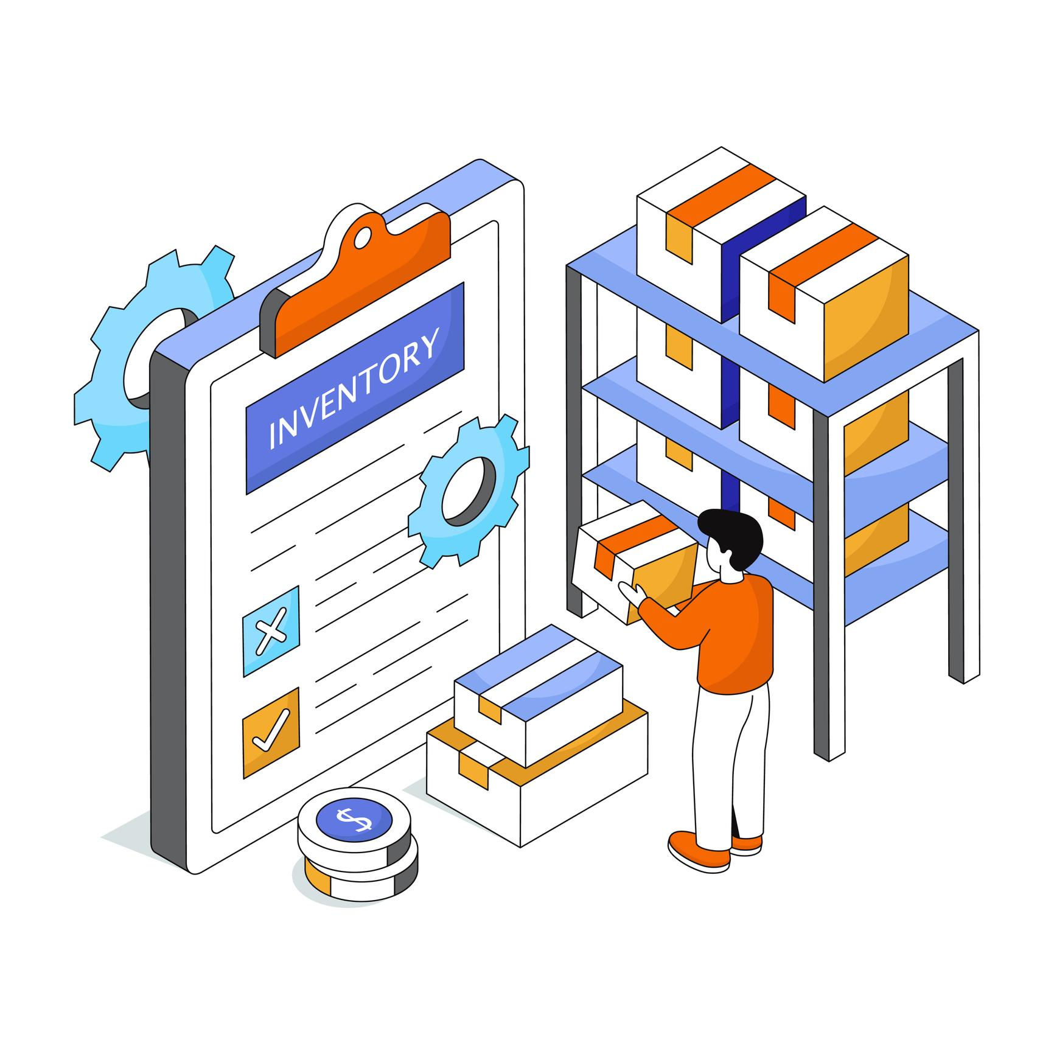
Introduction
SmartShelfX is an intelligent system optimizing stock levels using AI for demand forecasting.
It enables seamless product management and real time tracking of stock-in and stock-out operations.
Manual methods are time-consuming and error-prone, leading to inaccurate inventory data and delayed decision-making.

Slide 3
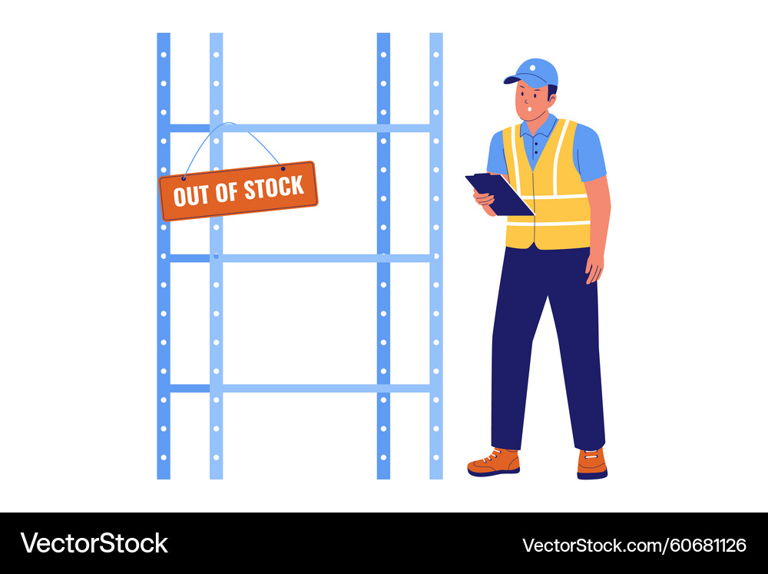
Traditional vs SmartShelfX
Traditional Inventory Issues:
Traditional methods suffer from manual tracking, inaccurate predictions, overstocking, stockouts, and a lack of real-time visibility hindering effective inventory control.
SmartShelfX Advantage:
SmartShelfX addresses these issues by leveraging AI to automate and optimize inventory management for better decision-making and resource allocation.

Slide 4


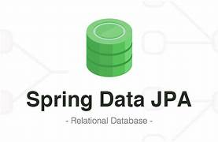
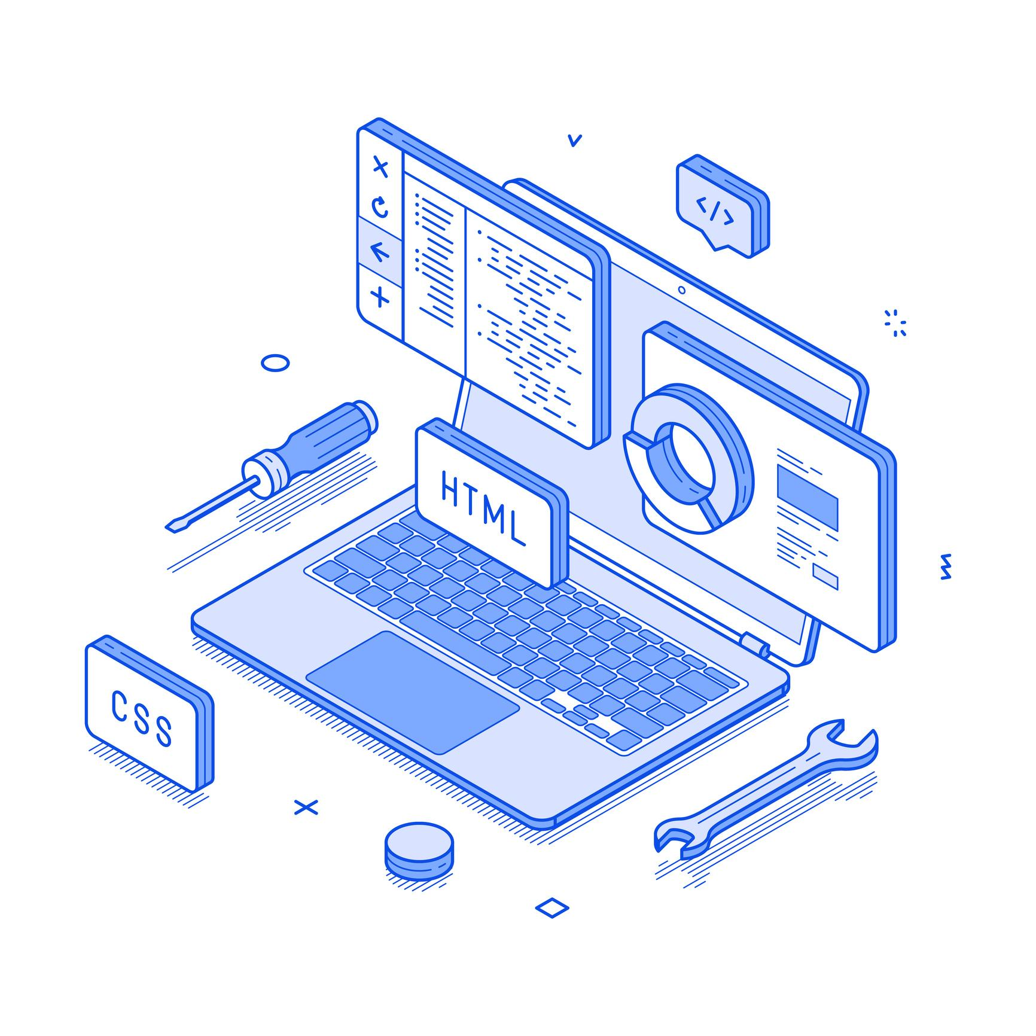



Technologies used

Slide 5

Modules
User & Role Management:
Login / Register
Users can securely access the system through login/registration processes which ensures controlled access to sensitive inventory data.
Role-Based Access:
Access control enables customized roles with predefined permissions. In this way, data security is enhanced.

Slide 6
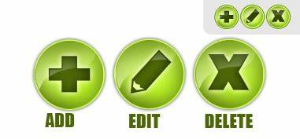


Inventory Management
Add/Edit/Delete Products:
Admins can manage the product catalog efficiently by adding, editing, or deleting products, maintaining accurate inventory records which leads to efficient tracking.
Product Catalog Management
Centralized product catalog simplifies searching and selection of items. Also, it simplifies stock management and reduces errors.
Vendor Management
Tracking vendors simplifies restocking, enables cost reductions, and manages supplier relationships effectively.

Slide 7
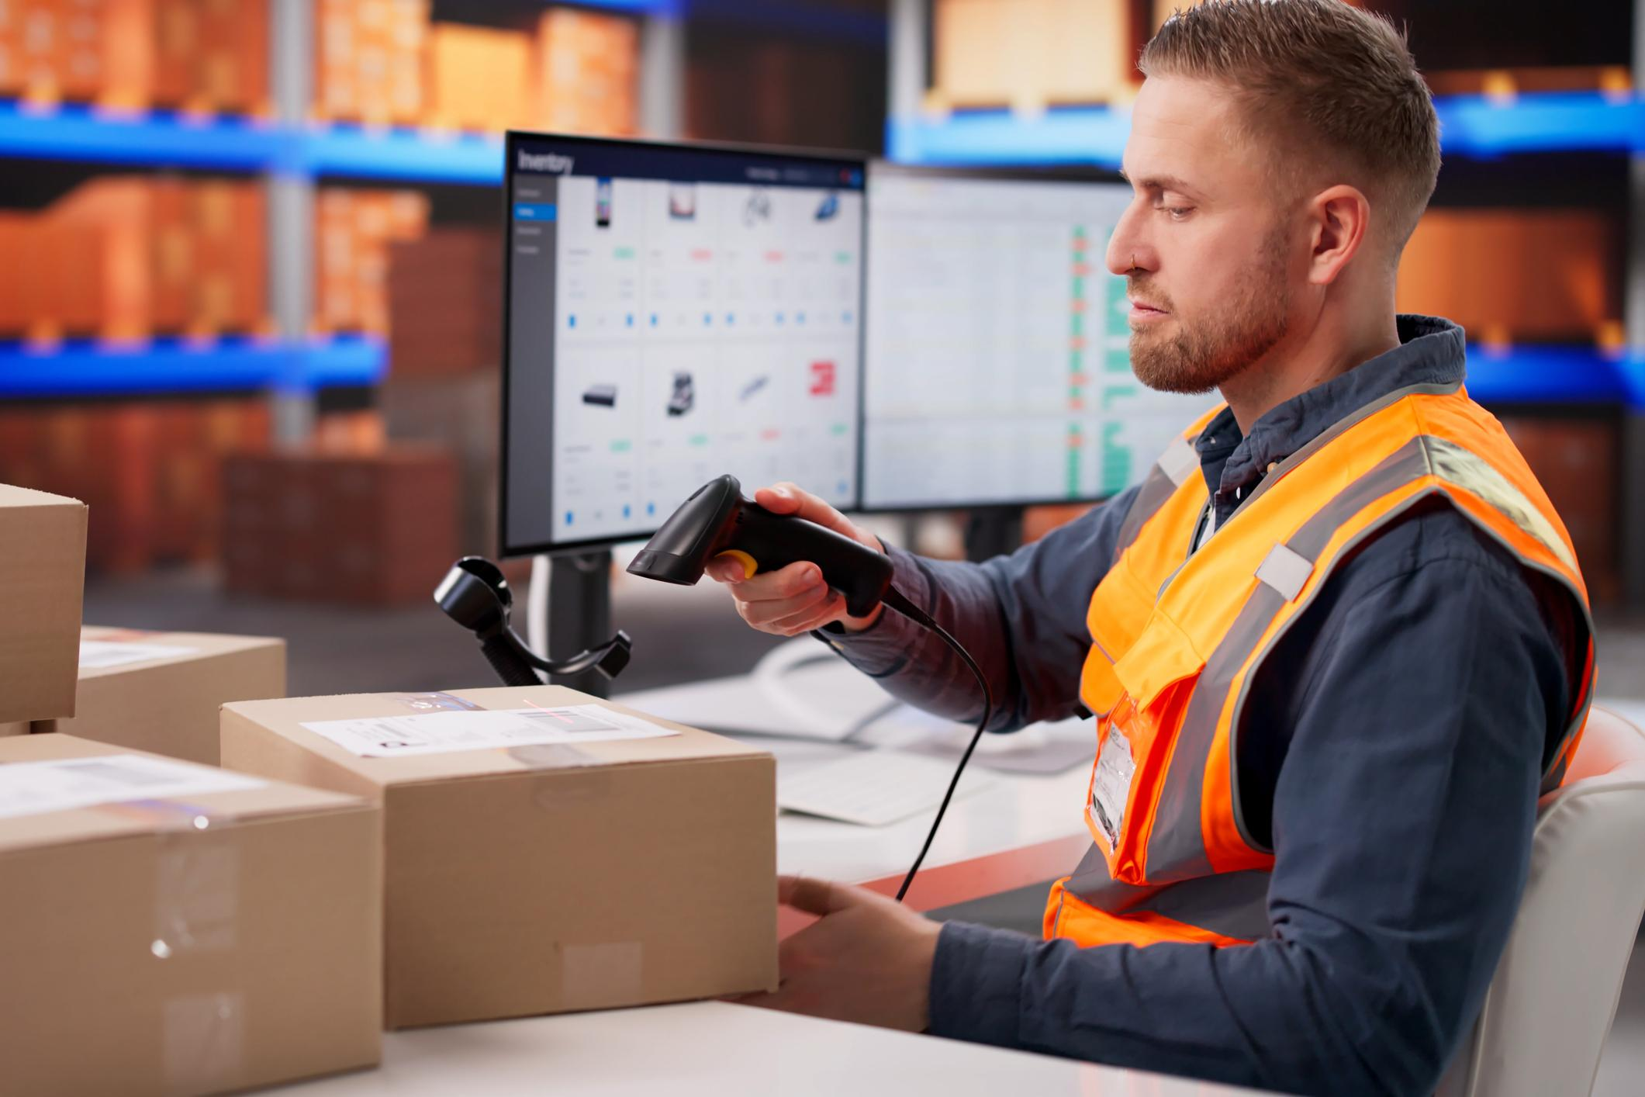
Stock Transactions
Stock-in:
Record incoming shipments,updating inventory count in real time ensuring accurate stock levels and minimizing discrepancies.
Stock-out:
Track product dispatch, detect from inventory automatically update availability quickly improve order fulfilment, accuracy and customer satisfaction.

Slide 8

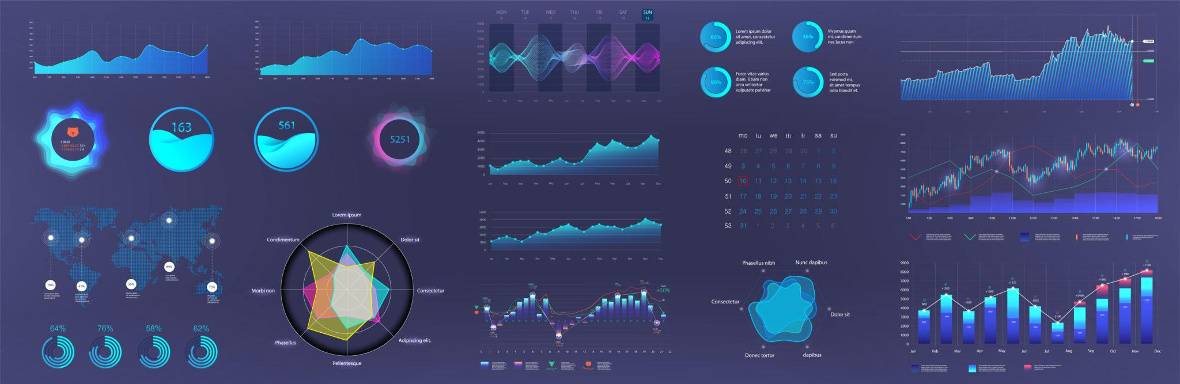
Project outcomes
Achieved secure role based management access for Admin,Manager,Vendor,users.
Automated solutions minimize staff workload and increase process efficiencies.
Improved real time stock accuracy using Analytics Dahboard.
Budget allocation for product purchasing that supports profitable growth and matches marketing and sales strategies.

Slide 9
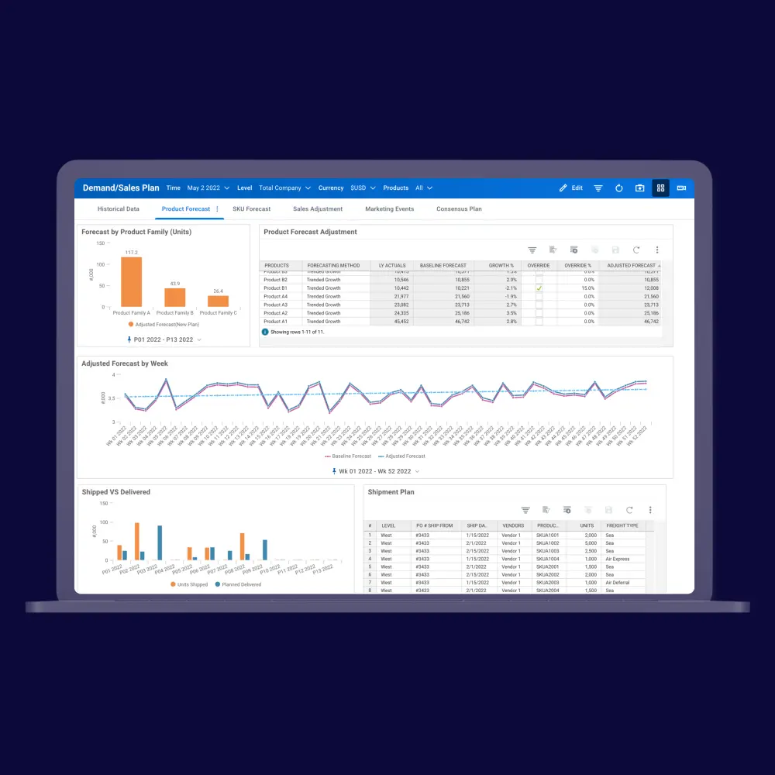
Future Enhancements
Develop a mobile application for convenient management of processes and Data.
Voice Assistant for Inventory Queries can be developed to Integrate voice commands like:
“Check stock of Product A”
“Show low stock items”

Slide 10

Conclusion
SmartShelfX provides an intelligent solution for efficient inventory management using AI-based demand forecasting. The system helps maintain optimal stock levels by predicting product demand and recommending automatic restocking. It reduces manual errors, prevents stockouts, and improves overall warehouse efficiency. Real-time monitoring and analytics dashboards support better decision making for businesses. Overall, SmartShelfX enables a smarter, more automated, and data-driven inventory management system.

Slide 11
Thank you

