Slide 1
Wine Quality Prediction
Group – 19
Roll.no: 19K41A05B1
Roll.no: 19K41A04H5
Roll.no: 19K41A05B0
Under the guidance of
Dr. V. V. Ramana
Assistnat Professor Dept. of EEE

Slide 2
Overview
Project Objectives
Project Stakeholders
Data Set Insights
Machine Learning Model
Comparative Results analysis
Application Demonstration
Conclusion and Future Scope

Slide 3
Objectives
The main aim of the project is to predict the quality of wine.
We classify the wine as either good or bad.

Slide 4
Stakeholders
Wine Consumers
Wine vendors

Slide 5
Data Set Insights
For this project, we used Kaggle website to collect the data.
We considered 10 input features and 1 output feature for this project, which are mentioned in the next page.

Slide 6
Input variables:
Fixed acidity
Volatile acidity
Citric acid
Residual sugar
Chlorides
Free sulfur dioxide
Total sulfur dioxide
Density
Sulfates
Alcohol
Output variable:
Quality of wine: Good or bad.

Slide 7
Machine Learning Model
Logistic Regression Model
Decision Tree
Random Forest

Slide 8
Logistic Regression Model
Training Accuracy = 0.747
Testing Accuarcy = 0.735
Decision Tree
Training Accuracy = 0.99
Testing Accuracy = 0.765
Random Forest
Training Accuracy = 0.947
Testing Accuracy = 0.756

Slide 9
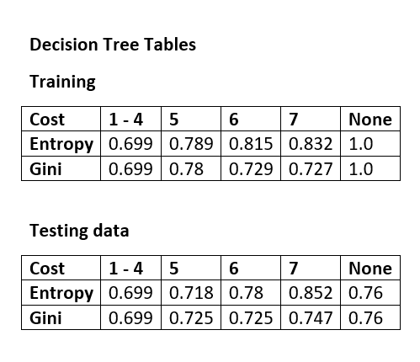

Slide 10
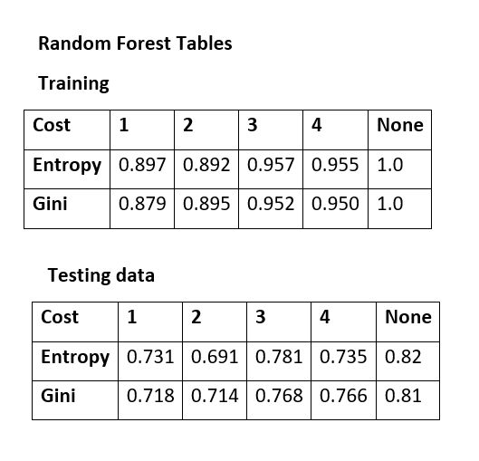

Slide 11
Application
The web page for our project is shown in the next slides.

Slide 12
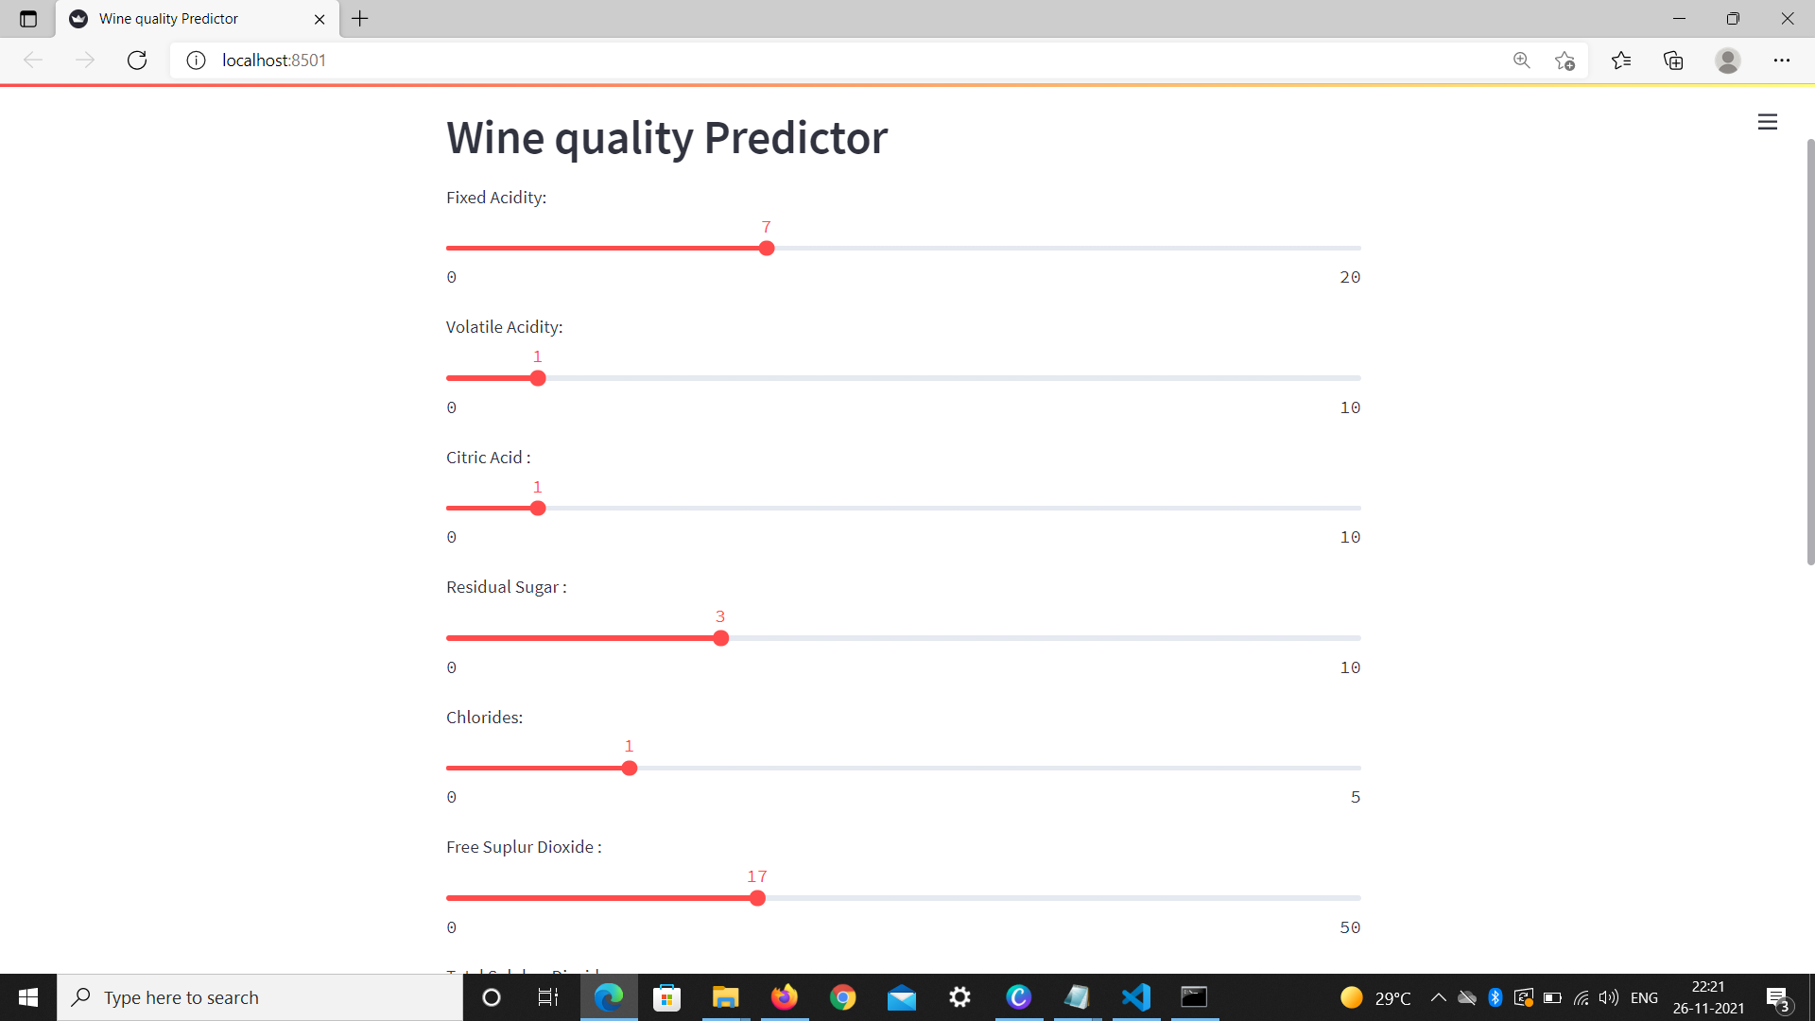

Slide 13
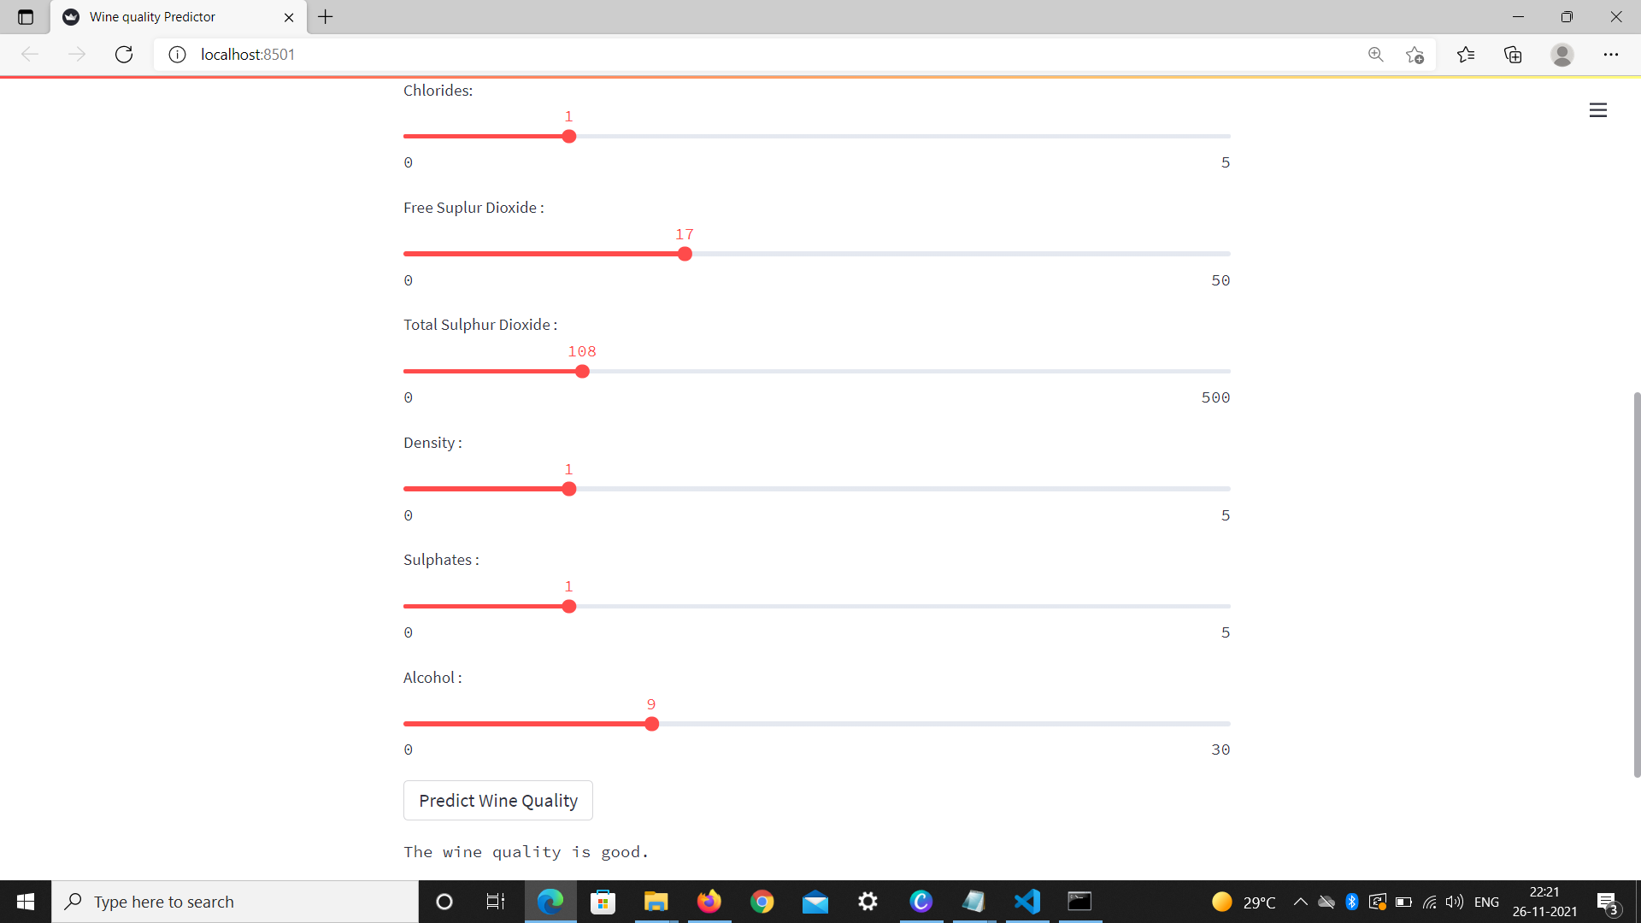

Slide 14
Conclusion
In this capstone project, we made a model with decision tree algorithm with 85% accuracy for predicting quality of wine.

Slide 15
Future scope
There is a scope to further improve the accuracy of the model.
We can try to implement more ML models on our data to get maximum accuracy

Slide 16
THANK YOU

