Slide 1
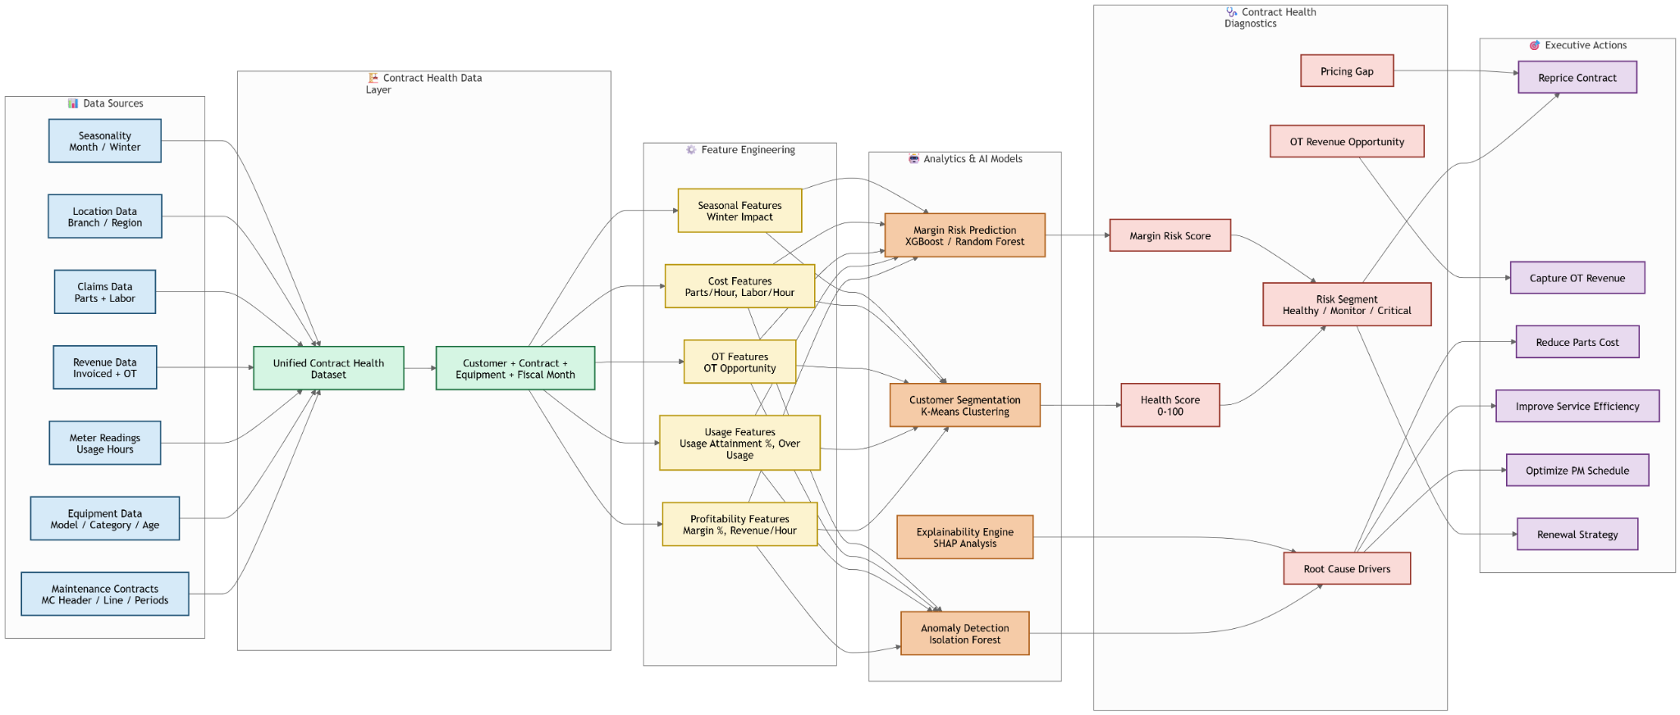
Maintenance Contract Health & Margin Optimization Architecture

